Slide 1
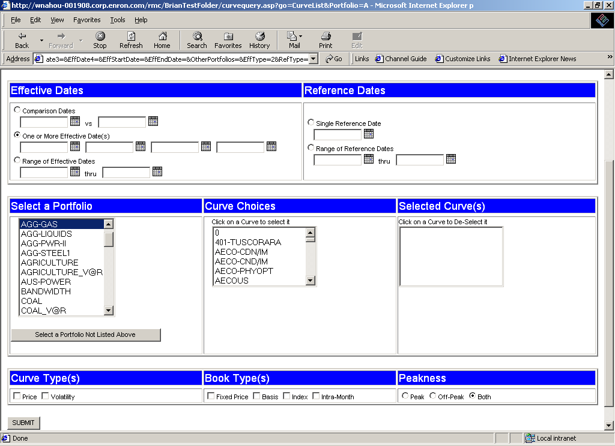
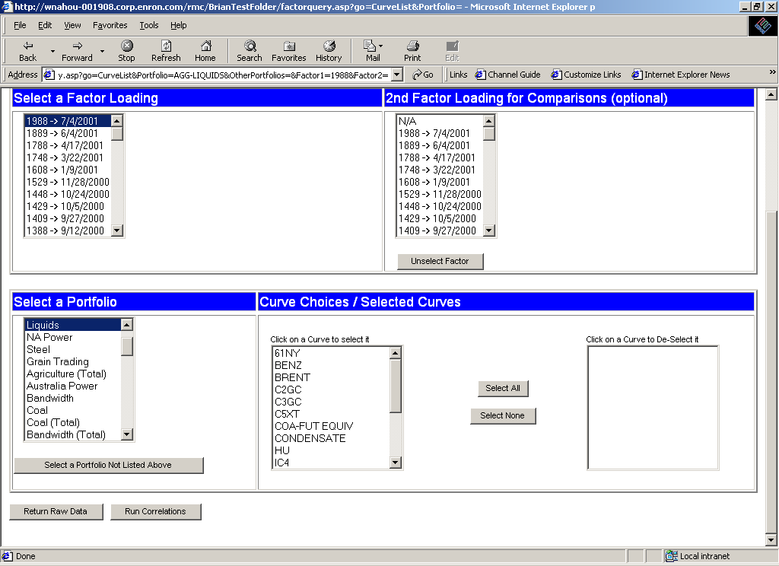
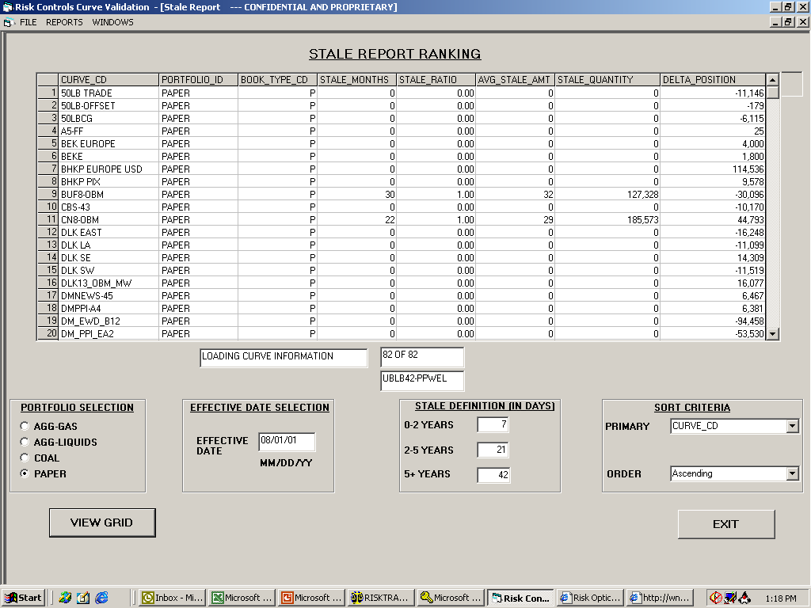
Stale Curve Query Tool
Input Screen
Term Structure Calendar Days Since Last Update
0 – 2 Years
2 – 5 Years
5 + Years
7
Use Calendar Tool
For Reference Dates
21
42
Click on individual curves for detailed view by term structure
Book Type # of Stale % of Total Average
Curve Code Portfolio Code Ref. Months Ref. Months Stale Amt. Delta Position

Slide 2
Stale Curve Query Tool
Functionality (1)
Term Structure Calendar Days Since Last Update
2
0 – 2 Years
2 – 5 Years
5 + Years
1
7
21
3
42
1
Select an Effective Date
Select a Portfolio
Select one or more Reference Dates and user-selectable “Calendar Days Since
Last Update”
The defaults are shown above
A user can change the values of the calendar days
Only after all three sections are completed is a curve list generated, since
the curve list will be filtered based upon the staleness criteria selected in
the “Reference Dates” section
2
3

Slide 3
Stale Curve Query Tool
Functionality (2)
1
A user can select either an individual curve or all curves
Select Price and/or Volatility
Select Peakness and hit Submit
* Note that the Book Type Code already exists with the Curve data
2
3
Click on individual curves for detailed view by term structure
Book Type # of Stale % of Total Average
Curve Code Portfolio Code Ref. Months Ref. Months Stale Amt. Delta Position
1
2
3

Slide 4
Stale Curve Query Tool
Explanation
When a user selects the portfolio a query is made against the same table used for
the Curve Query tool to generate a distinct list of curves
The curves derived from the query are used for a second query against the
RMS_CURVE_STATIC_MASTER and RMS_CURVE_STATIC_DETAIL
tables using the criteria defined in the Reference Dates section to refine
the list.
The refined list is queried against RMS_OPEN_POSITION to obtain the Delta
Position and against RMS_CURVE_DETAILS to provide the Book Type
Code, Number of Stale Months, Percent of Stale Months against Total
Reference Months and Average Stale Amount
When a user selects curve(s), Price and/or Volatility, and Peakness, a query is
made against RMS_CURVE_DETAILS to provide the entire term structure

Slide 5
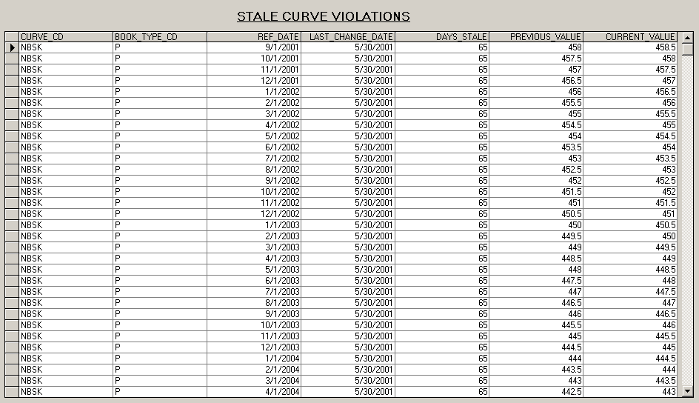
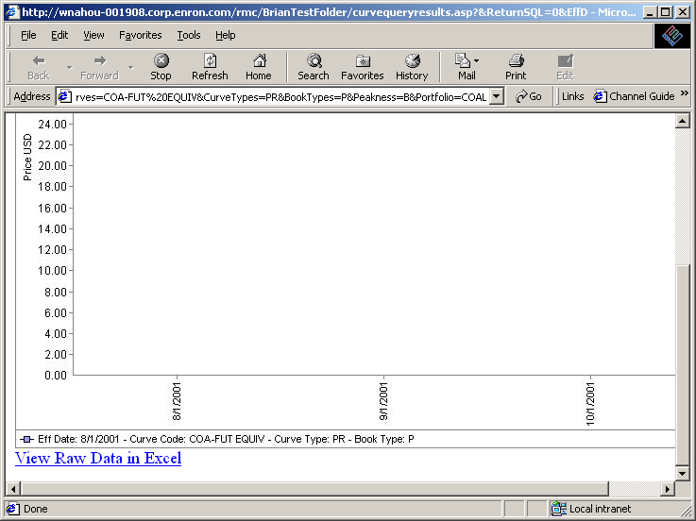
Stale Curve Query Tool
Output Screen

Slide 6
Stale Curve Query Tool
Example
Example of old tool

