Slide 1
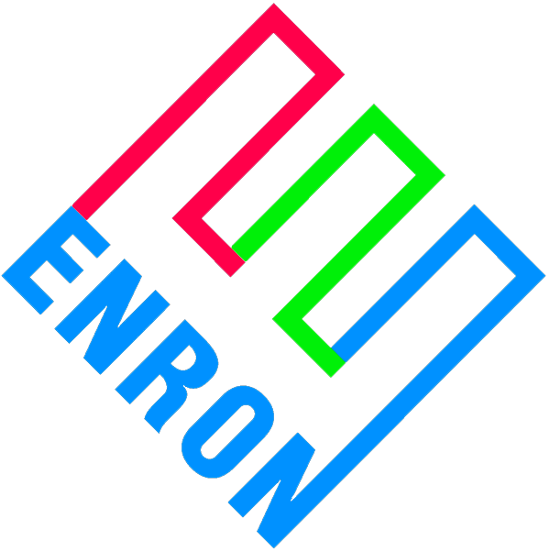
Strategic Asset Management Proposal to SkyGen
April 13, 2000

Slide 2
Asset Management Structure
SkyGen and Enron will form an entity (“Newco”) to manage the various price risks and merchandise the plant(s) outputs.
SkyGen will place the output of the specified plants into Newco.
SkyGen receives proceeds from Newco.
The entity will sell the physical energy to Enron at the appropriate market index.
SkyGen will pay a negotiated fee to Enron for the management of Newco.
Enron will provide the necessary human resources, systems and processes to Newco.
Enron will have a right to match on any tolling structures sold by Newco.

Slide 3
Benefits to SkyGen
Immediate access to Enron’s diverse and vast markets
Significant cost savings
Elimination of “trial & error” costs and mistakes of “build your own”
Utilization of Enron resources, reporting and markets
Access to Enron’s systems
Controls, processes and procedures established correctly
Structure allows SkyGen a lot of flexibility to develop various products including “Super Peak”, etc.

Slide 4
SkyGen/Enron Asset Management Structure
Physical Outputs
Resources
Index Power less Fee
SkyGen
Newco
Refusal Rights
Enron
P&L from Plants
Hedging Opportunities
Hedging Opportunities
Index Power
Hedging Opportunities
Marketplace

