Slide 1

Jeff Skilling
President & CEO
ENRON

Slide 2
Enron Annual Sales ($Billion)
100.8
5.5
9.2

Slide 3
Enron Market Value
($Billion)
72.1
9.6
2.7

Slide 4
Enron Price/Earnings Ratio
46.4
16.4
17.4
*Continuing operations

Slide 5
Enron Assets
($Billion)
65.5
10
12

Slide 6
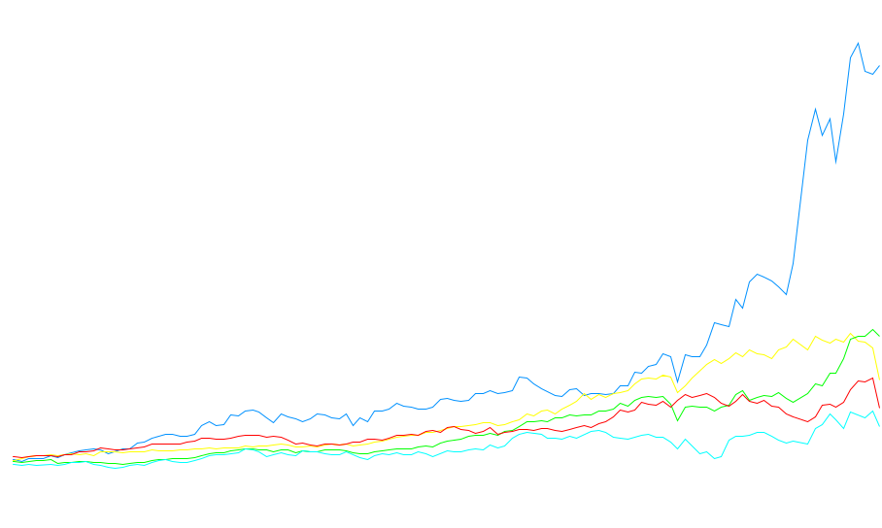
Total Return to Shareholders Jan 1, 1990 to Dec 31, 2000
1600
1400
Enron Corp.
S&P 500
Pipeline Avg.
Utility Avg.
E&P Avg.
1,415%
383%
545%
281%
217%
1200
1000
800
600
400
200
0
-200
Dec 90
Dec 91
Dec 92
Dec 93
Dec 94
Dec 95
Dec 96
Dec 97
Dec 98
Dec 99
Nov 00
Dec 00
Note: Calculated to December 31, 2000

Slide 7

Enron
Transportation
Services
Enron
Wholesale
Services
Enron
Energy
Services
Enron
Broadband
Services

Slide 8
Market Capitalization ($Billions)
World’s Largest Gas-Fired Power Plant Completed in the U.K.
Enron Broadband Services Established
Leading U.S. Wholesale Power Marketer
Leading U.S. Wholesale Gas Marketer
Largest U.S. Gas Pipeline Company from HNG/InterNorth Merger
EnronOnline Introduced
Leading European Wholesale Gas & Power Marketer
Enron Oil & Gas Company IPO
Enron Energy Services Established

Slide 9
Economic Trade-Off
Cost of
Interaction
$
Value of
Specialization
Volume

Slide 10
Evolution of Economic Trade-Off
1300’s
Creation of
Money
1800’s
2000’s
$
Transportation &
Communication
Internet &
InfoTech
Barter
Economy
Volume

Slide 11
Types of Interaction Costs
Credit
Legal &
Regulatory
Logistics
Price of
Successful
Economic
Transactions
Information
Seeking &
Gathering
Payments
Inventory

Slide 12
Cost of Interaction
Mining
Financial
Institutions
30-40%
60-70%
U.S.
India
40-50%
55%
Source: McKinsey

Slide 13
Business Structure
1.0
1.0
1.0
.90
Transformation
Interaction
Finished
Product
Transformation
Costs
Interaction
Costs
Total
Costs
.85
4.35
.60
4.95
.90
Costs for Finished Product
Transformation Interaction Total
3.45
3.00
6.45
.80
Costs for Finished Product
.95
1.10
1.20
1.10
Transformation Interaction Total
.20
.20
.20
4.35
.60
4.95

Slide 14
Cost of Teller Transaction
$1.50
$0.30
$0.01
1985
(Bank)
1995
(ATM)
2000
(Internet)

Slide 15
Length of Time to Provision Bandwidth
6-8 months
2-3 months
< 1 second
1995
Today
Next
Year

Slide 16
Length of Time to Execute a Long-Term Gas Contract
2-3 years
9 months
2 weeks
< 1 second
1981
1989
1997
2000

Slide 17
Change in Economics of Business Structure
1.0
1.0
1.0
.90
Transformation
Interaction
.10
.10
.10
.85
.90
Costs for Finished Product
Transformation Interaction Total
3.45
3.00
6.45
3.45
.30
3.75
.80
Costs for Finished Product
.95
1.10
1.20
1.10
Transformation Interaction Total
.20
.20
.20
4.35
.60
4.95

Slide 18
Where’s the Opportunity?
.90
.10
.10
.10
.85
Commoditized
Overcapitalized
Globalized
Can’t make compensatory
return in traditional asset
business
.90
.80
.95
1.10
1.20
1.10
No Longer Cost
Competitive
.20
.20
.20

Slide 19

Where’s the Opportunity?
.90
.10
.10
.10
.85
Creating low cost, dependable
market interfaces
Market making
Logistics
Back office
Trade finance
.90
.80
Providing packaged turnkey
solutions for customers
Complex structures
Differentiation
Customization
.95
1.10
1.20
1.10
“Virtual” Integration
.20
.20
.20

Slide 20
Enron Opportunity
Traditional
Business Model
Asset intensive
Vertically integrated
Slow moving and rigid
Hierarchical
New Business Model
Brain power intensive
Networked
Oriented toward “real options”
Fast moving
Entrepreneurial

Slide 21
Enron–Accelerating Market Development
Metals
Commodity
Product
Financial
Bandwidth
Australian Power & Gas
Pulp & Paper
Coal
Weather
Scandinavian Power & Gas
Plastics
Emissions
Financials (interest rate, equity)
UK Power & Gas
Electricity
Currencies
Natural
Gas
1985
1986
1987
1988
1989
1990
1991
1992
1993
1994
1995
1996
1997
1998
1999
2000
* Lighter shading indicates a developing market
Darker shading indicates a mature market

Slide 22
EnronOnline – Changing the Way Commodities Are Traded
6000
Free, Reliable Transaction System with Enron as Principal
5000
4000
3000
2000
1000
0
01/12/00
03/29/00
05/01/00
06/03/00
07/17/00
09/21/00
11/29/99
10/02/00
12/07/00
12/10/99
12/21/99
01/01/00
01/23/00
02/03/00
02/14/00
02/25/00
03/07/00
03/18/00
04/09/00
04/20/00
05/12/00
05/23/00
06/14/00
06/25/00
07/06/00
07/28/00
08/08/00
08/19/00
08/30/00
09/10/00
10/13/00
10/24/00
11/04/00
11/15/00
11/26/00
Transactions per day

Slide 23
Enron Efficiency Gains
Transactions
Per Market Maker
Marginal
Cost Per Transaction
(Indexed)
100
3,084
25
672
1999
2000
1999
2000

Slide 24
®

