Slide 1
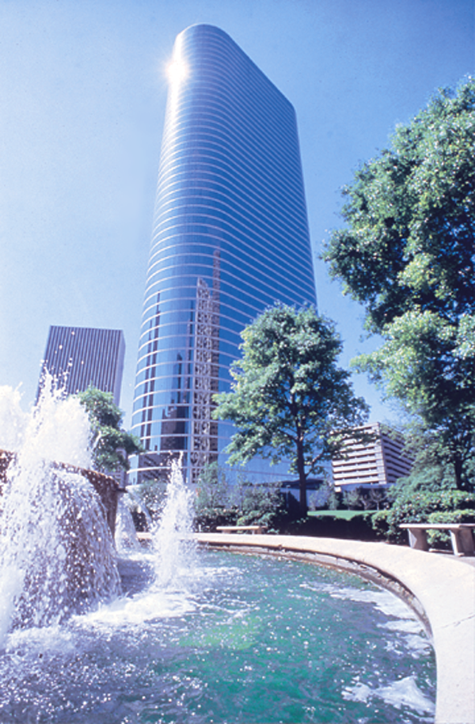

The Arrogance of Regulation:
The Power Crisis in California
Jeff Skilling
President & CEO
®
Commonwealth Club
San Francisco, California
June 21, 2001

Slide 2
Electricity Prices in Ohio, 1998
(Cinergy Mid Peak in $/MWh)
$2,461

Slide 3
Electricity Prices in Ohio, 1999
(Cinergy Mid Peak in $/MWh)

Slide 4
Electricity Prices in Australia, Dec 98 - Dec 99
(New South Wales Mid Peak in $/MWh)
$920

Slide 5
Electricity Prices in Australia, 2000
(New South Wales Mid Peak in $/MWh)

Slide 6
Electricity Prices in Australia, 2001 to date
(New South Wales Mid Peak in $/MWh)

Slide 7
Electricity Prices in Ohio, 2000
(Cinergy Mid Peak in $/MWh)

Slide 8
Electricity Prices in Ohio, 2001 to date
(Cinergy Mid Peak in $/MWh)

Slide 9
Electricity Prices in California
(Mid-Columbia Mid Peak in $/MWh)
$4,175
Spot Prices
Forward Prices

Slide 10
1999 Net Generation as a Percentage of Retail Sales
100%
59%
41%

Slide 11
California Wholesale Electricity Prices
vs. Enron Stock Price
$4,175

Slide 12
California Wholesale Electricity Prices
vs. Enron Stock Price
$4,175

Slide 13
®

