Slide 1
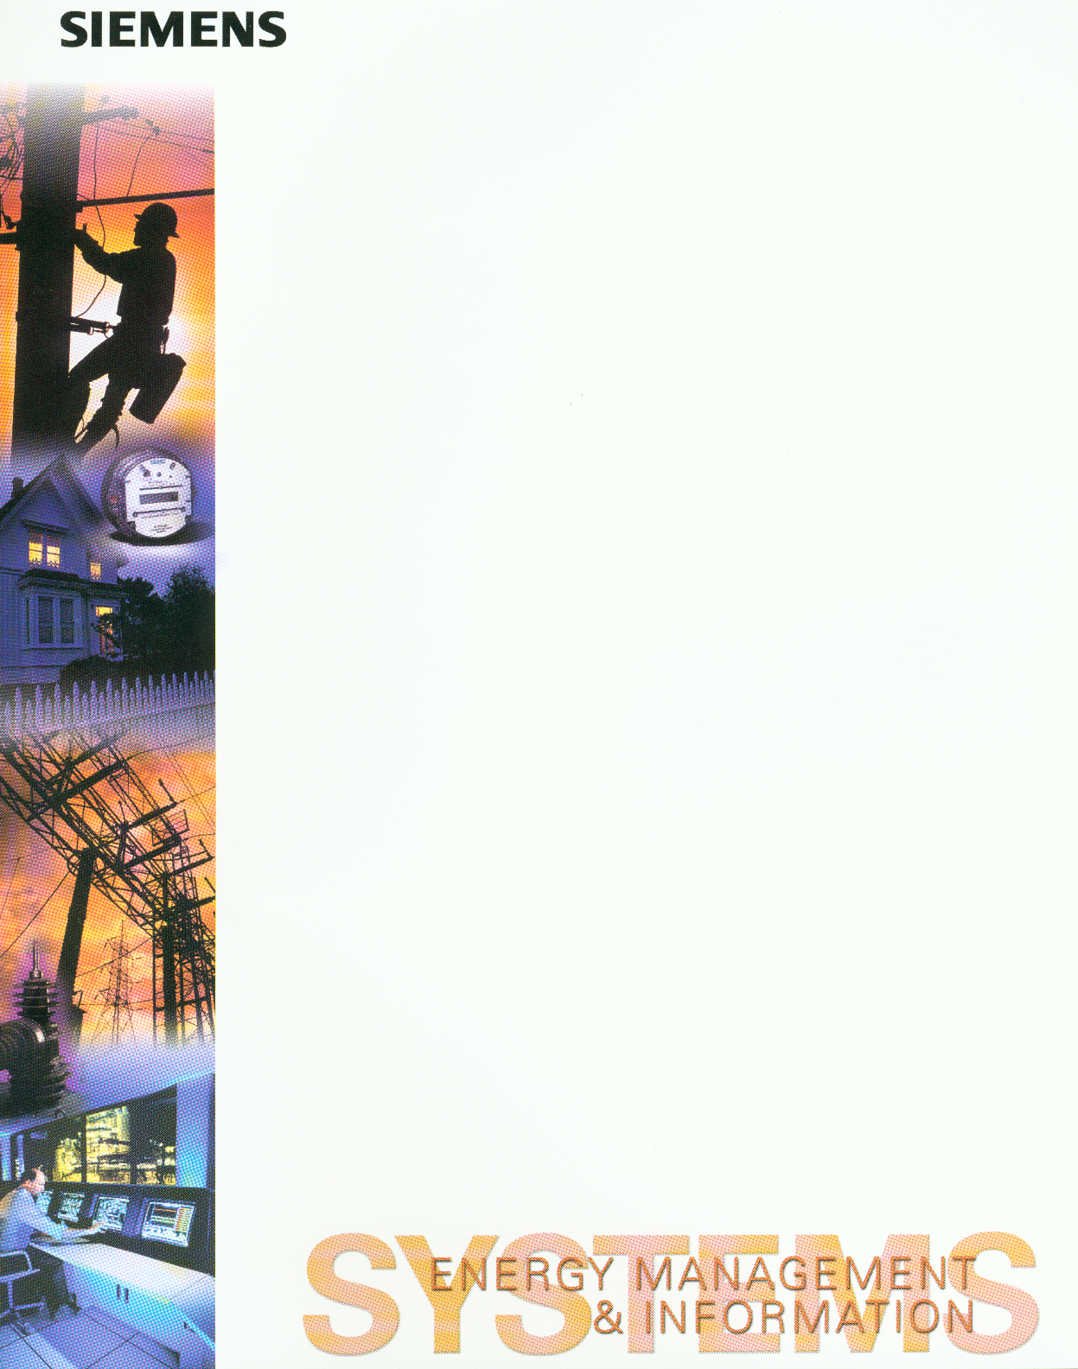
TM
PowerCC eTAG
A “No Tag, No Trade” Service Solution
From the providers of the electric industry’s first ASP-based market management system comes the “Siemens PowerCC eTAG™ service suite”. Siemens eTAG™ services are designed to make the job of electric purchase and selling entities and transmission operators easier to enable highly efficient volume business trading and to automatically keep your company current with regulatory changes without capital investment.
Shortly we will all be faced with a “no tag, no trade” industry. This service is perfect for companies that have no solution at all or for companies with an existing service needing to upgrade to NERC 1.7 and want a more competitive option.
Your eTAG™ site-resident web client (Internet Explorer 5 or Netscape) communicates with a central server in a process that conforms with all NERC E-tagging functional and security requirements and will remain compliant as NERC standards continue to evolve.
Siemens eTAG™ includes the NERC e-tagging version 1.7 protocol as well as a highly ergonomic User Interface to aid the trader in a dynamic marketplace. eTAG™ allows you to do more deals by incorporating key operating concepts like the ability to re-use work from previous tags with only a few keystrokes. And, with eTAG™, mistakes don’t mean a complete cancellation of a tag rather simple editing gets a trader back on track quickly. The eTAG™ user interface allows
single click access to important information. The eTAG™ service offering includes the eTAG™ Agent, eTAG™ Approval, and eTAG™ Authority functionality.
eTAG™ Agent major functions:
Tag creation features
Tag correction features to allow changes to previously submitted tags
Tag profile change features which allow changes to previously approved tags
Tag extensions to currently running tags
Tag features which allow more flexible use of transmission through vertical and horizontal stacking of reservations
Market segment features which track the title of products from one entity to another
Generation
Providing Entity
Tag
Agent
Service
New Tags
Tag
Authority
Service
Tag Data
Tag
Approval
Services
Tag Data
Approvals
and Denials
Tag Author
Schedule
Changes
Schedule
Changes
Transmission
Providers
Tag Data
Schedule
Changes
NERC
IDC
Scheduling
Control Areas
Security
Coordinator
Load Serving
Entity

Slide 2
TM
PowerCC eTAG
eTAG™ Authority major functions:
Distribution of the tag to all parties directly involved in the transaction,
Collection of approval states from all parties,
Forwarding of the tag to appropriate security entities
Profile change distribution
Maintenance of the single authoritative “copy of record” for each tag
eTAG™ Approval major functions:
Processing tag requests from Authority services
Receiving notification of transaction in which they are involved
Sending an approve or deny response to an Authority service for a valid request
Allows modification of the profile associated with a tag by authorized entities
eTAG™db Integration and back end systems:
As an option, eTAG™db is available as a client that resides as an RDBMS (Oracle or MS SQL) on customer site-resident hardware. The customer’s tags are contained in the eTAG™ data base. eTAG™db includes a license to the schema and standard API for interfacing with back end systems.
Usability
All three Siemens eTAG™ services include a world class User Interface (UI), specifically designed with input from an e-tag user community. The UI includes graphical display of important tag information, so the user can, with a single click,
see important summaries, status, etc. The UI is ergonomically engineered using the human factors discipline and allows you to personalize views using layout, color, graphs, sounds, and linkages to best support your workflow.
Other Business Solutions
Siemens eTAG™ services seamlessly integrates with other Siemens components and service offerings designed to support your entire business processes from reserving transmission capacity to CIM compliant data modeling and maintenance.
Siemens PowerCC OASIS allows rapid access to transmission reservations so that the user may easily set up and account for transmission usage. Siemens PowerCC tran$MART™ smartly manages all aspects of transaction scheduling. Siemens PowerCC Information Model Manager (IMM) is the industry leading data modeling, data maintenance, data exchange support and interoperability tool available in the market today. With IMM your power system data will be organized and fully compliant with the Common Information Model (CIM) now being advanced as an international standard.
For more information contact us at:
Phone: (763) 536-4785
FAX: (763) 536-4354
E-Mail: Marketing@siemens-emis.com
On line system-ready demonstrations are available to make your shopping easy!
Siemens Power Transmission & Distribution, Inc.
Energy Management & Information Systems
7225 Northland Drive
Brooklyn Park, MN 55428-1540
www.siemenstd.com
Tel: 763.536.7485
FAX: 763.636.4354
Email: prod.info@ptd.siemens.com
Siemens Power Transmission & Distribution.
The Intelligence to power your future.
Subject to change without notice
© 2001 Siemens Power Transmission & Distribution, Inc.
All rights reserved

