Slide 1

®
West Gas Origination Group
Natural Gas Market Overview
Prepared for
Alpha Company
by

Slide 2

The Transformation of Enron
Enron Today
Power Trading
Natural Gas Trading
Powerplant Construction
Weather Derivatives
Pulp & Paper Derivatives
Broadband Services
Energy Outsourcing
Gas Transportation Services
e-Commerce Initiatives
Enron 1985
Natural Gas Transmission
Exploration & Production
$2 Billion Market Cap
$50 Billion Market Cap

Slide 3
Enron - Ranked at the Top
FORTUNE’S Most Admired Companies
(500 Companies Ranked)
Overall Ranking By Revenue
16. Sears Roebuck
17. American International
18. Enron
19. TIAA-CREF
20. Compaq Computer
Energy Companies
1. Enron
2. Williams
3. El Paso Natural Gas
4. Dynergy
5. Equitable Resources
Innovativeness
1. Enron
2. Charles Schwab
3. Herman Miller
Source: Fortune Magazine March 1, 2000
Risk Management Rankings
Gas Derivatives Electricity
1. Enron 1. Enron
Risk Advisory Ratings (Overall Category)
1997 1998
Juniors 1 1
Intermediates 1 1
Seniors 3 2
Source: Risk Magazine

Slide 4
Enron – Ranked At The Top Enron Ranked 7th on the Fortune 500 List of America’s Largest Corporations

Slide 5
International Energy Companies Enron’s Leading Market Position - Natural Gas and Power
(TBtue/d)
45.6
13.0
12.3
11.5
10.6
8.9
8.2
7.5
6.3
Enron
BP Amoco
EdF
France
Exxon Mobil
RWE
Germany
Chevron
Royal
Dutch Shell
Tokyo
Electric
Japan
ENEL
Italy
Source: Company Reports, Enron Analysis

Slide 6

Transportation
&
Distribution
Wholesale
Services
Retail
Energy
Broadband
Services
Natural Gas Transportation and Electric Distribution
Marketing and Delivery
of Commodities Worldwide
Energy Outsourcing to Commercial and Industrial Customers
Bandwidth Intermediation and Content Services

Slide 7
Enron North America’s Energy Network
Industrials
Power Plants /IPPS
$
$
People
Technology
Contractual Assets
Owned Assets
$
Products & Services
Products & Services
Information
Information
Financial Market
$
$
Marketers
Products & Services
Products & Services
Information
Information
Producers
$
$
Utilities
Products & Services
Products & Services
Information
Information
Rapid Capture of Real Time Market and Grid Information
Quickly Disseminated and Acted Upon By Enron
Clear Information and Liquidity Advantage for Customer

Slide 8
Enron North America
Value Formula
Network Competitive Advantages
+
Core Capabilities
+
Enron Culture
=
Value
Physical Commodity Products
Greater Flexibility and Speed to Market
More Effective Risk Management in Volatile Markets
Price Advantages
Superior Market Knowledge
Innovative
Best and the Brightest Employees
Entrepreneurial Environment
Premium Structured Products
Financial Risk Management
Regional and Cross-Commodity Arbitrage
Capital Structuring and
Services
Liquidity Provision
Asset Development
And Operation
Generating Consistent Value Regardless of Market Conditions

Slide 9
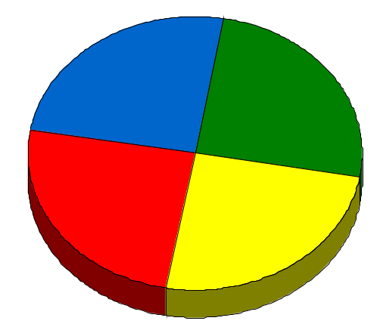
Enron’s Wholesale Services Model
Origination
Physical
e-Commerce
Financial
Enron uniquely combines its origination, physical, financial and
e-Commerce capabilities to provide wholesale commodity services

Slide 10
Enron North America
North America Energy Markets Providing Tremendous Market Opportunity
Very Large and Rapidly Growing
Increasingly Volatile and Complex
Enron is the Leading Provider of Energy in North America
Enron Employs the Most Valuable, Flexible Network
Clear Liquidity and Information Advantages
Consistent Earnings Growth
Superior Returns on Invested Capital
Market-Making + Technology + Scale + Select Assets = Sustainable Competitive Advantage

Slide 11
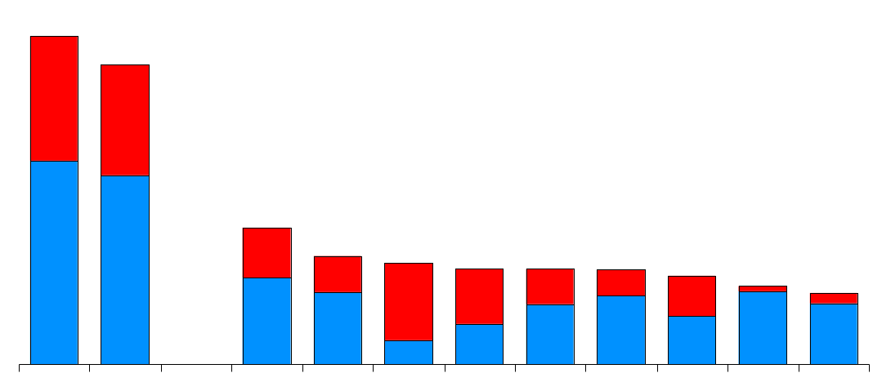
Domestic Energy Marketers
Enron’s Leading Market Position - 2000
45.6
(TBtue/d)
41.7
Power
Gas
19.2
15.0
14.1
13.3
13.2
13.1
12.3
10.9
9.9
Enron FY00
Enron
Duke
Aquila
AEP
PG&E
Reliant
Dynegy
Southern
Coral
Sempra
3Q YTD
Source: Gas Daily, Power Markets Week, Oil Daily

Slide 12
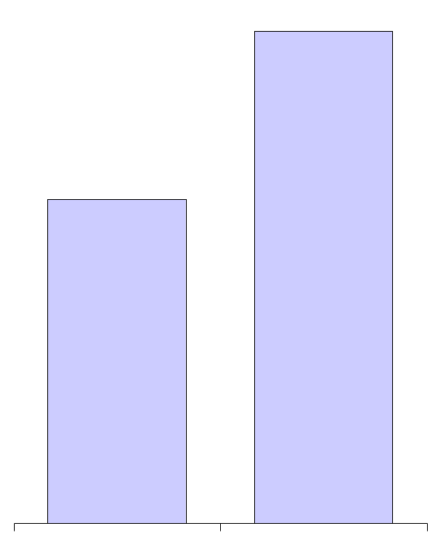
Volume Growth – North America
Natural Gas
(Bcf/d)
Power
(Millions MWh)
24.7
579
381
13.9
+77%
+52%
1999 2000
1999 2000

Slide 13
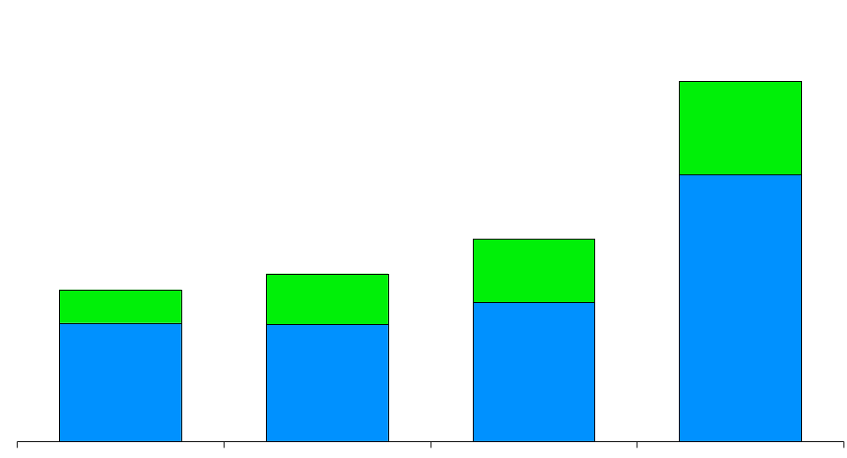
Enron North America Physical Natural Gas Sales Volumes
(Bcf/d)
Canada
U. S.
24.7
13.9
10.4
11.5
+77%
1997
1998
1999
2000

Slide 14
Enron’s Wholesale Gas Network (Volumes in Bcf/d)
Canada
Central
6.3
4.4
5.9
2.3
43%
156%
1999
2000
1999
2000
West
East
2.4
7.4
1.1
4.1
118%
Henry
80%
Henry
Henry
Henry
Hub
Hub
Hub
Hub
1999
2000
1999
2000
Texas
Marketing Offices
Leased Capacity
NYMEX
Leased Storage
Gas Marketing Activity
2.7
2.0
35%
1999
2000

Slide 15
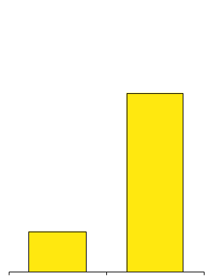
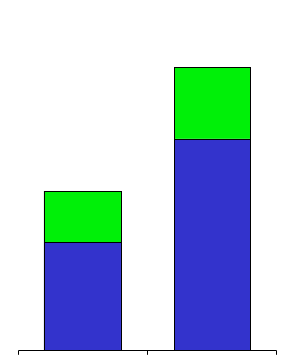
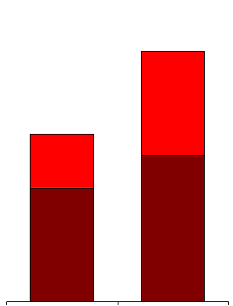
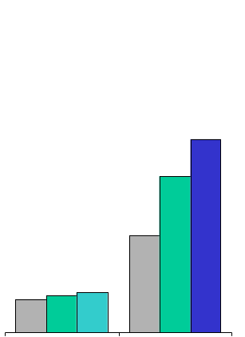
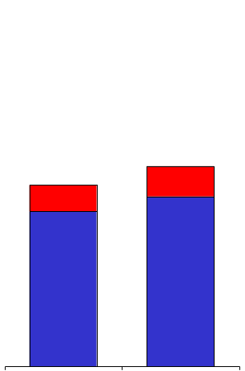
North America Network Growth
Natural Gas Volumes (Bcf/d)
Power Volumes (Million MWh)
EnronOnline Products
(N.A. Gas and Power)
24.7
West
East
579
Canada
U.S.
330
381
13.9
75
+77%
+52%
+340%
1999
2000
1999
2000
1999
2000
Gas Pipeline Nominations
(Thousands)
Physical Delivery Points
Power
Gas
West
Central
East
156
126
2,520
2,280
78
27
30
32
+10%
+304%
Q4 1999
Q4 2000
1999
2000
West Gas Origination Group

Slide 16
Enron’s Wholesale Power Network (Volumes in Million MWh)
West
East
239
340
MAPP
MAIN
260
NPCC
260
ECAR
121
COB
ComEd
Hub
PJM
Hub
Hub
MAAC
Cinergy
Cinergy
Cinergy
Hub
Hub
Hub
WSCC
Cinergy
97%
SPP
Hub
31%
SERC
1999
2000
Palo
Palo
Palo
Palo
1999
2000
Verde
Verde
Verde
Verde
Hub
Hub
Hub
Hub
TVA
Hub
Entergy
Entergy
Entergy
Hub
Hub
Marketing Offices
NYMEX
Marketing Hub
ERCOT
Hub
FRCC
Power Plants
In Operation
In Operation; Sale Pending
Under Development
Power Marketing Activity
Transmission Grid

Slide 17
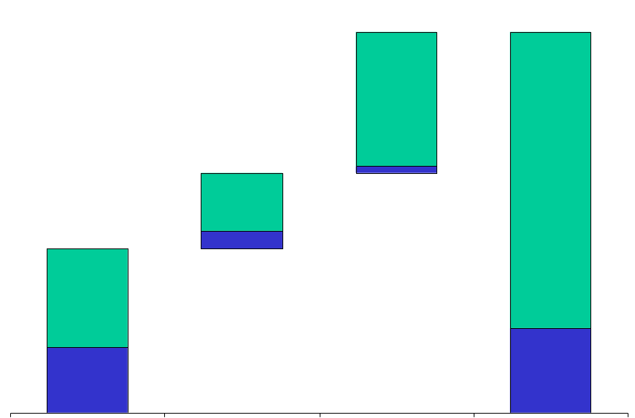
Enron’s Market Opportunities (Revenues in Billions)
$1,410
$3,885
Future
Today
$1,393
$765
$17
$3,028
$585
$1,710
$180
$1,050
$660
$857
Wholesale Gas & Power
Retail Energy
Broadband Services
Total

Slide 18



Fortune Magazine, February 2001

Slide 19
Transportation
&
Distribution
Wholesale
Services
Retail
Energy
Broadband
Services
Natural Gas Transportation and Electric Distribution
Marketing and Delivery
of Commodities Worldwide
Energy Outsourcing to Commercial and Industrial Customers
Bandwidth Intermediation and Content Services

Slide 20
Transportation & Distribution Services
Portland General
Northern Natural Gas
4.3 Bcf/d Peak Capacity
16,463 Miles
$1.2 Billion Rate Base
100% Owned
Enron Transportation Services
Sale of PGE Is on schedule to close near year end
Continued strong operations
Strong Returns with Consistent Earnings and Cash Flow
Strong Competitive Position with Expansion Opportunities in Markets Served
Market-Oriented Business Approach
Technology Used to Expand Revenues and Reduce Costs
Northern Border
2.4 Bcf/d Peak Capacity
1,214 Miles
$1.4 Billion Rate Base
8% Owned
Florida Gas
Transwestern
1.5 Bcf/d Peak Capacity
4,795 Miles
$1.3 Billion Rate Base
50% Owned
1.7 Bcf/d Peak Capacity
2,487 Miles
$500 Million Rate Base
100% Owned

Slide 21
Technology Benefits
EnronOnline Used to Rapidly Market Capacity; 48 Transactions Completed
Cost Reductions Realized Through the Automation of Compression, Monitoring and Measurement; Excellent Safety Record Maintained
Scheduling and Gas Control Improvements Increasing Customer Flexibility
Extensive Use of Internet for Customer Applications
Customer Nomination Opportunities Increased to Six Times per Day
Dynamic Modeling Programs Maximizing Revenues and Throughput at Lowest Cost
Throughput
(Bcf/d)
Employees
(Operations)
Expense
($/MMcf)
9.1
3,100
$135
7.1
$100
2,000
+28%
-35%
-26%
1992
Today
1992
Today
1992
Today

Slide 22
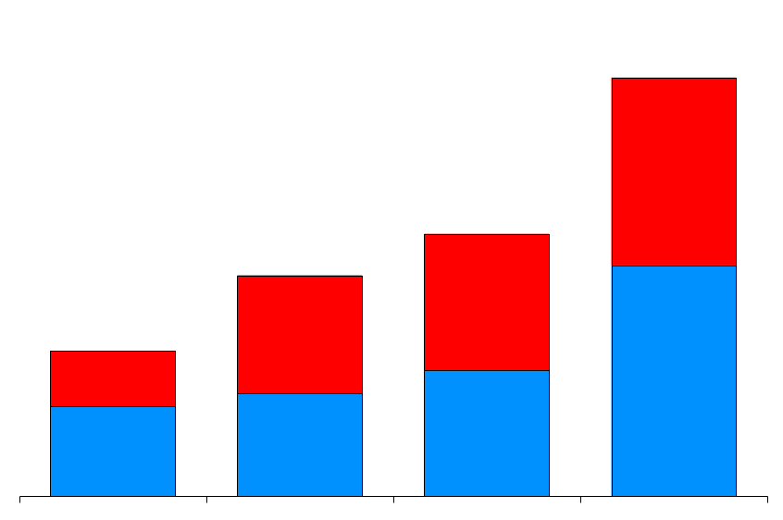
Wholesale Services
Physical Volumes
(BBtue/d)
Financial Settlements
(BBtue/d)
51,715
196,148
Power and Other
Gas
32,429
27,308
99,337
75,266
17,970
49,082
1997 1998 1999 2000
1997 1998 1999 2000

Slide 23
Wholesale Services Average Daily Transactions
8,000
7,900
EnronOnline
Traditional
6,000
4,000
2,000
650
0
Nov Dec Jan Feb Mar Apr May Jun Jul Aug Sep Oct Nov Dec
1999
2000

Slide 24
North America Physical Power Volumes
(Million MWh)
579
402
381
192
+52%
1997
1998
1999
2000

Slide 25
Enron North America
The Most Flexible, Reliable and Valuable Energy Network
CALGARY
Marketing Offices
Gas Pipeline Access
Electric Grid Access
NYMEX
Leased Gas Storage
Power Plants
In Operation
In Operation; Sale Pending
Under Development
PORTLAND
TORONTO
NEW YORK
COB
PJM
Hub
OMAHA
Hub
SAN FRANCISCO
CHICAGO
WASHINGTON
DENVER
Palo
Verde
Hub
Entergy
Hub
Henry
Hub
HOUSTON
MONTERREY
Expansive Market-Making
Least-Cost Packaging
Reliable Delivery
Broad Customer Reach
Cross-Commodity Expertise
Innovative Products

Slide 26
Enron’s North American Wholesale Energy Franchise
Enron Offices
NYMEX
Marketing Hub
MAAC
Power Plants
In Operation
In Operation; Sale Pending
Under Development
Henry
Henry
Henry
Henry
Hub
Hub
Hub
Gas
Power
Transmission Grid
Leased Capacity
Leased Storage
Hub

Slide 27
Volume Growth – North America
Natural Gas
(Bcf/d)
Power
(Millions MWh)
24.7
579
381
13.9
+77%
+52%
1999 2000
1999 2000

Slide 28

Ecommerce Control Center

Slide 29
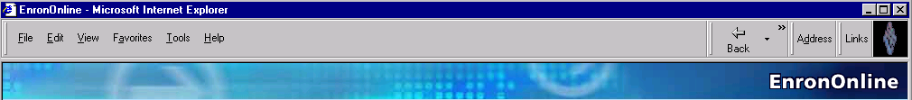
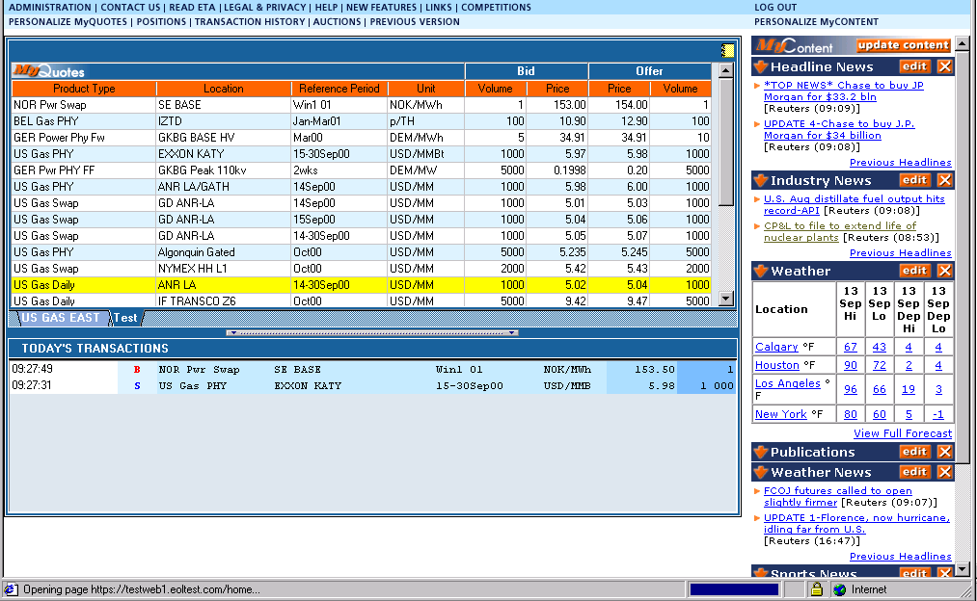
EnronOnline
Changing the Way Commodities are Traded
A Free Internet-based, Global Transaction System Which
Allow Counterparties to View Real Time Prices From Enron’s
Traders and Transact Instantly Online

Slide 30
EnronOnline - 2000
Number of Transactions 548,000
Gross Notional Value Transacted $336 Bn
Daily Transactions* 3,900
Daily Notional Value* $3.0 Bn
Products Offered* 1,157
Customers Logged On* 3,000
The World’s Largest Web-Based Ecommerce Site
^{*4Q00 Average}

Slide 31
EnronOnline Utilization
North American Natural Gas and Power
Online Transactions as a % of Total Transactions
26%
33%
39%
74%
54%
67%
77%
61%
46%
23%
4Q 1Q 2Q 3Q 4Q
1999
2000
Traditional
EnronOnline

Slide 32
EnronOnline
Daily Customers
(Average)
Daily Products Offered
(Average)
3,000
1,157
2,427
909
623
1,227
323
224
53
44
Q499 Q100 Q200 Q300 Q400
Q499 Q100 Q200 Q300 Q400

Slide 33
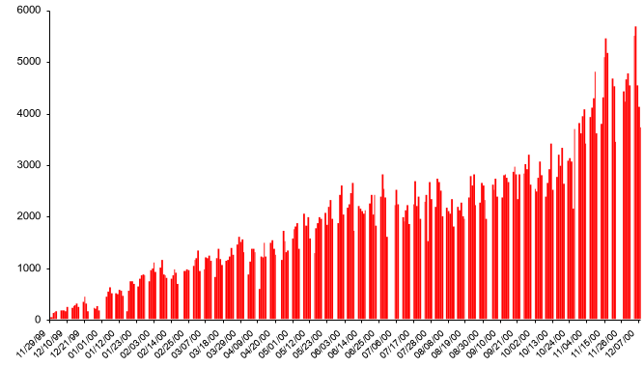
EnronOnline Transactions per day
Free, Reliable Transaction System with Enron as Principal
02/28/01
12/21/99
06/14/00
01/31/01
11/29/99
06/25/00
12/07/00
12/10/99
01/01/00
03/18/00
05/12/00
10/13/00
11/26/00
01/23/00
07/06/00
10/24/00
02/03/00
02/14/00
02/25/00
03/07/00
03/29/00
04/09/00
05/23/00
06/03/00
07/17/00
07/28/00
08/08/00
08/19/00
08/30/00
09/10/00
09/21/00
10/02/00
11/04/00
01/12/00
04/20/00
11/15/00
05/01/00
1999 - 2000
2001

Slide 34

EnronOnline Instantaneous Market Making
Growth of Daily Transactions
1999
2000
2001
Free, reliable transaction system with Enron as principal

Slide 35
EnronOnline Product Slate
1999 - 4Q
March 2001
Natural Gas
U.S.
Canada
Power
U.S.
Nordic
Coal
Pulp & Paper
Plastics
Natural Gas
U.K.
Belgium
Argentina
Canada
Power
U.K.
Germany
Holland
Switzerland
Australia
Coal
Europe
U.S.
International
Options
Continental power options
Nuclear outage knock-in call options
US & UK gas options
Bandwidth
Weather
U.S.
Europe
Japan
Australia
Emissions Credits
Crude & Refined Products
Petrochemicals
Plastics
LPG
Steel
Pulp & Paper
Metals
U.S.
U.K.
Japan
Asia
Seafreight
Lumber
Auctions
Emissions
EnBank Virtual
Storage
Pipeline Capacity
Auction
Credit Derivatives
Aluminum
Japan
Holland
Spain
Austria
Nordic Pool
Canada

Slide 36
EnronOnline Utilization North American Natural Gas and Power
Online Transactions as
a % of Total Transactions
74%
67%
61%
46%
23%
4Q 1Q 2Q 3Q 4Q
1999
2000

Slide 37
EnronOnline - 2000
Number of Transactions 548,000
Gross Notional Value Transacted $336 Bn
Daily Transactions* 3,900
Daily Notional Value* $3.0 Bn
Products Offered* 1,157
Customers Logged On* 3,000
The World’s Largest Web-Based Ecommerce Site
^{*4Q00 Average}

Slide 38
North American Natural Gas and Power
EnronOnline vs. All Major Reporting Platforms
(TBtue)
All Major Platforms Reporting Combined (Includes Altrade, DynegyDirect, Intercontinental Exchange and NGX)
EnronOnline
31,151
22,594
23,149
10,625
3,680
1,021
1,689
1,452
1Q00
2Q00
3Q00
4Q00

Slide 39
EnronOnline vs. Major Competitors
North American Natural Gas and Power
(TBtue)
31,151
22,594
23,149
10,625
3,680
1,021
1,689
1,452
1Q00
2Q00
3Q00
4Q00
All Major Platforms Reporting Combined (Includes Altrade, DynegyDirect, Intercontinental Exchange and NGX)
EnronOnline

Slide 40

Fourth Vision
“Set Unreasonable Expectations” - Gary Hamel
Become the World’s
Leading Company
(2001- )
Third Vision
Become the World’s
Leading Energy
Company
(1995-2000)
Second Vision
Become the World’s
First Natural Gas Major
(1990-95)
First Vision
Become the Premier Integrated Natural Gas Company in North America
(1986-89)
© 2001 RB-UofH-0101-<number>

Slide 41

We’ve Outgrown Our Current Vision --
To Become the World’s Leading Energy Company
Announced
1996
Achieved
2000

Slide 42
Open Access: U.S. Wholesale Gas (1985- )
Expanding Scope: Market Making
Gas Pipelines
Open Access: U.S. Wholesale Power (1994- )
Open Access: Europe Whol. Gas and Power (1995- )
Energy Outsourcing (1997- )
Niche Assets; Niche Services
Niche Assets; Niche Services
Online Trading (1999- )
Premium Bandwidth Services (1999- )

Slide 43
Income Contribution to Enron of
New Businesses
(Estimated Percent of Net Income)
5%
40%
75%
$226M
$453M
$893M
1989
1994
1999
New
Natural Gas Pipelines and E&P

Slide 44
“Set Unreasonable Expectations” - Gary Hamel
World’s Leading
Energy Company
World’s First
Natural Gas Major
Premier Integrated Natural
Gas Co. in N. America
1985
1990
1995
2000

Slide 45
North America Enron’s Leading Market Position
Third Quarter 2000
(TBtue/d)
40.5
37.4
Power
Gas
1999
19.2
15.0
14.1
13.3
13.2
13.1
12.3
10.9
9.9
Enron FY00
Enron
Duke
Aquila
AEP
PG&E
Reliant
Dynegy
Southern
Coral
Sempra
3QYTD
Source: Gas Daily, Power Markets Week, Oil Daily

Slide 46
Outgrowing the Vision
EnronOnline
Launched
Enron Networks
Formed
Launched
Enron Metals
Launched
Clickpaper.com
EBS
Created
EnronCredit.com Launched
New Power
Company Formed
Created
EGM & EIM
Nov. 1999
April 2000
July 2000
Sept. 2000
Jan. 1999
Feb. 2000
May 2000
Aug. 2000

Slide 47
S&P 500 6th in Revenues
233
186
184
170
130
$
Billions
101
98
88
80
75
Exxon Mobil
Wal-Mart
GM
Ford
GE
Enron
Royal
Dutch
IBM
Philip
Morris
Citigroup

Slide 48
Global 15 Companies 10th in Revenues
233
186
184
170
150
$
Billions
131
130
121
110
101
98
98
89
88
80
Daimler
Chrysler
Enron
Royal Dutch
AXA
Phillip Morris
Exxon Mobil
Wal-Mart
BP Amoco
GE
Total
Elf
NTT
IBM
GM
Ford
Toyota

Slide 49
Global 15 Companies 1st in 5-Year Compound Revenue Growth
60%
50%
40%
30%
20%
10%
0%
56
16
15
14
13
12
6
4
4
4
4
3
.4
0
0
Enron
Total
Elf
NTT
IBM
Toyota
Phillip
Morris
GM
AXA
Exxon Mobil
BP Amoco
Ford
Royal
Dutch
Daimler
Chrysler
Wal-Mart
GE

Slide 50
S&P 500 3rd in 5-Year Revenue Growth
100%
90%
80%
70%
60%
50%
40%
30%
20%
10%
0%
89
73
57
49
45
44
43
42
41
38
AOL
WorldCom
Enron
Tyco
Qualcomm
Cisco
Dell
Morgan
Stanley
Citigroup
EMC

Slide 51
Global 15 Companies 1st in Revenues per Employee
5.6M
1.9M
1.6M
1.5M
1.1M
963_{Th}
587_{Th}
564_{Th}
476_{Th}
467_{Th}
437_{Th}
382_{Th}
320_{Th}
249_{Th}
163_{Th}
Enron
Exxon Mobil
BP Amoco
Royal
Dutch
Total
Elf
Toyota
Phillip
Morris
AXA
GE
GM
NTT
Daimler
Chrysler
Wal-Mart
Ford
IBM
M indicates Millions
Th indicates Thousands

Slide 52
®

