Slide 1

Natural Gas Fundamentals Summary
SaskFerco
March 16, 2001
This information is provided to you pursuant to your request and is provided solely for informational purposes and without prejudice or limitation to any rights of Enron Canada Corp. or any of its affiliates. This information reflects internal calculations made by Enron Canada Corp. which may or may not have been calculated in accordance with the provisions of any agreements between Enron Canada Corp. or any of its affiliates and you, and such information is subject to change at any time. Further, Enron Canada Corp. and its affiliates make no representation or warranty, and shall have no liability whatsoever, relating to the accuracy, currency or completeness of this information and no person receiving this information shall, or is entitled to, rely on this information in any manner whatsoever. This information is not intended to, and shall not in any way, bind or otherwise impose any legal or equitable obligation on Enron Canada Corp. or any of its affiliates (which are expressly released).
Private and Confidential

Slide 2
U.S. Supply

Slide 3
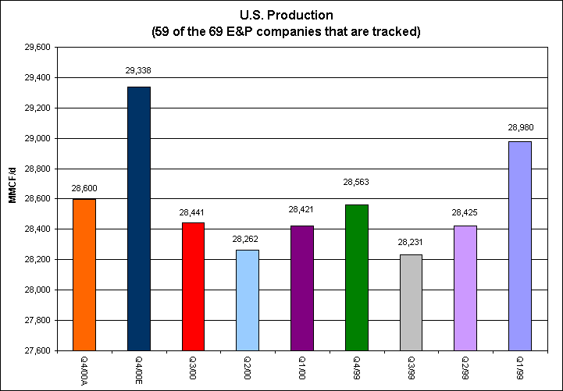
U.S. Production Survey
Source: Gas Fundamentals

Slide 4
EIA U.S. Field Receipts
Source: EIA

Slide 5
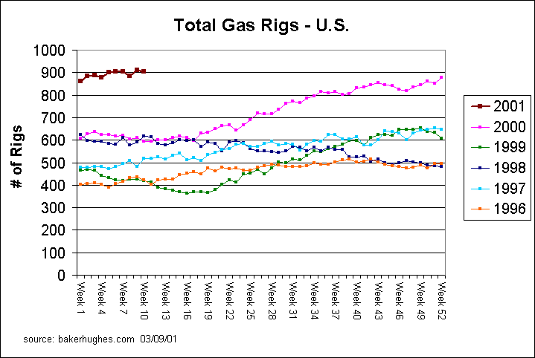
Total Gas Rigs - U.S.
Source: Gas Fundamentals

Slide 6
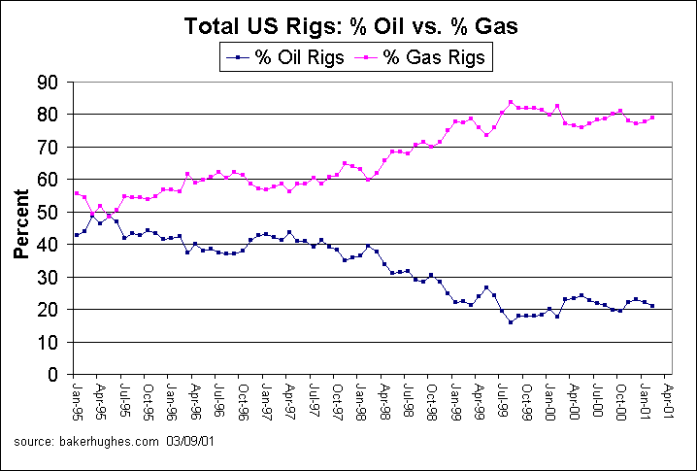
Total U.S. Rigs - %Oil vs. %Gas
Source: Gas Fundamentals

Slide 7
Imports From Canada
Source: PIRA Energy Group

Slide 8
US Supply
Field receipts are responding at a slower pace than forecast
EIA data suggests larger build than substantiated by company reporting
expectation for estimates to be revised downwards
Drilling continues to be robust
Well completions are trending upwards
Imports from Canada increase YOY due to Vector and Sable Island

Slide 9
Canadian Supply

Slide 10
Alberta Drilling
Source: PIRA Energy Group

Slide 11
Alberta Drilling
Source: PIRA Energy Group

Slide 12
Alberta Field Receipts
Year on Year Difference
(60 Day Rolling Average)
500
400
300
200
100
0
(100)
(200)
(300)
(400)
1-Jan-99
1-Feb-99
1-Apr-99
1-Jun-99
1-Jul-99
1-Aug-99
1-Oct-99
1-Jan-00
1-Feb-00
1-Apr-00
1-Jun-00
1-Jul-00
1-Aug-00
1-Oct-00
1-Jan-01
1-Feb-01
1-Mar-99
1-May-99
1-Sep-99
1-Nov-99
1-Dec-99
1-Mar-00
1-May-00
1-Sep-00
1-Nov-00
1-Dec-00
1-Mar-01
Source: Enron

Slide 13
BC Field Receipts
Year on Year Difference
(60 day Rolling Average)
300
250
200
150
100
50
0
(50)
(100)
(150)
01-Jan-99
01-Apr-99
01-Jul-99
01-Oct-99
01-Apr-00
01-Jul-00
01-Oct-00
01-Mar-99
01-Jun-99
01-Jan-00
01-Mar-00
01-Jun-00
01-Jan-01
01-Mar-01
01-Feb-99
01-Aug-99
01-Feb-00
01-Aug-00
01-Feb-01
01-Sep-99
01-Nov-99
01-Sep-00
01-Dec-99
01-Nov-00
01-May-99
01-May-00
01-Dec-00
Source: Enron

Slide 14
Imports from the U.S.
Vector impact
Source: PIRA Energy Group

Slide 15
Canadian Supply
Drilling continues at record levels
Capital expenditures are on the rise
Completions are robust
Alta & BC field receipts are beginning to show improvement
Deeper exploration needed to move growth forward

Slide 16
Pricing

Slide 17
Nymex, Aeco and Aeco Basis
$US/MMBtu
10.50
9.50
8.50
7.50
6.50
5.50
4.50
NYMEX
3.50
2.50
1.50
Historic
Forward Prices
0.50
AECO
-0.50
-1.50
AECO BASIS
Historical Basis
Average (0.71)
-2.50
Jun-90
Oct-90
Feb-91
Jun-91
Oct-91
Feb-92
Jun-92
Oct-92
Feb-93
Jun-93
Oct-93
Feb-94
Jun-94
Oct-94
Feb-95
Jun-95
Oct-95
Feb-96
Jun-96
Oct-96
Feb-97
Jun-97
Oct-97
Feb-98
Jun-98
Oct-98
Feb-99
Jun-99
Oct-99
Feb-00
Jun-00
Oct-00
Feb-01
Jun-01
Oct-01
Feb-02
Jun-02
Oct-02
Source: Enron

Slide 18
AECO “C” N.I.T. PRICES Historical and Forward Market
Source: Enron

Slide 19
Nymex Prices Historical and Forward Markets
Source: Enron

Slide 20
Canadian Demand

Slide 21
Canadian Demand Composition
Source: PIRA Energy Group

Slide 22
U.S. Demand

Slide 23
U.S. Gas Demand Components
Source: PIRA Energy Group

Slide 24
Canadian Storage

Slide 25
Intra-Alberta Storage Levels
Forecast - exit heating season at historic lows
Source: Enron

Slide 26
West CGA Storage Level
Source: CGA

Slide 27
East CGA Storage Level
Source: CGA

Slide 28
U.S. Storage

Slide 29
U.S. Storage Levels
Source: Enron

Slide 30
AGA Storage Comparison
Forecast - exit heating season at historic lows

Slide 31
U.S. Weather

Slide 32
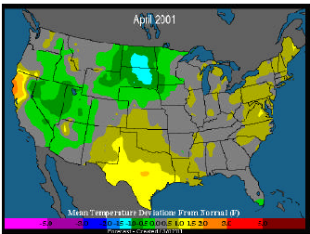
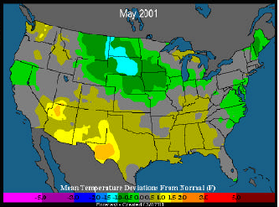
Spring Weather
Source: EarthSat

Slide 33
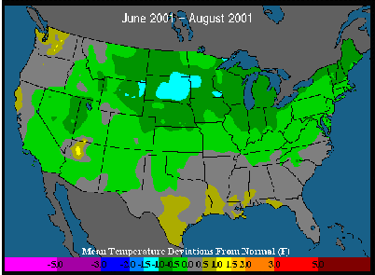
Summer Weather
Source: Enron

Slide 34
Summary
Storage levels will be at historic lows at the end of the heating season
Mild weather in January and February have caused prices to fall dramatically - the “crisis” is over
Expect support for prices as storage competes with increasing demand for cooling and power generation
Wild Cards
Summer heat
Demand destruction (4-5 bcf/d off market now)
Recession
Supply response picks up

