Slide 1


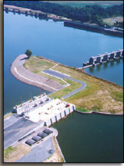
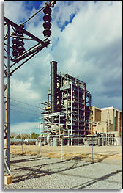



Presentation to:
by
Enron North America
December 1, 2000
CONFIDENTIAL

Slide 2

Executive Summary
Arkansas Electric CC
Founded in 1949
16 member cooperatives
Owns coal, gas, and hydro-electric generation facilities
1,970 MW of generation capacity
Energy sales of greater than 6 million MWh
Committed to providing reliable power generation
Enron
Largest wholesaler of electricity and natural gas in the United States
Knowledge-based company creating efficiencies from inefficient markets
World’s leading energy company and premier global provider of broadband communication services
Fortune’s “Most Innovative Company in America” (5th consecutive year)
Proposition: Comprehensive Strategic Alliance
Increase AECC shareholder value through:
Commodity (energy and fuels) risk reduction
Supply / Procurement of power
Fuel supply optimization
Enhancing performance by extracting additional value from assets
EnronOnline - Business to business e-commerce applications
<number>

Slide 3
AECC Current Issues
Reliable power to meet load growth demand
Deregulation and the “new” market
Current Arkansas legislation requires that retail markets open to competition by June 30, 2003
Arkansas PSC is currently investigating the California electric power market
Rising and volatile energy and fuel costs
Increased energy price volatility and decreased reliability in the “new” market
Retail competition in Arkansas may be delayed until as late as 2005 to avoid supply problems and price spikes as seen in California
Cash flow and balance sheet pressures
<number>

Slide 4
Potential Opportunities
Supply / procurement of energy and fuel optimization
Possible development of joint energy projects
Develop and/or monetize on-site generation
Physical and/or financial power and natural gas supply
Cross-commodity swaps
Risk Management Tools
Financial hedges to control price volatility and risk
Available for electricity, gas, coal, and other related commodities
Weather derivatives and emissions services
EnronOnline
Market Intelligence
Commodity transactions
Increasing AECC profitability
Provide higher cash flow consistency as a result of risk management
Lower risk exposure = improved predictability and profitability
Financial market welcomes strategic risk-management and energy partnership with Enron
<number>

Slide 5
AECC - Enron Alliance
Enron’s Proposition:
Enron’s North America Partnership: an efficient allocation of resources
Front, mid and back office core energy management functionality
Integrated into AECC’s strategic and tactical decision making process
Supplying commodity and risk management to meet required reliability at stable, predictable and attractive prices
Maximizing the return on AECC’s asset portfolio by taking advantage of the optionality and volatility inherent in a deregulating marketplace
Dedicate Enron’s resources to finding, valuing, developing, enhancing, and maximizing the return on the options inherent in AECC’s energy portfolio relative to the deregulating market and Enron’s significant portfolio
<number>

Slide 6
Electric Volatility: Entergy
<number>

Slide 7
Enron’s Network and Products

Slide 8

Enron Corporation
$40 Billion in annual revenues (1999)
$33 Billion in assets
$57 billion equity market cap
America’s leading commodity risk management company
Largest Natural Gas Marketer in North America
Largest Electricity Marketer in North America
First to broadly introduce risk management products to plastics, petrochemicals, pulp & paper, coal and weather markets
EnronOnline: world’s largest e-commerce site
Transactions to date in excess of $263 billion
Global platform for premium broadband communication services
<number>
Notes:
<number>
<footer>
<header>
1999 Summary
· a 28 percent increase in revenues to $40 billion;
· a 37 percent increase in net income to $957 million;
· an 18 percent increase in earnings per diluted share to $1.18;
· a 19 percent increase in marketed volumes to 32 trillion British thermal unit equivalents per day (TBtue/d); and
· a more than doubling of new retail energy services contracts to $8.5 billion.

Slide 9

Enron Corporate Overview
Revenue: $40 Billion
Assets: $33 Billion
Net Income (12/99): $893 Million
Market Cap (5/00): $57 Billion
Employees: 20,000
Network Businesses
North
America
Europe
Wholesale
South America
Wholesale
Energy
Services
Bandwidth
Emerging
Networks
Largest Marketer of natural gas and electricity in North America
Energy-related trading, risk management and finance transactions
Leading market maker in coal, pulp and paper, and petroleum liquids
Leading position in liberalized UK and Nordic market and strong position in continental markets
Leading developer and provider of merchant and finance services for integrated energy projects
Leading provider of Integrated energy and facilities outsourcing solutions to the commercial, light industrial, & Institutional markets
Building long-haul fiber-optic networks to provide wholesale bandwidth to telecom companies
India Wholesale
Caribbean Wholesale
Middle East Wholesale
Asia/Africa Wholesale
Europe Retail
South America Retail
Major marketer in Europe, Latin America, and Australia
Gas
Pipeline Group
Networks
Azurix
Operates intrastate pipeline
One of the largest natural gas transmission systems in the world
EnronOnLine, world’s largest e-commerce site
MG acquisition (estimate 07/00)
Pursuing opportunities in global water business-acquired Wessex Water, Plc. in July 1998
<number>
Notes:
<number>
<footer>
<header>
2

Slide 10
Enron’s Wholesale Power Network
Peaking Generation
(MW)
2,800
MAPP
1,300
MAIN
0
ECAR
NPCC
1998
1999
2000E
COB
ComEd
Hub
PJM
Hub
Hub
MAAC
Cinergy
Cinergy
Cinergy
Hub
Hub
Hub
Counterparties
Cinergy
WSCC
Hub
WSCC
SPP
Manufacturing
Marketers
SERC
Utilities
Palo
Palo
Palo
Palo
Verde
Verde
Verde
Municipal
Verde
Hub
Hub
Hub
Others
Hub
TVA
Hub
Entergy
Entergy
Entergy
Hub
Hub
ERCOT
Hub
Contract Term
NYMEX
Marketing Hub
FRCC
<1Yr
Power Plants
1-5Yr
>5Yr
In Operation
Under Development
Power Marketing Activity
Transmission Grid
<number>

Slide 11
Enron’s Wholesale Natural Gas Network
Storage Capacity
(Bcf)
52
28
Leased
Owned
Counterparties
Manufacturing
Marketers
Producers
Utilities
Others
Henry
Henry
Henry
Henry
Hub
Hub
Hub
Hub
Contract Term
Marketing Offices
Owned and Leased Capacity
NYMEX
Owned Gas Storage
Leased Storage
<1Yr
1-10 Yr
>10Yr
Gas Marketing Activity
<number>

Slide 12
Enron’s Coal Market Services
Over 57% of U.S. Generation is Coal Fired
Change in the Coal Industry is Driving Generators to Pursue Volume Flexibility and Price Certainty
Enron Provides Comprehensive Coal Management Services:
Owner/Principal Agent in several coal mines in the Appalachian and Illinois basins
Physical Delivery
Price Risk Management
Investment Capital
Enron’s Transactions
715
250
46
0
1996
1997
1998
1999
Enron’s Volumes
( Thousand Tons)
12,330
4,693
0
20
1996
1997
1998
1999
<number>

Slide 13
Weather Derivative Products
Enron’s Transactions
Strong Demand for Weather Products to Manage Weather-Related Earnings
Enron’s Weather Desk:
Manages Internal Commodity Exposure Dependent on Weather
Provides Weather Risk Management to Expanding Customer Base
Expects Broad End-User Participation With Highly Structured Products
Evolution of Weather Market:
Industry’s First Weather-Indexed Transaction Completed in Aug-97 (Enron)
First Financial Transaction Completed in Sep-98 (Enron)
Weather Futures Traded on Chicago Mercantile Exchange Since Sep-99
500
350
25
1997
1998
1999
Total Market Transactions Estimated at 3,000
Transaction Value
(Notional Value in Millions)
$700
$400
$24
1997
1998
1999
Total Market Estimated at $5 Billion
<number>

Slide 14
Enron’s Emissions Services
Most Active Participant in SO2 Market
Information Lead On:
Market Supply & Demand
Market Prices
Insight into Customer Needs
Economics of Generation
Structure Customized, Bundled Products to Meet Generators Needs to Comply with Regulations:
Alternative Fuel
Emissions Credits
Alternative Power Supply
Capital
Optionality
Marketed Volumes Increasing
(Thousand Tons)
Allocation of Allowances
Marketed (Spot) Allowances
Banked Allowances
1995
1996
1997
1998
1999
Source: RDI Inc.
<number>

Slide 15
Risk Management Opportunities
Risk Management Products
Swap
Cap
Floor
Collar
Reverse Tolling
Enron Online
What is EnronOnline
EnronOnline Overview:
Statistics
Benefits
Customization
Transactions
Utilization
<number>

Slide 16
Risk Management Tools - The Swap
Description:
A swap is a financial agreement to exchange periodic payments. Generally, one party pays a fixed payment, and the other party pays a floating payment based on current market prices. Swaps allow energy users and generators to convert an index price into a known fixed price with no changes to their current physical arrangements. This synthetically creates a fixed price transaction, or can change the structure of an existing contract.
Example:
Generator (Long Position)
A generator sells its power at the PJM market index (clearing) price. It enters into a swap in which it will pay the PJM power index price each hour specified (i.e. each off-peak hour) for a 6-month term and for 50 MW per hour, and receives a fixed price for the same volume. The generator’s swap offsets the price risk of selling at the unknown PJM price. The index payments for the swap and the physical sale cancel each other out, and net effect is a synthetic fixed price sale.
Market Price
AECC
Enron
Fixed Price
Electrons
Market Price
Off-Taker
<number>

Slide 17
Risk Management Tools - The Swap (cont.)
Example:
Load Serving Entity / User (Short Position)
An end user purchases power requirements at the PJM market index (clearing) price. It enters into a swap in which it will receive the PJM market index price for each hour specified (i.e. each on-peak hour) for a 1 year term and for 100 MW per hour, and pays a fixed price for the same volume. The customer’s swap offsets the price risk of buying power at an unknown price. The index payments for the swap and the physical transaction cancel each other out, and the net effect is a synthetic fixed price purchase.
Characteristics:
Provides 100% protection against price risk exposure
No Cost
Known future price
No benefit if price moves in your favor
Can maintain existing physical arrangements
Can be structured for gas, power, or coal transactions
Market Price
AECC
Enron
Fixed Price
Electrons
Market Price
Market
<number>

Slide 18
Risk Management Tools - The Cap
Description:
A cap is a series of consecutive call options which provides continuous protection to a consumer of energy. The cap buyer has the right but not the obligation to purchase energy at the specified price for the specified term. Because a cap is a series of call options, it provides a consumer with multiple exercise opportunities. A financial cap pays a cash settlement of the difference that the clearing price (index) exceeds the strike for a pre-specified time period. The cap buyer pays for the cap with a front-premium payment.
Example:
A consumer pays the day ahead or real time prices, but would like to ensure a maximum energy cost, yet take advantage of the market when prices are low – “cap” their costs. The customer buys cap for up to 100MW, 5X16, with a strike at $50. The consumer pays an up front fee, and will pay the floating market index price for power when the index is below the cap strike. If the buyer thinks the index will rise above the cap, the buyer exercises the cap (or can be structured as automatic exercise), and would pay only the cap strike price, or (financially) will be reimbursed by Enron the difference between the market price and the cap strike.
Characteristics:
Provides 100% protection from a rise in prices above the strike.
Guarantees worst case scenario and still maintain potential to benefit from low price environments
Can be tailored as “disaster insurance” (high strike and low up front premium)
Option can be customized, i.e. , daily ahead, monthly, automatic exercise, averaging
Can be structured physically or financially.
Can be structured for gas, power, or coal transactions
UPFRONT FEE
AECC
Enron
Electrons
Floating Market Price (PJM Index)
When market price > strike,
customer exercises option.
Enron supplies energy (physical),
Or pays customer difference between market and strike (financial)
Market
<number>

Slide 19
Risk Management Tools - The Floor
Description:
A floor is a series of consecutive put options which provides continuous protection to a seller of energy. The floor buyer has the right but not the obligation to sell power at the specified price for the specified term. Because a floor is a series of put options, it provides a seller with continuous exercise opportunities. A financial floor pays a cash settlement of the difference that the clearing price (index) is below the strike for a pre-specified time period and quantity. The floor buyer pays for the floor with a front-premium payment.
Example:
A Generator receives the day ahead or real time prices, but would like to ensure a minimum return yet take advantage of the market when prices spike up. The generator buys a floor for up to 100MW, 5X16, with a strike at $30. The generator pays an up front fee, and will receive the floating market index price for power when the index is above the $30 floor strike. If the buyer thinks the index will fall below the $30 floor strike, the buyer exercises the floor (or can be structured as automatic exercise), and would receive the $30 floor strike price. If financial, the generator will be reimbursed by Enron the difference between the market price and the floor strike (when the market price is below the floor).
Characteristics:
Provides 100% protection from a fall in prices below the strike.
Guarantees worst case scenario and still maintain potential to benefit from high price environments
Option can be customized, i.e. , daily ahead, monthly, automatic exercise, averaging
Can be structured physically or financially.
Can be structured for gas, power, or coal transactions
UPFRONT FEE
AECC
Enron
Electrons
Floating Market Price (PJM Index)
When market price < strike,
customer exercises option.
Enron buys energy (physical) at strike,
Or pays customer difference between market and strike (financial)
Off Taker
<number>

Slide 20
Risk Management Tools - The Collar
Description:
A collar designates a specific price range within which a generator may sell its power. It is constructed by buying a floor (set of put options) and selling a cap (set of call options). A “costless collar” can be achieved by establishing the collar bands at strikes that result in exactly offsetting premiums (i.e. no upfront payments). The collar band can be structured at various widths, depending on desired coverage and risk. The floor provides protection against falling prices, and is financed by selling the cap, which limits upside potential, thus creating a band of price opportunities.
Example:
A generator receives the day ahead or real time prices, but would like to ensure minimum earnings, yet gain some benefit when prices are high. The generator executes a daily collar on 100MW, 5X16, PJM-W for July/August with a band of $75-$150. The generator will earn the floating market index price for power when it is within the band. When the index is below the lower band, the lower band of $75 is earned. Above the upper band, earnings are capped at $150.
Characteristics:
Provides a hedge against adverse price move at the lower band.
Receives 100% of price increase to the upper band.
Can be structured with no up front fee.
Guarantees worst case scenario and limited upside potential.
Can be customized: physical, financial, daily, monthly, average.
Option can be customized, i.e. , daily ahead, monthly, automatic exercise, averaging
Can be structured for gas, power, or coal transactions
<number>

Slide 21
Risk Management Tools - Reverse Tolling
Description:
A natural gas fired generator exchanges its natural gas (in storage or purchased under contract) for power. This allows the generator/utility to meet its power obligations while realizing maximum value in an environment where natural gas is expensive relative to power.
Example:
A gas-fired generator has contracted to buy gas at a fixed price of $5.00/ MMBtu for the winter. An extremely cold winter sends gas prices to $7.00/MMBtu. The generator can purchase wholesale power from Enron in exchange for their gas at a savings. The generator/utility is able to meet firm commitments to deliver power without using their generation assets. Value in the below market gas contract can also be realized.
Fuel Costs expressed per MWH:
Price/MWh = (Price/MMBtu) X Heat Rate X 1,000
Price/MWh = ($7.00/1,000,000 Btu) X (11,000 Btu/kWh) X (1,000/MWh)
Price/MWh = $77.00
Power Buyer
50 MW
AECC
Gas
Gas Supplier
Tariff/Price
$5.0/MMBtu
50 MW
$45/
MWh
Gas
$7/MMBtu
Enron
<number>

Slide 22
Risk Management Tools - Reverse Tolling (cont.)
Cost of generating:
Fuel Cost: $77.00
Operations & Maintenance: 2.00
Total variable costs: 79.00
Cost of Reverse Tolling:
Power cost: $45.00
Total Variable Cost: $45.00
*additional gain of $2.00/MMBtu on gas contract
Benefits:
Power Savings: $79MWh - $45MWh = $34MWh
Gain on Nat Gas Contract: $7/MMBtu - $5/MMBtu = $2/MMBtu
<number>

Slide 23
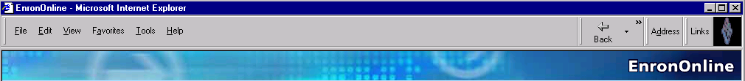
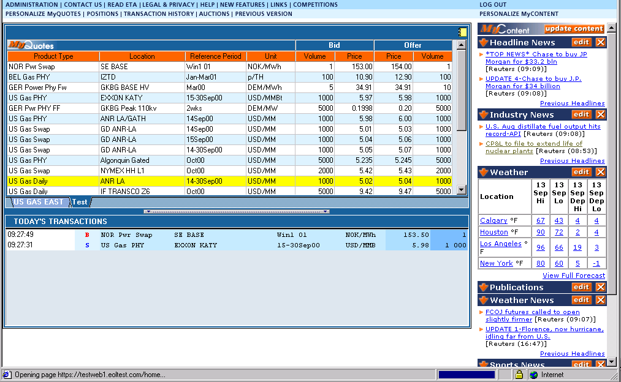
What is EnronOnline?
A Free, Internet-based, Global Transaction System Which Allows Counterparties to View
Real Time Prices From Enron’s Traders and Transact Instantly Online
<number>

Slide 24
EnronOnline Overview
Commodities Traded
Results
Natural Gas
Power
Crude Oil
Weather Derivatives
Emissions Allowances
Plastics
Petrochemicals
Pulp
Paper
Coal
Broadband
Metals
Average Weekly Transactions
Capabilities
Proprietary Technology - dynamic, real-time pricing
Scalable - over $178 Billion notional value transacted since inception (11/99)
Flexible - adaptable to unlimited products in multiple currencies
Reliable - a principal-based trading system
Leading e-commerce platform
Most liquid e-marketplace
>50% of all Enron’s transactions
<number>

Slide 25
Benefits of EnronOnline
Free of charge
Enron’s Best Prices
Real-Time Pricing Information
Access to complementary markets and product information
Simple access via the internet
Easy to use
Fast and Secure Execution
Market News and Quotes
Price Limit Orders
Industry Publications
Weather Insights
Advance Customization
Downloadable Transactions
Floating Windows
<number>

Slide 26
EnronOnline Statistics
Total Life to Date Transactions > 464,000
Average Daily Transactions > 3,000
Life to Date Notional Value of Transactions > $263 billion
Daily Notional Value Approximately $2.4 billion
Number of Products Offered: Approximately 1,150
Number of Currencies Traded in = 13
EnronOnline Version 1.0 Launch Date: November 29, 1999
EnronOnline Version 2.0 Launch Date: September 18, 2000
<number>

Slide 27
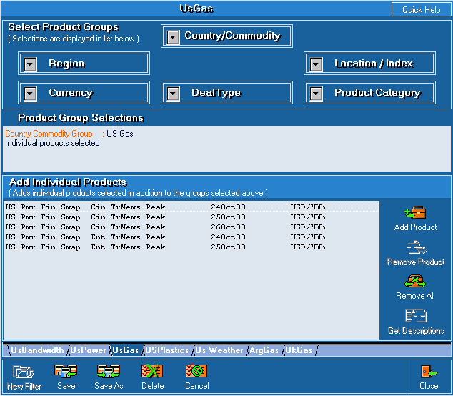
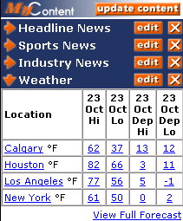
Customized Information
Customize your products and information according to your interests.
Commodity
Content
<number>

Slide 28
Transactions via EnronOnline
Quarterly
<number>

Slide 29
Utilization of EnronOnline
EnronOnline Transactions as a % of Total Transactions
Traditional Channels
* The percentage of transactions on EnronOnline declined in 3Q00 due to the purchase of MG Metals.
EnronOnline
<number>

