Slide 1

September 2000

Slide 2
SOUTHWEST POWER, L.L.C.
Overview
Operates as a QF under PURPA
Capable of generating an average of 53 MW
Provides 45 MW of on-peak capacity and energy to Nevada Power under its PPA
Remaining capacity is available for merchant sales
Thermal host is a 12-acre tomato greenhouse (Sunco) that is 100% owned by Southwest Power
A 224 MW expansion is in advanced stages of development - scheduled online date is June 2002

Slide 3
SOUTHWEST POWER, L.L.C.
Success Attributes
PPA with merchant capabilities
LV Cogen enjoys the financial stability associated with an anchor PPA and the potential upside of selling excess megawatts into nearby power markets
Strategically located to allow dispatch into Mead, SP-15 and Nevada markets
LV Cogen is located in North Las Vegas, Nevada, 5 miles from Las Vegas, the fastest growing city in the United States
Expansion of facility will bring an additional 224 MW online starting in June 2002
Potential PPA Restructuing
Significant barriers to entry
access to water rights
air quality standards
access to industrially zoned property and existing transmission interconnections and substations
availability of turbines
environmental concerns

Slide 4
SOUTHWEST POWER, L.L.C.
Project Development
LV Cogen began commercial operation in May of 1994
LV Cogen acquired by ENA on August 31, 1999
LV Cogen repowered by replacing its existing LM 6000 PA with a state-of-the-art LM 6000 PC, reducing the heat rate from 8,473 Btu/kWh to 7,900 Btu/kWh and increase capacity
A 224 MW expansion is underway that will be online by June 2002

Slide 5
SOUTHWEST POWER, L.L.C.
Ownership Structure
Enron & Affiliates
Southwest Power, L.L.C.
100% Interest
100% Interest
100% Interest
Desert Arc I, L.L.C.
Desert Arc II, L.L.C.
LVC II L.L.C.
Sunco Ltd., L.L.C.
85% GP Interest
15% LP Interest
Las Vegas Cogeneration, L.P.
$55.5 MM Debt
Greenwich NatWest
Structured Finance, Inc.
P & I

Slide 6
SOUTHWEST POWER, L.L.C.
Equipment Overview
A GE LM 6000 PC aeroderivative gas turbine rated at 44 MW
A Foster Wheeler triple pressure Heat Recovery Steam Generator (HRSG)
A Dresser-Rand high/intermediate pressure steam turbine, driving a net 10 MW generator
Two 520 ton trane absorption chillers and misting (fogging) system
Balance of plant equipment includes a selective a catalytic reduction NOx treatment system, a pump station, a (leased) demineralized water unit, a cooling tower, a transformer to increase the voltage to match that of the adjacent switchyard, an administrative building, a maintenance shop, and a spare parts warehouse with inventory

Slide 7
SOUTHWEST POWER, L.L.C.
Power Purchasing Agreement
45 MW of peaking power to Nevada Power - 30 year contract ending May 2024
Heating Peaks - 5 A.M. to 10 A.M. and 4 P.M. to 12 P.M. October through April
Cooling Peaks - 10 A.M. to 10 P.M. May through September
Operates 4,500 hours per year with 550 starts per year
NPC has the right to purchase the entire output of plant during peak hours (as specified in the PPA)
NPC has right of first refusal on net output of the plant during off-peak hours
Thermal energy (hot water) to Sunco for greenhouse heating

Slide 8
SOUTHWEST POWER, L.L.C.
Interim Sales Agreement
LV Cogen has entered into a Limited Release Agreement with NPC in April 2000 to facilitate timely entry of energy in excess of 45 MW into the wholesale market
Agreement has a one-year term, and may be terminated upon 30 days notice by either party
Agreement provides a mechanism for LV Cogen and NPC to share the net value of sales to third parties of excess energy generated by the plant
It is LV Cogen’s position that following termination of this agreement, it has the right to market energy in excess of 45 MW during peak periods without obligation to NPC. Off-peak can be offered to third parties once it has been offered to NPC at the price and terms of the proposed sale

Slide 9
SOUTHWEST POWER, L.L.C.
Restructuring of PPA
NPC is entertaining LV Cogen’s proposal to restructure the PPA
LV Cogen’s proposal includes the following items:
Delivery point flexibility, allowing LV Cogen to meet its contractual obligations under the PPA from nearby markets or via self-generation
The removal of QF status, releasing LV Cogen from maintaining strict operating standard required of a QF as well as the necessity of serving a thermal host
Release of NPC sharing rights under Limited Release Agreement
The opportunity will still exist for purchaser to negotiate buyout of the contract as provided by the Nevada settlement agreement

Slide 10
SOUTHWEST POWER, L.L.C.
Status of Nevada Deregulation
Nevada Law
SB438 mandates open access to customers
Provides an obligation to mitigate QF contract
Maintains the rights of QF holders
Stipulation and Agreement (NPC vs. PUCN dated July 14, 2000)
Open access to retail customers will be phased in, scheduled to begin Nov. 1, 2000
Auction process to buy down QF contracts as form of stranded cost mitigation
Merger Settlement
Nevada Power and Sierra Pacific are divesting of their generation assets and transforming themselves into transmission & distribution companies

Slide 11
SOUTHWEST POWER, L.L.C.
Operating History

Slide 12
SOUTHWEST POWER, L.L.C.
Environmental Compliance
Air Quality
Operates as the cleanest and most efficient plant in Las Vegas Valley
SCR for NOx control
CO catalyst for CO control
Operates below air permit levels
No air emission violations
Water
Plant water use for 1998 was 97.7 million gallons
City desires to sell additional water for revenue gain
No water discharge violations

Slide 13
SOUTHWEST POWER, L.L.C.
Environmental Compliance (continued)

Slide 14
SOUTHWEST POWER, L.L.C.
Status of Emission Reduction Credits
Present ERC balance is 170.5 tons as of October 8, 1999
Facility has enough ERC’s to operate the facility for the next 14 years??

Slide 15
SOUTHWEST POWER, L.L.C.
Interconnection Agreements
Southwest Gas distributes gas to LV Cogen
Water is purchased from the City of North Las Vegas and is also supplied by a water well adjacent to the site
Electrical interconnection with NPC switchyard via 138 kV line onsite

Slide 16
SOUTHWEST POWER, L.L.C.
Southwest Gas Distribution Agreement
4.5 mile lateral pipeline between Kern River and the Project site
MDQ is 5,200 MMBtu/d with rights to increase to 10,000 MMBtu/d
Base capacity demand charge of $ 17,917/month, which escalates at 80% of the CPI. Volumes in excess of 5,200 MMBtu/d are at base rate of $0.05/MMBtu
Agreement is for 17 years ending August 2011 and month-to-month thereafter

Slide 17
SOUTHWEST POWER, L.L.C.
Gas Supply & Transport
Primary gas supply and transport with Duke Fuels and Kern River pipeline
Gas hedged through April 2010 with ENA
Secondary gas supply and transport agreement is with ENA. The purchaser will need to replace this agreement

Slide 18
SOUTHWEST POWER, L.L.C.
Primary Gas Supply & Transportation
Primary gas supply is provided by Duke Fuels under a 17 year agreement, which expires April 2011
The Maximum Daily Contract Quantity is 5,000 MMBtu/d
Primary delivery point is the interconnect between Kern River Pipeline and Southwest Gas
Index based for the balance of the contract plus tariff transport charges on Kern River Pipeline
Scheduling, balancing and other services are provided under a percent of index management fee

Slide 19
SOUTHWEST POWER, L.L.C.
Primary Gas Hedge
A series of forward commodity swaps were entered into between ENA and LV Cogen for a period of 10 years from May 1, 2000 to April 30, 2010
These swaps result in a fixed gas price of $2.40/MMBtu

Slide 20
SOUTHWEST POWER, L.L.C.
Secondary Gas Supply & Transportation Agreement
Secondary gas supply is provided for under a 25 year agreement between ENA and LV Cogen, which ends May 31, 2024
The Maximum Daily Quantity is 5,000 MMBtu/d
The primary point of delivery is the interconnect between El Paso Gas Pipeline and Southwest Gas
Pricing is Daily Index price, for SoCal Border
The purchaser will need to replace this contract upon the consummation of this sale

Slide 21
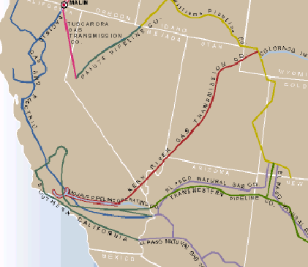
SOUTHWEST POWER, L.L.C.
West U.S. Pipeline Overview

Slide 22
SOUTHWEST POWER, L.L.C.
Operations & Maintenance
Currently operated by a staff of 10
4-year overhaul cycle
major overhauls on 8-year cycle
1999 cost of $1.1 million for minor overhaul, $3.2 million for major overhaul

Slide 23
SOUTHWEST POWER, L.L.C.
Sunco: Description
500,000 ft² - (12 acre) natural ventilation glass greenhouse with an additional two acres occupied by administration and warehouse facilities
Located adjacent to LV Cogen
Constructed in 1993
Climate computer controlled for temperature and humidity
Nutrients computer controlled for EC & pH

Slide 24
SOUTHWEST POWER, L.L.C.
Sunco: Description
Heating System
LV Cogen is the primary source of hot water heat
Gas fired boiler for secondary and backup
Cooling System
Automatic roof vents, high pressure fog, white wash
Perlite bags filled on site, recycled annually to potting soil supplier
Biological
Bumble bees for pollination, beneficial insects, biological sprays

Slide 25
SOUTHWEST POWER, L.L.C.
Sunco: Proposed Sale
Southwest Power is currently in the process of soliciting bids for the sale of the greenhouse
If LV Cogen retains QF status, the buyer of LV Cogen could retain ownership of Sunco or negotiate a new commercial agreement
14 acre property, industrially zoned, valued at approximately $2.0-$3.0 million

Slide 26
SOUTHWEST POWER, L.L.C.
Financing Terms & Conditions
Borrower
LV Cogen Limited Partnership
Term Loan
$55.5 million currently outstanding
Assignable to purchasers of project
Maturity
10 years to September 30, 2009
Pricing
Years 1-3 LIBOR + 1.125%
Years 4-6 LIBOR + 1.375%
Years 7-10 LIBOR + 1.625%

Slide 27
SOUTHWEST POWER, L.L.C.
Financing Terms & Conditions (continued)
Amortization
Quarterly amortization to a 53% balloon payment ($29.9 million)
Letters of Credit
Southwest Gas Corporation
$855,712
Amortizing over 3 year term
Duke Fuels
$3,000,000
3 year term
Pricing of LCs same as Term Loan margin

Slide 28
SOUTHWEST POWER, L.L.C.
Financing Terms & Conditions (continued)
Debt Service Reserve
$3,500,000 secured by Enron LC (This will need to be replaced)
Equal to approximately 6 months debt service
Cash Trap/Sweep
No distributions to equity prior to September 30, 2000
No distributions to equity where DSCR is less than
1.10x (until September 30, 2005)
1.20x (October 1, 2005 - September 30, 2006)
1.30x (October 1, 2006 - September 30, 2007)
1.40x (October 1, 2007 - September 30, 2008)
1.50x (October 1, 2008 - September 30, 2009)

Slide 29
SOUTHWEST POWER, L.L.C.
Financing Terms & Conditions (continued)
Revised Forecast Cash Trap/Sweep
Revised forecast for the period 2009 to 2016 prepared annually from 2004
Sliding scale of required forward looking coverage ratios
Cash traps/prepayments in the event that required forward looking ratios not achieved

Slide 30
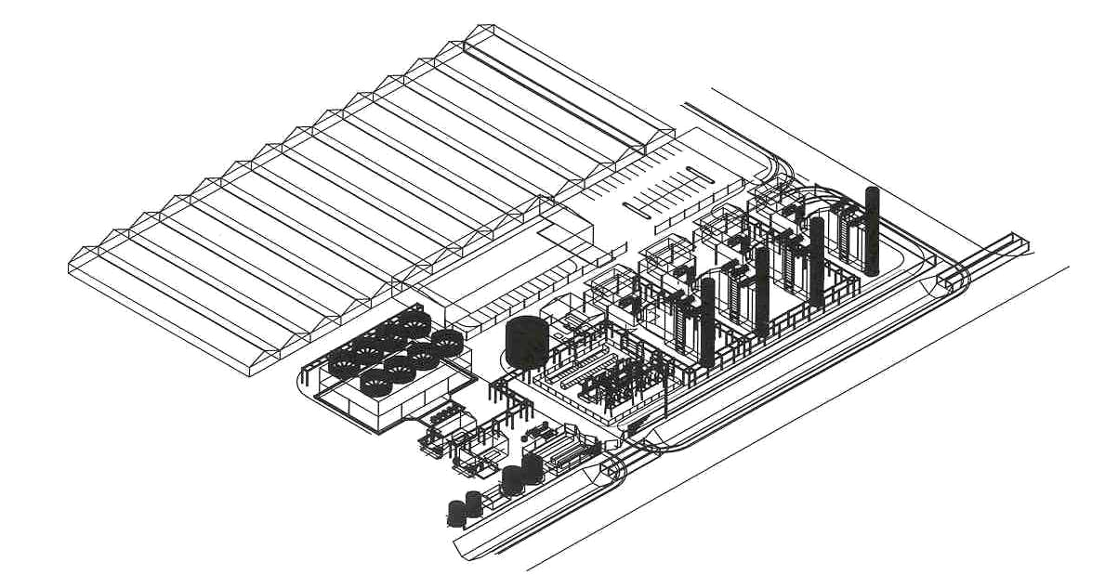
SOUTHWEST POWER, L.L.C.
Expansion Site LV Cogen II

Slide 31
SOUTHWEST POWER, L.L.C.
LV Cogen II: Expansion Overview
224 MW, 7,526 Btu/kWh (HHV) natural gas fired plant consisting of two, two-on-one combined cycle units (4 LM 6000 PC).
Inlet cooling will be used to maximize output during warm ambient conditions
Project will be located adjacent to existing plant on approximately four acres owned by LV Cogen
Southwest Gas Pipeline, Nevada Power Transmission and City of North Las Vegas water supply is located at boundaries of project site

Slide 32
SOUTHWEST POWER, L.L.C.
LV Cogen II: Development Benefits
Load pocket location in high growth state short on reserves
Power market fundamentals:
Robust and increasingly volatile SP-15
Ability to sell into Mead or the Southern Nevada market, which is scheduled to begin deregulation in November 2000
First mover advantage; first new resource to enter market in Nevada

Slide 33
SOUTHWEST POWER, L.L.C.
LV Cogen II: Timeline

Slide 34
SOUTHWEST POWER, L.L.C.
LV Cogen II: Project Assumptions

Slide 35
SOUTHWEST POWER, L.L.C.
LV Cogen II: Capital Cost Assumptions

Slide 36
SOUTHWEST POWER, L.L.C.
LV Cogen II: Operating Cost Assumptions

Slide 37
SOUTHWEST POWER, L.L.C.
LV Cogen II: Permits
Air Permit
Application was submitted March 27, 2000
Deemed complete on June 9, 2000
Site Plan
Zoned industrial - allows for power plant construction
A determination of “No Hazard to Navigation” issued on August 9, 2000
The City of North Las Vegas Planning Commission approved the site plan on August 23, 2000

Slide 38
SOUTHWEST POWER, L.L.C.
LV Cogen II: Water Supply & Waste Water
Water
The City of North Las Vegas has communicated in writing its intention to issue a “will server” letter once all fees have been paid and both hydraulic analysis and final drawings have been approved
Waste Water
The City of North Las Vegas will discharge the water water
On June 16, 2000, flow and concentration was approved

Slide 39
SOUTHWEST POWER, L.L.C.
LV Cogen II: Energy Sales
Power would be sold to NPC or wheeled to markets at Mead or California
Given its location in the load center, LV Cogen II should be able to sell ancillary services when Nevada deregulation is implemented
Beginning November 1, 2000, the largest commercial customers of NPC, including the large casinos and mines, will be able to select their electric power supplier

Slide 40
SOUTHWEST POWER, L.L.C.
LV Cogen II: Interconnection
Transmission
LV Cogen II will interconnect with Nevada Power’s 138 kV substation at the site
A request for long-term firm transmission to the Mead substation was submitted to NPC on August 14, 2000 and a LC is in place to reserve 230 MW of capacity for the project

Slide 41
SOUTHWEST POWER, L.L.C.
LV Cogen II: Interconnection
Fuel Supply
Either compression or a new 4.3 mile pipeline from the Kern River mainline will be needed to meet the requirements of LV Cogen II. ENA is in discussions with Southwest Gas and Kern River to determine lowest cost alternative
Southwest Gas has provided a proposal to build a gas lateral from the Kern River Pipeline
Kern River has indicated that it can expediently expand via increased compression to provide at least an additional 350,000 MMBtu/d at tariff rates

Slide 42
SOUTHWEST POWER, L.L.C.
Summary
PPA with merchant capabilities
LV Cogen enjoys the financial stability associated with an anchor PPA and the potential upside of selling excess megawatts into nearby power markets
Strategically located to allow dispatch into Mead, SP-15 and Nevada markets
LV Cogen is located in North Las Vegas, Nevada, 5 miles from Las Vegas, the fastest growing city in the United States
Expansion of facility will bring an additional 224 MW online starting in June 2002
Potential PPA Restructuing

