Slide 1
Exhibit SVV-3: Principal Interconnections and Pricing Points in the WSCC
The Dalles
COB
To/From Northwest Markets
Colstrip
Tule Hub
COB
NOB
Jim Bridger
NOB
San Francisco
Mona
Mead/El Dorado
Los Angeles
To/From Southwest Markets
Mead
Phoenix
Palo Verde
Palo Verde
<date/time>
<footer>

Slide 2
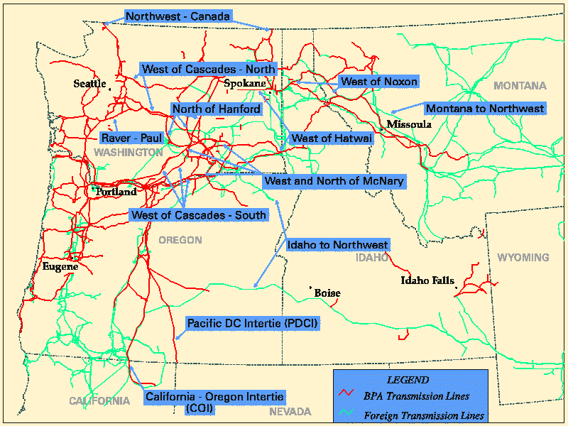
Exhibit SVV-4: Pacific Northwest Transmission System
Source: Bonneville Power Administration OASIS website, 2001

Slide 3
Exhibit SVV-5: Comparison of Generation Resources in PNW to WSCC
PNW Generation Resources by Fuel Type
Source: NWPPC Fourth Conservation and Electric Power Plan, Appendix A, 1998.

Slide 4
Exhibit SVV-6: Comparison of Generation Resources in California to PNW
PNW Generation Resources by Fuel Type
California Generation Resources by Fuel Type
Sources: NWPPC Fourth Electric Power Plan, 1998, and CEC 1999 Resources Report

Slide 5
Exhibit SVV-7: Block Forward Market Prices for First Quarter 2001 at NP-15 as a Percent of the Average of Spot Prices
Source: BFM Trade Statistics from the CalPX website, and the Energy Market Report, 2001.

Slide 6
Exhibit SVV-8: BPA’s 1998 Regional Monthly Firm Capacity Surplus/Deficit Projections Under Extreme Weather Conditions, 2000-2001¹
Source: 1998 Pacific Northwest Loads and Resources Study: The White Book, Bonneville Power Administration, December 1998.
¹1937 was used as the base year for extreme weather conditions associated with poor hydro supply..

Slide 7
Exhibit SVV-9: Historical PNW Hydro Generation Supply vs. 2001 Levels
Source: Energy Information Agency, Department of Energy, Electricity Power Plant Database, Forms 759 and 900, 1992-2001. Most recent data is available for April 2001.

Slide 8
Exhibit SVV-10: Indexed Internet Stock Decline Compared to Indexed Mid-Columbia Third Quarter Forward Contract Prices
Percent of Zenith Price, ISDEX and Mid C Q3 2001
Days of Trading Since Zenith

