Slide 1





Steven Kean
February 6, 2001
<number>

Slide 2
Corporate Staff Functions
<number>

Slide 3
Overview
PR/Communications and Regulatory Affairs
Human Resources
Corporate Administrative Services
Function
Approach
Progress
Initiatives

Slide 4
PR/Communications
<number>

Slide 5
Functions
Public
Relations
Internal
Communications
Brand
Media Relations
“Experience Enron”
University Outreach
Annual Report
Advertising
Common “Look and Feel”
Employee Publications
Employee Meetings
Intranet: my.home.enron.com
ETV
Online and Interactive: E-Speak / E-Meet / Idea Bank

Slide 6
Approach
Focus on target audiences
CXO’s
Opinion Leaders: Media and policy makers
Investors
Prospective Employees
Active engagement of media
Targeted advertising on key elements of our brand
Challenging the status quo-- “Ask Why”
Feature Enron’s innovation

Slide 7
Progress
Breakout performance in earned media
Enron-only feature stories
New media coverage
Broader view of Enron: from “Leading Energy Company” to “Leading Company”
Substantial expansion of Familiarity and Favorability as measured by opinion research
Internal Communication is no longer just a “newsletter”
Moved Online
ETV
IPTV Broadcast Employee Meetings
“Best Lists”
Most admired companies
Best companies to work for
Global

Slide 8
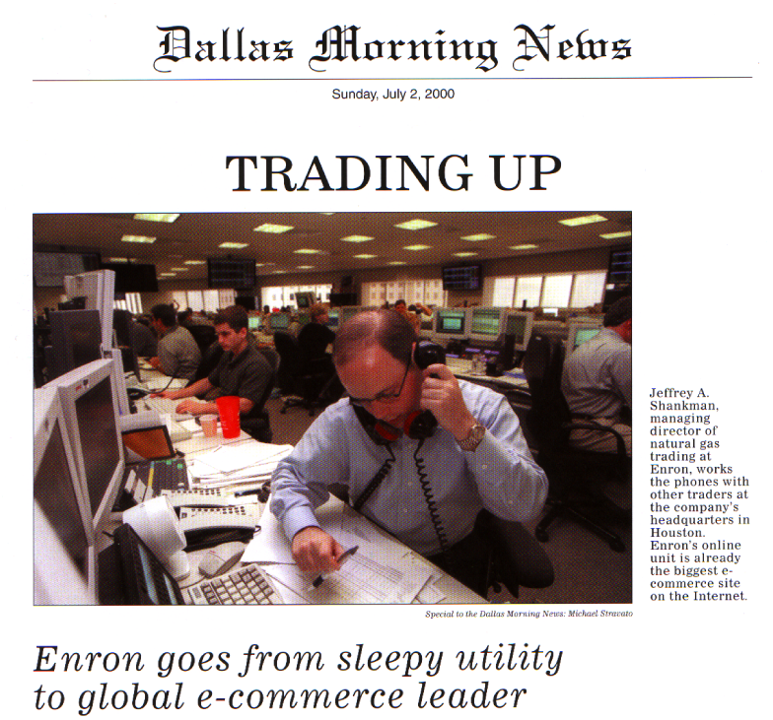
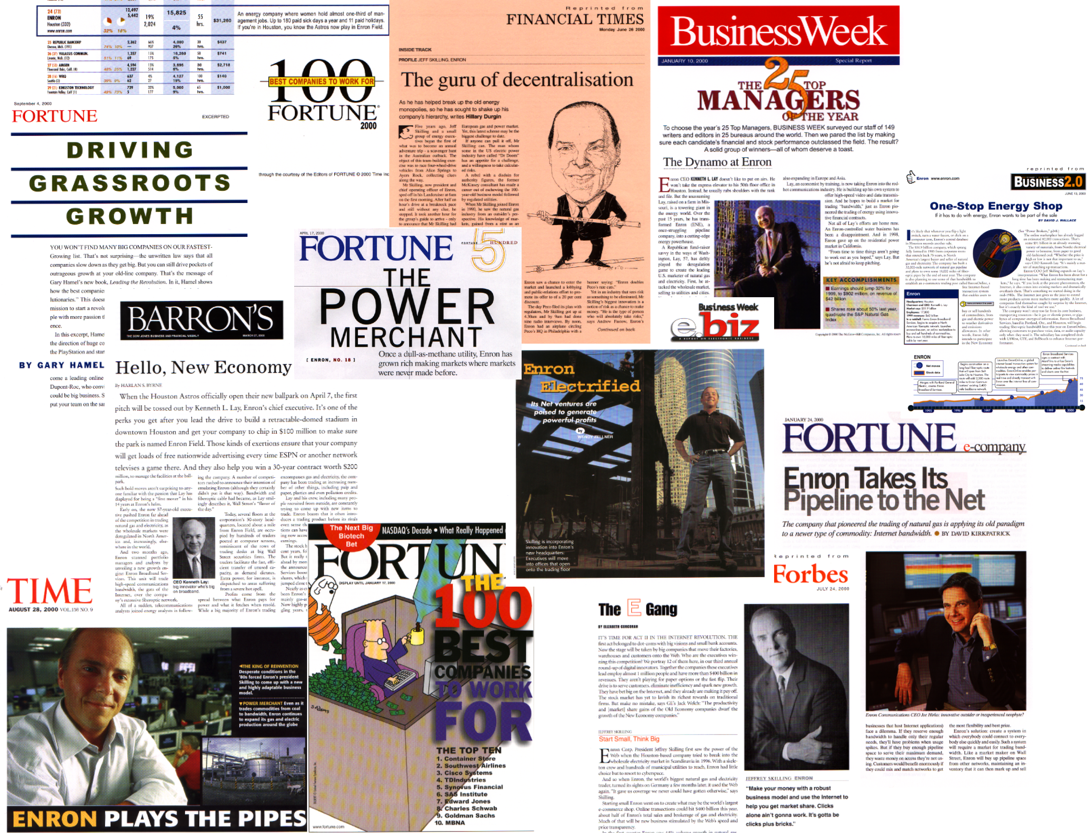
Enron Public Relations

Slide 9
Initiatives
Further Expansion of Enron Coverage
From feature stories to cover stories
Targeted, direct delivery of Brand

Slide 10
Government and Regulatory Affairs
<number>

Slide 11
Functions
Advocacy
Business Unit
Support
Risk Identification
and Mitigation
Open markets and free trade
Focus on
Electric Market
Open Access
Derivatives regulation
North America, Europe and Japan
Transaction support
Protecting existing assets and positions
Information/Intelligence gathering
Identify regulatory/political risks/opportunities
Mitigation/capture plan
Organized by operating company, geographical area and substantive area

Slide 12
Approach
Positioned as the leading voice for open and competitive markets
Form/Lead coalitions to effect change
Mission Shift: From advocacy to transaction support and risk mitigation
Rigorous resource allocation process

Slide 13
Progress
Substantially exceeded budget with quantifiable opportunities captured and risks mitigated
CFTC reforms
Environment, Health and Safety organization successfully launched
California crisis generating backlash

Slide 14
Initiatives
Campaign to
isolate California
get the real story out
generate opportunities for Enron’s services
Support for networks, global markets and industrial markets
Wholesale open access in North American and European power markets

Slide 15
Human Resources
<number>

Slide 16
Functions
Facilitation of HR Strategy & Policy
Executive Company
Compliance
Redeployment
Systems
Organize discussions across business units regarding
Compensation
Performance Mgmt.
Gathering Market Data
Implementing Corporate Company Policy
Ensuring Consistency
Fair Employment
Reporting
Formalized process to move talent around Enron
Performance Management
Online employee Information
Directory/Expert Finder
Business Units
Training
Staffing/Recruiting
Compensation
Employee Relations
Outsourced
Payroll
Benefits

Slide 17
Approach
Decentralize core functions
Compensation
Recruiting
Collaborative, non-hierarchical approach to HR Strategy and Implementation
Outsource noncore function
Develop common systems to support company-wide activities
Performance management
Compensation
Redeployment
Enable employee self service (HR online)
Ensure that programs/initiatives have quantifiable business value

Slide 18
Progress
Reduced HR costs across Enron by 20% ($12mm)
Improved HR ratio from 1:35 to 1:75
Took HR services to online platforms
Community relations:
United Way: 33% increase
JDF/MS-150: 89% increase
Other fundraising: 77% increase

Slide 19
Initiatives
Increased Focus on Culture and Work Environment
Click@Home
Onsite daycare
alternate work arrangements
Implementation of partnership model
Commercialization of HR systems

Slide 20
Corporate Administrative Services
<number>

Slide 21
Functions
Property
Development
Aviation
Security
Property Management
and Administration
Real Estate Leasing and Acquisition
Facility Planning
Construction Management
Relocation/ churn
New Building
Corporate Arc
Chartering
Building Security
“default provider” of security services
Billing and Allocations
Administration of third party contracts

Slide 22
Approach
Outsource noncore functions; employees focus on administration of third party contracting
Drive cost accountability through detailed billing and allocation process
Drive productivity: collocation, flexible and open environment, churn

Slide 23
Progress
Further outsourcing - EES assuring facility management services (25% of budget)
Dramatic efficiency gains (16% reduction in G&A)
30% increase in Houston employee/contractor base
25% increase in churn (8400 moves)
designed, construction of 300,000 sq. ft. of short term
Reconstructed corporate aviation fleet
New building (EBII) on track to meet schedule and budget commitments

Slide 24
Initiatives
Enron Center
creating the premier urban office campus
new work place design and collaboration technology
showcase transaction floors
up-to-date work life amenities (daycare, restaurants, fitness center, food service)
Mitigation of exposure to downtown lease obligations

