Slide 1

Waha HubCo
Sid Richardson
Overview
September 2001

Slide 2
ENA TX Gas Overview
ENA recently sold Houston Pipeline as part of an “asset lite” strategy to:
  Retain a strong presence in gas and power trading.
  Continue purchasing gas from producers and marketing gas to end users.
  Develop a transport/storage network to meet the needs of customers rather than the other way around.
  Increase Enron’s ability to transact by increasing price transparency and market liquidity.
ENA’s asset lite strategy allows us to more closely align our interest with our customers:
  We are not trying to maximize the profitability of our assets at the expense of our customers
  We can tailor our products/services to our customers needs:
    Bundled Services: Gas purchases/sales, asset management, logistics, producer services
    Unbundled Services: Commodity risk management, marketing, transportation, processing, back-office, measurement, EOL, asset development.

Slide 3
ENA Texas Gas Business Strategy
Develop a flexible network of commodity, transport, and storage positions:
    Acquire access to pipeline capacity to link supply and demand.
    Acquire access to storage capacity to serve swing markets – IPPs and others
    Establish direct access to both suppliers and end-use customers
    Create supply and market hubs to increase price transparency and liquidity
Provide products that enable customers to increase optionality and extract value from the market:
    Leverage Enron’s market making capability to create liquidity and optionality for customers
    Leverage Enron’s processes, systems and information flow to increase the efficiency of our customer businesses.
    Differentiate ourselves by offering both bundled and unbundling products.
    Position EOL as a tool to increase liquidity and price transparency
Integrate EOL into Texas intrastate market to increase transportation and commodity liquidity; Key points of presence:
    Trading Hubs – Waha, King Ranch, Katy, Carthage
    Supply Zones – Agua Dulce, Banquette, Thompsonville
    Market Areas – Houston Ship Channel, Beaumont
    Intrastate Transportation – HPL, Midcon/KN, Tejas, El Paso, Oasis

Slide 4
HubCo
Implement the asset lite strategy by creating a HubCo at Waha and other key trading points:
  Establish a new intrastate pipeline company to allow physical connectivity between market participants
  Serve as an contracting intermediary between interstate pipelines, intrastate pipelines, producers, and trading entities
HubCo Objectives/Benefits:
  Purchase/sell transport and storage positions to access physical supply and offtake points at Waha
  Create a physical header system at Waha that attracts physical supply and third party interconnects.
  Provide for a physical Waha basis that will support the development of a synthetic transport product between Waha and other EOL points within Texas.
  Maximize physical flow across HubCo
HubCo Role/Activity:
  Enter into an asset management contract with the ENA for hub management services.
  Seek complimentary transport and storage positions with other intrastate and interstate pipelines/storage operators

Slide 5
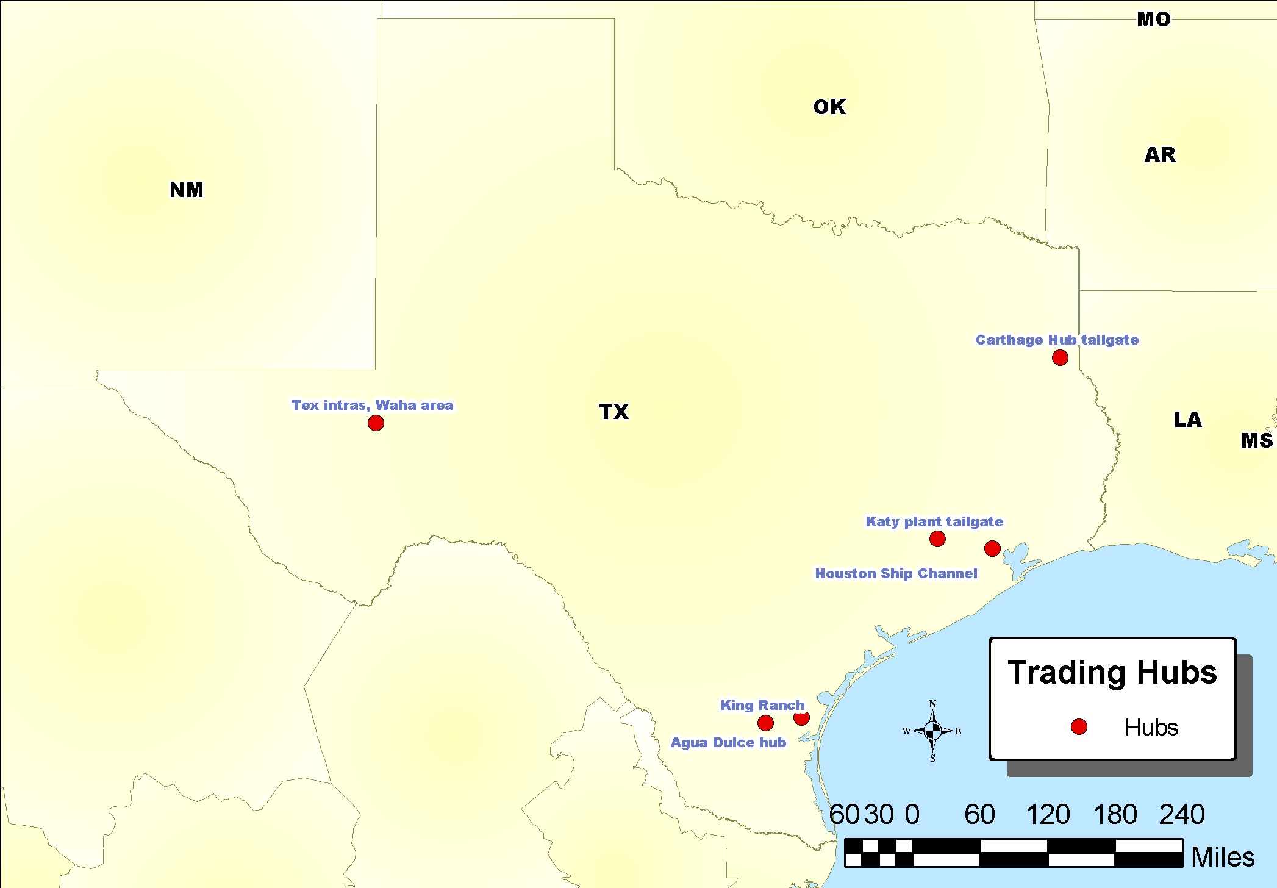

Slide 6
Sid Richardson
Sid Richardson Objectives/Benefits:
  Increase connectivity between Sid Richardson’s assets
  Increase operational flexibility to maximize asset utilization
  Increase optionality to access multiple markets, offtake points, and/or storage
Sid Richardson Role/Activity:
  Contribute capacity rights, physical assets and/or capital to establish a physical Waha hub.
  Receive capacity rights, return on capital, and hub management/trading services from HubCo.
Sid Richardson Actions:
  Discussions with ENA engineers to develop flow and interconnection options
  Discussions with ENA to establish commercial arrangements

Slide 7
ENA
ENA Objectives/Benefits:
  Establish direct access to pipeline/storage capacity to link supply and demand.
  Establish direct access to both suppliers and end-use customers
  Create supply and market hubs to increase price transparency and liquidity
ENA Role/Activity:
  Establish physical EOL products at Waha to create liquidity and price transparency
  Enter into a hub management agreement with HubCo to leverage Enron’s processes, systems and information flow.
  Attract new participants to maximize throughtput across HubCo.
ENA Actions:
  Discussions with Sid Richardson, TW and/or others to develop flow and interconnection options
  Discussions with participants to establish HubCo structure and commercial arrangements.

Slide 8
HubCo Deal Structure
Physical & Financial Transactions
Physical & Financial Transactions
ENA
Gas Mkt
Shippers
Nomination, Scheduling & Hub Mgmt. Services
Capital and/or assets
[$, equity in HubCo, or Firm Transport Capacity across HubCo]
[$ Hub Fee]
HubCo Storage & Transport Services (Firm & Interruptible)
TW & Others
Capacity rights, capital and/or assets
HubCo
Access to production in/around Waha
Access to intrastate and interstate pipelines
Access to Unocal storage field
EOL trading point
Nomination, scheduling & hub mgmt services
Capacity rights, capital, and/ or assets
Sid Richardson
[$, equity in HubCo, or Firm Transport Capacity across HubCo]
[$, equity in HubCo, or Firm Transport Capacity across HubCo]

