Slide 1
Compensation
Structure

Slide 2
Personnel Processes
Current Situation
Compensation is mix of
  salary
  cash bonus
  LTIP - restricted stock and options
Previous structures provided special equity participation to individuals starting new businesses; now all on Enron currency
P/L focus may make leaders unwillingly to share resources with new businesses
Enron vunerable to loss of talent in the event of shock to ENE price

Slide 3
Personnel Processes
Current Situation
Objectives
Compensation is mix of
  salary
  cash bonus
  LTIP - restricted stock and options
Previous structures provided special equity participation to individuals starting new businesses; now all on Enron currency
P/L focus may make leaders unwillingly to share resources with new businesses
Enron vunerable to loss of talent in the event of shock to ENE price
Compensation structure which enhances collaboration and resource sharing across organization
Provide additional compensation which may remain valuable in the event of shock to ENE stock price
Investment vehicle in which all partners share in new business creation

Slide 4
Personnel Processes
Issues/Considerations
How much of compensation must come from investment vehicle to create real incentives to collaborate?
Investment vehicle may have a delayed effect on management incentives to collaborate
  may need to use additional levers: e.g. performance management process
To what extent should management incentives be “de-linked” from ENE price?
What decision making process for making investment decisions?

Slide 5
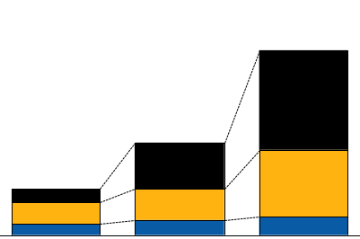
Compensation Structure
“Strawman”
Compensation tenets
Relative level of compensation at-risk for partners
  Partners have more compensation at risk than a typical corporate executive
  Increasing variability/ spread in compensation ranges by level
  Corporate-wide bonus pools for each partnership level
Options/ restricted shares
Cash bonus
Base salary
VP
Range of MD compensation

Slide 6
Compensation Structure
Methodology
Challenges/implications
Approach 1
Use salary, cash bonus, and Enron corporate options/ restricted shares as the sole tools to compensate all partners
  Easy to lose focus on the importance of business building
  Partners reluctant to donate best people to a new venture with more distant and indirect impact on stock price
✗
Approach 2
Create special incentives (e.g., formulaic compensation vehicles) to be shared by those individuals directly involved with the creation of new businesses
  Violates key tenet of partnership (i.e., single profit pool)
  Value of new ventures may not be readily or accurately reflected in stock price
  Leaders with formulaic compensation may be reluctant to “pull the plug” on non-performing businesses
✗
Approach 3
Create specific compensation vehicles linked to building new businesses, but with distributed ownership across entire partnership
  Aligns entire leadership group toward creation of new businesses
  Allows partners to have a portion of compensation tied to long term Enron growth in a vehicle other than stock price
✓

Slide 7
Compensation Structure
Type of growth opportunity
Funding sources
Existing core business growth opportunity (e.g., Enron Europe, Enron Japan)
Enron equity
Future or potential core business (e.g., Networks, original EES, Data Storage)
Non-core business ventures that leverage proprietary knowledge (e.g., NewPower Corp., Wind)
Deferred partnership compensation

Slide 8
Decisions

Slide 9
Next Steps

Slide 10
