Slide 1

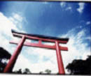



Succeeding in a Restructured Energy Market
May 15, 2001
09/27/25
Notes:
Notes for Presentation
This presentation is designed to provide an international perspective to the liberalization of electricity markets, in the context of the Japanese emerging markets.
The conference coincides with the public announcement of a paper commissioned by Enron Japan which makes specific recommendations for electricity sector reform in Japan.
The accompanying slide notes are provided for support and information purposes only.
The audience is broad, including utilities, large-lot customers, ministry officials, consultants, and other interested parties.
THE PRESS WILL BE ATTENDING

Slide 2
Benefits of Liberalization
Achieving a Competitive Market
Strategies for Success

Slide 3
Benefits of Liberalization
Not a “zero sum game”
Net benefits created
Better solutions to transition issues
Cost savings
Improved reliability
Improved product choice
Improved allocation of capital
Improved allocation of risk
Environmental benefits
Improved
speed
flexibility
solutions
to problems in the market
Notes:
Industrial Electricity Prices 1998 (PPP basis)
Japan 16.81 yen/kWh
OECD Ave. 13.55 yen/kWh
(IEA, Energy Policies of IEA Countries, Japan 1999 Review)
Japan introduced wholesale competition in 1995 and partial retail competition in March 2000.
Phase I (1995): Introduction of bidding system for supply to electricity companies from IPPs.
Phase II (2000): Partial liberalization of retail supply. Customers which take electric service at 20kV or higher able to choose their supplier.
High electricity prices are harming Japanese industry’s international competitiveness. The Japanese Ministry of Economic and Industry (METI) White Paper on International Trade 2000 states that a significant contributor to Japan's loss in global market share is the inefficiency in Japan's energy sector - specifically low productivity and high prices. It says that these inefficiencies are a result of the absence of market competition.

Slide 4
Benefits - Cost Savings Price Decrease from Deregulation in Five U.S. Industries
Percent Decrease
50
40%
40
30
2 years
5 years
10 years
20
10
0
Trucking
Railroads
Airlines
Natural Gas
Long Distance Telecom
Source: Brookings Institution/George Mason University
Notes:
Trucking Rail Airlines Telecom Gas
2 years 0% 4 13 11 24
5 years 10 20 12 32 34
10 years 42 44 29 44 42
Japanese consumers have also benefited from deregulation. The Japanese Economic Planning Agency estimated in a January 2000 report that 8.6 trillion yen of “consumer benefit” (a function of lower prices and increased demand) was achieved between 1995 and 1998 in eight key industries through deregulation (telecoms, domestic airlines, car insurance, electricity, gasoline, gas, brokering).

Slide 5
Benefits – Cost Savings
Indices of Real Industrial Electricity Prices (%)
Source: IEA
Notes:
Real Price Comparisons
1995 1996 1997 1998 1999
Japan 100 100 102.3 103.7 105.3
OECD Europe 100 98.8 95.5 94.3 94.8
OECD 100 98.6 96.3 93.1 91.9
USA 100 95.2 90.7 83.9 80.9
“Real” price indices are the current price indices divided by the country specific Producer Price Index.
(Source: IEA, Electricity Information 2000)
Small Reductions in Japan’s electricity prices. Prices for electricity consumers in Japan have reduced by between 3.78 - 6.90 per cent (average 5.42 per cent) since the introduction of the second phase of deregulation. However, these price reductions were unilateral reductions made by the utilities in the expectation of competition, rather than as a result of competition. Further, the price reductions were partially negated by increases in electricity charges introduced as a result of rising fuel prices.

Slide 6
Benefits – Improved Reliability
Reliability improves in an open market
Merchants find new paths between supplies and markets, effective reserve margins increase
Information provided by system users is better than predictions
Customers can choose their level of service
Investment decisions become more rational, bringing supply and demand into better balance
Notes:
The Brattle report makes three recommendations in order to ensure system reliability:
Ensure that incentives exist to expand generation and transmission capacity before reserve margins fall too low. Regulator should provide as much regulatory certainty as possible regarding the process for liberalizing the market. Utilities should continue to hedge risks through long-term financial contracts.
Implement liberalization as rapidly as possible to avoid problems with transition periods, to send real-time price signals to consumers, and to deter market power abuse.
Monitor demand growth, capacity requirements, and new investments, and ensure that appropriate incentives exist for cost effective energy efficiency programs.
Reliability is not achieved at least cost in a regulated market. The US EIA noted that the reserve margin in 1982 was 33% and concluded that “Utilities had planned and built more capacity than was actually needed by the time the capacity was created.” (Performance Issues for a Changing Electric Power Industry, DOE/EIA, Jan. 1995, p.vii)
Japanese Reliability Figures. In 1998 Japanese utilities quoted reliability figures of 99.995 per cent as being significantly better than their US or European counterparts. Yet Japan's largest utility and New York's largest utility, which have similar network configurations, have similar reliability performances - 99.999 per cent, according to 1995 figures. However, the Japanese company's transmission prices are more than twice New York's and estimates of costs for the New York company's constant supply to a 1MW load are approximately a third of those in Japan

Slide 7
Benefits – Improved Reliability
Supply Failures for UK Electricity Suppliers
(minutes/year)
Source: Ofgem
Notes:
Supply Failures for UK Electricity Suppliers
(minutes/year)
227mins 1995 98mins
104mins 1996 87mins
107mins 1997 88mins
96mins 1998 81mins
98mins 1999 71mins
All companies reported figures for 1999/00 which were better than their 10 year average performance.
(Source: Ofgem)
Examples of market forces responding most effectively to supply/demand imbalances.
1996: 100 year drought in Norway
1998: US Mid-West

Slide 8
Benefits – What Went Wrong in California?
California’s reliability problems are due to a badly designed framework for liberalization, regulatory barriers and economic fundamentals, not deregulation
Supply has not kept pace with demand
Regulatory requirements for siting and wholesale price caps have hindered new supply
Utilities required to purchase their electricity from the volatile spot market rather than allowing them to enter into long-term contracts with stable prices
Unusually hot and dry weather throughout the west exacerbated the problem last summer
Notes:
Should also reference potential issues in New York and Florida
Regulatory requirements for new plants in Japan.
Japan base-load plant development cycle is 10-15 years
Permitting is sequential not concurrent.
Environmental assessment process takes 3 years.
Japan is not factoring in the impact of the Internet on electricity demand.
The Japanese government through its E-Japan initiative wants to be at the forefront of e-business development by the end of the decade. Under the initiative, the Government is aiming to increase household Internet penetration from the current 19% to 60% by 2005.
Over the last decade electricity demand in Japan has increased at an average rate of 2-3%, and Japan is not anticipating a significant change in demand over the next decade.

Slide 9
Benefits – What Went Wrong in California?
The solution is to implement full liberalization
Create a competitive market. Buyers and sellers should be free to set mutually beneficial terms, and buyers are able to react to market signals by moderating consumption
Open access. All parties should have open access to the entire transmission grid under the same rules
Provide choices for customers. In California’s regulated retail environment, less than 1% of customers are served by competing suppliers
Streamline regulations. Streamline California’s burdensome siting and regulatory laws

Slide 10
Benefits – Improved Customer Choice
Electrons are fungible but contract terms and contracting parties are not
Physical Product Differentiation
quantity/quality
delivery terms
flexibility to changes in load requirements (timing)
flexibility in take obligations
combined services (risk management products, physical/financial tie-ups)

Slide 11
Other Benefits
Efficiency in capital investment
Open market produces forward price signals -signals producers when investment in new facilities will be supported by the market
Forces producers to find lowest cost solutions
More efficient allocation of risk
In an open market risk is allocated to those in the best position to manage it, rather than end consumers
Environmental Benefits
Environmental goals achieved at least cost
Provides an opportunity for firms to reduce costs and find new sources of profit through innovative approaches to carbon emissions
Notes:
Approaches to carbon emissions. In the Brattle paper tradable carbon permits are suggested as a way for Japan to achieve its targets at least cost. Japan’s Kyoto protocol commitment is to reduce its greenhouse gas emissions to 6% below 1990 levels over the period 2008-12. This will be difficult to achieve.

Slide 12
Benefits of Liberalization
Achieving a Competitive Market
Strategies for Success

Slide 13
Policy Goals – A Workably Competitive Power Market
Liquid trading market (spot & forward)
efficient production and allocation of resources
transparent price signals
reliable price information reflecting the outcome of independent valuations by numerous buyers and sellers.
Adequate number of firms in competitive sectors
ensures development of a liquid market
stops market power from undermining price predictability
improves ability of new entrants to enter competitive sectors
Strong and independent regulator with a clear charter
Non-discriminatory regulated access to transmission and other monopoly sectors
Thorough information disclosure
Notes:
Japanese competition is inhibited by three major factors:
Japanese regional electricity markets are extremely concentrated (The least concentrated region in Japan exceeds the US DOJ standard for HHI by 82%).
Specific market features deter incumbents from competing with each other:
- vertical integration in separate geographic territories
- history of commercial agreements among power companies
Substantial barriers deter entrants:
- lack of fair and non-discriminatory regulated access to transmission access
- absence of an independent regulator with power to regulate the market

Slide 14
Successful Transition to Deregulation
Every country’s circumstances are unique - tailored approach is required
Typical concerns
reliability and security of supply
disruption to existing firms (employees, existing investments and institutions)
environmental concerns
The most successful approaches
Phase liberalization (starting with large customers and wholesale markets)
Move without compromise through each phase
Develop interim policies to reduce disruption without reducing competition
Notes:
Japan’s key public energy goals are:
Reliability
Energy security. Japan traditionally sees itself as a resource poor country and energy security is a key concern of long-term energy policy. This is currently pursued through an active nuclear generation program and promotion of energy efficiency.
Environmental protection

Slide 15
Successful Transition to Deregulation
Promoting efficiency...
Allowing private/foreign investment in:
generation
transmission
distribution
Open regulated access to transmission and distribution
Deregulation of sales terms and prices
Choice of supplier for all customers
Transparent rules for information disclosure
…while reducing disruption
Phased approach starting with large customers
Market based determination of stranded costs, with recovery through a neutral levy
Measures to support programs aimed at ensuring system reliability and energy security, and other public goals
Carbon emissions regulation through market based mechanisms
Reducing disruption without reducing competition
Notes:
Measures to support programs aimed at ensuring system reliability, energy security and other public goals. The Japanese government remains committed to nuclear power as a tool for ensuring energy security, one of the key public goals of Japanese energy planning.
Brattle Proposals for Public Policy Issues:
System Reliability: Reliance on market. (If more required politically - adoption of a competitively neutral mechanism for providing reliability, such as: Tenders for Capacity or Reserve Requirements – PJM)
Nuclear Power: “Franchise auction” for nuclear investment. Government subsidizes nuclear plant construction. Plant built and operated by firm willing to accept the least subsidy or, tendering for plant construction with regulated nuclear power rates.
Carbon Emissions: Tradable carbon permits.
Stranded Costs: Incumbents who de-merger or sell assets get stranded cost compensation. Stranded cost recovery through competitively neutral levy on the pool price.

Slide 16
Transition Issues and Solutions -Unsuccessful Approaches-
- Existing utilities given superior access to transmission and distribution service
higher rates to new entrants
Failure to separate competitive and monopoly businesses in existing utilities
US power market (FERC Order 888)
- Allocation of all available savings to existing utilities (high charges to third parties)
California power market
- Failure to divide existing assets among numerous owners
UK power market
Lack of a strong and independent regulator
Germany
Notes:
The Brattle paper makes the following recommendations:
Implement Virtual Independent Power Producer auctions (VIPP) – France, Ireland
Vertical and horizontal de-merger of generation (Stage One)
Vertical Separation of transmission, distribution, and retail supply (Stage Two)
Privatization of EPDC assets
Limiting capacity expansion by incumbents
Review of technical regulations for power plants
Liberalization of the natural gas industry
Full market opening, with aim of achieving full eligibility within the next 3 years
A Japanese Pool with bilateral financial trading
Establishment of an independent regulator

Slide 17
Benefits of Liberalization
Achieving a Competitive Market
Strategies for Success

Slide 18
The New Management Philosophy
“We’ve reached the limits of incrementalism…The goal is to transform industries, not just organizations…To be a leader, a company must take charge of the process of industry transformation.”
Gary Hamel and C.K. Prahalad,
Competing for the Future

Slide 19
Two Energy Models
20th Century Energy Company
Capital-intensive
Vertically integrated
Geographically dominant
Commodity price dependent
Hierarchical
21st Century Energy Company
Intellectual capital intensive
Network integrator
Differentiation dependent
Entrepreneurial culture

Slide 20
Today’s New Economy
New Economy Business Model is Fundamentally Different than the Old Economy Model
Successful Companies are Increasingly Knowledge-Based Businesses (with Increasing Incremental Returns)
Network-Based Businesses Lead to Market Share Gains and Continued Scale Advantages
Technology, Innovation and Intellectual Capital are Critical
“Winner-Take-All” Outcomes are More Frequent
Metcalfe’s Law
Internet is Changing Everything
Notes:
Enron Online Statistics (as of April 27th, 2001)
Total Life to Date Transactions > 900,000
Average Daily Transactions > 4,500
Life to Date Notional Value of Transactions > $540 billion
Daily Notional Value Approximately $2.6 billion
Number of Products Offered: Approximately 1,500
Number of Currencies Traded in = 13
Online Transactions as a % of Total Transactions
1999 4Q Trad. 77% EOL 23%
2000 1Q Trad. 46% EOL 54%
2000 2Q Trad. 61% EOL 39%
2000 3Q Trad. 67% EOL 33%
2000 4Q Trad. 74% EOL 26%
The Japanese government is publicly committed to making Japan a leading IT nation within the next 5 years. Energy companies in Japan must therefore also embrace these lessons.

Slide 21
Components of Transformation Process
Define
Product
Standards
and Contracts
Obtain Access
to Physical
Product
Develop
Physical
Distribution
Innovative
Structured
Products
Market Making
Establishes
Liquidity
Risk
Management
Transformed Markets
Transformation in Process
Natural Gas
North America
United Kingdom
Power
North America
United Kingdom
Nordic Region
Australia
Continental Europe
Global Coal
Non-Ferrous Metals
Agricultural Products
LNG
Broadband
Emissions Credits
Pulp and Paper
Weather
Shipping

Slide 22
Enron and the Japanese Market
Create multi-commodity merchant business with flexibility to capitalize on opportunities in newly opened electricity market, developing capital markets, rapidly expanding e-commerce and internet-based markets and other Enron-specialized capabilities in metals, pulp and paper, weather, credit, gas, coal, petroleum products and foreign exchange.
Notes:
Enron Japan Reactive Statement Para. 1 (May 8 2001)
“Enron has taken the decision to temporarily suspend all further activities in power marketing in Japan. Though Japan continues to make progress towards a liberalized electricity market, significant barriers to electricity sales by new entrants remain under the arrangements introduced in March of last year. Those barriers include the absence of fair and non-discriminatory regulated access to the transmission network and the absence of an independent regulator with the power to regulate the market. “

Slide 23
Enron and the Japanese Market
Enron Japan
Electricity
Global Markets
Capital Markets
✓
Power
Development
✓
Petrochemicals
✓
Commodity
linked
✓
✓
Crude/Liquids
financing
Electricity
Management
✓
Vendor
✓
Coal
finance
✓
Agricultural Products
✓
Structured
finance
solutions
✓
Distressed
Metals
e-Commerce
debt
restructuring
✓
Trading &
✓
Extension of
✓
M & A
marketing
Enron
non
-
ferrous
platforms to
Weather
metals
Japan
✓
Structured,
✓
Weather risk
customized
management
solutions
product
✓
Finance
✓
Alternative
structures
risk transfer
Notes:
Enron Japan Reactive Statement Para. 2 (May 8 2001)
“Enron remains committed to Japan. We have established several businesses here including metals, coal, LNG, weather derivatives, power plant development (via EPower) and electricity sales, and we have closed transactions with Japanese companies in each of those businesses. Significant additional opportunities exist in our non-electricity businesses and, if energy deregulation in Japan proceeds as expected, significant opportunities will exist in future in our power marketing businesses.”

Slide 24
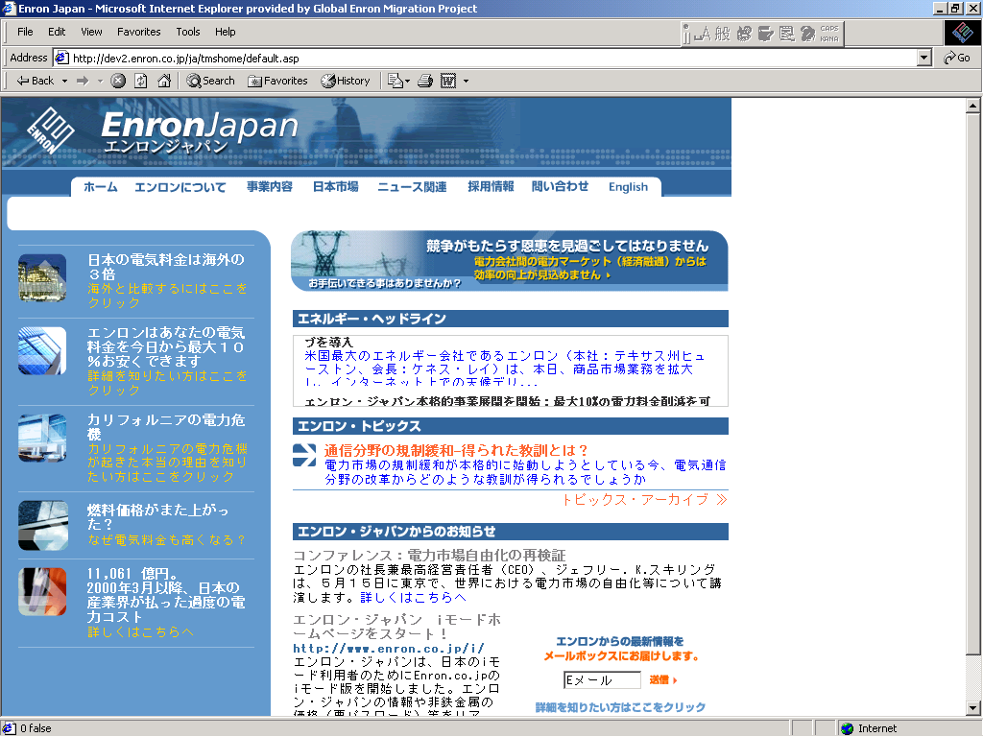
Enron Japan Website

Slide 25
Strategies for Success for Consumers
If your company is supplied power at Extra High Voltage (20,000V or higher) , you may be able to obtain a more competitive price for your electricity.
Consider how your electricity costs could be reduced by varying your contract structure to better fit your load pattern.
Ask for pricing information from your supplier to find out how your electricity costs are constructed.
Request more pricing options from your current electricity supplier.
If you have excess generation then consider selling it competitively in order to maximize profits.
Use regulatory and competition authorities to your best advantage.
Think about how your electricity costs could be reduced through utilizing risk management instruments.
Be inventive in thinking about reducing costs. Contract structures can be designed to fit virtually any customer need.
Notes:
Currently there exists no formal notification from the Ministry of Economy and Trade (METI) to contestable customers
Nearly one-third of Japan’s electricity market is open to competition by allowing eligible customers to choose their supplier.

Slide 26
Succeeding in a Restructured Energy Market - Conclusion
Liberalization is not a “zero-sum game”
- net benefits created
better solutions to transition issues
Successful transition achieved by:
promoting efficiency while reducing disruption
- phasing liberalization while moving through each stage without compromise
Energy industry is being transformed in the new economy – energy companies must adapt to this change
Significant new opportunities already exist for power producers and consumers to maximize their competitiveness

Slide 27

®

