Slide 1





Corporate Staff Functions
<number>

Slide 2
Overview
Areas
Topics
PR/Communications
Government and Regulatory Affairs
Corporate Administrative Services
Security/Business Controls
Functions
Approach
Progress
Initiatives

Slide 3
PR/Communications
<number>

Slide 4
PR/Communications
Functions
Public
Relations
Brand
Internal
Communications
Media Relations
“Experience Enron”
University Outreach
Annual Report
Advertising
Common “Look and Feel”
Employee Publications
Employee Meetings
Intranet:my.home.enron.com
ETV
Online and Interactive: E-Speak / E-Meet / Idea Bank

Slide 5
PR/Communications
Approach
Focus on target audiences
CXO’s
Opinion Leaders: Media and policy makers
Investors
Prospective Employees
Active engagement of media
Targeted advertising on key elements of our brand
Challenging the status quo-- “Ask Why”
Feature Enron’s innovation

Slide 6
PR/Communications
Progress
Breakout performance in earned media
Enron-only feature stories
New media coverage
Broader view of Enron: from “Leading Energy Company” to “Leading Company”
Substantial expansion of Familiarity and Favorability as measured by opinion research
Internal Communication is no longer just a “newsletter”
Moved Online
ETV
IPTV Broadcast Employee Meetings
“Best Lists”
Most admired companies
Best companies to work for
Global

Slide 7

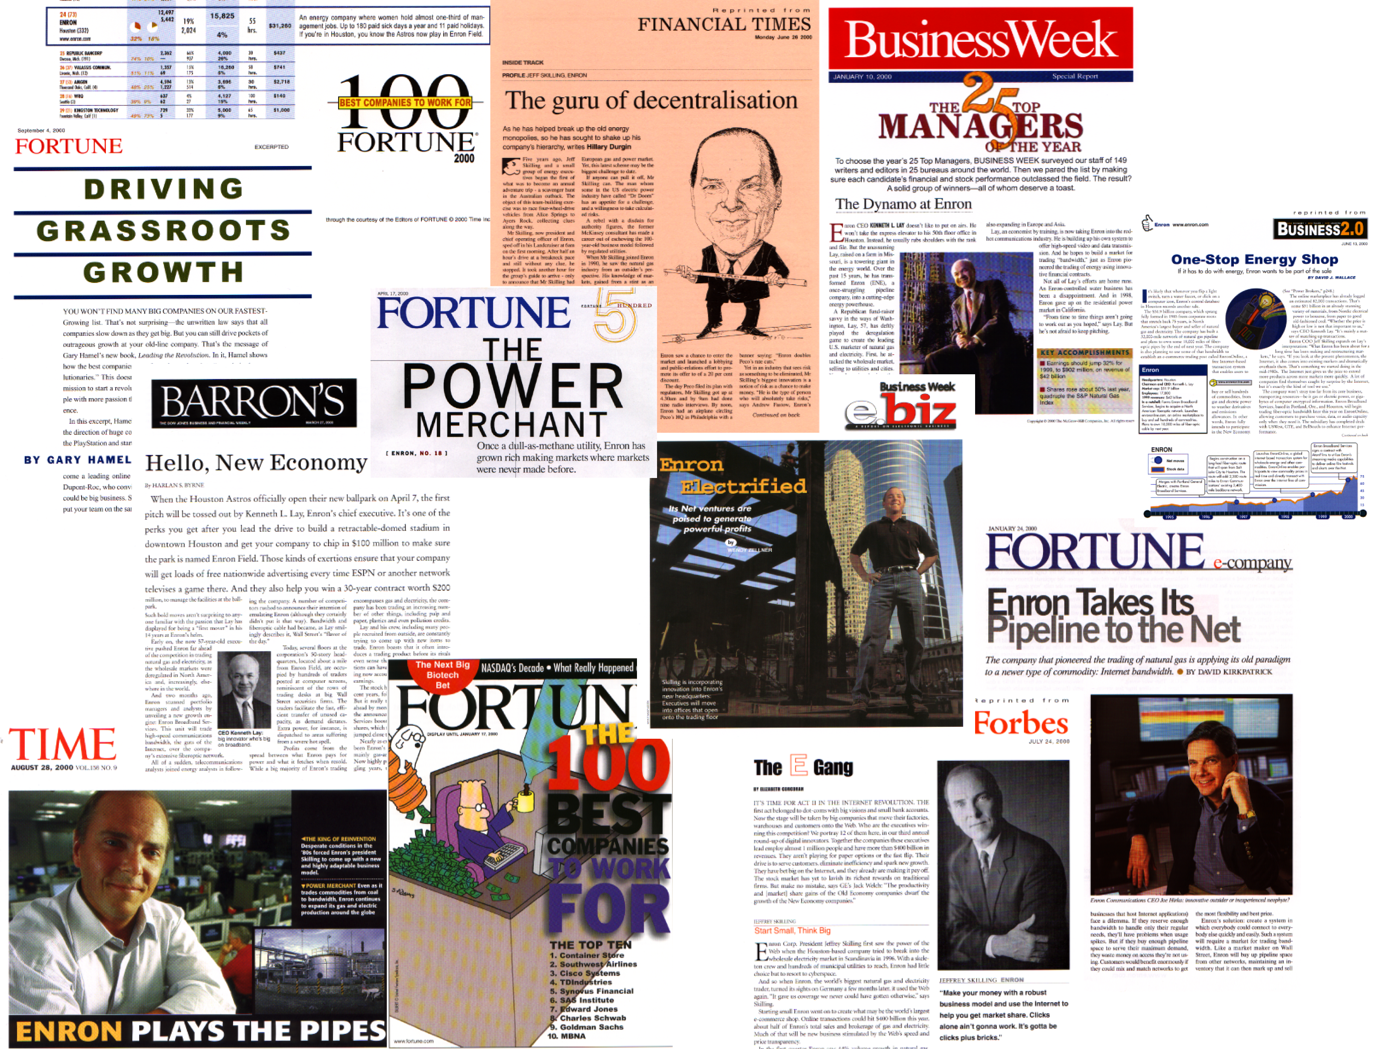
PR/Communications
Enron Public Relations

Slide 8
PR/Communications
Initiatives
Further Expansion of Enron Coverage
From feature stories to cover stories
Targeted, direct delivery of Brand

Slide 9
Government and Regulatory Affairs
<number>

Slide 10
Government and Regulatory Affairs
Functions
Advocacy
Business Unit Support
Risk Identification and Mitigation
Open markets and free trade
Focus on
Electric Market
Open Access
Derivatives regulation
North America,
Europe and Japan
Transaction support
Protecting existing assets and positions
Information/Intelligence gathering
Identify regulatory/political risks/opportunities
Mitigation/capture plan

Slide 11
Government and Regulatory Affairs
Approach
Positioned as the leading voice for open and competitive markets
Form/Lead coalitions to effect change
Mission Shift: From advocacy to transaction support and risk mitigation
Rigorous resource allocation process

Slide 12
Government and Regulatory Affairs
Progress/Update
Quantifiable opportunities captured and risks mitigated substantially exceeded expenditures
CEA reforms
Environment, Health and Safety organization successfully launched
California crisis generating backlash

Slide 13
Government and Regulatory Affairs
Initiatives
Campaign to
isolate California
get the real story out
generate opportunities for Enron’s services
Support for new Enron business units including Enron NetWorks, Enron Global Markets and Enron Industrial Markets
Wholesale open access in North American, European and Japanese power markets

Slide 14
Corporate Administrative Services
<number>

Slide 15
Corporate Administrative Services
Functions
Property
Development
Aviation
Property Management
and Administration
Real Estate Leasing and Acquisition
Facility Planning
Construction Management
Relocation/ churn
New Building
Corporate Aircraft
Chartering
Billing and Allocations
Administration of third party contracts

Slide 16
Corporate Administrative Services
Approach
Outsource noncore functions; employees focus on administration of third party contracts
Drive cost accountability through detailed billing and allocation process
Drive productivity: co-location, flexible and open environment, churn

Slide 17
Corporate Administrative Services
Progress
Further outsourcing - EES assuming facility management services (25% of budget)
Dramatic efficiency gains (16% reduction in G&A)
30% increase in Houston employee/contractor population
25% increase in churn (8400 moves)
design and construction of 300,000 sq. ft. of short term leases
Reconfigured corporate aviation fleet
New building (EBII) on track to meet schedule and budget commitments

Slide 18
Corporate Administrative Services
Initiatives
Enron Center
creating the premier urban office campus
new work place design and collaboration technology
showcase transaction floors
up-to-date work life amenities (daycare, restaurants, fitness center, food service)
Mitigation of exposure to downtown lease obligations

Slide 19
Security/Business Controls
<number>

Slide 20
Corporate Administrative Services
Functions
Facilities Security
Crisis Response
Default Provider
Enron Center
International Facilities
Broadband Network
Crisis Center
Crisis Management Plan
Security
Intelligence
for business units without these functions

