Slide 1
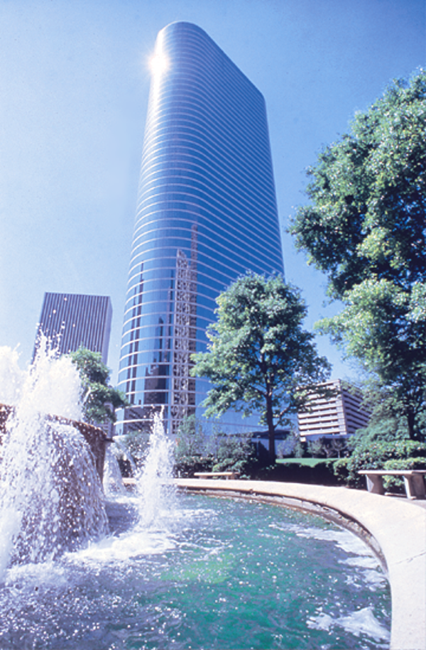

Corporate Transformation
at Enron
Steve Kean
EVP and Chief of Staff
®
Highlands Forum XVII
Carmel Valley, California
June 25, 2001

Slide 2
The Enron Case: A New Integration Model. . .
Traditional Integration
High transaction costs;
“do it yourself”
Horizontal (scale)
Vertical (scope)
“Virtual” Integration
Low transaction costs;
“shop and bundle”

Slide 3
. . . and Resource Model
Traditional
Asset intensive
Vertically integrated
Slow moving and rigid
Hierarchical
New
Networked
“Real options” oriented
Brain power intensive
Fast moving & entrepreneurial

Slide 4
Networked and “Real Options” Oriented
Network provides
  speed to market
  information
  optionality
Information is key to
  extract opportunity profits
  build and execute optionality
Investment in proprietary technology to deploy network creates a competitive advantage
Metcalf’s Law
Two-way network
Value of Network
One-way network
Sarnoff’s Law
n
The entire business has to be built based on real options and the value of the network

Slide 5
Brain Power Intensive - A Knowledge Based Organization
Super-
ordinate
Goal
Recruit ... new people bring new ideas
  Best and the brightest
  Innovative and entreprenurial
Create a corporate culture that sets the stage for employees to innovate and transform the company
Shared
Values
Strategy
Style
Structure
Staff
Systems
Source: McKinsey & Company
People are the most valuable asset

Slide 6
Superordinate
Goal
Crusade for free markets
  Bust monopolies
  Promote open competition

Slide 7
De-integration
  Leverage technology and risk
  management to reduce
  interaction costs
“Virtual” integration
  Focus on creating low cost, dependable market interfaces (logistics company)
New Model
  Real options oriented
  Knowledge-based
  Networked
Strategy

Slide 8
Flat / Horizontal
  Distributed power based / decision making
Labor Mobility
  Unified compensation
  Portable titles
Structure

Slide 9
PRC
  Company wide 360⁰ evaluation
  Relative ranking against peers
  Screen for “who gets it”
RAC
  Understanding and management of overall company risk exposure
Systems

Slide 10
Staff
Best & Brightest
  Associate/analyst rotational program
Innovative and Entrepreneurial

Slide 11
Tight
  Risk management
  Cash-in / Cash-out
  Legal obligations
  Performance review / compensation
Loose
  Business unit strategy
  Working environment
    Work schedule
    Dress code
    Floor design
  Organization
  Training
Style

Slide 12
Respect
Integrity
Communication
Excellence
Shared
Values

Slide 13
Fast Moving and Entrepreneurial
Aggressively looking for new opportunities in the market place
  innovation
  incubator for new ideas
Leading the changes in the market place
  one-step ahead of competitors
Quickly responding to new conditions in the market place
Change necessary to escape the equilibrium inertia of normal rates of return

Slide 14
“The difficulties . . . arise from the inherent conflict between the need for corporations to control existing operations and the need to create the kind of environment that will permit new ideas to flourish — and old ones to die a timely death.”
- Richard Foster & Sarah Kaplan

Slide 15
®

