Slide 1
Importance to U.S. Economy of Energy
Expenditures
In Billion Dollars (Nominal)
$729
$695
$536
Natural Gas
Power
Petroleum
Estimated U.S. energy expenditures in 2001 are 36% higher than 1999 (+$193 billion)
Source and Assumptions: Enron Corp. Government Affairs; DOE EIA Actuals for 1999; 2001 assumes NYMEX and weather 10% colder assumes 2¢/KWH higher wholesale power prices on half of U.S. volumes and demand growth at 3%/year. Year 2001 oil prices 10% lower and use up 2%

Slide 2
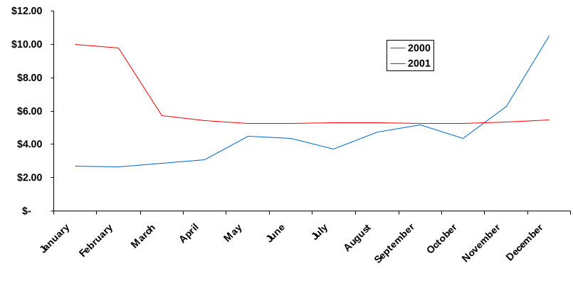

Impact of Higher U.S. Natural Gas Prices
$ MMBTU
Price $/Billions
Industrial $37B Immediate
Commercial $10B 30-360 day lag
Residential $16B 30-360 day lag
Total $63B
Increased Spending
Compared to 1999*
* Assumes 2001 winter 10% colder than 2000 levels -- NYMEX prices as of 2/7/01 from Gas Daily
<number>
AA-FedReserve-1200

