Slide 1
Best Practices Review
October 17, 2001
Steve Kean
Executive VP & Chief of Staff

Slide 2
Agenda
Enron Overview
Overview of Approach to Human Resources
Corporate Environment and Management Processes
Tour of Enron Facilities
People Practices and Processes
Utility Participants’ Team Meeting

Slide 3
Enron Overview

Slide 4
Overview of Approach to Human Resources

Slide 5

®
Global
Services
Wholesale
Services
Retail
Services
Broadband
Services
Portland
General
Global
Assets
Transmission
Services
North America
Power
Gas
Europe
Power
Gas
Metals
Other
Industrial
Markets
Global
Markets

Slide 6
Enron Total Revenues
(In Millions)
100,789
100,189
40,112
31,260
20,293
8,984
9,189
13,289
5,460
6,415
7,986
4,970
4,373
4,526
4,631
5,698
1986
1987
1988
1989
1990
1991
1992
1993
1995
1999
2000
2001*
1994
1996
1997
1998
Source: Statistical Supplement
* Through June 30, 2001

Slide 7
Industry Maturation Curve
Mature Industry
Enron Global Services
Growth Industry
Enron Wholesale Services
Enron Retail Services
Emerging Industry
Enron Global Markets
Enron Industrial Markets
Enron Broadband Services

Slide 8
Enron’s Wholesale Businesses
Natural Gas
Power
Coal &
Emissions
Global Crude &
Products
Shipping
Weather
Financial
Trading
LNG
Insurance
Freight
Pulp &
Paper
Merchant
Investments
Metals

Slide 9
Promoting Efficient Logistical Networks
MAPP
MAIN
NPCC
ECAR
COB Hub
ComEd
Hub
PJM Hub
Cinergy Hub
MACC
WSCC
SPP
SERC
Paulo Verde Hub
TVA
Hub
ERCOT
Henry Hub
Entergy Hub
FRCC
Offices
Energy Exchanges
Energy Partnerships
Third-Party Capacity
Leased Gas Storage
Power Plants
In Operation
Sale Pending
Under Development
Marketing Activity
Gas Coal
Power Metals

Slide 10
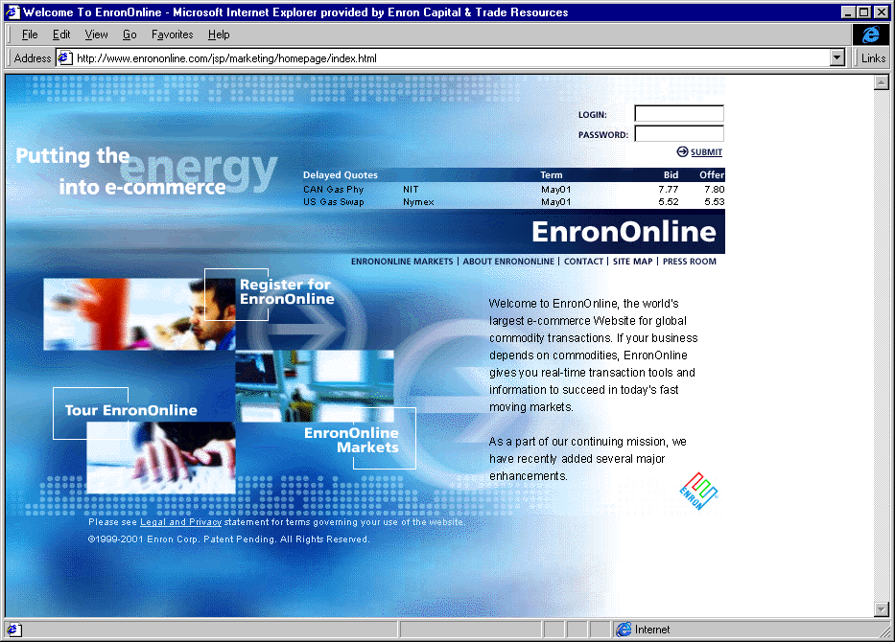
Converging Virtual and Physical Networks
Third- Party
Systems
MAPP
MAIN
ECAR
NPCC
COB Hub
ComEd
Hub
MACC
PJM Hub
WSCC
SPP
Cinergy Hub
Paulo Verde Hub
SERC
Henry Hub
Entergy Hub
TVA
Hub
ERCOT
Arcos
1,200 MW
FRCC

Slide 11
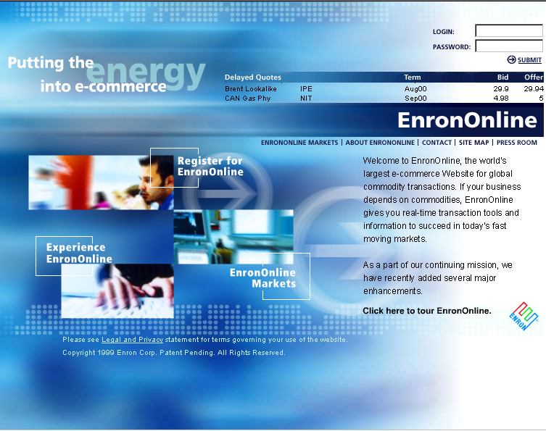
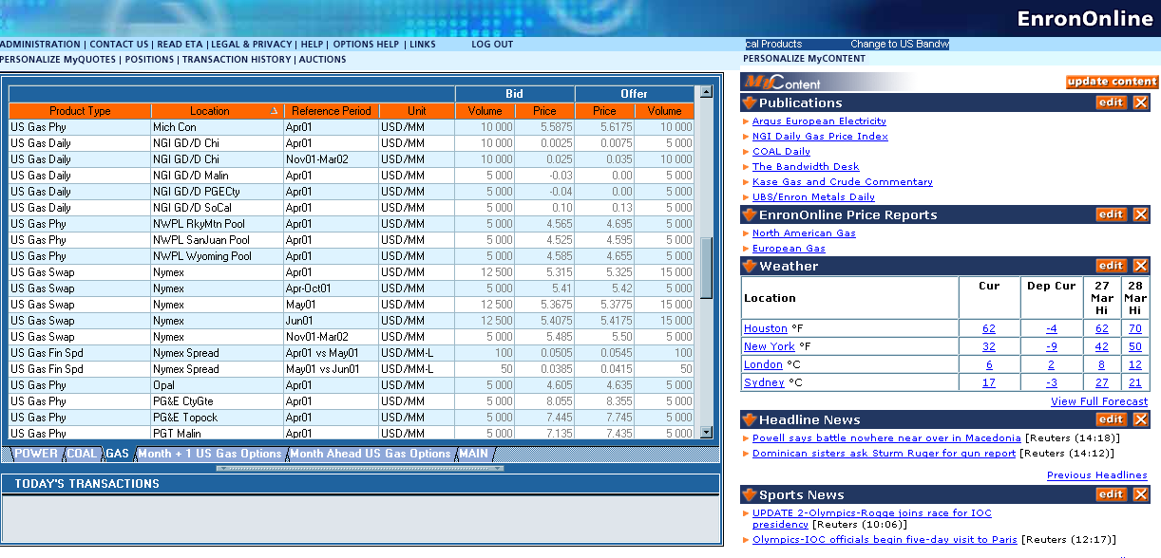
EnronOnline
The free, internet-based, global transaction system that allows counterparties to view real time prices from enron’s traders and transact instantly online.

Slide 12
Commodities Available on EnronOnline
Argentine Natural Gas
Asian Crude & Products
Asian Metals
Australian & Japanese
Weather
Australian Power
Austrian Power
Bandwidth
Belgian Natural Gas
Canadian Natural Gas
Canadian Power
Credit Derivatives
Dutch Power
Dutch Aluminium
Emissions
European Coal
European Weather
German Power
International Coal
Japanese Aluminum
LME Metals Contracts
LPG
Nordic Power
Oil & Refined
Products
Petrochemicals
Plastics
Pulp & Paper
Sea Freight
Spanish Power
Swiss Power
UK Metals
UK Metal Spreads
UK Natural Gas
UK Power
US Gas Pipeline Capacity
US Gas Spreads
US Lumber
US Metals
US Natural Gas
US Power
US Steel
US Weather

Slide 13
Enron Retail Services Energy Outsourcing
The comprehensive long-term management of energy-related assets, information, and facility services.
Energy Asset Management
Energy
Information
Management
Commodity Management
Capital
Design & Engineering
Construction
Operations &
Maintenance
Facility Management
Commodity supply and metering in deregulated markets
Tariff management in regulated markets
Utility representation
Tariff arbitrage
Reduced commodity consumption through optimization of capital investment
Reduced demand charges through load management
Lower operation and maintenance costs
Improved worker productivity and/or customer experience through better environment
Increased labor productivity through elimination of craft specialization and application of best practices
Reduced administrative and purchasing costs
Competitive cost of capital
Customized realization
Asset/Contract monetizations
Reduced administrative costs
Consolidated billing for services
Correction of utility over billing
Improved decision making through better use of information

Slide 14


























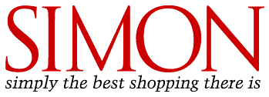


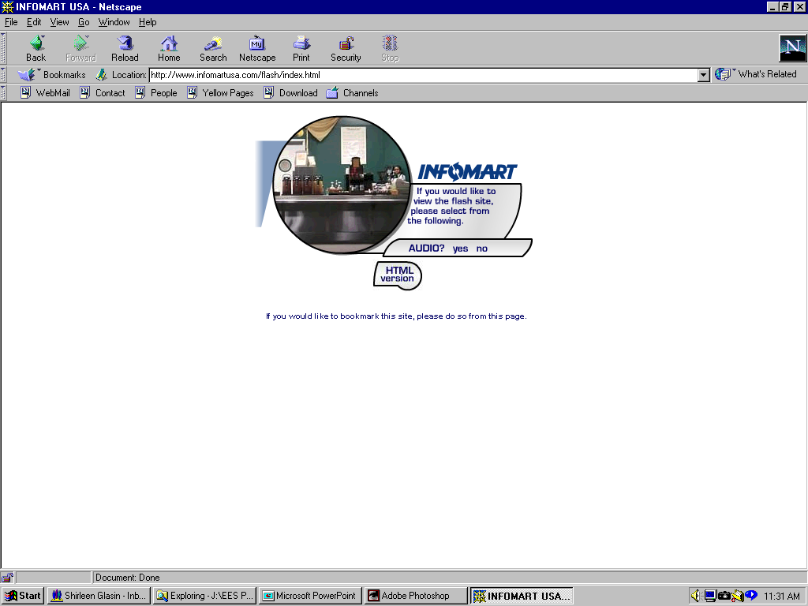












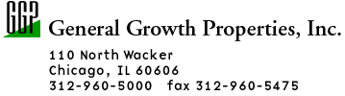
























Partial List of Enron Retail Clients
Industrial / Manufacturing
High Technology
REITs / Retail
Structure
Hotels
Food Processing
Sports Venues
Financial Institutions
Public Sector/Institutions
Notes:
-Upstream / downstream supply chain
-nat.l / 10 yr. deal
-Others not here - confidentiality - competitive advantage
-BICCGeneral - Leading manufacturer of specialty cable products to the telecommunications and high-tech markets through 60 facilities, world-wide
manufacturing - quebecor, rigid, firestone, polaroid, ownes corning, TRW, springs, solo, tyco, O-I, Pilkington, Eli Lilly
high tech - pacific bell, IBM, lucent, applied materials, GTE, infomart, compaq,cypress, sony, cisco, triquint
hotels / reits - hyatt, simon, glacier, excelsior hotel, hilton, starwood, general growth properties
food processing - packaged ice, tricon, ocean spray, rich’s, suiza
sports venues - enron field, giants, browns
financial institutions - chase, bank of america, fidelity, prudential
public sector/institutions - general service admin, los angeles county, veterans affairs

Slide 15
Implications for Human Resources Management
Building and Supporting a Successful Business at Enron
Enron’s Business
Human Resources
Making Markets
  Expanding Existing Markets
  Making New Markets (Where they did not exist before)
Retail Energy Services
Transportation Services
Earnings come from people — intellectual capital rather than physical capital
Company depends on building and growing business and growing business organically
  many functions/jobs entirely new
  institutionalize change
Recruiting
Retention
  Compensation
  Work Environment
Training

Slide 16
Recruiting
Formalized, centralized recruiting process for undergraduates and MBAs
Decentralized process for hiring experienced employees

Slide 17
Retention
Compensation
  Baseline: 55 percentile (base pay); 75 percentile (with incentive)
  Substantial upside for superior performance (and for equity appreciation)
Work Environment
  Culture
  Quality of Work
  “Cause”

Slide 18
People Practices and Process
More Detailed Discussions
Analyst/Associate Program
Performance Management

Slide 19
Analyst / Associate Program Overview
October 17, 2001

Slide 20
Global Overview
1991 – Program Started with 14 A&A
1992 – 21 A&A’s
1994 – 66 A&A’s
  VP Promotions
1996 – Rotations Outside ECT
  International Rotations
1998 – 350 A&A’s
  Leading New Businesses
  MD’s, VPs
2001 – 800 A&A’s
  Global Franchise
  Hemisphere-Based Management
  Office of the Chairman, MD’s, VP’s, …
  Commercial Management of the Program
Program
“AAC”
West
(Houston)
East
(London)
A/A Total
Associates
Analysts
Total
Program
Management
550
220
330
35
250
110
140
9
Note: As of 9/1/01

Slide 21
Business Plan
Purpose Identify and Launch the Careers of the Future Leaders and Innovators of Enron…
Enron Business Units
(Incl. “AAC”)
Framework
One Program
“One Enron”
Rotations
Needs Estimates
Active Involvement
Market Information
Future Innovators & Leaders
Investor Relations
Company Message
Expertise
Associate / Analyst Program
HR
Brand & Marketing
Systems
PR/ Univ. Affairs
Talent
Enron Message & Opportunities
Talent
Campus
Real Time

Slide 22
Business Plan
Guiding Principles
Program Exists for Business Units
Rotations Are Best Way to Learn Enron and Skills for Success
Messaging “On Brand”
Economies of Scale in Recruiting and Career Development
Careers at Enron Are Largely “Self-managed”
Everyone We Talk to Is a Future Customer or Hire
Aggressive Targeted Communication
Premium on “Real-Time” Recruiting

Slide 23
Where We Recruit
Analyst Recruiting Targets
AUC Morehouse
Baylor
Florida
Howard
LSU
NYU
OU
Penn
Rice
Texas A&M
Univ. of Houston
Michigan
Texas
UVA
Vanderbilt
Wellesley
Cal Berkeley
Associate Recruiting Targets
Baylor
Carnegie Mellon
Chicago
Columbia
Cornell
Darden
Georgetown
Harvard
Kellogg
Michigan
MIT-Sloan
NYU-Stern
Jones-Rice
Stanford
Thunderbird
UCLA
Texas
Vanderbilt-Owen
Wharton
Yale

Slide 24
Campus Recruiting Strategies
“…broader/shallower net for talent…”
Broad Based
Direct
Expected Hires
4-7
1-2
University Relations
Primary Focus
Secondary Focus
Approach
• Executive/Faculty Visits
• Campus Presentation /
Reception
• Multiple Social Events
• Classroom / Organization
Presence
• Multiple Visits
• Multiple Interview Schedules
• “Buddy System”
• Executive/Faculty Visits
• Postings
• Resume Books
• Key Organizations & Classes
• Direct Mail, etc.
• Phone Screen / Video
Interviews
• One Interview Schedule
• “Buddy System”
Fantastic Fridays/Super Saturdays
Offers
Cultivation Events

Slide 25
Analyst Program
For The Development of Entry-Level Professional
24 – 36 Months in Length
Rotational in Nature With One Year Assignment
Ability to Have Immediate Impact
Exposure to Enron’s Culture and Core Competencies
Opportunity to Gain New Knowledge and Acquire Additional Skills
Option to Return to School* or Receive Merit-based Promotion to 3rd Year Analyst After 24 Months
Option to Return to School* or Receive Merit-based Promotion to Associate After 36 Months
*Merit based educational assistance packages maybe available

Slide 26
Associate Program
Cornerstone for Development of Enron’s Commercial Talent
18 – 24 Month Program
Rotational in Nature With 6 Month Assignments
Immediate Responsibility and Impact
Exposure to Enron’s Core Competencies and Culture
Significant Networking Opportunities
Merit-Based Promotions to Manager After 18 – 24 Months

Slide 27
Real Time Resume Analysis

Slide 28

eCard Announcing Campus Presentation

Slide 29
Fall Recruiting Process
Teams Based on Alumni
Campus Presentations
Resume Selection
Campus Interviews
Super Saturday / Fantastic Friday Interviews
Sell Weekend

Slide 30
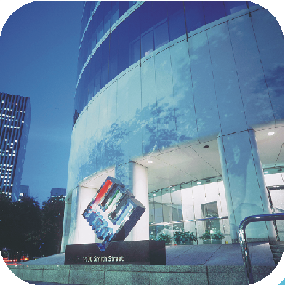
ENRON
GLOBAL PERFORMANCE MANAGEMENT
OCTOBER 17, 2001
Notes:
Introduce the Team
Who is new to the Process?

Slide 31
Philosophy
Developing and Maintaining the Best Talent
Remaining on the Cutting Edge
“Raising the Bar” As New Talent Is Brought in and Developed
Creating Value
Working As a Partnership
Entrepreneurial Environment
Promoting Meritocracy
Performance Is Absolute

Slide 32
Purpose
Business identification of potential for competitive advantage and talent development
Clear identification of top performers on a regular basis for mobility and succession planning
Clear identification of performers for development actions and improved performance
Fair and equitable measure for promotion decisions
Identification of future recruitment needs
360° feedback / evaluations / coaching tool
Consistent global process fosters a “One-Enron” approach in measuring success.
Mechanism to help facilitate compensation decisions

Slide 33
Overview
This process allows Enron to evaluate employees’ performance within Business Units and across functional groups
PEP (Performance Evaluation Process) is a web-based 360° global performance evaluation system. Through the 360° evaluation process the employee receives feedback from selected reviewers that should include the employee, their supervisor, direct reports, peers, internal or external business associates.
Employees use the PEP system to suggest reviewers to their supervisor. The supervisor adjusts and approves reviewers.
Reviewers evaluate employees on specific performance categories such as innovation, communication, teamwork, vision & values, analytical, etc.
Enron uses this information to provide employees constructive feedback and as a basis for development.

Slide 34
Discussion of Intellecutal Capital
Identification of top 10% and bottom 10% of performers. Meetings are lead by the senior business unit lead, typically facilitated by the HR Rep
Identification of top talent in each business unit for future business leaders and the bottom 10% for continued development opportunities
Focus on intrinsic skills, leadership and future potential
Discussion on the re-deployment of talent, bench strength
Discussion on the relative value to; and the needs of; the organization
Top-tier management cross-calibrate all VPs and MDs enterprise wide
Promotion discussions and decisions

Slide 35
Performance Evaluation Process (PEP) System
World-wide access via the Enron Intranet
14,000 employees and 3,000+ Business Associates (scalable to support many times this number)
Integrated with worldwide HR Information Systems
Full HR Maintenance Services allowing quick and easy data integrity audits
Supports full Performance Management Process from feedback to meetings to formal employee reviews with same data source
Supports multi-business units, functional areas and job groups
Customized feedback forms for different job groups or business areas based on job groups and performance categories
Tailored evaluation forms for formal employee reviews
Key players in the process employee, supervisor, HR Rep and Global Performance Management Team

Slide 36
Global Performance Management Activity Flow
Testing/Implementation
Development
System Opens for Feedback
HR Training
System Closes for Feedback
Executive Committee Meeting
Employee Training
System Opens to HR Community
Relative Talent Review Meetings
Message to All Employees – UserID & Password
Employee One on One Evaluations
All Employee Communication Opening
Message to All Employees – Feedback Deadline

