Slide 1

®
California
Presentation to Enron
Advisory Counsel
April 11, 2001
© 2001 SK-3040119-<number>

Slide 2
Overview
The History
The Economics
The Politics
Possible Outcomes
Enron’s Public Position

Slide 3
The History

Slide 4
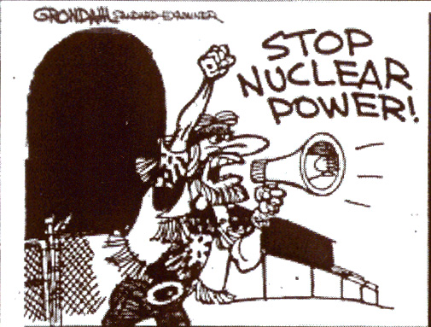
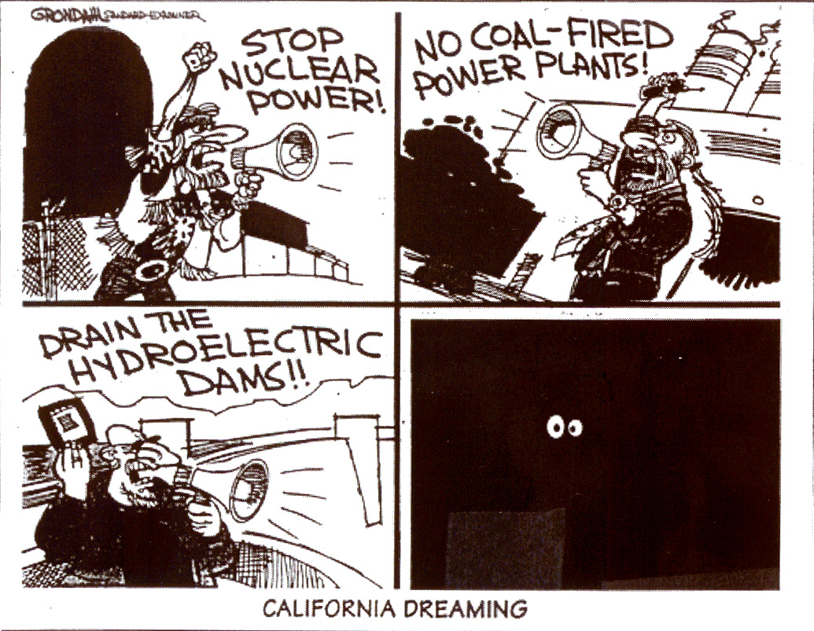
CALIFORNIA DREAMING

Slide 5
History
From sound economics to political compromise
1993-94 Blue Book: Pure deregulation / open access
1994-95 CPUC Orders: Emergency of centralized market institution
1995-96 The legislature takes over (AB1890): Something for everyone (customer choice, divestiture, environmental and rate payer subsidies, stranded cost recovery)
1996-97 FEBC “rubberstamps”
1998 Implementation: - $500 million computer system
- Three month delay
- Very little residential switching
- Some (10-15%) large customer switching
2000-01 California’s psychotic episode:
- paranoia
- denial
- violence

Slide 6
The Economics

Slide 7
The Economics
Powerful “NIMBY/BANANA” sentiment → NO significant supply additions
Rapid economic growth throughout western U.S. → significant demand growth.
Regulated retail rates prevented demand side response
SHORTAGE

Slide 8
The Economics
Powerful “NIMBY/BANANA sentiment
Strong environmental movement
Very little new capacity added
Tight emissions limits
Increasing dependence on imports
Old, inefficient (polluting) facilities subject to breakdown
emissions costs
gas costs
Shortages → Blackouts
Skyrocketing wholesale prices
Bankruptcy
Utilities totally exposed to spot prices
Flat to lower supply
Lower hydro capacity availability
Reduced imports into California
Rapid economic growth throughout Western U.S.
Increased demand
Highly compromised, negotiated legislation
Retail Rate Caps (no demand response)
Stranded cost recovery mechanism inhibiting switching (utilities continue to serve most load)
State constructed spot market; no hedging
Deregulated wholesale prices

Slide 9
The Politics

Slide 10
The Politics
The State
Blame everybody else (and prosecute them)
Create the illusion of activity … uncontroversial activity
Make a deal … at the last possible moment
Overriding constraint: initiative process
The Federal government
Congress: not anxious to do the hard (unpopular) things for Davis
Administration: standing on principle (e.g. price caps don’t work); more detailed proposal forthcoming

Slide 11
Likely Outcome

Slide 12
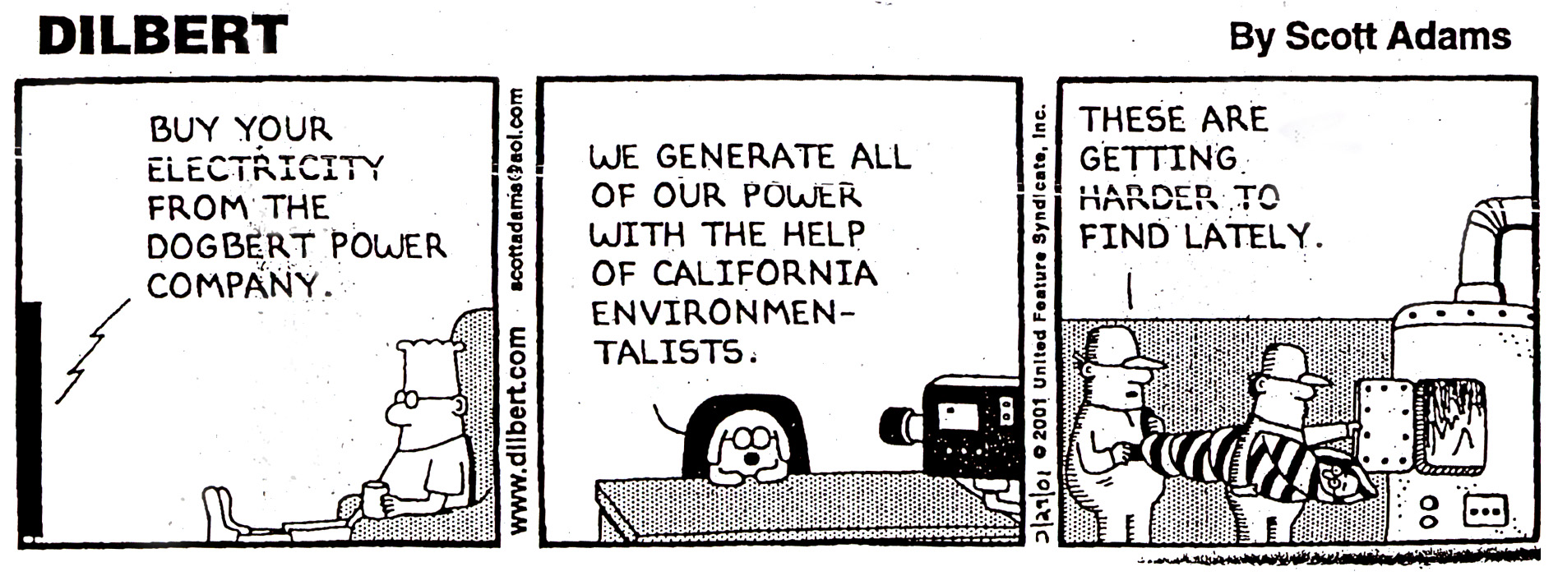

Slide 13
Likely Outcome
Long, slow recovery
Deep economic damage to California
Increasing government intervention in the power sector

Slide 14
Enron Policy Objectives & Strategy

Slide 15
Enron Policy Objectives & Strategy
3-Part Campaign
Get paid
Contain damage to deregulation
Take advantage of California’s mistakes to obtain better outcomes elsewhere
Stay on top of California situation; focus on limited objectives (e.g. preserve direct access)
Focus on federal solution
Other jurisdictions: Don’t let this happen to you

