Slide 1

MOU with SCE and DWR
Monday April 30, 2001
Presented by
Michael Tribolet

Slide 2
Overview
Is the DWR's position (Size, Price, Tenor) sufficient to close the open short position and what increase in rates is sufficient to cover the bond offering, plus future power costs at DWR?
Utility Past Debt Clean-Up. What is the size of the past due amounts to be paid down with the $6.1 Billion in sources ($2.76 B from Transmission, $400 mln from EIX and $3.0 B SCE bond offering)
Quantification/Certainty around rates to SCE of 4.9 cents per KWH to pay retained generation, QF’s and cost of service. Is this enough to satisfy these amounts with floating QF pricing?
Who will assume the net short position in 2003?

Slide 3
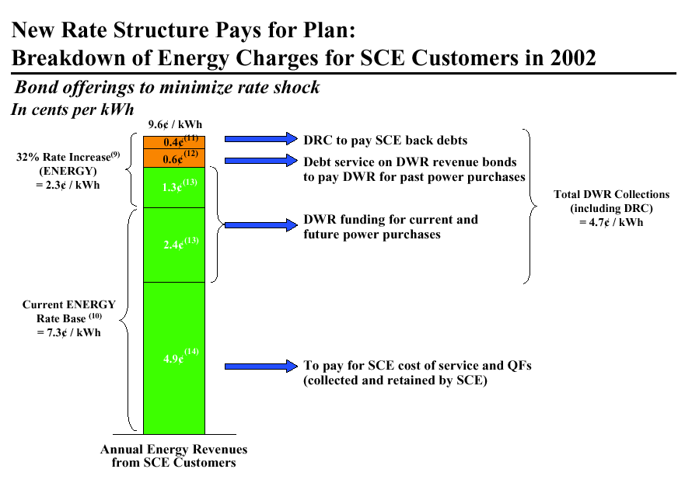

Slide 4
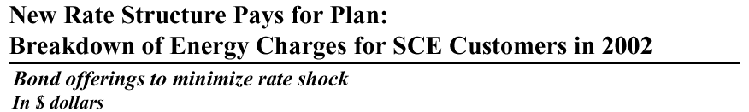
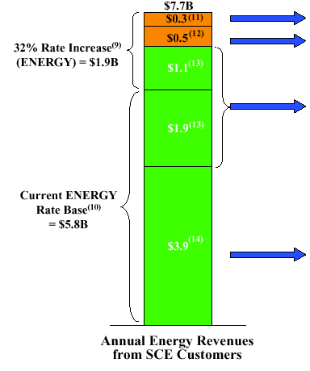
Stated Open Issues
DRC to pay SCE back debts How much are they assuming for these
back debts? How are they going to get it?
Debt Service on DWR revenue bonds to pay What is the amount of the past
DWR for past power purchases power purchases? When does the
rate increase take effect?
Is that achievable?
DWR funding for current and Is this sufficient going forward?
Future power purchases Does this include DWR as the
counterparty in 2003-forward?
To pay for SCE cost of service and QFs What assumptions are made for
(collected and retained by SCE) the terms of the restructured QF
contracts?

Slide 5
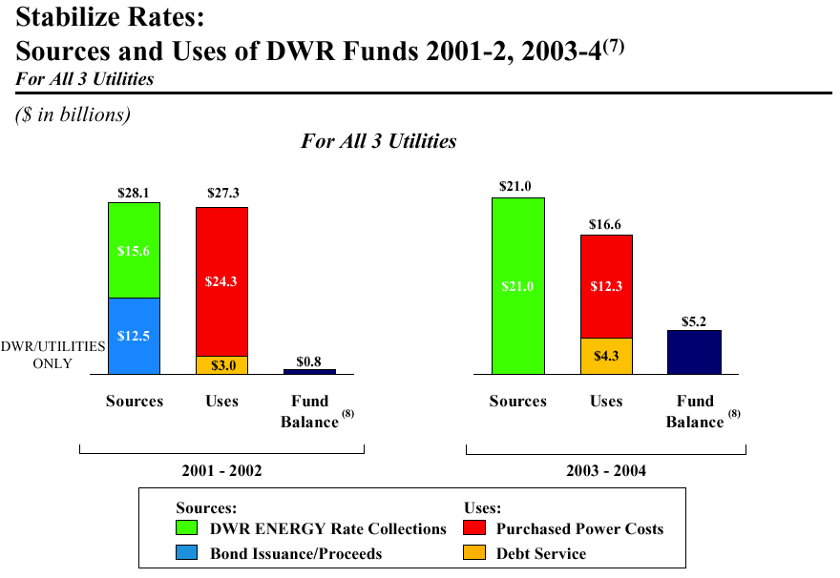

Slide 6
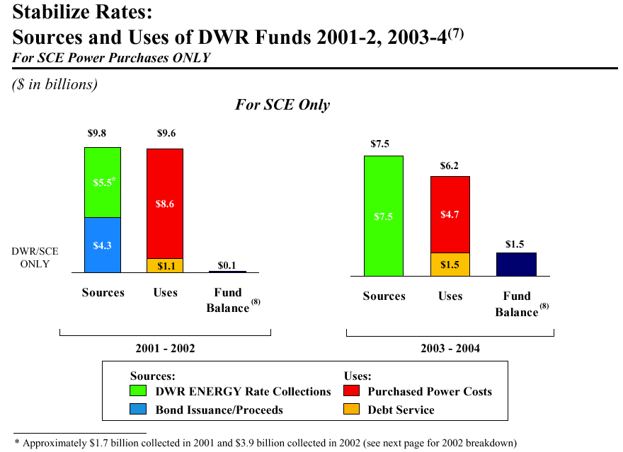
Counterparty in 2003-2004?

