Slide 1
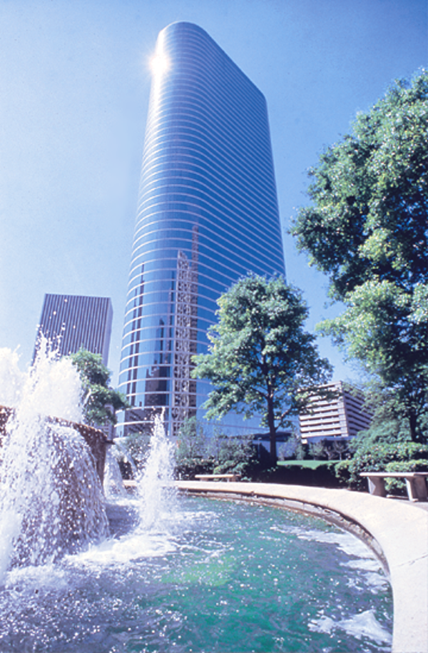

How to Develop a Creative,
Risk-taking, and
Results-based Culture
Joseph W. Sutton
Vice Chairman
Developing Breakthrough New Products and Services
28th Annual Philip B. Hofmann Executive Seminar
New York City
March 7, 2000

Slide 2
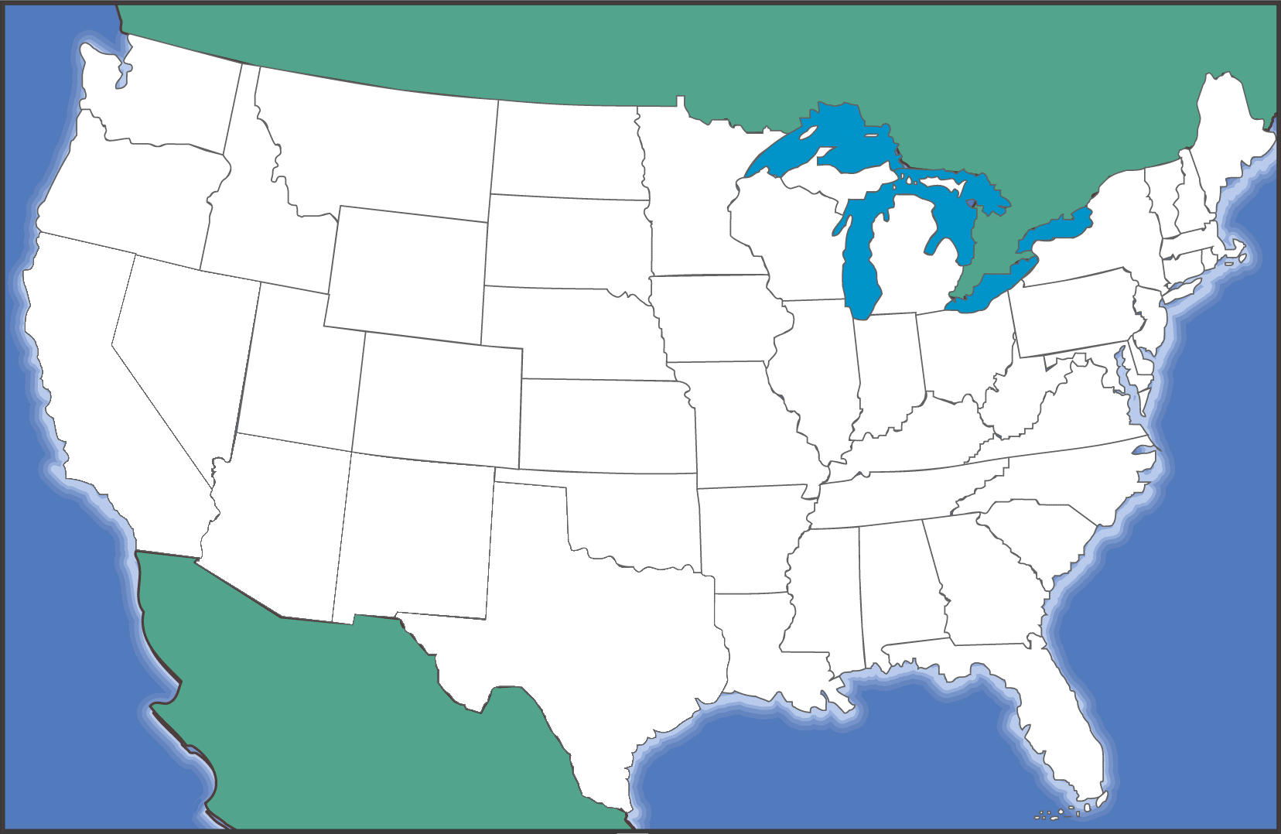
The Old Enron (1985)
Trailblazer
Intrastate Pipelines
HPL Houston Pipe Line
Interstate Pipelines
NNG Northern Natural Gas
TW Transwestern Pipeline
FGT Florida Gas Transmission
NBPL Northern Border Pipeline

Slide 3
Enron Today: North America
COB
COB
Hub
Hub
Cinergy
Cinergy
Hub
Hub
Palo
Palo
Verde
Verde
Hub
Hub
Entergy
Entergy
Hub
Hub
Henry
Henry
Hub
Hub

Slide 4
Enron Today: International Presence
In Operation
Power Plant
Pipeline
Other
E&P
LPG Facility
LNG Facility
Water
Gas Distribution
Electricity
Distribution
In Construction
Power Plant
Pipeline
Other
LPG Facility
LNG Facility
In Development
Power Plant
Pipeline
Other
E&P
LPG Facility
LNG Facility
LNG Vessel
Barge
Teesside
1,875 MW
United Kingdom
London
Offices
Office
Locations
Poland Elektrocieplownia
Nowa Sarzyna
116 MW
Sutton Bridge
790 MW
Wessex
Germany
Bitterfeld
125 MW
Jertovec
240 MW
Italy
Milan
Croatia
Zagreb
China
Beijing
Turkey
Trakya
478 MW
Western-Eastern China
Natural Gas Pipeline
South Korea
Seoul
Dominican Republic
Santo Domingo
Italy
Sarlux
551 MW
Palestine
Gaza
Power Project
EOG
Sichuan
E&P
Wuhan
Loop
Sichuan-Wuhan
Natural Gas Pipeline
SK-Enron
Gas Distribution
LPG Import
Puerto Rico
San Juan
United Arab Emirates
Dubai
LNG Vessel
135 Mc³m
Dabhol-
Talasari
Pipeline
EOG - India
3,200 Bbls/d
38 MMcf/d
Wuhan Qingshan
443 MW
Guatemala
Guatemala City
Puerto Plata
185 MW
EcoEléctrica
507 MW
LNG Facility
Chengdu
Logun
284 MW
Wuhan Wuchang
189 MW
Guam
Anigua
Puerto Quetzal
110 MW
124 MW
Jamaica
Kingston
San Juan Gas
LDC
Abu Dhabi
500,000 Tons
LNG Export
Oman
1.6 MM Tons
LNG Export
India
Delhi,
Mumbai
Philippines
Manila
Piti
80 MW
IGL
ProCaribe
Trinidad and
Tobago
EOG
115 MMcfd;
3,500 Bbls/d
Dabhol
LNG
Import
Thailand
Bangkok
Hainan Island
160 MW
Subic Bay
116 MW
Nicaragua
Corinto
70MW
Progasco
Nigeria
Lagos State
Power Project
90 MW Barge
560 MW CCGT
Vietnam
Hanoi
Batangas
110 MW
Venezuela
Caracas
India
Dabhol
2,184 MW
Phase I: 740 MW
Phase II: 1,444 MW
Malaysia
2.6 MM Tons
LNG Export
First Gas Power Co
Fuel Supply
30-35,000 Bbls/d
Panama
Bahía Las Minas
355 MW
Phase I: 245 MW
Phase II: 110 MW
Colombia
Bogotá
Ventane
Citadel Venezolana
Benin
Integrated Gas
& Power Project
80 MW
20 Miles
Singapore
Promigas
1,062 Miles
Bachaquero III
Centragas
357 Miles
CALIFE
LDC
Accro III & IV
Gaspart Northeast
5 LDC
Pantanal Energía
480 MW
Phase I: 150 MW
Phase II & III: 330 MW
Indonesia
Jakarta
Bolivia
Santa Cruz
Brazil
Salvador, Sáo Paulo, Rio de Janeiro
Maputo Iron &
Steel Project
Integrated Steel Slab
Manufacturing Facility 3.5 MTPY
TRANSREDES
3,093 Miles
Cuiabá Pipeline
385 Miles
Riogás/CEG
LDC
Bolivia to Brazil
Pipeline
1,864 Miles
Gaspart South
2 LDC
Pande Gas Project
378 Miles
Elektro Eletricidade e Serviços
South Africa
Johannesburg
Mozambique
Maputo
Obras Sanitarias
de Mendoza
Australia
Sydney
Argentina
Buenos Aires
TGS
4,104 Miles
Enron projects completed or underway
in more than 30 countries

Slide 5
Energy Businesses
New Business
Wholesale
Energy
Transportation
&
Distribution
Retail
Energy
Broadband
Services
Gas Pipelines
Portland General
Developed Regions
- North America
- Europe
Developing Regions
- South America
- India
- Asia/Pacific
- Other
Enron Energy Services

Slide 6
1999 Financial Breakout
Old Businesses
20%
International
40%
New Businesses
80%
Domestic
60%

Slide 7

Enron -
Doing Something Right
Most Innovative Company Years in a Row!
Fortune, Feb. 2000
- #1 in Quality of Management
- #2 in Employee Talent
1
2
3
4
5
Energy/Commodity Derivatives
House of the Year
Risk magazine, Jan. 2000
100 Best Companies to Work For in America
Fortune, Jan. 1999 (#73) Jan. 2000 (#24)
innovative
100 best companies to work for in america
most innovative company
most innovative company
100 best companies to work for in america

Slide 8
Total Return to Shareholder
January 1990 to January 21, 2000
Market Cap
$50+ billion
1200
Enron
Pipeline Avg
E&P Avg
Utility Avg
S&P 500
1,082%
206%
40%
155%
424%
1000
800
600
400
Market Cap
$4 billion
200
0
-200
Dec-89
Dec-90
Dec-91
Dec-92
Dec-93
Dec-94
Dec-95
Dec-96
Dec-97
Dec-98
Jan-00
*Dividends Reinvested in Security

Slide 9
The Energy Network Model
Applications
Utility Facility
Operations
& Management
Energy
Outsourcing
Fuel
Management
Services
eCommerce
Applications
Physical Delivery
Contracts
Price Risk
Management
Contracts
Settlement
Services
Peaking &
Storage Services
Finance
Market Making
Contract Access
Physical Assets

Slide 10
Market Making & Risk Management
Wholesale natural gas marketing (1985)
Wholesale electricity marketing (1994)
Emissions marketing (1997)
Pulp and paper risk management (1997)
Weather derivatives marketing (1997)
Coal marketing (1997)
Total energy outsourcing (1997)
Bandwidth marketing (1999)
EnronOnlineTM (1999)
EnronCredit.comTM (2000)

Slide 11
Case Study: Enron Bandwidth Services
Volume
High Bandwidth Applications
  Video
  Large File Transfer
  [Developing]
Enron Market
Low Bandwidth Applications
  Voice
  Text
  [Maturing]
1999
2001
2002
2003
2004
2005
2006
2007
2008
Today

Slide 12
EBS Network Connectivity
_{Seattle}
_{Portland}
_{Minneapolis}
_{Toronto}
_{Albany}
_{Boston}
_{London}
_{Boise}
_{Detroit}
_{Paris}
_{Salt Lake City}
_{Omaha}
_{Copenhagen}
_{New York}
_{Munich}
_{Denver}
_{Chicago}
_{Cleveland}
_{Sacramento}
_{Philadelphia}
_{Amsterdam}
_{San Francisco}
_{St. Louis}
_{Rome}
_{Kansas City}
_{Washington D.C.}
_{San Jose}
_{Las Vegas}
_{Albuquerque}
_{Charlotte}
_{Tokyo}
_{Phoenix}
_{Dallas}
_{Atlanta}
_{Los Angeles}
_{Jackson}
_{San Diego}
_{New Orleans}
_{Orlando}
_{San Antonio}
_{Houston}
Servers
_{Miami}
Public Pooling Points
Fiber Network

Slide 13
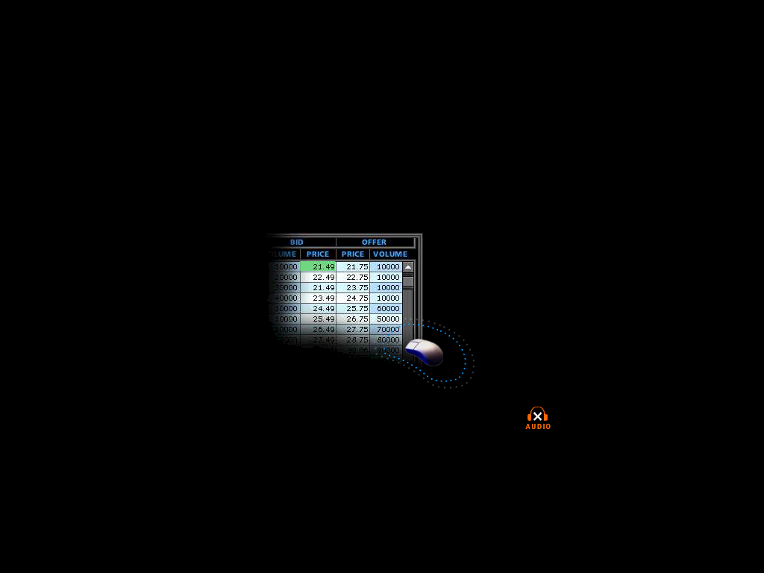
Case Study: EnronOnline
A Free, Internet-Based, Global Transaction System That Allows Counterparties to View Real-Time Prices From Enron’s Traders and Transact Instantly Online
Multi-commodity
Multi-currency
Multi-lingual
Real-Time Transparent Prices
Customized Profiles
Customer Friendly Environment
Best Prices
Click ’n’ Transact

Slide 14
eCommerce Business Comparison
Value of Goods*
(Million)
Business To Consumer (B2C)
eBay
Amazon.com
Dell.com
$ 2,650
1,600
10,190
Business To Business (B2B)
FreeMarkets
Cisco
Intel
Altrade
$ 1,400
9,480
10,500
12,000
EnronOnline**
$ 22,000
* Est. 1999 Annual Results
** Annualized Based on Results to Date

Slide 15
Pride
Diversity
Compensation
Community
Communication
Perks
Partnerships
Work Life
Corporate Culture, Visions, and Values
at Enron
Values
Optionality
Vision
Innovation
Stress Management
Fun
Empowerment

Slide 16
Management Strategy: Tight and Loose
Tight Controls
  Financial accounting
  Risk management
  Performance reviews
  Legal obligations
Loose Controls
  Organization
  Creativity/new business ideas
  Dress code
Performance should drive protocol,
not vice versa

Slide 17
Enron Employees
Qualified and Experienced Workforce
Analyst/Associate – New Hires
393
17,900 Employees Worldwide
3,560 Employees have Advanced Degrees
7% Growth in New Jobs Expected in 2000
8 Year Average Enron Experience
Over 50 Languages Spoken
323
209
1997
1998
1999

Slide 18

Fourth Vision
?
(2000- )
Enron’s Visions
to Date
Third Vision
To Become the World’s Leading Energy Company
(1995-1999)
Second Vision
Become the World’s
First Natural Gas Major
(1990-1995)
First Vision
Become the Premier Integrated Natural Gas Company in North America
(1986-1989)
© 2000 RB-PhilipHofmann-0200-<number>

Slide 19
Enron Values
Respect
Communication
Excellence
Integrity

Slide 20
Employee Satisfaction: Strengths
(% Favorable Response)
Satisfaction With Employee Benefits - 81%
Supervisors/Managers Deal Fairly With People - 74%
Supervisors/Managers Encourage Teamwork - 70%
People Are Treated With Respect and Dignity - 69%
Credibility of Information From Top Management - 69%
People Would Recommend Enron as a Good Place to Work - 67%
The Workload is Reasonable - 64%
People Are Committed to Enron as More Than Just a Place to Work - 61%

Slide 21
Employee Satisfaction: Concerns
(% Favorable Response)
Employees Feel Free to Voice Opinions Openly - 46%
Employee Suggestions Are Acted Upon - 45%
Employees Encouraged to Challenge Status Quo 42%
Decisions Are Communicated Well - 41%
Communication Across Departmental Lines is Good - 30%

Slide 22



Slide 23
“Winner Takes All”
1966
1998
100
90
80
70
60
50
40
30
20
10
0
80
70
60
50
40
30
20
10
0
The goal
Frequency
Frequency
-26
-9
5
9
18
28
38
-10
0
4
8
12
16
20
100
200
ROE (%)
ROIC (%)
Source: Financial Strategy, William E. Fruhan, Jr. 1979
Based on 1,448 Compustat Companies
Source: CFSB estimate. Based on S&P Industrial Avg.

Slide 24
®

