Slide 1
Risk Management

Slide 2
EES North America - Risk Management
Risk Management Introduction - Tony Spruiell & Don Black
Power - Dennis Benevides
Gas - Jess Hewitt
Utility Risk Management - Scott Stoness
Integrated Asset Management - Dave Roberts & Gary Weiss
Performance Measurement Center - Mary Sullivan & Neil Shah
Emissions Credit - Heather Mitchell
Credit - Denise Furey & Jim Harris
Project Gutenberg - Sean Holmes
Tony Spruiell - Vice President - Throughput
Don Black - Vice President - Position Management

Slide 3
Power Commodity
Dennis Benevides

Slide 4
Power Commodity
Risk Pricing Capability
Commodity & Ancillary Services
Pricing Capability Complete
Refinement to Bid/Offer methodology in process to send origination signals. Tightening of spreads & increased ability to hedge long-dated positions is expected. Completion mid Feb.
Consumption Risk
Outsource & Regional Commodity pricing methodologies have been combined for +/- 10% annual bands.
Continued refinement of consumption premiums underway to differentiate by Region and SIC as well as address alternate band levels for small and medium commercial customers. Results expected end of Q1.

Slide 5
Power Commodity
Load Profile Risk
Regional load profile library
Twenty-two generic commercial shapes in nine U.S. regions by March 1.
Twenty generic industrial shapes in nine U.S. regions by April 1.
Key component of Breakthrough Project.
Expert system will standardize profile choices.
System will incorporate riskiness of profiles.

Slide 6
Types of Risk (areas of concern)
Acceptable
Deregulated energy & ancillary service price risk nationwide with some areas of concern.
Concerns
Sale of call options (or collars) nationwide. Markets very illiquid.
Florida

Slide 7
2001 Key U.S. Markets
WA
ME
MT
ND
VT
OR
MN
NH
WI
NY
MA
ID
SD
MI
CT
RI
WY
PA
NJ
IA
NE
OH
MD
DE
NV
IL
IN
WV
UT
CO
VA
CA
KS
MO
KY
NC
TN
AZ
OK
AR
SC
NM
MS
AL
GA
TX
LA
FL
Key U.S. Market
Key Areas of Concern

Slide 8
Key Markets
California
Regulatory uncertainty.
Focus on Commodity only product offerings until market structure uncertainty is resolved.
Restructure of existing contracts.
New York
Emerging market. Utility Specific deregulation. Limited liquidity.
ENA to make longer dated two way markets. No short calls. Structure index based or long positions.

Slide 9
Key Markets
Northeast
MA, ME, NJ, PA, MD
All behind power pools. Logistics established. Default Service provisions are changing.
Sell uncertainty and ensure regulatory switch option is contractually available.
DSM opportunities exist today in markets where we physically serve.
Ohio
2001 market opening. Physical delivery capability under development. Not likely until 2002. Contract must include regulatory switching capability.

Slide 10
Key Markets
Texas
Market opens 2002. Sell price stability and certainty.
Illinois
ComEd focus. Sell price stability and certainty.
Canada
Alberta and Ontario. Start up efforts in process. Sell price stability and certainty.

Slide 11
Gas Desk: Finding Value in Risk Management
Jess Hewitt

Slide 12
Regional Market Description
West Region
Average Sales: 580,000 MMbtu/d
East Region
Average Sales: 200 MMbtu/d
West Region: LDC States East Region: LDC States
Active: 53 20 Active: 67 19
Due Diligence Opportunities: Atlanta Gas Light; Chicago - Nipsco & Peoples; Public Service of Colorado
States With No Sales Activity
Notes:
<number>
<footer>
<header>
<date/time>

Slide 13
Gas Desk Market Perspective

Slide 14
Gas Desk Tool Box
Answering the RISK question with specific tools that allow “Value Creation” for the outsourced customer
• Now
Fixed Price
Index Price
Standard NYMEX Options
OTC Traded Options
• Future
Storage Loans
Fuel Management
Delivery Insurance
Market Intelligence
Burnertip Balancing
Storage Management
Portfolio Management
Optimization Management
Transportation Management
Budget Performance Tracking
Deal Central: web-based and direct call support

Slide 15




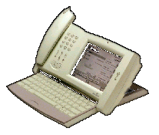
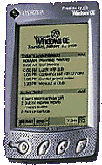
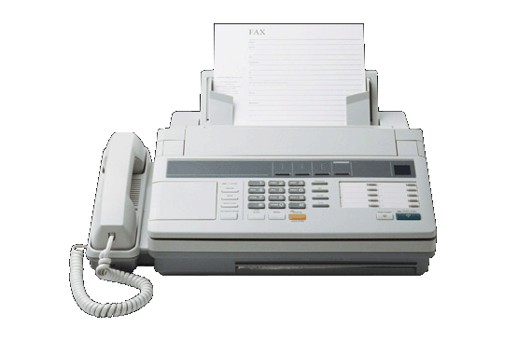


Value Creation
New Products
“Tool Box” Approach
Match Needs To Products
Enron Energy Services
New Products
Identify Needs
Maximize Value!
Product Delivery
Hands Free
Rapid Response
E-Marketing
Selling & Training Aids
Customers
Create Profits
Value Creation
Hassle-Free “Menu” Delivery
Instant Ordering

Slide 16

Value Creation
Enron Energy Services
Database
Mine Database
Customer Profile
Location
Habits
Load Forecasting...
E-Service
Maximize Value!
Mine & Retain
Order & Confirmation
Systems Are “Go”
Contracts
Credit
Accounting
Customer Service
Service Delivery
Customers
E-Service
Manage Exceptions

Slide 17
Value Creation
Enron Energy Services
Refine The Mine
New Value Creation Tools
Customer Feedback
Value Success / Failure?
Create New Value
Profiling
Maximize Value!
Customers
Value “Alerts”
Up-sell Triggers
Profit Creation
Cross Sell

Slide 18
Value Creation
New Products
“Tool Box” Approach
Match Needs To Products
Enron Energy Services
Refine The Mine
New Value Creation Tools
Customer Feedback
Value Success / Failure?
New Products
Database
Mine Database
Customer Profile
Location
Habits
Load Forecasting...
Create New Value
Identify Needs
Profiling
E-Service
Maximize Value!
Mine & Retain
Product Delivery
Hands Free
Rapid Response
E-Marketing
Selling & Training Aids
Order & Confirmation
Systems Are “Go”
Contracts
Credit
Accounting
Customer Service
Service Delivery
Customers
E-Service
Manage Exceptions
Value “Alerts”
Up-sell Triggers
Profit Creation
Cross Sell
Create Profits
Value Creation
Hassle-Free “Menu” Delivery
Instant Ordering

Slide 19
Utility Risk Management
Scott Stoness

Slide 20
Utility Risk Management & Bear Trap
Summary of Utility Risk Management:
Produce forward curves for delivery and bundled rate before deregulation
Support Sales/Structuring in new Origination
Hedge opportunities related to our positions
Utility Risk Management Market Facing Support:
Standard documentation on top 20 markets
Identify markets where we have a different view than the market
Ensure curves match modeling
Ensure pre-approval is defined
Ensure booking is predefined
Model common products
New Organization more focused/Accountable:
Market Support Group – Roger Yang
Systems Improvement Group – Colin Carlsen
Hedging Group – Savage / Anderson
Curve Support Group – Rudolph / Bachmeier

Slide 21
Tariff Risk Pricing Status
> 1,000 curves developed looking forward 15 years
> 400 curves with significant positions
10 year view of retail Index produced daily
Turnaround new curve 2 weeks
All pricing done against curves
10’s of billions of deals priced against curves
Positions by utility/rate available daily
Curves reviewed periodically for changes Exposure to interest rates measured, limits defined, hedged

Slide 22
Improvements Planned to Support Origination
Improve systems ==> offer more products
Differentiate T, D, CTC
V@R
Volatility
Position
Develop alternate products ==> allow business to grow
Retail index products
System to tract options needed ==> Allows option sales
Dedicated Metrics Person ==> Ensures feedback in Market Support

Slide 23
Utility Risk Management 2001 Preferences
Retail index offers superior in Non Top 20 States
Non deregulated utilities are more difficult to hedge
Retail index product results in less risk
Nation’s long to pension fund
Leverage historical Enron Relationship
Retail index offer preferable to Wholesale Index Offer
Wholesale index is equivalent to a fixed c/kWh fixed-for-floating offer
Fixed c/kWh has greater pricing risk
Fixed-for-floating swap riskier that retail index offer
Pricing structures based on discount off tariff or synthetic tariff preferable
Less risk in pricing
Options with fixed start dates preferable
Options with dates that depend on deregulation riskier than fixed dates
Prefer products that increase long position on Curves with large positions or those rated as Yellow by Gov. Aff.
ComEd (IL) , Illinois Power (IL), Ohio Power (Oh), SPS (Tx), Duke (SC/NC), PSI (IN) are curves rated as yellow by Gov. Aff. curve validation process
Green = Consistent with Gov. Aff. View
Yellow = More aggressive than Gov. Aff. View but within the range of reasonable
Red = Considered improbable by Gov. Aff.
SCE/PG&E (CA)

Slide 24
Yellow Curves
Washington
Maine
Montana
North Dakota
Minnesota
Mich
VT
NH
Oregon
Wisconsin
NY
MA
RI
Idaho
South Dakota
Mich
CT
Wyoming
Iowa
Pennsylvania
NJ
Nebraska
Ohio
Maryland
Indiana
West
Virginia
DE
Nevada
Illinois
Utah
Virginia
California
Colorado
Kansas
Missouri
Kentucky
North Carolina
SPS
Tennessee
South Carolina
Oklahoma
Arkansas
Arizona
New Mexico
Mississippi
Alabama
Georgia
Texas
Louisiana
Florida

Slide 25
Integrated Asset Management
Dave Roberts
Gary Weiss

Slide 26
Introduction and Greeting
EES has proven integrating demand side assets with supply side products adds value
Example: Load Curtailment Program
However…
IAM must show more leadership in supporting both origination and execution
EES must evolve from a deal-centric, customized shop to a product-based, scalable, learning organization
IAM must align with other similar EES initiatives

Slide 27
How will we get there?
Further alignment of the Asset and Labor pieces of our business into an efficient organization will:
1. Consolidate investment decisions
2. Institutionalize knowledge and tighter feedback
3. Integrated alignment with delivery organizations
4. Ensure consistent product delivery across all accounts - “One face of EES”

Slide 28
Pricing Objectives
Significantly reduce cycle time and increase accuracy, quality, competitiveness
Reduce pre-contract due-diligence
Maximize use of actuarial data for ECM and O&M bets
Use actuarial curves for IAM review of traditional due-diligence pricing and comparison to “best-in-class”
Use standardized process to improve scalability and consistency in risk quantification
RAC buyoff on pricing methodology
Reduce DASH approval time
Accelerate deployment of Breakthrough Concepts to align with market facing initiatives

Slide 29
Actuarial Pricing Approach
Disagg Actuarials
Actuarial Database
Savings Actuarials (% of Baseline)
Pricing Model
CapEx Actuarials ($/kWh)

Slide 30
Actuarial Pricing - Recent Deals

Slide 31
Project valuation tools will allow EES to better quantify risk as information increases
Low
High
EXAMPLE -PURGERS
LEVEL OF INFORMATION
Parameters
Asset Costs
Purging Points
Suppliers
P(%)
P(%)
Purging Points
Complexity
- Ease of access
- Distance to purger
Location
Asset Costs
Asset Costs
Installation
Costs
P(%)
P(%)
Installation Costs
Installation Costs
Cycle Time
Purging Points
Delays in Activity
Chain
P(%)
P(%)
Cycle Time
Cycle Time
O&M
Savings
Maintenance Costs
Energy Savings
P(%)
P(%)
O&M Savings
O&M Savings
Contract duration
Discount rate
P(%)
P(%)
NPV
NPV
NPV
Reduced uncertainty increases IAM offer value

Slide 32
Project valuation tools will allow EES to better quantify risk as information increases
Low
High
EXAMPLE -PURGERS
LEVEL OF INFORMATION
Parameters
Asset Costs
Purging Points
Suppliers
P(%)
P(%)
Purging Points
Complexity
- Ease of access
- Distance to purger
Location
Asset Costs
Asset Costs
Installation
Costs
P(%)
P(%)
Installation Costs
Installation Costs
Cycle Time
Purging Points
Delays in Activity
Chain
P(%)
P(%)
Cycle Time
Cycle Time
O&M
Savings
Maintenance Costs
Energy Savings
P(%)
P(%)
O&M Savings
O&M Savings
Contract duration
Discount rate
P(%)
P(%)
NPV
NPV
NPV
Reduced uncertainty increases IAM offer value
Best-in-Class Practices increase overall IAM value

Slide 33
Actuarial Curves - Current Data

Slide 34
EAM Pricing - What’s Next?
People
Pricing & Product Development Team
Project Valuation Team: modeling and field operations
Process
IAM Pricing Standardized Process
Project Valuation process for Savings Verification
performance measurement
Tools
IAM Actuarial Database under development
Standardized Pricing Tools (w/ Underwriting and National Development)

Slide 35
Performance Management Center
Neil Shah
Mary Sullivan

Slide 36
The New PMC will ...
Create value by measuring, capturing, analyzing, and leveraging performance information
Create “best in class” Operations Centers by integrating the IPT "Customer Care" operations plus expanded diagnostics and energy analytics.
Leverage IPT measurement processes (SPI) to measure performance of “Negawatt” delivery.
Set a new standard for benchmarking Performance (and setting standards such as Enron Quality Hours) & open a new Market to trade “Negawatts”.

Slide 37
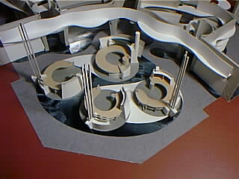
PMC Operations Center

Slide 38
The New PMC Houston Ops Center
Customer Interface Demonstration - PODS for:
Call Center Customer Care (inbound)
Remote Diagnostics
Provider Specialists (outbound)
Analytics - “forward look”
Operations Research - “data mining”
Demonstrate EES uses Knowledge-based Approach
Shows how to Leverage technology and the Internet
Living Lab, meter calibration, severs, UPS

Slide 39
PMC Results
Facility Load Shapes Pre- and Post-Implementation
350
Pre-PMC
Post-Implementation
300
Consumption (kW)
250
200
Electricity
150
100
Common Area
50
0
1
3
5
7
9
11
13
15
17
19
21
23
Hour of Day
Approximately 30% Reduction in Consumption

Slide 40
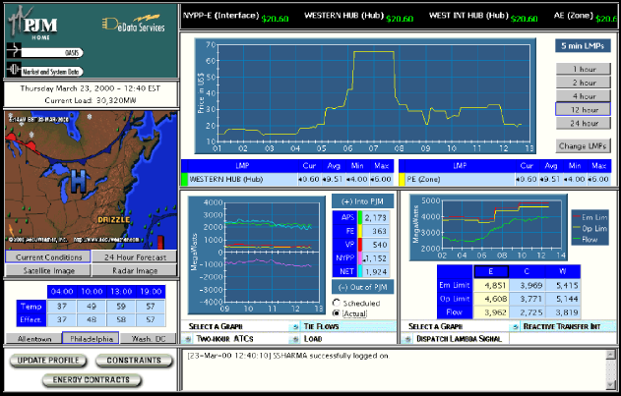
Opportunity Example: Capturing Synergies
PMC has capability to modify energy asset operations based on Commodity Costs.
Implement peak limiting algorithms during periods of unusually high cost

Slide 41
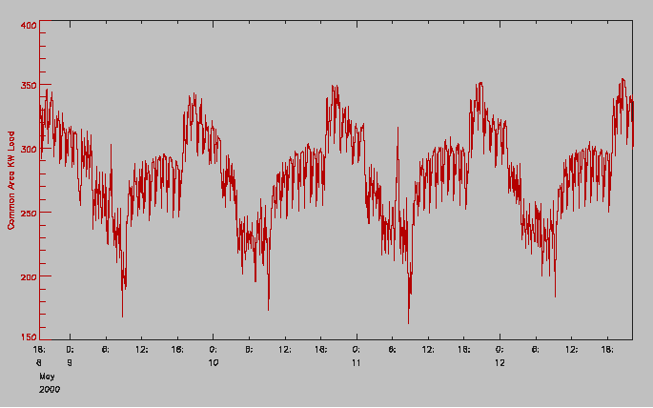
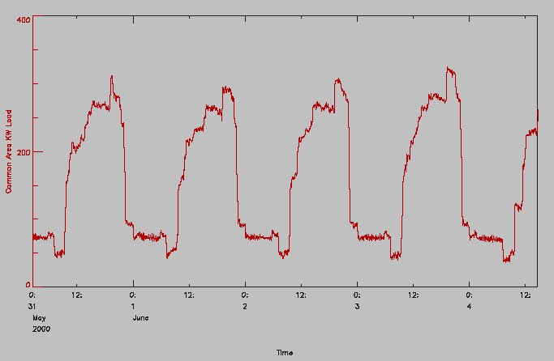
Knowledge Yields $
Anomaly: Facility load Profile indicates major pieces of equipment are cycling on and off.
Opportunity: Controls System eliminates unnecessary cycling and electric consumption.
Uncontrolled Operations
Controlled Operations

Slide 42
Service Delivery Performance Measures Equipment, Service Provider and Asset for Every Transaction
TIME BETWEEN FAILURES
TIME TO REPAIR
SERVICE
COMPLETION
SERVICE
CALL
SERVICE
COMPLETION
EQUIPMENT DOWN TIME
SERVICE
CALL
ETA ENTERED
ETA
CHECK-IN
SERVICE
COMPLETION
EQUIPMENT
Time Between Failures
Time To Repair
Availability (Uptime/Downtime)
Assessment of PM Schedule
Criticality vs. Condition
Replacement Decisions
SERVICE PROVIDER
Response & Completion Times
Repair Costs
Adherence to PM schedules
Quality of PM workscope
Service provider rankings

Slide 43
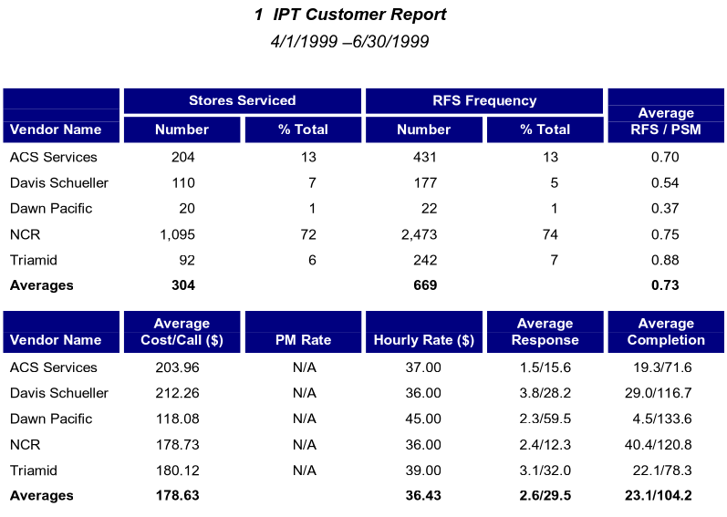
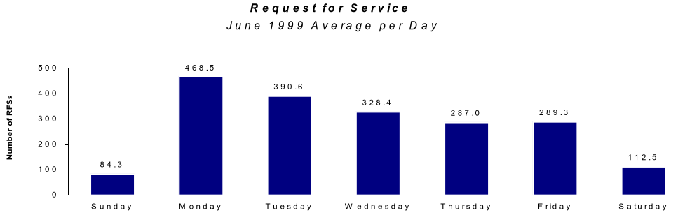
Operations Research Creates Awareness and Enables Modification of Behavior
IPT Database and Knowledge Management
100,000,000 square feet of R&M data
3.75 million R&M transactions
Equipment performance
Routine reporting - buyers and suppliers
Change behavior or process to improve uptime and maximize profits

Slide 44
The PMC enhances facility operation and maintenance through. . .
Monitoring
Through analysis of energy profiles and operational service levels:
Benchmark efficiency of each facility to find outliers in performance
Identify equipment operating outside intended specifications
Identify opportunities to install economizers, DSM strategies
Optimization
Optimize use of existing equipment through control strategies
Coordinate peak shaving opportunities w/ real time commodity pricing
Identify behavioral changes that would improve operations or reduce costs
Service Level Enhancement
Validate historical service levels
Provides continuous monitoring of key service levels
Monitor key maintenance indicators to establish optimal intervals rather than time-based intervals.

Slide 45
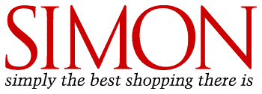



Business Model Creates a Market for Customers and High Quality Service Providers
Facility Maintenance
Outsourcing
Service Provider
Procurement
Preventive Maintenance
Scheduling
Dispatching, Monitoring,
Measuring
Service Provider
IndexTM
Invoicing, Payment
Management Reporting
Facility Services B2B Model
CUSTOMERS
SUPPLIERS
Over 30 Trades
HVAC,
Plumbing,
Electrical,
General Maintenance,
Roofing...
Structure

Slide 46
Emissions Risk Management
Heather Mitchell

Slide 47
Monetizing the Clean Air Benefit of Energy Efficiency
Energy efficiency outsourcing has a clean air benefit:
Pollution released into the atmosphere is reduced
Capturing the benefit:
Emission reduction credits (NOx and CO2)
Negawatts in a Green Power program
Positive environmental public relations
Electricity Reductions
Natural Gas Reductions
Consumption
Pre
Post
Add’l Value
Pre
Post
Add’l Value
Emission reductions represent an additional
value stream in energy outsourcing

Slide 48
Current and Future Emission Credit Markets and Prices
Current Markets
NOx
Ozone Transport Region (OTR)
Non-attainment areas
California
Set-asides for energy efficiency
NJ, NY, MA, MD
CO2
Kyoto Protocol
Future Markets
NOx
SIP Call and set-asides for energy efficiency
Negawatts
PA Pilot Program
NOx, CO2, PM, mercury
Non-Attainment Areas
Projected prices:
NOx SIP Call ($/ton):
$2,000 - $5,000
Current prices:
OTR NOx ($/ton):
$500 - $6,000
Current prices:
California NOx ($/ton):
$8,000 - $104,000
Current prices:
Texas NOx ($/ton):
$1,000 - $7,000

Slide 49
Companies Could Create OR Need NOx Emission Credits
The following are examples of EES projects that could create or need NOx emission credits:
Direct fuel use
Fuel switch
Electricity consumption
Boiler and/or furnace efficiency
New boilers, generating equipment
Stand-by capacity
Lines of production
Manufacturing process
Facility shutdown

Slide 50
Example: Chase Emissions Creation Potential
Chase states with greatest square footage
Other states with Chase operations
NOx Emission Reductions
17 tons per ozone compliance season at New York facilities
Gross estimated value of $34,000-$86,000 per year starting in 2004
Potential to create tradable reductions prior to 2004
CO2 Emission Reductions
50,000 metric tons per year total for US facilities
Gross estimated value of $100,000-$250,000 per year
Current market fairly illiquid for pre-2008 (pre-Kyoto) reductions
Assumptions:
Expected annualized DSM savings: $9 million
Total annual electricity consumption: 581 million kWh
NY annual electricity consumption: 393 million kWh (based on NY’s square footage as a percent of total square footage)
Average electricity rate for NY: 11.04 cents/kWh
NY DSM in kWh: 82 million kWh
Average electricity rate for all states: 10.50 cents/kWh
All states DSM in kWh: 86 million kWh

Slide 51
Example: Potential Emissions Value of Existing Deals
Nationwide CO2 (tons) $ Value per Year
Archdiocese of Newark 24 $48
BICCGeneral 21,604 $43,208
General Cable 16,057 $32,114
Infomart 4,626 $9,252
Lodgian - -
Macerich 1,352 $2,704
Molded Fiber Glass 7,889 $15,778
Ocean Spray 12,207 $24,414
Owens Corning 117,875 $235,750
Packaged Ice 22,891 $45,782
Polaroid 12,453 $24,906
Ridge Tools 7,636 $15,272
Simon 65,344 $130,688
Springs Industries 16,480 $32,960
Starwood 151 $302
Suiza 60,210 $120,420
TRW - -
Tyco Healthcare Group 55,034 $110,068
UC/CSU - -
Quebecor 28,591 $257,182
Total 560,227 $1,120,454
NOx SIP Call Region NOx (seas. tons) $ Value per Year
BICCGeneral 5.5 $11,000 - $27,500
General Cable 4.1 $8,200 - $20,500
Molded Fiber Glass 3.6 $7,200 - $18,000
Ocean Spray 2.4 $4,800 - $12,000
Owens Corning 28.1 $56,200 - $140,500
Packaged Ice 4.0 $8,000 - $20,000
Polaroid 6.4 $12,800 - $32,000
Ridge Tools 3.6 $7,200 - $18,000
Simon 22.5 $45,000 - $112,500
Springs Industries 4.2 $8,400 - $21,000
Suiza 23.6 $47,200 - $118,000
Tyco Healthcare Group 21.4 $42,800 - $107,000
Quebecor 40.1 $80,200 - $200,500
Total 169.5 $339,000 - $847,500
California NOx (ann. tons) $ Value
Owens Corning 2 $29,000
Simon 1 $42,054
Suiza 1 $42,054 Quebecor 2 $60,054
Total 6 $173,162
Note: Based on projects in PCCS as of January 8,2001

Slide 52
Next Steps
Establish ownership of emission reductions
Include ownership language in new and existing contracts
Evaluate emission opportunities
Regional (NOx) and international (CO2) trading
State incentives
Utility rebates
Complete pilot projects
NOx set-asides for energy efficiency
California NOx credits
Green energy

Slide 53
EES - Credit Environment
Denise Furey
Jim Harris

Slide 54
Current Credit Market
Softening economy has dual impact on EES business
Increased demand for EES products and services
Concern that credit quality of customers will decline
Default rates on publicly rated debt highest since 1991
Overall defaults reached 2.27% in 2000
Average over last 10 years 1.43% (60% increase)
Rating agency downgrades increased in 2000
S&P downgrades outpaced upgrades 3:1
Over 20 years downgrades exceeded upgrades 2:1

Slide 55
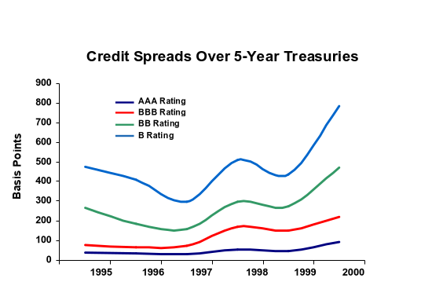
Current Credit Spreads
Credit spreads are at historic highs
More normal spreads expected within 6 to 12 months

Slide 56
Current Market for Bonds
Market is soft for non-investment grade issues
Issuance of High Yield Bonds
# of Issues
Billions of USD
# of Issues ($billions)
1998
1999
2000

Slide 57
EES Credit Issues in Deals
Unsecured position in commodity agreements
Unsecured position for Operations & Maintenance
Secured or ownership interest in energy assets
Energy assets integral to customer’s operations
Accounts Receivable / Unbilled Receivable exposures
Long-term contracts (typically 10 years)
Customer credit quality may deteriorate over time

Slide 58
Structural and Mitigating Solutions
Identify exact legal entity that is party to contracts
Financial covenants included in contracts
Debt Rating downgrade trigger
Leverage and debt coverage ratios
Material Adverse Change (“MAC”) Clause
Assignment language
Approval granted at sole discretion of EES
Qualified assignee based on ratings or covenants
Billing procedures reducing receivables exposure

Slide 59
Credit Roles
Deal Structuring
Assist origination in negotiating credit terms protecting EES from credit risks
Implement structures and contracts marketable to financial buyers
Work with EES Credit Desk and RAC to identify and mitigate credit concerns early
Work with EES Global Finance to confirm deals are compatible with investment vehicles for off balance sheet financing and monetization
EES Credit Desk
Evaluate credit quality of customer and report to deal team
Recommend structures / covenants to reduce EES credit risks
Day to day interface with RAC concerning credit related issues
Work with RAC and deal teams to identify the effect of various structures on the credit reserve
Monitor credit quality of customers and suppliers
RAC
Evaluate credit risks in EES transactions
Final approval of all EES transactions
Advise on structure and credit issues
Establish credit reserve for each transaction
Develop controls that mitigate credit risks

Slide 60
Project Gutenberg
Sean Holmes

Slide 61
Process Roadmap
Why?
Goals
What’s Happening?
"Is" Maps Disconnects
What?
Should Design Specs / Measures
What?
"Should" Subprocesses / Measures
What?
Linear Process Map

Slide 62
Process Roadmap
"Should” Cross Functional Process Maps
What & Who?
What & Who?
Roles and Responsibilities
Function
Function
Function
Function
Function
1
2
3
4
5
1. Step
P
A
R
I
S
2. Step
Changes?
Recommendations
Who, When, How?
Implementation Strategy

Slide 63
Concerns We Have Heard
Where is the breakthrough?
What is the real change?
Are these changes going to produce the results we need?

Slide 64
Where is the Breakthrough?
What person was the most influential over the last millennium?

Slide 65
Where is the Breakthrough?
Individual Letters
Metal Type
Screw Press

Slide 66
What is the Real Change?
Before
Custom Deal Making
“Notional” Pricing
Pervasive Disconnects
Multiple Handoffs
Difficult Re-forecast and Analysis
Unreliable Data & Reconciliation
Deal Flow Requires One-on-One Resources
Conflict Around Subjective Assessments
Last Minute Scrambles
Silos of Information
Disjointed Management Policies
After
Flexible Deal Making
Disciplined Use of Proxies
Living Deal View
Functions A, B, C and D
Componentization and Evolving Data Sets
Risk-assessed Used of Available Information
Infinite Scalability
Transparent Objectivity
Prioritized Resources and Schedules
Open Sharing through Common Workflow
Aligned Incentives & Priorities

Slide 67
EES Operating Systems
Qualified Prospect
Booked Positions
Product Feedback
Commenced Delivery
Executed Contracts
Prospect Identification and Qualification
Pricing (Product Confirmation, Valuation, Contracting and Booking)
Account Installation (Baseline and Risk Validation)
Product Delivery and Account Maintenance
Standardized Products
New/Updated Components
New/Updated Curves
Upsell Opportunities
Prospect Identification and Qualification
Components Development and Management
Curve Development and Management

Slide 68
Component Summary
Curves
Example:
TETCO M3 Gas Basis
Lighting Efficiency Opportunity
Vendor Management Opportunity
Owner:
Risk Desks
Site Profiles
Example:
Gas Load Profile
Power Load Profile
Tons of Cooling
Owner:
Site Profile Owners
Value
“Risk Book Effect”
Comparative Values & Sensitivities
Root Cause of Change Tracking
Components
Parameters
Example:
Price to Customer
Option Strike Price
Sharing Percentage
Owner:
Sales

Slide 69
Macro Block 1 – Scope Established
Customer
A
B
C
D
Info
MGMT
Other

Slide 70
Macro Block 2 – Site Profiles Created
Customer
A
B
C
D
Info
MGMT
Other

Slide 71
Macro Block 3 – Structure Defined
Customer
A
B
C
D
Info
MGMT
Other

Slide 72
Macro Block 4 – Contract Approved
Customer
A
B
C
D
Info
MGMT
Other

Slide 73
Macro Block 5 – Deal Booked
Customer
A
B
C
D
Info
MGMT
Other

Slide 74
Will These Changes Produce the Needed Results?
The 50 times growth in productivity is only achievable if we are committed to the process, BUT it is achievable!
Leadership
Time
Cooperation
Resources

