Slide 1
Why Renewable Energy Has A Role In The National Energy Policy
RICK WALKER
Director, Renewable Energy Business Development
AEP Energy Services, Inc.
and
2001 President of
Texas Renewable Energy Industries Association

Slide 2
So What Is Renewable Energy?
Definitions Used In Texas: Energy that is naturally regenerated over a short time and derived directly from the sun, indirectly from the sun or from moving water or other natural movements and mechanisms of the environment. Renewable energy does not rely on resources derived from fossil fuels, waste products from fossil fuels or waste products from inorganic sources.
Wind energy
Solar energy (photovoltaic or solar thermal)
Biomass (agricultural wastes or dedicated crops)
Methane from decomposing wastes (landfill gas)
Geothermal energy
Hydroelectric energy (excluded by some states)
Municipal solid waste (excluded by most states)

Slide 3
What Is TREIA?
The Texas Renewable Energy Industry Association, or TREIA, is an industry trade association that includes about 120 businesses, universities, and organizations.
Its members include:
Manufacturers: Enron Wind, Vestas, NEG Micon, Trinity Steel, Bergen Steel, Sun Trapper
Engineering & Consulting Firms: PBS&J, Virtus Energy, Electric Power Engineers, CSG Services
Utility Companies: American Electric Power, Austin Energy, City Public Service of San Antonio, LCRA, Reliant Energy, and TXU Electric & Gas.
Universities: Texas A&M, University of Texas, Texas Southern Univ. West Texas A&M, UT-El Paso, UT-Brownsville, Texas Agricultural Extension Station

Slide 4
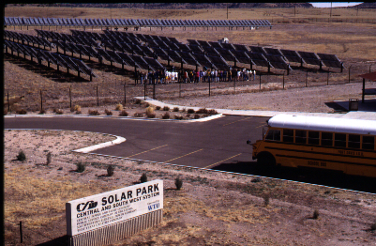
AEP’s Fort Davis Solar Park Built in 1995-96

Slide 5
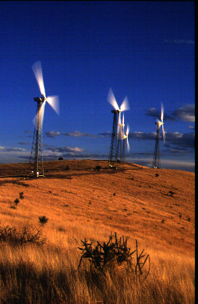
AEP’s 6 MW Wind Energy Project near Fort Davis, Texas Built in 1995

Slide 6
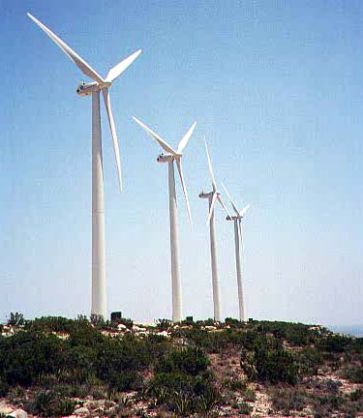
75 MW Southwest Mesa Wind Farm near McCamey, Texas Built in 1999 With FPL Energy

Slide 7
150 MW Trent Mesa Wind Farm
Located in Nolan County, Texas
100 Enron Wind 1.5 MW, variable-speed turbines
65 meter tubular steel towers made by Trinity Steel in Fort Worth
Towers painted in Coleman, Texas
Will provide wholesale electricity to TXU Electric & Gas and can provide energy for 30,000 to 40,000 residential customers
Potential for additional expansion at site
AEP ProServ managing EPC

Slide 8
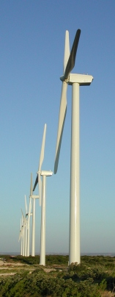
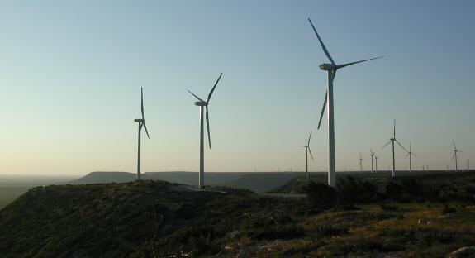
AEP’s 150 MW Trent Mesa Wind Farm
With 100 Enron Wind 1.5 MW Turbines

Slide 9
Reasons That Renewable Energy Has An Important Role In The National Energy Policy
Rapidly declining cost
Rapidly growing industry ➔ job creation
Hedge against fossil fuel price volatility
Hedge against fossil fuel supply disruptions
Environmental benefits
High levels of public support
Legislative or regulatory mandates
Abundant local resources
Regional economic development

Slide 10
Cost of Wind-Generated Electricity
1980 to 2005 in Levelized Cents/kWh
Source: American Wind Energy Association

Slide 11
World Wind Energy Capacity
Actual Through 2000; Projected Through 2005
Source: BTM Consult
MW
18,449 MW in 2000

Slide 12
Declining Cost of Solar Energy
Cost of Crystalline PV Modules (1992 $/Wp)
Source: Electric Power Research Institute

Slide 13
Declining Cost of Solar Energy
Cost of Amorphous Silicon PV (1992 $/Wp)
Source: Electric Power Research Institute

Slide 14
Rapidly Growing Market
Growth Rate by Energy Source (1990-98)
Source: Vital Signs 1999, Worldwatch Institute
Wind Energy 22.9%
Solar Energy 15.9%
Geothermal Energy 4.3%
Hydroelectric Power 1.9%
Oil 1.8%
Natural Gas 1.6%
Nuclear Power 0.6%
Coal 0.0%

Slide 15
Rapidly Growing Market
Energy Companies Making Significant Investments in Renewable Energy
Royal Dutch Shell
Enron
British Petroleum / Amoco
Florida Power & Light
American Electric Power
Cinergy

Slide 16
Natural Gas Price Volatility
Average Annual Price ($/MMBtu)
Source: Cambridge Energy Research Associates

Slide 17
Increasing Regulation of Emissions
Highlights of 1998 Merrill Lynch Report
The largest risk to the electric utility industry over the next 10 years may be environmental compliance costs, not competition.
Environmental costs could “flip-flop the batting order” in the competitive marketplace.

Slide 18
Customer Support
AEP Deliberative Poll Results
(after deliberation)

Slide 19
State Legislative Mandates
States Passing Renewables Mandates
Arizona (1.1% by 2007)
Connecticut (7% by 2009)
Iowa (wind energy requirement - 105 MW)
Maine (30% including hydro, but already 50%)
Massachusetts (4% by 2009)
Minnesota (NSP - 950 MW by 2012)
Nevada (1% by 2009)
New Jersey (4% by 2012)
New Mexico (up to 5%)
Pennsylvania (2% rising 0.5% per year)
Texas (2000 MW to be added by 2009)
Wisconsin (2.2% by 2011)

Slide 20
Abundant Local Resources
Wind Energy Potential in Billions of kWh
Source: Pacific NW Lab’s 1991 Study

Slide 21
Local Economic Development
Texas Energy Production vs. Consumption
Source: Texas Railroad Commission & U.S. EIA State Energy Data
Quads of Energy

Slide 22
Local Economic Development
Almost $1 billion of investment in renewable energy generation this year in Texas
Manufacturing jobs (Bergen Steel, Trinity Steel, MFG, Enron)
Construction jobs
Operations & maintenance jobs
Landowner royalties
Property taxes
New market for agricultural crops

Slide 23
Renewable Energy Issues
Tax credit expiration (Wind & Biomass)
Intermittancy/Dispatchability (Solar & Wind)
Distance of Resource from Load (Wind)
Availability of Transmission Lines
Birds / Endangered Species (Wind)
Noise /Aesthetics / FAA Lighting (Wind)
Lightning Damage (Wind & Solar)
Erosion / Deforestation (Wind)
Chemicals used to Manufacturer (Solar)
Emissions (Biomass / Landfill Gas)

Slide 24
Concluding Summary
Rapidly Declining Cost Makes Renewable Energy Increasingly Competitive for Large-Scale Generation And a Growth Industry
Public Polls Continue to Demonstrate High Levels of Support For Additional Development of Renewable Energy Primarily Due to Perceived Environmental Benefits
Texas and Many Other Regions of the U.S. Have an The Abundance of Renewable Resources That Can Provide Economic Development Opportunities

Slide 25
Concluding Summary
An Increasing Number of States Have Mandated The Use of Renewable Energy Resources by Utilities, and Federal Mandates Are Being Considered
Renewable Energy Reduces Risk of Fuel Supply Disruptions and Price Volatility
Renewable Energy Technologies are Increasingly Reliable and Can be Integrated with Utility System

