Slide 1
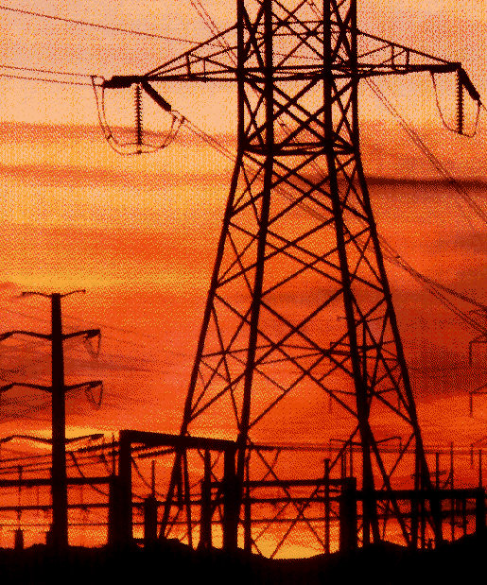
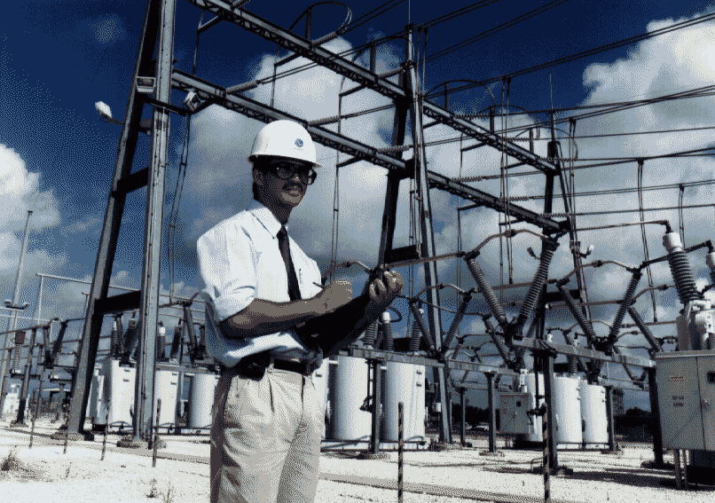
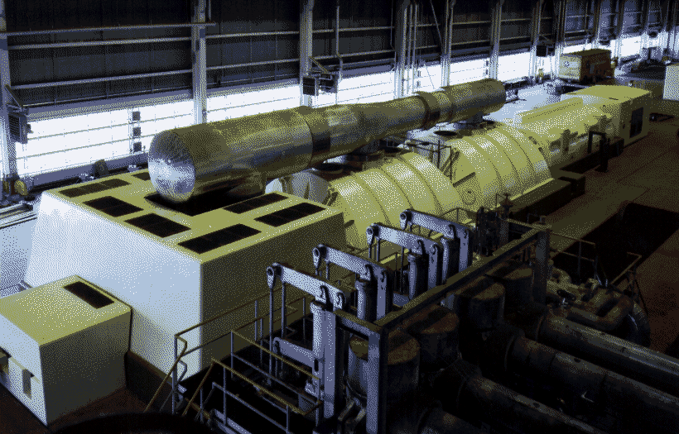
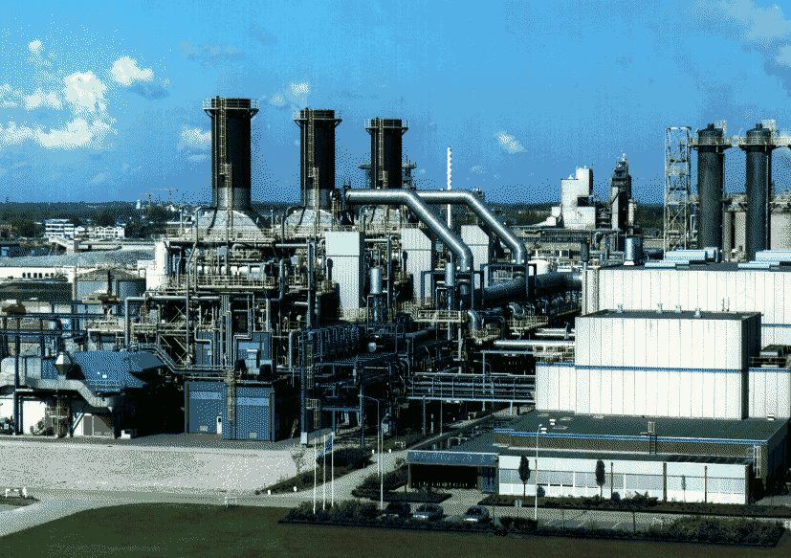
Energy Services
and
The World Trade Organization:
The Path To Liberalization
The World Services Congress
Atlanta, Georgia
November 1, 1999
Timothy J. Richards
General Electric Company

Slide 2
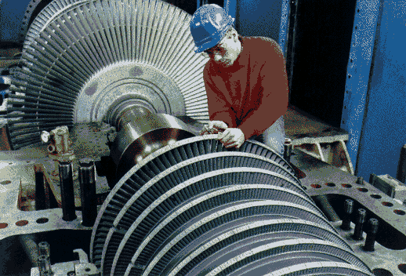

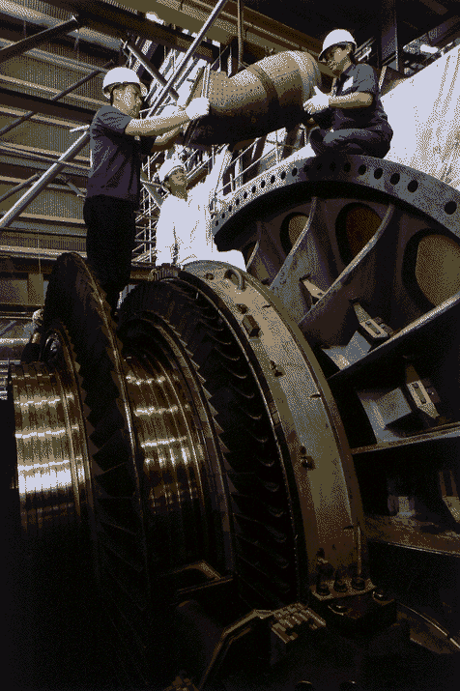
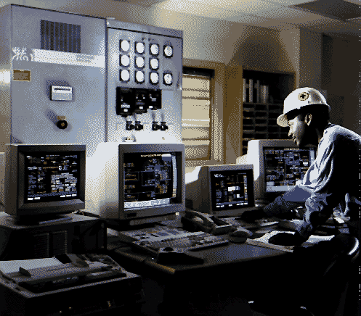
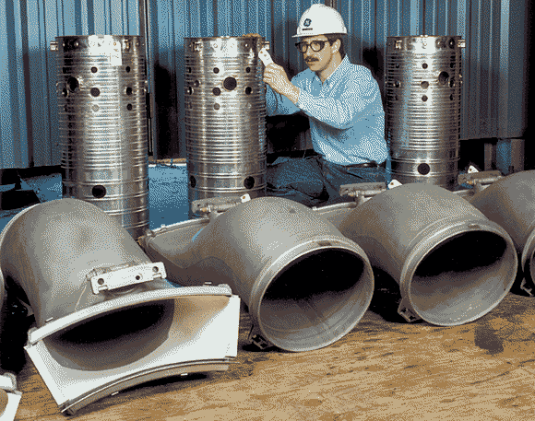
GE Power Systems
Engineering Services
Global Services
Apparatus Services
Operation & Maintenance
Parts & CMUs
A426-10
New Initiatives

Slide 3
Commitments Made By WTO Members Related to Energy Services
Incidental
to Mining
Energy
Distribution
Pipeline
Trans.
Engineering
Services
Construction
& Engineering
Environ.
Construction
for Civil Eng.
Source: WTO Secretariat, Energy Services, Background Note by the Secretariat, S/C/W/52 (Sept. 9, 1998); Christopher P. Melly, U.S. International Trade Commission, Existing Coverage of Energy Services in the General Agreement on Trade in Services, (Aug. 18, 1999); Harry P. Pstuszek, III, Summary of Energy-Related Commitments Made Under GATS, (1999).
Other Commitments Which May Relate to Energy Services
Related Scientific & Technical Consulting
Architectural Services
Rental & Leasing Services without Operators
Maintenance & Repair of Equipment
Computer & Related Services
Management Consulting Services
Technical Testing & Analysis Services
Other Environmental Protection Services

Slide 4
Energy Services and GATS
LOW HIGH
LOW HIGH
LOW HIGH
LOW HIGH
?
?
LOW HIGH
LOW HIGH
LOW HIGH
LOW HIGH
LOW HIGH
LOW HIGH
LOW HIGH
LOW HIGH
LOW HIGH
LOW HIGH

Slide 5
Tough Issues In Seeking Energy Services Liberalization
Defining Energy Services:
Critical to achieve special GATS consideration
Enumerated characteristics or broader definition to permit evolution?
How to treat electricity?
As a good - GATT?
As a service - GATS?
Both?
Negotiating Approach:
NAFTA Model (Negative List)
Telecom Sector Model
Horizontal Model
Cluster Model
Request - Offer
Identifying and Eliminating Regulatory Barriers
Introduction of competition
Access to transmission/distribution grids
Privatization
Telecom sector as model for transparent, harmonized regulations

