Slide 1

Retail Mechanics Update
Bill Bojorquez
October 18, 2001

Slide 2
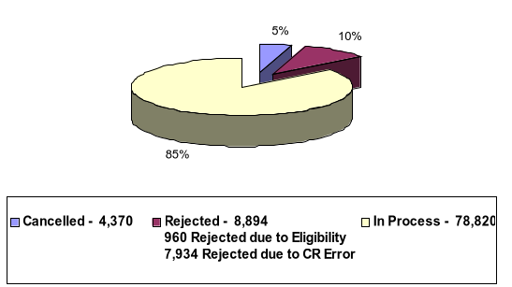
Switch Requests Received – 92,084 (as of October 17, 2001)

Slide 3
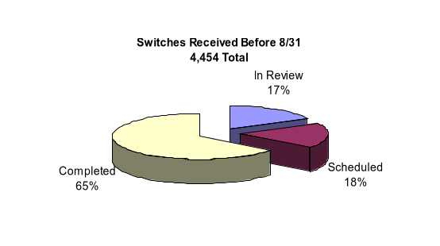
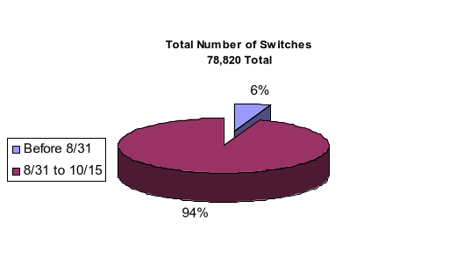
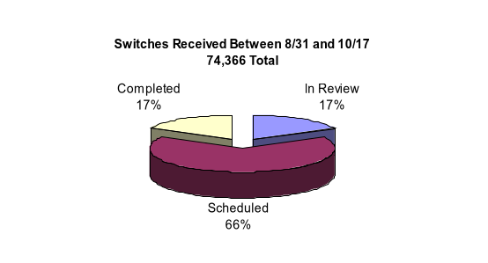
Status of Switches in Process as of 10/17
Notes:
Prior to 8/31:
In Review – 766
Scheduled – 804
Complete – 2,884
Total – 4,454
8/31-10/17:
In Review – 12,916
Scheduled – 48,906
Complete – 12,544
Total – 74,366
Totals:
In Review – 13,682
Scheduled – 49,710
Complete – 15,428
Total – 78,820

Slide 4
Five Steps to a Switch
 | Step | Statistics | Status
1 | Transaction Received, Acknowledged, Validated and Forwarded | 92,000 Completed Up to 15,000 in one day | Fully exercised
2 | Customer Notices Sent | 75,000 Completed | Fully exercised
3 | Switch Cancellation | 4,400 Completed | Fully exercised
4 | Switch Completion (Inc. Final Meter Read) | 15,400 Completed | Fully exercised Timing concerns
5 | On-going Metering Data | 1,900 Completed | Timing concerns

Slide 5
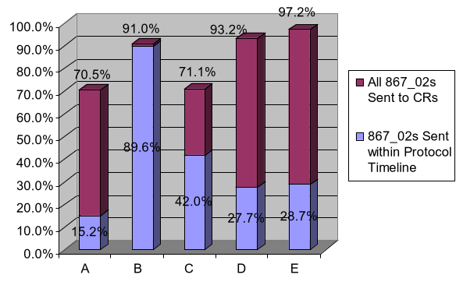
Status of 867_02s (Historic Consumption Requests)
Data for 8/31-10/15
Notes:
Total switches by TDSP from 8/31-10/15:
A – 33,482
B – 1,105
C – 35,483
D – 2,448
E – 1,416

Slide 6

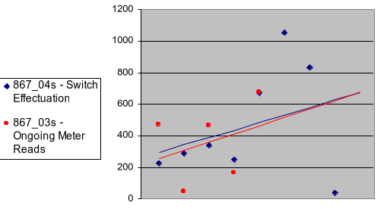
Weekly Number of 867_04s and 867_03s Sent
Week Ending (867_04) | 8/17 | 8/24 | 8/31 | 9/7 | 9/14 | 9/21 | 9/28 | 10/5 | 10/12
Week Ending (867_03) | 9/14 | 9/21 | 9/28 | 10/5 | 10/12

