Slide 1
The Research Group: Quantitative Analysis the Enron Way
Anjam S Ahmad
Presentation to Enron Europe Staff
Thursday 20th April 2000
Notes:
1

Slide 2
Background
Enron Europe...
Aggressive growth
Large amounts of data to be analyzed
Many novel and complex swap and option deals
Senior management views development of new businesses as real options (= unlimited opportunity)
Quantitative analytical skills are critical to ensuring a competitive advantage
Notes:
2

Slide 3
About the [Quantitative] Research Group
Research Group function:-
support for the modelling of energy prices, demand and weather data
to develop and support value-at-risk and credit risk/trading models
to provide traditional quantitative analysis of swaps and exotic options
decision-support tools created in response to commercial groups’ needs
never blue-sky but instead applied quantitative research
problem-solving involves thinking “outside the box”
Albert Einstein: “The important thing is not to stop questioning”
Notes:
4

Slide 4

Recognizing the Research Group Member
Before joining
Notes:
6

Slide 5

Recognizing the Research Group Member
After
Notes:
6

Slide 6
Why Quantitative Research Matters to Enron
Energy markets: unique characteristics
Inflation book
Exotic options library
Power volatility curves
Weather derivatives and insurance
Energydesk.com
Continental European emerging markets
Real options
Bandwidth Trading decision-support tools
Notes:
12

Slide 7
Unique Characteristics of Energy Markets
Traditional derivative pricing models make assumptions that do not hold for energy commodities which exhibit:
mean or trend-reversion as well as seasonality
dramatic volatility that humbles even the liveliest of internet stocks
jumps
Market and credit risk management therefore difficult
on June 25 1998, US mid-west power that had been selling for between $50 and $100 per megawatt hour traded at $7,500 per hour
Notes:
12

Slide 8
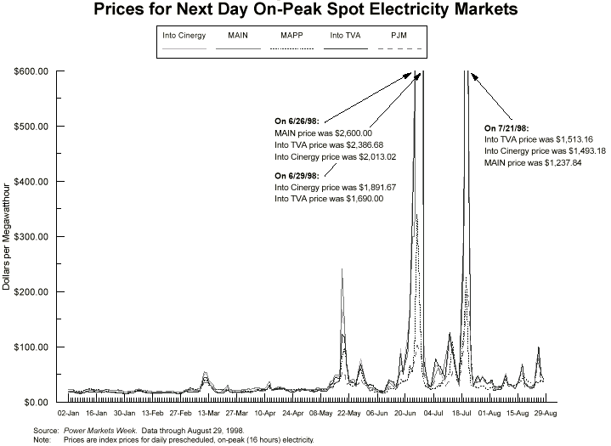
US Mid-West Power Price Spikes 98
Notes:
13

Slide 9
Energy Commodity Prices: Voltage Spike
Notes:
14

Slide 10
Inflation Book: Identifying the Hidden Value
Long-term energy swaps often have fixed-price escalators that are linked to wholesale price inflation indices: PPI
Exposures can be hard to mark-to-market due to lack of quoted prices for PPI instruments
Idea was to build accurate PPI forward curve/forecast
Short-term model predicts PPI out to 12 months
Long-term model predicts PPI from 12 months to 15 years based on RPI curve
Notes:
12

Slide 11
Error-Correcting Short-Term PPI Model
Notes:
12

Slide 12
Exotic Options Library
Exotic options and swaps are embedded within many deals struck by traders, marketers, structurers and asset developers
Internal models offer advantages over those from external vendors:-
commercially-responsive continuous development and improvement
accountability and auditability
close to zero marginal cost for additional users
models can be fine-tuned so that they reflect our unique understanding of the underlying energy markets
can be included in Energydesk.com modules
Location: S:\RESEARCH\EXOTICA\EXCEL\EXOTICA.XLA
Notes:
8

Slide 13
Examples from Exotic Options Library
EURO: European option (exercisable at expiry)
AMER: American option (exercisable any time)
ASV or ASVGC: Asian option (payoff depends on average)
SPREADOPT: Spread option (payoff depends on difference)
TURKISH: mainly Asian, but with a slight European flavour
Notes:
8

Slide 14
Power Volatility Curves and Option Pricing
UK: Idea is to be able to price short and long-term options on EFA months (baseload) or blocks of EFA slots or half-hour level
NETA may lead to financial penalties for generators that fail to deliver promised power
May increase demand for short-term electricity options
Volatility curve generator tool developed
Nordpool volatility curve generator under construction
Useful for valuing power stations (real and virtual)
Notes:
12

Slide 15
Vol Curves: Gold at the end of the Rainbow?
Notes:
12

Slide 16
Time Series for Weekday Half Hour #38
Notes:
12

Slide 17
Weather Derivatives & Insurance
Demand for products from energy and non-energy customers
Build a diversified portfolio of deals in order to ensure success
diversification through time, geography and underlying variable
watch out for trends (e.g. global warming)
Norway Dry Reservoir Insurance Product (“DRIP”)
idea to provide hydro plant owners with insurance against “dry years”
insurance pays out a fixed cash amount if triggered
New areas: insurance on unscheduled outages and transmission
Employ actuarial pricing (e.g. extreme value theory)
Notes:
19

Slide 18
DRIP Pricing: Singing in the Rain
Notes:
20

Slide 19
Supporting Energydesk.com
Huge demand for trading, risk management and back-office systems amongst energy market players as markets deregulate
Energydesk.com is in a strong position to take advantage with good IT, quantitative and business knowledge
Curve generators and supporting models are designed to keep customers happy whilst maintaining confidentiality
Can help bring more players to the European energy-trading poker table
Notes:
12

Slide 20
EnergyDesk.com: Smoothly Does it
Notes:
12

Slide 21
Continental Power Markets
Rapid growth in Continental European electricity markets
Emerging electricity markets are uncertain and therefore volatile
Understanding the future uncertainty is key to forward, future and option trading
New tools that give us confidence in trading new products
parameterized volatility estimates from arbitrary distribution
or Monte Carlo sampling from the arbitrary distribution
Japan: same method for developing volatility curves for position risk limits and option pricing
Notes:
12

Slide 22
Are You Gonna Go My Way?
Notes:
12

Slide 23
Real Options: Let’s Keep it Real
Real options approach improves on the DCF approach allowing managers to optimize resource allocation e.g.
option to defer
time-to-build option
option to alter
abandonment
switching
Sun Tze:
“Opportunities multiply as they are seized”
Notes:
12

Slide 24
Enron Broadband Services
Enron Broadband Services (EBS) is developing the Enron Intelligent Network (EIN)
Delivering the platform for the emerging Internet economy
internet traffic doubling every year
Pay for the bandwidth you need, when you need it
Optimized to transport rich media and high-bandwidth delay-sensitive content:
live television programming
videoconferencing
Data centres in major cities along network: allow LSPs and ISPs to house their interconnect equipment
Notes:
12

Slide 25
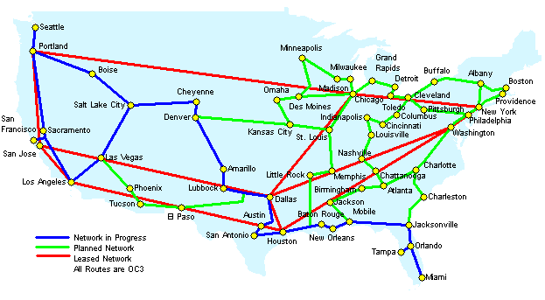
From NY to LA: the Enron Intelligent Network
Notes:
12

Slide 26
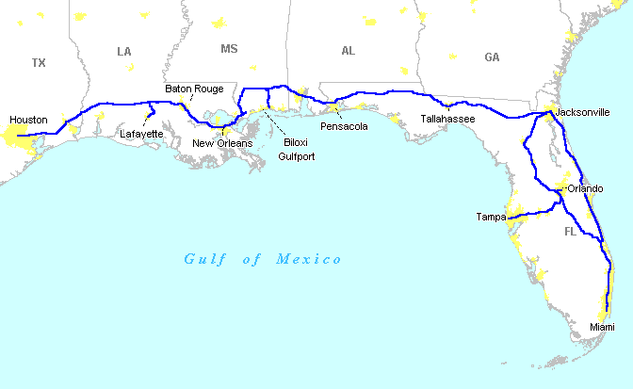
Houston to Miami
Notes:
12

Slide 27
Bandwidth Trading/Optimization Software
Pure IPTM Enron Intelligent Network made up of:
optical fibre back-bone
Cisco Systems Gigabit Routers - determine the path for IP bits
OneHop Sun Microsystems Enterprise distributed servers
Ciena Dense Wave Division Multiplexors (DWDM) - creates the optical circuits
EBS InterAgent® software on every server - ensures digital content is routed efficiently and reliably to a server only “one-hop” from end user
demand-balancing
bandwidth scheduling
usage metering
Research Group will be involved in the software development
Also in valuation of partner internet companies for JVs
Notes:
12

Slide 28

If You WAN-na get Connected...
Notes:
12

Slide 29
… to More Info on Quantitative Analysis
Books:-
“Derivatives: The Theory and Practice of Financial Engineering” by Paul Wilmott, John Wiley & Sons, 1st Edition
“Quantitative Methods in Finance” by T. Watsham, Thomson Press, 1st Edition
“Managing Energy Price Risk”, RISK Publications & Enron
“Managing Energy Price Risk II”, RISK Publications & Enron
Research Group Intranet site
contains tutorials
links
Contact details:
Anjam Ahmad (ext. 35383)
First floor, Enron House
Notes:
12

