Slide 1


Status Report
Global Network Development
January 2000

Slide 2
North American Challenge
Make a positive contribution to earnings
Establish credibility in the market place
Develop a backbone for the EIN
Develop 10,000 route miles of network by 4Q99
Develop 17,000 route miles of network by 4Q00

Slide 3
North American Solution
LIT DATE
NOW
4Q 1999
1Q 2000
2Q 2000
3Q 2000
4Q 2000
Option

Future Builds


































POP















Slide 4
European Challenge
Develop a network by 4Q99
Maximize flexibility
Maximize scalability
Develop local workforce
Minimize capital expenditures

Slide 5
European Solution (Phase One)
Single provider (Level3)
Four cities (London, Amsterdam, Frankfurt & Paris)
300 square feet enclosed space
Pay-as-we-go (Price per Mbps)
Additional space and dedicated circuits available if needed

Slide 6
Typical Co-location Suite European Network Phase One

Slide 7
Typical Co-location Installation European Network Phase One

Slide 8
European Network: Phase I
London
Amsterdam
Frankfurt
Paris

Slide 9
Canada Bell Nexxia Deal
PoP Locations
Toronto
Vancouver
Montreal
Ottawa
Calgary
Edmonton
US PoP Interconnection Sites
Chicago
Vancouver
New York
Canada Development Strategy

Slide 10
Bell Nexxia Deal
Wide Area Network Architecture
Usage Based IP Transport (L3 “Crossroads” Type of Service)
Burstability up to DS3
Option to Migrate to Dedicated Circuits
OC12 “Hubbing” Service for outbound Circuits
Canada Development Strategy

Slide 11
INDIA
IRCON
Maharashtra State Electricity Board (MSEB)
MetGas
FLAG
Data Centers

Slide 12
India Communications Enron (ICE)
Delhi
Kanpur
Japur
Lucknow
Ahmedabad
Calcutta
Nagpur
FLAG: EXISTING LANDING
Hyderabad
Bombay
Pune
Sutrat
Madras
Cities linked with Satellite
Cities linked with Fiber
Bangalore
Kochi

Slide 13
Latin America
Primary objective is to establish connectivity to and within Latin America.
First achieve thin network capacity at a reasonable cost then expand as markets mature -- points to satellite.
Simultaneously analyzing development of a proprietary fiber optic network for long term use.
As connectivity is being established, team is opening discussions with content providers and ISPs within target countries -- Argentina, Brazil, Chile, Mexico.

Slide 14
Satellite Reach
Interlink testing of symmetrical IP/DVB platform on Satmex 5 or Solidaridad 2 initiating in 3/00.
If positive, downlinks to ISPs in Brazil, Chile, Central America during 5-7/00.
Solution for content deals and teleport facilities in Latam providing return path to US.
PanAmSat Global Opportunity
Global Strategy defined 1/00.
Deal signed with PanAmSat 3/00.
Testing and implementation 4/00.
Latam Coverage by 4/00.

Slide 15
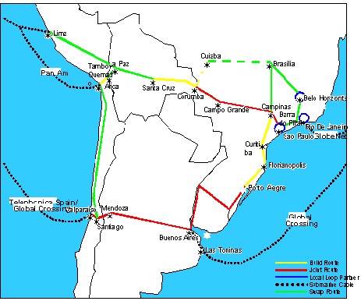
Potential Network Development

Slide 16
Pan Regional Content and ISPs
2 deals closed that currently need network support:
LatinSoccer.net
Grupo Azteca
In discussions with the following:
ForeignTV.com, Que Pasa, El Sitio, El Foco

Slide 17
Asia Strategy
Current Projects
JAPAN: NTT in Japan:
ECI to swap/obtain transpacific capacity via the US-China submarine cable
NTT to swap for capacity on EIN: San Jose, Los Angeles, and New York
NTT to provide backhaul capacity in Tokyo
ECI to initially store 2-3 racks in NTT’s colo space in Otemachi facility in Tokyo with option to increase to 10-12 racks to support applications and trading within a year
Contracts to be in place by February 2000
Also developed relationships with KDD, PSINet, Level 3, etc.
Future Plans/Strategy
HONG KONG: Continue discussions with Hong Kong players; currently discussing swap arrangement with Cable & Wireless Hong Kong Telecom for trans-pacific and/or Pan-Asian capacity; met with ISPs Netvigator, PSINet, HKNet; met with content providers Wharf Cable, Pacific Century Cyberworks
SINGAPORE: Pursue opportunity with ST Telemedia in Singapore - contacts with StarHub
SOUTH KOREA: Follow through on contacts with Korea Telecom (KT); capitalize on KT’s new relationship with NTT
TAIWAN: Met with Chungwha Telecom on capacity, SEEDnet, Taiwan Telecom Network Services (TTNS)
AUSTRALIA: Jan 2000 trip planned to meet with Telstra Corporation, C&W Optus, PowerTel, MCIWorldcom - Ozmail, Davnet
Obtain trans-Pacific capacity to Japan, then extend EIN to Hong Kong, Singapore, etc.

Slide 18
NTT Deal Schematic
Tokyo
Otemachi
OC3 x 2
[ San Jose-New York, April 1st 2000 ]
( 2,550 miles x 2 = 5,100 miles )
STM1
Tokyo - San Jose
April 1st 2000
( Half Ring )
New York
111 8th
San Jose
250 Stockton
OC3 x 1
[ San Jose - Los Angeles, April 1st 2000 ]
(295 miles)
Los Angeles
530 W 6th, Suite 300

