Slide 1
Transwestern
Pipeline
Company
Rating Agency Presentation
February 2002

Slide 2
Table of Contents

Slide 3
Revolving Credit Agreement
$550 million, 364-day facility secured by pipeline assets and pledge of stock; libor + 250
Guaranteed by ENE; amendment forthcoming
Fully drawn on Nov. 13, 2001
  Proceeds loaned to ENE (unsecured claim)
Key Covenants
  Kevin to fill in
Events of Default
  Restructured payments
  Default under ENE revolving credit facility
  Minimum consolidation tangible net worth of $750 million
Current “Ring Fencing” of cash prohibits all loans/distributions

Slide 4
Historicals/Projections

Slide 5
Liquidity
Additional borrowing capacity of $
Excess cash flow per month ??
  Pre-Red Rock in-service $??
  Post-Red Rock in-service $??
Projected cash balances
  $?? at June 30, 2002
  $?? at Sept. 30, 2002
  $?? at Dec. 31, 2002

Slide 6
System Map
See Kim Watson

Slide 7
Enron Restructuring Plan
Stephen Cooper named interim CEO and Chief Restructuring Officer
Develop and implement comprehensive restructuring plan for Enron (Isn’t this the impetus of the slide?)
Renewed focus on hard assets with predictable revenues and cash flows
Leverage commercial, regulatory and operational expertise
Continued growth in Enron’s pipelines
See Steve Young
Access to capital for regulated pipelines driven by current credit ratings

Slide 8
Bankruptcy Remote Structure
Enron Transportation Services
Wilmington Trust Company
100%
Voting Trustee
Transwestern Holding Company, Inc
200 shares of common stock
TPC Voting Trust
800 shares of common stock
Pledge of TW stock
Lenders
Transwestern Pipeline Company

Slide 9
Key Terms and Conditions
Voting Trust Agreement
200 shares of TW held in voting trust
Trust is a Delaware statutory business trust
Voting trust stock and remaining TW stock pledged to paying agent
Voting trustee shall vote to disapprove of the following:
  Certain changes to TW’s Certificate of Incorporation
  Merger/consolidation; sale/lease of all TW assets
  Dissolve/liquidate TW; file voluntary bankruptcy
  Authorization/issuance of additional common stock of TW
Voting trust agreement and stock pledge agreement shown in Appendix

Slide 10
Industry Environment
Market area trends
  California markets
  Arizona, New Mexico and southern Nevada markets
Supply area trends
  San Juan Basin
  Permian and Anadarko Basins

Slide 11
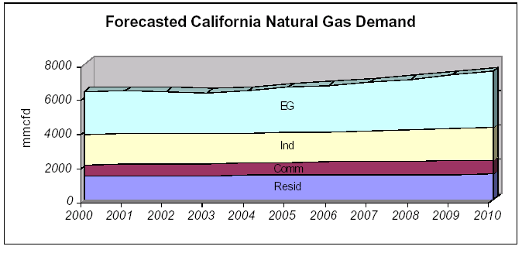
Growing California Markets for Natural Gas
California’s natural gas use will increase from 6,400 MMcfd in 2000 to 7,500 MMcfd in 2010
110,000 MMcfd annual average increase (NEED TO VERIFY)
2.5% projected annual average demand growth for electric generation
All expansion activity based upon long-term, firm transportation contracts
Source: California Energy Commission

Slide 12
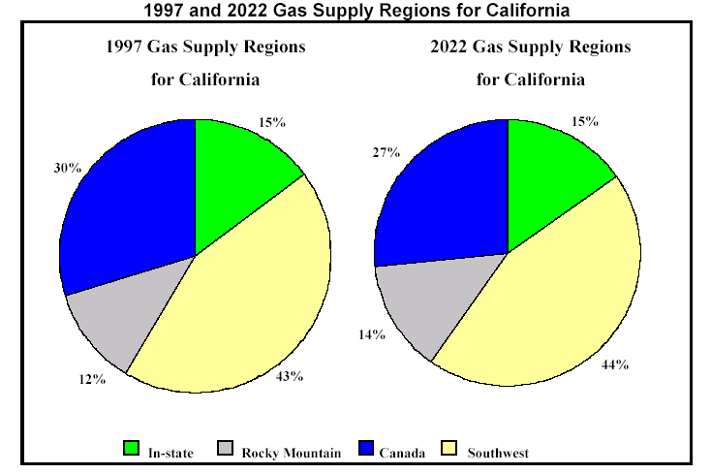
California Demand for Southwest Supplies
Source: California Energy Commission

Slide 13
Growing Power Generation Markets for Natural Gas
Arizona, New Mexico and Nevada
Existing Generation Mix
24,204 MW
2009 Generation Mix
35,967 MW
24%
Gas
49%
Gas
Hydro
Coal
Nuclear
Oil
Gas
Source: ????

Slide 14
San Juan Basin Forecast
Basin production peaked in 1999 at 4.3 Bcfd
2.4% decline by 2010 to 3.5 Bcfd
Transwestern is positioned to supplement its San Juan lateral supplies with Rockies gas via NWPL and TransColorado interconnects
Source: Lippman Consulting, Inc.

Slide 15
Permian and Anadarko Supplies Shift
Canadian Gas Flow
Impact on California
Decrease Canadian
Supplies to California
Increase Canadian
Supplies to Chicago
Canadian supplies shift to Mid-continent
Transwestern receives increased Permian and Anadarko supplies via East of Thoreau interconnects
Relieves excess capacity challenge in Northern California
MMBtu/d
Increase Rockies
to California
Decrease Permian & G.C.
Supplies to MidContinent
Increase Permian & Anadarko
to California

Slide 16
Competitive Environment
Other pipelines in market areas
  Deliverability at California border
  Comparative rates
Expansions
  Proposed expansions to California
  Transwestern expansion projects

Slide 17
Current Interstate Pipelines to California
PIPELINE | CAPACITY (MMcfd) | MAX DEMAND RATE AND FUEL | 2001 Average Throughput
PG&E-GTN | 1,930 | $.2628 + 2.21%
Kern River | 700 | $.7708 + 1.10%
Transwestern | 1,090 | $.3453 + 5.00%
El Paso | 3,320 | $.3600 + 3.47%
Total Delivery Capacity | 7,040
See Kim Watson

Slide 18
Proposed Expansions to California
Filed with FERC
WA
PGT
200,000 MMBtu/d
Kern
OR
Southern Trails
ID
WY
EPNG
NV
TWPL
1,010,000 MMBtu/d
UT
CO
CA
120,000 MMBtu/d
150,000 MMBtu/d
OK
AZ
NM
230,000 MMBtu/d
TX

Slide 19
Proposed Expansions to California
Project | Status | In-Service | Volume (mmbtu/d) | Primary Market
EPNG | Certificate Issued | Aug, 2001 | 230,000
PGT (Phase I) | Certificate Issued | Nov, 2001 | 200,000
Kern River | Certificate Issued | May, 2002 | 125,000
TW Red Rock | Certificate Issued | June, 2002 | 120,000
Southern Trails | Certificate Issued | July, 2002 | 120,000
Kern River | Filed with FERC | May, 2003 | 885,000
Sonoran (Phase I) | Announced | Summer, 2003 | 750,000
EPNG | Announced | Summer, 2003 | 320,000
PGT | Announced | Nov, 2003 | 400,000
CIG Ruby | Announced | Dec, 2003 | 750,000
TW Sun Devil | Announced | Jan, 2004 | 330,000
TOTAL |  |  | 4,230,000
See Kim Watson
Note: Needs to mention CA take away & bottleneck at the border

Slide 20
Red Rock Expansion
Incremental 120,000/d delivered to California & Arizona for 1.210 Bcf/d total deliveries West
106,700/d subscribed, resulting in 17.2% ROE (15.5% DCF)
Additional ?? HP at Stations 1, 2 &3
Supplies from Permian & Anadarko basins
In-service June, 2002
Cost = $93 million; funded from free cash flow
Key Shippers
  PPL
  Calpine
  BP Energy
  Western
  Frito Lay
Nevada
Utah
Colorado
California
1
2
3
New Mexico
Arizona
Texas

Slide 21
TransPecos Project
Nevada
Utah
Colorado
NNG
California
Kansas
New Mexico
Arizona
TWPL
Oklahoma
TransPecos
Texas
Proposed TW joint venture with Kinder Morgan
176 mile, 24” pipeline from Ward County, TX to Hudspeth County, TX
311,000/d capacity to serve Mexican markets
$130.9 million capital expenditure
Negotiating 240,000/d, 20 year firm contract with Pemex at $0.261
Provides Pemex with supply diversity for growing load
NGPL

Slide 22
Sun Devil Project
Nevada
Utah
Colorado
California
Kansas
Arizona
New Mexico
TWPL
Oklahoma
Sun Devil
Phoenix
New supply to new markets
$911 million capital cost
New 500 mmcfd capacity to Phoenix
+780,000/d Blanco to Thoreau on TW
+330,000/d to CA border on TW
New pipe and “linear storage”
Key shippers include:
  Panda
  Arizona Public Service
Texas

Slide 23
Revenue Generation
Sources of income
Breakdown of sources (relative %)
Top shippers ($, volume, contract tenor)
Highlights of FT contract structure
Historical breakdown of FT/IT

Slide 24
Transportation Demand Margin Growth
Total transportation margin increased 10% in 2001 due to ????
$130
Million
Demand
$137
Million
Demand
$146
Million
Demand
See Kim Watson

Slide 25
2002 Gross Margin by Type
Operational
Gas Sales
16%
Demand
80%
New Contracts
& Commodity
4%

Slide 26
Top 10 Customers by Revenue in 2001
Company | Revenue | 2001%
Southern California Gas Company | $53,341,529
Texaco | $16,539,329
Pacific Gas & Electric | $16,001,629
Sempra | $14,294,836
BP Energy | $10,990,113
Duke Energy | $7,621,234
El Paso Energy | $7,198,942
Burlington Resources | $5,170,685
Agave | $4,741,447
USGT | $4,672,449
Subtotal | $140,572,193
Total 2001 Revenue | $???? | 100%
See Jim Saunders or Gary Zahn

Slide 27
Firm Transportation Contract Structure
Definitions
  Firm Transportation: Guaranteed 365 days a year. Service cannot be interrupted except for an event of force majeure.
  Maximum Daily Transportation Quantity (MDQ): Amount of pipeline capacity reserved for shipper on firm basis.
  Demand (or Reservation) charge: The rate multiplied by the MDQ to derive the amount to be paid to Transwestern for the term of the agreement, regardless of usage.
  Commodity (Usage charge: The rate multiplied by the quantity actually scheduled for transportation each day under the agreement.
  Term: The start and end date of the agreement
Character of Service
  The shipper under a firm transportation service agreement “owns” the capacity (its MDQ) on Transwestern’s system. Transwestern reserves such capacity for the shipper as well as guaranteeing delivery of gas scheduled under the agreement. In exchange for this reservation and guarantee of service, the shipper pays Transwestern a demand charge for such capacity whether or not it is utilized.

Slide 28
Capacity Subscription Level By Segment
Weighted average contract term of nearly 9 years
Mainline West 85% subscribed on average through 2005
Blanco to Thoreau 93% subscribed on average through 2005
% of Revenue

Slide 29
Increasing Load Factors & Throughput Growth
West 98%
East 68%
West 90%
East 61%
West 89%
East 63%

Slide 30
Marketing Strategy
Risk Management
Manage operational gas sales, incorporating price hedges or selling month-to-month as necessary, to generate incremental revenue
Determine optimum mix of index to index & fixed rates for re-subscription of capacity to generate additional income
Projected 92% average west throughput of 1.044 Bcfd (excluding Red Rock construction outages)
  Manage commodity risk through weather hedges, if possible
Minimize risk under existing or new services:
  Operational & financial management of gas inventory
  Manadatory OBA cash-out in constrained areas
  Scheduling alternate FT by price
  Charge a fee for restructured pooling services

Slide 31
Marketing Strategy (continued)
Capacity Re-subscription Negotiations
Negotiate rollover of ROFR contracts prior to trigger dates
Maximize opportunities for incremental 50,000/d take-away at Needles
Continue expansion strategy to enhance supply/market access
Virtual expansion via NNG to create West Texas capacity

Slide 32
Current Regulatory Regime
Transwestern’s current transportation environment has been shaped by three major regulatory rate filings, as reflected in TW’s currently effective FERC tariff
  TW’s 1993 Rate Case Settlement (Docket Nos. RP93-34, et.al)
  TW’s 1995 Global Settlement (Docket No. RPP95-271-000)
  TW’s 1996 Mini Settlement (Docket Nos. RP95-271, et.al.)

Slide 33
Rate Case Overview
Rate Method
  Transwestern’s currently effective tariff rates implemented under the 1993 Rate Case Settlement use the Straight Fixed Variable (SFV) rate design mandated by FERC Order No. 636
  Transwestern also has in effect its Settlement Base Rates (SBR), which were implemented under its Global and Mini- Settlements (Docket Nos. RP95-271, et.al.). The SBRs are applicable to seven specific shippers, identified in the Global and Mini- Settlements as “Current Firm Customers” or “CFC.”
Current Rate Structure – Revenue Requirement
  Transwestern’s current revenue requirement was established under Docket No. RP93-34 and amended by Docket Nos. RP95-271, et.al. is as follows:
      Adjusted FTS-1 Reservation Charge Revenue $134.8
      FTS-1 Commodity Charge Revenue $ 5.9
      ITS-1 (Allocated from FTS-1 Demand) $ 6.1
      Total Revenue Requirement $146.8
      * NOTE: The parties to the Global and Mini- Settlements did not stipulate to the Cost of Service underlying the Settlement Base Rates.

Slide 34
Rate Case Overview (con’t)
1993 Rate Case Settlement
  FERC approved March 30, 1994
  SFV Rate Design
  Additive zone based rates by path (see table 1)
  Rates effective April 1, 1994
  General rate increase moratorium until November 1, 1996
  Next rate case to be effective no later than April 1, 1998

Slide 35
Rate Case Overview (con’t)
1995 Global Settlement
  FERC approved July 27, 1995
  Established Settlement Base Rates (SBR) applicable to specified Current Firm Customers (see table 2) for the term of each CFC’s service agreement, subject to an escalation factor beginning November 1, 1998
  Resolved (1) Southern California Gas Company’s (SoCal) turnback capacity (457,281 MMBtu) costs; (2) all issues pertaining to the recovery of take-or-pay costs; (3) all issues with respect to the then pending certificate proceedings (which included abandonment of gathering facilities); and (4) issues related to the Commission’s mandated SFV Rate Design under Order No. 636
  Settlement Base Rates effective November 1, 1996
  Established a Shared Cost Surcharge for CFCs to recover the following percentages of turnback capacity costs:
    50% TW/50% CFC from Nov. 1, 1996 through Oct. 31, 1997
    75% TW/25% CFC from Nov. 1, 1997 through Oct. 31, 2001
    100% TW/0% CFC from Nov. 1, 2001 forward (TW absorbs entire costs)
  Next rate filing to be effective no later than November 1, 2006

Slide 36
Rate Case Overview (con’t)
1995 Mini Settlement
  FERC approved October 16, 1996
  Same term as Global Settlement
  Issues involved:
    Resolved all issues involving recovery of un-recovered Purchase Gas Adjustment Costs
    Adjusted and finalized all issues relating to take-or-pay, buy-out, buy-down, and contract reformation costs
    Reduced the depreciation of Mainline transmission facilities from 1.7% to 1.2%, effective January 1, 1996
    Provided a rate adjustment to the Global Settlement Base Rates
    Established an Amortization Mechanism for certain costs

Slide 37
Rate Case Overview (con’t)
Next Rate Case – Expected changes
  A general rate case filing must be filed to become effective no later than November 1, 2006
  All remaining Current Firm Customers’ service agreements will expire within six months of the effective date of the next rate case
  Costs allocations could be affected by any imposed FERC rulings
Regulatory Trends/Outlook
  FERC Order No. 637: Transwestern currently has a compliance filing pending at the FERC
    The major issues include segmenting and mandatory cash-outs for imbalances

Slide 38
TABLE 1: 1993 Rate Case Settlement – Maximum Transportation Tariff Rate Matrix

Slide 39
TABLE 2: 1995 Global Settlement – Base Rates as Adjusted by 1996 Mini-Settlement

