Slide 1
Transwestern Pipeline Company
Rating Agency Presentation
February 2002

Slide 2
Table of Contents

Slide 3
OVERVIEW

Slide 5
HISTORY OF TRANSWESTERN PIPELINE COMPANY
In 1958 Texas Eastern received the FPC certificate to proceed with the construction of the Transwestern system. In 1959-1960 approximately 644 miles of 30” pipe was constructed along with stations #3, #5, #7, and #9 as TW’s mainline core. During that same period the West Texas lateral was constructed which included about 166 miles of 24” pipe and WT-1 station. In 1967, stations #1, #2, #4, #6, and #8 were constructed as well as new units at stations #3, #5, #7, and #9. Also in 1967 the West Texas lateral was expanded with a new station WT-2 and a unit added to WT-1. The West Texas lateral was expanded by adding 76 miles of 24” and 36” loop from 1965 to 1972. In 1968 about 18 miles of 30” loop was installed on the mainline and in 1969 approximately 281 more miles of 30” was added. During the beginning of construction, a third line named the Panhandle lateral was being built which consisted of 290.7 miles of 24” pipe. In 1969, P-3 was constructed on the Panhandle lateral. Stations P-1, P-2, & P-3 addition was completed in 1982.
The Transwestern system capacity progressed from 350 MMcf/d to 750 MMcf/d through all of the above construction phases. In 1991, a major expansion was completed which included two new laterals, one into the San Juan Four-Corners, NM area consisting of 96.8 miles of 30” pipe for a capacity of 520 MMcf/d and the other into Topock, CA with a capacity of 400 MMcf/d through 18.4 miles of 24” pipe. The mainline was also expanded by 340 MMcf/d for a total west capacity of 1090 MMcf/d by completing the loop lines from the San Juan junction to 4 miles east of the California border. The San Juan lateral was enhanced several times since 1991 to it’s current capacity 0f 850 MMcf/d. It was extended into Colorado in 1996 with the purchase of about 33 miles of 30” pipe and the La Plata CS. Total system capacity to California remains at 1090 MMcf/d with the San Juan lateral at 850 MMcf/d into the mainline.
Current plans are to expand the mainline to 1210 MMcf/d by replacing the existing units at Stations #1, #2, and #3 to increase to horsepower. This will be in service mid 2002.

Slide 6
Historicals/Projections

Slide 7
STRATEGY
(Add 10 year plan assumptions here.)

Slide 8
Revolving Credit Agreement
$550 million, 364-day facility secured by pipeline assets and pledge of stock; LIBOR + 250
Guaranteed by ENE; amendment forthcoming
Fully drawn on Nov. 13, 2001
Proceeds loaned to ENE (unsecured claim)
Key Covenants
Kevin to fill in
Events of Default
Restructured payments
Default under ENE revolving credit facility
Minimum consolidation tangible net worth of $750 million
Current “Ring Fencing” of cash prohibits all loans/distributions

Slide 9
Liquidity
Additional borrowing capacity of $
Excess cash flow per month ??
Pre-Red Rock in-service $??
Post-Red Rock in-service $??
Projected cash balances
$?? at June 30, 2002
$?? at Sept. 30, 2002
$?? at Dec. 31, 2002

Slide 10
Enron Restructuring Plan
Stephen Cooper named interim CEO and Chief Restructuring Officer
Develop and implement comprehensive restructuring plan for Enron (Isn’t this the impetus of the slide?)
Renewed focus on hard assets with predictable revenues and cash flows
Leverage commercial, regulatory and operational expertise
Continued growth in Enron’s pipelines
See Steve Young
Access to capital for regulated pipelines driven by current credit ratings

Slide 11
Bankruptcy Remote Structure
Enron Transportation Services
Wilmington Trust Company
100%
Voting Trustee
Transwestern Holding Company, Inc
200 shares of common stock
TPC Voting Trust
800 shares of common stock
Pledge of TW stock
Lenders
Transwestern Pipeline Company

Slide 12
Key Terms and Conditions Voting Trust Agreement
200 shares of TW held in voting trust
Trust is a Delaware statutory business trust
Voting trust stock and remaining TW stock pledged to paying agent
Voting trustee shall vote to disapprove of the following:
Certain changes to TW’s Certificate of Incorporation
Merger/consolidation; sale/lease of all TW assets
Dissolve/liquidate TW; file voluntary bankruptcy
Authorization/issuance of additional common stock of TW
Voting trust agreement and stock pledge agreement shown in Appendix

Slide 13
Industry Environment
Market area trends
California markets
Arizona, New Mexico and southern Nevada markets
Supply area trends
San Juan Basin
Permian and Anadarko Basins

Slide 14
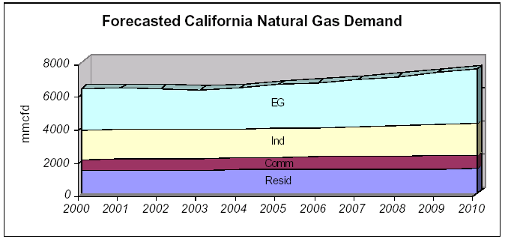
Growing California Markets for Natural Gas
California’s natural gas use will increase from 6,400 MMcfd in 2000 to 7,500 MMcfd in 2010
110 MMcfd annual average increase
2.5% projected annual average demand growth for electric generation
All expansion activity based upon long-term, firm transportation contracts
Source: California Energy Commission

Slide 15
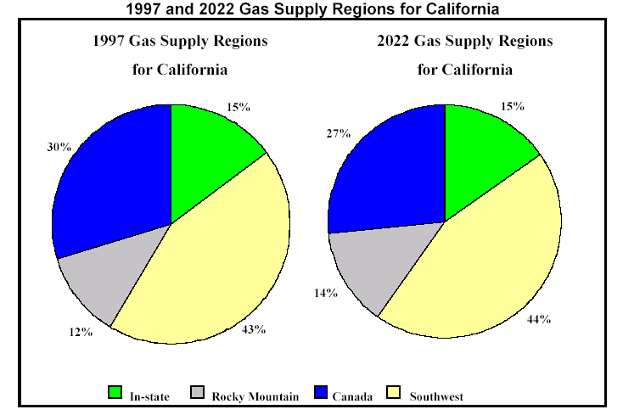
California Demand for Southwest Supplies
Source: California Energy Commission

Slide 16
Growing Power Generation Markets for Natural Gas Arizona, New Mexico and Nevada
Existing Generation Mix
24,204 MW
2009 Generation Mix
35,967 MW
24%
Gas
49%
Gas
Hydro
Coal
Nuclear
Oil
Gas
Source: Arizona Corporation Committee

Slide 17
San Juan Basin Forecast
Basin production peaked in 1999 at 4.3 Bcfd
22% decline by 2010 to 3.5 Bcfd, 2.4% per year
Transwestern is positioned to supplement its San Juan lateral supplies with Rockies gas via NWPL and TransColorado interconnects
Source: Lippman Consulting, Inc.

Slide 18
Permian and Anadarko Supplies Shift
Canadian Gas Flow
Impact on California
Decrease Canadian
Supplies to California
Increase Canadian
Supplies to Chicago
Canadian supplies shift to Mid-continent
Transwestern receives increased Permian and Anadarko supplies via East of Thoreau interconnects
Relieves excess capacity challenge in Northern California
MMBtu/d
Increase Rockies
to California
Decrease Permian & G.C.
Supplies to MidContinent
Increase Permian & Anadarko
to California

Slide 19
Competitive Environment
Other pipelines in market areas
Deliverability at California border
Comparative rates
Expansions
Proposed expansions to California
Transwestern expansion projects

Slide 20
Current Interstate Pipelines to California
PIPELINE | CAPACITY (MMcfd) | MAX DEMAND RATE AND FUEL | 2001 Average Throughput (MMBtu)
PG&E-GTN | 1,930 | $.2628 + 2.21%
Kern River | 700 | $.7708 + 1.10%
Transwestern | 1,090 | $.3453 + 5.00% | 1,837
El Paso | 3,320 | $.3600 + 3.47%
Total Delivery Capacity | 7,040

Slide 21
Proposed Expansions to California Filed with FERC
WA
PGT
200,000 MMBtu/d
Kern
OR
Southern Trails
ID
WY
EPNG
NV
TWPL
1,010,000 MMBtu/d
UT
CO
CA
120,000 MMBtu/d
150,000 MMBtu/d
OK
AZ
NM
230,000 MMBtu/d
TX

Slide 22
Proposed Expansions to California
Project | Status | In-Service | Volume (mmbtu/d)
EPNG | Certificate Issued | Aug, 2001 | 230,000
PGT (Phase I) | Certificate Issued | Nov, 2001 | 200,000
Kern River | Certificate Issued | May, 2002 | 125,000
TW Red Rock | Certificate Issued | June, 2002 | 120,000
Southern Trails | Certificate Issued | July, 2002 | 120,000
Kern River | Filed with FERC | May, 2003 | 885,000
EPNG | Announced | Summer, 2003 | 320,000
PGT | Announced | Nov, 2003 | 400,000
CIG Ruby | Announced | Dec, 2003 | 750,000
TW Sun Devil | Announced | Jan, 2004 | 330,000
TOTAL |  |  | 3,480,000

Slide 23
Red Rock Expansion
Incremental 120,000/d delivered to California & Arizona for 1.210 Bcf/d total deliveries West
106,700/d subscribed, resulting in 17.2% ROE (15.5% DCF)
Additional ?? HP at Stations 1, 2 &3
Supplies from Permian & Anadarko basins
In-service June, 2002
Cost = $93 million; funded from free cash flow
Key Shippers
PPL Energy
Calpine
BP Energy
Western Gas Resources
Frito Lay
Nevada
Utah
Colorado
California
1
2
3
New Mexico
Arizona
Texas

Slide 24
TransPecos Project
Nevada
Utah
Colorado
NNG
California
Kansas
New Mexico
Arizona
TWPL
Oklahoma
TransPecos
Texas
Proposed TW joint venture with Kinder Morgan
176 mile, 24” pipeline from Ward County, TX to Hudspeth County, TX
311,000/d capacity to serve Mexican markets
$130.9 million capital expenditure
Negotiating 240,000/d, 20 year firm contract with Pemex at $0.261
Provides Pemex with supply diversity for growing load
NGPL

Slide 25
Sun Devil Project
Nevada
Utah
Colorado
California
Kansas
Arizona
New Mexico
TWPL
Oklahoma
Sun Devil
Phoenix
New supply to new markets
$911 million capital cost
New 500 mmcfd capacity to Phoenix
+780,000/d Blanco to Thoreau on TW
+330,000/d to CA border on TW
New pipe and “linear storage”
Key shippers include:
Panda
Arizona Public Service
Texas

Slide 26
OTHER POTENTIAL EXPANSIONS
(Add bullets on expansions assumed in 10 year plan here.)

Slide 27
Revenue Generation
Sources of income
Breakdown of sources (relative %)
Top shippers ($, volume, contract tenor)
Highlights of FT contract structure
Historical breakdown of FT/IT

Slide 28
Transportation Demand Margin Growth
Total transportation margin increased 10% in 2001 due to capitalizing on market volatility
$130
Million
Demand
$137
Million
Demand
$146
Million
Demand

Slide 29
2002 Gross Margin by Type
Operational
Gas Sales
16%
Demand
80%
New Contracts
& Commodity
4%

Slide 30
Top 10 Customers by Revenue in 2001
Company | Revenue | 2001%
Southern California Gas Company | $53,341,529 | 30%
Texaco | $16,539,329 | 9%
Pacific Gas & Electric | $16,001,629 | 9%
Sempra | $14,294,836 | 8%
BP Energy | $10,990,113 | 6%
Duke Energy | $7,621,234 | 4%
El Paso Energy | $7,198,942 | 4%
Burlington Resources | $5,170,685 | 3%
Agave | $4,741,447 | 3%
USGT | $4,672,449 | 3%
Subtotal | $140,572,193 | 78%
Total 2001 Revenue | $179,447,244 | 100%

Slide 31
Firm Transportation Contract Structure
Definitions
Firm Transportation: Guaranteed 365 days a year. Service cannot be interrupted except for an event of force majeure.
Maximum Daily Transportation Quantity (MDQ): Amount of pipeline capacity reserved for shipper on firm basis.
Demand (or Reservation) charge: The rate multiplied by the MDQ to derive the amount to be paid to Transwestern for the term of the agreement, regardless of usage.
Commodity (Usage charge: The rate multiplied by the quantity actually scheduled for transportation each day under the agreement.
Term: The start and end date of the agreement
Character of Service
The shipper under a firm transportation service agreement “owns” the capacity (its MDQ) on Transwestern’s system. Transwestern reserves such capacity for the shipper as well as guaranteeing delivery of gas scheduled under the agreement. In exchange for this reservation and guarantee of service, the shipper pays Transwestern a demand charge for such capacity whether or not it is utilized.

Slide 32
Capacity Subscription Level By Segment
Weighted average contract term of nearly 9 years
Mainline West 85% subscribed on average through 2005
Blanco to Thoreau 93% subscribed on average through 2005
% of Capacity Subscribed

Slide 33
Increasing Load Factors & Throughput Growth
West 98%
East 68%
West 90%
East 61%
West 89%
East 63%

Slide 34
Marketing Strategy
Risk Management
(Add strategy from 10 year plan here.)

Slide 35
Marketing Strategy (continued)
Capacity Re-subscription Negotiations
(Add strategy from 10 year plan here.)

Slide 36
Current Regulatory Regime
Transwestern’s current transportation environment has been shaped by three major regulatory rate filings, as reflected in TW’s currently effective FERC tariff
TW’s 1993 Rate Case Settlement (Docket Nos. RP93-34, et.al)
TW’s 1995 Global Settlement (Docket No. RPP95-271-000)
TW’s 1996 Mini Settlement (Docket Nos. RP95-271, et.al.)
(Add rate assumptions from 10 year plan here.)

Slide 37
Rate Case Overview
Rate Method
Transwestern’s currently effective tariff rates implemented under the 1993 Rate Case Settlement use the Straight Fixed Variable (SFV) rate design mandated by FERC Order No. 636
Transwestern also has in effect its Settlement Base Rates (SBR), which were implemented under its Global and Mini- Settlements (Docket Nos. RP95-271, et.al.). The SBRs are applicable to seven specific shippers, identified in the Global and Mini- Settlements as “Current Firm Customers” or “CFC.”
Current Rate Structure – Revenue Requirement
Transwestern’s current revenue requirement was established under Docket No. RP93-34 and amended by Docket Nos. RP95-271, et.al. is as follows:
Adjusted FTS-1 Reservation Charge Revenue $134.8
FTS-1 Commodity Charge Revenue $ 5.9
ITS-1 (Allocated from FTS-1 Demand) $ 6.1
Total Revenue Requirement $146.8
* NOTE: The parties to the Global and Mini- Settlements did not stipulate to the Cost of Service underlying the Settlement Base Rates.

Slide 38
Rate Case Overview (con’t)
1993 Rate Case Settlement
FERC approved March 30, 1994
SFV Rate Design
Additive zone based rates by path (see table 1)
Rates effective April 1, 1994
General rate increase moratorium until November 1, 1996
Next rate case to be effective no later than April 1, 1998

Slide 39
Rate Case Overview (con’t)
1995 Global Settlement
FERC approved July 27, 1995
Established Settlement Base Rates (SBR) applicable to specified Current Firm Customers (see table 2) for the term of each CFC’s service agreement, subject to an escalation factor beginning November 1, 1998
Resolved:
Southern California Gas Company’s (SoCal) turnback capacity (457,281 MMBtu) costs;
all issues pertaining to the recovery of take-or-pay costs;
all issues with respect to the then pending certificate proceedings (which included abandonment of gathering facilities); and
issues related to the Commission’s mandated SFV Rate Design under Order No. 636
Settlement Base Rates effective November 1, 1996
Established a Shared Cost Surcharge for CFCs to recover the following percentages of turnback capacity costs:
50% TW/50% CFC from Nov. 1, 1996 through Oct. 31, 1997
75% TW/25% CFC from Nov. 1, 1997 through Oct. 31, 2001
100% TW/0% CFC from Nov. 1, 2001 forward (TW absorbs entire costs)
Next rate filing to be effective no later than November 1, 2006

Slide 40
Rate Case Overview (con’t)
1995 Mini Settlement
FERC approved October 16, 1996
Same term as Global Settlement
Issues involved:
Resolved all issues involving recovery of un-recovered Purchase Gas Adjustment Costs
Adjusted and finalized all issues relating to take-or-pay, buy-out, buy-down, and contract reformation costs
Reduced the depreciation of Mainline transmission facilities from 1.7% to 1.2%, effective January 1, 1996
Provided a rate adjustment to the Global Settlement Base Rates
Established an Amortization Mechanism for certain costs

Slide 41
Rate Case Overview (con’t)
Next Rate Case – Expected changes
A general rate case filing must be filed to become effective no later than November 1, 2006
All remaining Current Firm Customers’ service agreements will expire within six months of the effective date of the next rate case
Costs allocations could be affected by any imposed FERC rulings
Regulatory Trends/Outlook
FERC Order No. 637: Transwestern currently has a compliance filing pending at the FERC
The major issues include segmenting and mandatory cash-outs for imbalances

Slide 42
TABLE 1: 1993 Rate Case Settlement – Maximum Transportation Tariff Rate Matrix

Slide 43
TABLE 2: 1995 Global Settlement – Base Rates as Adjusted by 1996 Mini-Settlement

Slide 44
(Financial Statements should follow here.)

