Slide 1
D R A F T
1/18/2002

Slide 2
Industry Environment
Market Area Trends
  California Markets
  Arizona, New Mexico and Southern Nevada Markets
Supply Area Trends
  San Juan Basin
  Permian and Anadarko Basins

Slide 3
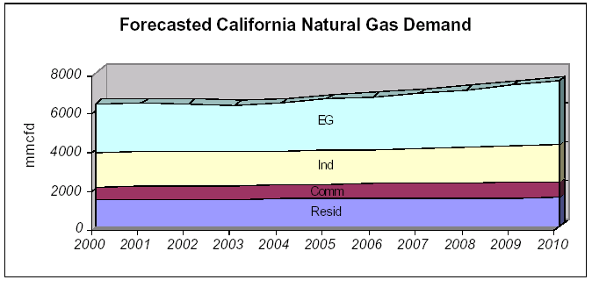
Growing California Markets for Natural Gas
California’s natural gas use will increase from
6,400 MMcfd in 2000 to 7,500 MMcfd in 2010
110,000 MMcfd annual average increase
2.5% projected annual average demand growth for
electric generation
Source: California Energy Commission

Slide 4
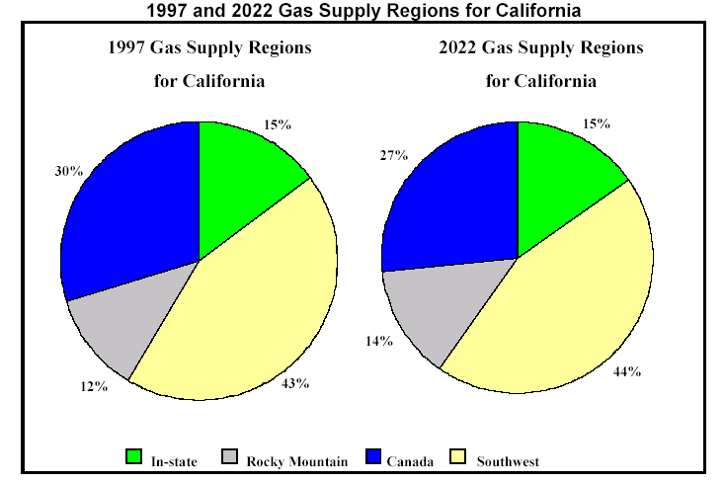
California Demand for Southwest Supplies
Source: California Energy Commission

Slide 5
Growing Power Generation Markets for Natural Gas
Arizona, New Mexico and Nevada
Existing Generation Mix
24,204 MW
2009 Generation Mix
35,967 MW
24%
Gas
49%
Gas
+11,815 MW
Hydro
Coal
Nuclear
Oil
Gas

Slide 6
San Juan Basin Forecast
Basin production peaked in 1999 at 4.3 Bcf/d
2.4% decline by 2010 to 3.5 Bcf/d
Transwestern is positioned to supplement its San Juan
lateral supplies with Rockies gas via NWPL and
TransColorado interconnects
Source: Lippman Consulting, Inc.

Slide 7
Permian and Anadarko Supplies Shift
Canadian Gas Flow
Impact on California
Decrease Canadian
Supplies to California
Increase Canadian
Supplies to Chicago
Canadian supplies
shift to
Mid-continent
Transwestern’s
receives increased
Permian and
Anadarko supplies
via East of Thoreau
pipeline
interconnects
MMBtu/d
Increase Rockies
to California
Decrease Permian & G.C.
Supplies to MidContinent
Increase Permian & Anadarko
to California

Slide 8
Competitive Environment
Other Pipelines in Market Areas
  Deliverability at California Border
  Comparative Rates
Expansions
  Proposed Expansions to California
  Transwestern Expansion Projects

Slide 9
Interstate Pipelines to California
PIPELINE | CAPACITY (MMcfd) | MAX DEMAND RATE AND FUEL
PG&E-GTN | 1,930 | $.2628 + 2.21%
Kern River | 700 | $.7708 + 1.10%
Transwestern | 1,090 | $.3453 + 5.00%
El Paso | 3,320 | $.3600 + 3.47%
Total Delivery Capacity | 7,040

Slide 10
Proposed Expansion to California
Filed with FERC
WA
200,000 MMBtu/d
PGT
Kern
OR
ID
Southern Trails
WY
EPNG
NV
TWPL
1,010,000 MMBtu/d
UT
CO
CA
120,000 MMBtu/d
150,000 MMBtu/d
OK
AZ
NM
230,000 MMBtu/d
TX

Slide 11
Proposed Expansions to California
Project | Status | In-Service | Volume
TW Red Rock | Certificate Issued | June, 2002 | 120,000/d
EPNG | Certificate Issued | August, 2001 | 230,000/d
PGT (Phase I) | Certificate Issued | November, 2001 | 200,000/d
Southern Trails | Certificate Issued | July, 2002 | 120,000/d
Kern River | Certificate Issued | May, 2002 | 125,000/d
Kern River | Filed with FERC | May, 2003 | 885,000/d
TW Sun Devil | Announced | January, 2004 | 330,000/d
Sonoran (Phase I) | Announced | Summer, 2003 | 750,000/d
EPNG | Announced | Summer, 2003 | 320,000/d
PGT | Announced | November, 2003 | 400,000/d
CIG Ruby | Announced | December, 2003 | 750,000/d
TOTAL |  |  | 4,230,000/d

Slide 12
Red Rock Expansion
Incremental 120,000/d delivered to
California & Arizona for 1.210 Bcf/d
total deliveries West
106,700/d subscribed, resulting in
17.2% ROE (15.5% DCF)
Additional hp at Stations 1, 2 & 3
Supplies from Permian & Anadarko
basins
In-service June, 2002
Nevada
Utah
Colorado
California
1
2
3
New Mexico
Arizona
Texas

Slide 13
TransPecos Project
Nevada
Utah
Colorado
NNG
California
Kansas
New Mexico
Arizona
TWPL
Oklahoma
TransPecos
Texas
Transwestern joint venture with Kinder Morgan
176 mile, 24” pipeline from Ward County, Texas
to Hudspeth County, Texas
311,000/d capacity to serve Mexico markets
$130.9 Million capital expenditure
Negotiating 240,000/d firm contract with Pemex
NGPL

Slide 14
Sun Devil Project
Nevada
Utah
Colorado
California
Kansas
Arizona
New Mexico
TWPL
Oklahoma
Sun Devil
Phoenix
New supply to new markets
$911 MM capital cost
New 500,000/d capacity to Phoenix
+780,000/d Blanco to Thoreau on TW
+330,000/d to CA border on TW
Texas

Slide 15
Revenue Generation
Sources of Income
Breakdown of Sources (relative %)
Top Shippers ($, volume, contract tenor)
Highlights of FT Contract Structure
Historical Breakdown of FT/IT

Slide 16
Transportation Demand Margin Growth
Total transportation margin increased 10% in 2001
$130
Million
Demand
$137
Million
Demand
$146
Million
Demand

Slide 17
2002 Gross Margin by Type
Operational
Gas Sales
16%
Demand
80%
New Contracts
& Commodity
4%

Slide 18
Top 10 Customers by Revenue in 2001
Southern California Gas Company | $53,341,529
Texaco | $16,539,329
Pacific Gas & Electric | $16,001,629
Sempra | $14,294,836
BP Energy | $10,990,113
Duke Energy | $7,621,234
El Paso Energy | $7,198,942
Burlington Resources | $5,170,685
Agave | $4,741,447
USGT | $4,672,449

Slide 19
Firm Transportation Contract Structure
Definitions:
  Firm Transportation. Guaranteed 365 days a year. Service cannot be interrupted except for an event of force majeure.
  Maximum Daily Transportation Quantity (MAXDTQ). Amount of pipeline capacity reserved for Shipper on a firm basis.
  Demand (or Reservation) Charge. The rate multiplied by the MAXDTQ to derive the amount to be paid to Transwestern for the term of agreement, regardless of usage.
  Commodity (Usage) Charge. The rate multiplied by the quantity actually scheduled for transportation each day under the agreement.
  Term. The start and end date of the agreement.
Character of Service:
  The Shipper under a Firm Transportation Service Agreement “owns” the capacity (its MAXDTQ) on Transwestern’s system. Transwestern reserves such capacity for the Shipper as well as guaranteeing delivery of gas scheduled under the agreement. In exchange for this reservation and guarantee of service, the Shipper pays Transwestern a demand charge for such capacity whether or not it’s utilized.

Slide 20
Capacity Subscription Level By Segment
Weighted average contract term of nearly 9 years
Mainline West 85% subscribed on average through 2005
Blanco to Thoreau 93% subscribed on average through 2005

Slide 21
Increasing Load Factors & Throughput Growth
West 98%
East 68%
West 90%
East 61%
West 89%
East 63%

Slide 22
Marketing Strategy
Risk Management
Manage operational gas sales, incorporating price hedges or selling month-to-month as necessary, to generate incremental revenue
Determine optimum mix of index to index & fixed rates for resubscription of capacity to generate additional income
Projected 92% average west throughput of 1.044 Bcf/d (excluding Red Rock construction outages) - manage commodity risk through weather hedges if possible
Minimize risk under existing or new services:
    - Operational & financial management of gas inventory
    - Mandatory OBA cash-out in constrained areas
    - Scheduling alternate FT by price
    - Charge a fee for restructured pooling service

Slide 23
Marketing Strategy (continued)
Capacity Resubscription Negotiations
Negotiate rollover of ROFR contracts prior to trigger dates
Maximize opportunities for incremental 50,000/d take-away at Needles
Continue expansion strategy to enhance supply/market access
Virtual expansion via NNG to create West Texas capacity

