Slide 1
Rates & Revenue Project Kickoff
October 12, 2001

Slide 2
Rates & Revenue Project Kickoff
Introduction
Objectives
System Interfaces
Development Process
Requirements & Testing
Timeline

Slide 3
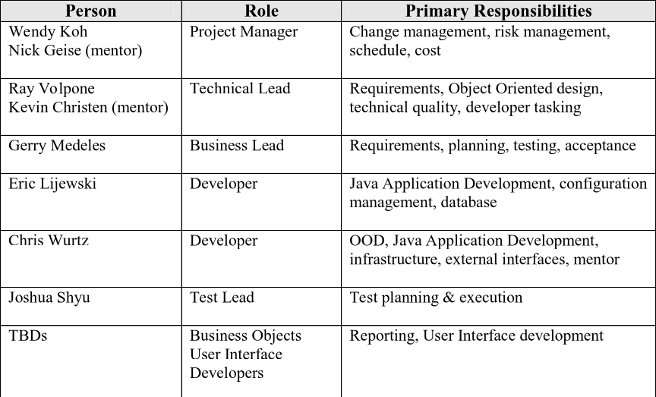
Introduction

Slide 4
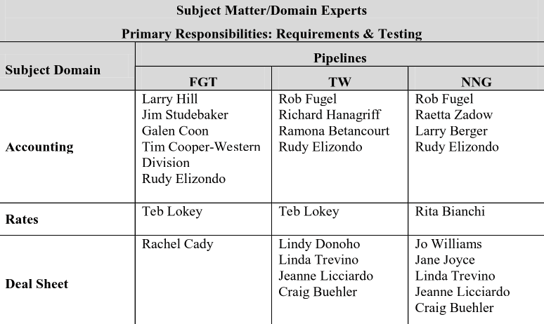
Introduction

Slide 5
Objectives
High Level Functionality
Rates & discounts maintenance & calculations
Reservation Invoicing
Commodity Invoicing
Variance Invoicing
Invoicing for overrides & corrections
Allocations
Cash In/Cash Out processing
Deal sheet for automation of standard deals

Slide 6
System Interfaces
TMS
PLE
CMS
CRS
Business
Objects
RRS
Deal
Sheet
MFE
PGAS
Internet
Postings
SAP

Slide 7
Objectives
Benefits
Migrate towards common processes & practices
Migrate to paperless environment
Provide greater flexibility for new services & regulatory changes
Improve audit controls by reducing manual efforts
Improve cash flow through flexibility in billing cycles
Reduce IT support costs through common technology

Slide 8
Development Process
Different approach to software development
Adopted the Unified Process (UP)
Shorter cycles (iterations) to develop functionality
Continuous feedback from users during each iteration

Slide 9
Timeline
FGT
Inception Phase
Elaboration Phase (I 1-3)
Construction Phase
Transition Phase
Go Live
TW
Elaboration Phase
Construction Phase
Transition Phase
NNG
Elaboration Phase
Construction Phase
Transition Phase
Start End
Feb 2001 March 2001
Oct 2001 Jan 2002
Feb 2002 July 2002
August 2002 August 2002
September 2002
2nd Qtr 2002
4th Qtr 2002
3rd Qtr 2002
2003

Slide 10
Requirements & Testing
Elaboration Iteration 1
Requirements 10/1 – 10/5
Testing 10/23 – 10/29
11/1 – 11/7
Elaboration Iteration 2
Requirements 11/14 – 11/20
Testing 11/26 – 11/30
12/5 – 12/11
Elaboration Iteration 3
Requirements 12/18 – 12/26
Testing 1/7 – 1/11
1/16 – 1/22

