Slide 1
MISO/Alliance Companies’ RTO Status Reports
Presented by:
Joseph Power
Tony Ingram
Rahim Amerkhail
Patrick Clarey

Slide 2
Illinois Power Settlement
Maintain financial viability of MISO
Preserve Alliance business model
Foster seamless market between both entities

Slide 3
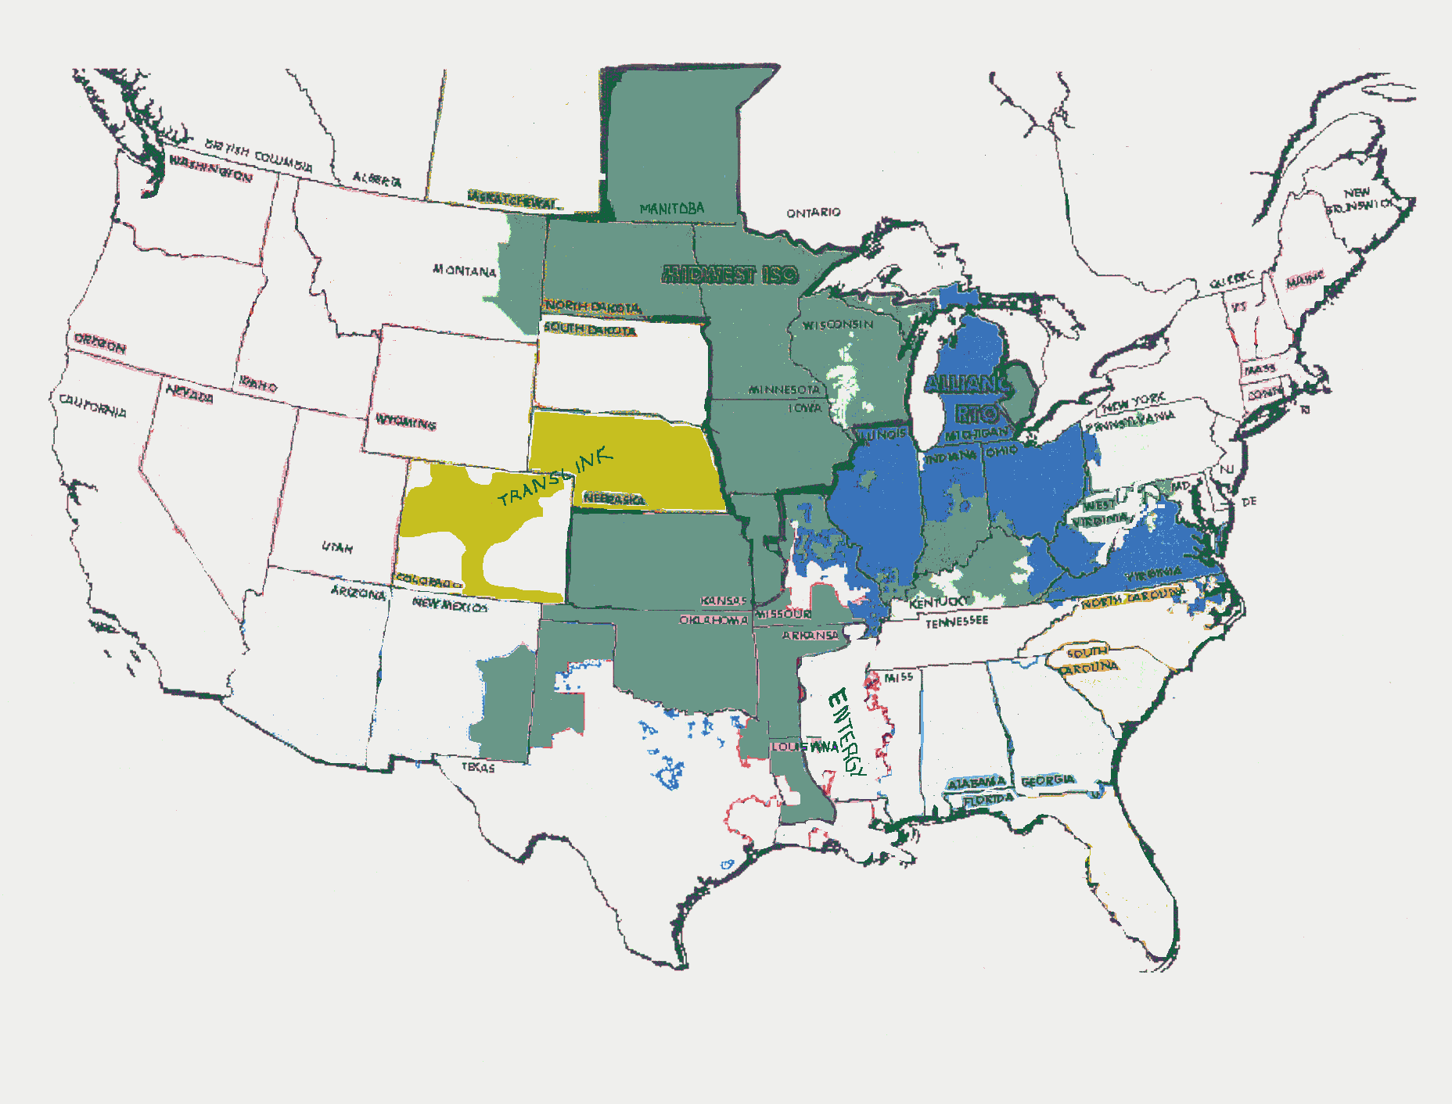

Slide 4
ATC Coordination
Requires development of a standardized process to determine ATC within the region
MISO, Alliance and SPP will calculate ATC and TTC using similar (not identical) methods. Each will exchange information on an hourly basis to be used by each entity for determination of ATC

Slide 5
Security Coordination
Requires implementation of mechanisms to share security information and to work toward an agreement for reliability redispatch
Framework established whereby security information will flow over existing infrastructures

Slide 6
One-Stop Shopping
Calls for facilitation of one-stop shopping for transmission service
MISO, Alliance, GridSouth, PJM, SPP and TVA agree on a common approach to electronically coordinate schedules between RTOs

Slide 7
One-Stop Shopping (cont.)
Detailed protocols still need to be developed and agreed upon, initially one-stop shopping will only be available for hourly and daily non-firm service

Slide 8
Congestion Management
Requires development of an open and accessible electronic bulletin board system for posting congestion management information
Have agreed on Day one to use MISO's bulletin board for posting congestion information

Slide 9
Congestion (cont.)
MISO continues to develop its Day one congestion management procedures and will complete these soon - Both parties continue to discuss Day 2 congestion management procedures

Slide 10
Imbalance Markets
Requires the proposed RTOs to cooperate in developing their imbalance markets to ensure compatibility for multi-RTO transactions
MISO and Alliance did not develop a common energy imbalance market, they maintain that they are compatible

Slide 11
Transmission Planning
Requires coordination of long-term transmission planning to ensure compatibility of planning across the region
RTO transmission planning committee formed
Two planning sub-committees will be formed once operational to coordinate long-term planning activities

Slide 12
Planning (cont.)
Final procedures for these committees will be developed by early December and the committees are expected to be functional early next year

Slide 13
Market Monitoring
Requires joint market monitoring
Has been expanded to include SPP and a single entity to provide joint market monitoring for the three has been appointed
Final monitoring plan due to be filed soon

Slide 14
Super-Region Rate
Illinois Power Settlement calls for elimination of multiple access charges within the region - Each entity has filed a super-region rate proposal in their respective pending “RT” dockets

Slide 15
MISO Systems
Approximately $160 million spent to become operational
Staff assembled that is capable of assuming operational control of transmission facilities by 12/15
Physical infrastructure in place and market trials of its integrated systems have been completed

Slide 16
Alliance Systems
Will not be operational by December 15th
Can be operational 90-120 days upon final approval of their proposed RTO
Various systems (billing, ATC and loss calculations) in place and being tested

Slide 17
Alliance Systems (cont.)
Other systems on hold until National Grid and business plan are approved and market design decisions can resume
Staffing incomplete

