Slide 1
Seattle
Powder River
Portland
Wind River
Clay Basin
Denver
CIG
Salt Lake City
CIG/PSCO Storage
Foothills
Kern River
KN
Northern Bord
NWPL
Overthrust
PGT
Questar
Las Vegas
Trailblazer
Raton Basin
TransCanada
TransColorado
WBI
WIC
San Juan Basin
SJ Basin
Susan Scott

Slide 2
ROCKIES MAP
Pacific NW
Powder River
Wind River
Kemmerer
Glenrock
Mid-Continent
Opal Plant
Salt Lake City
Clay Basin
Cheyenne Hub
Denver
CIG/PSCO Storage
Kit Carson
CA/NV
Raton Basin
CIG
KERN
Over Thrust
SJ Basin
WIC
KN
NWPL
Trailblazer
Questar
Transcolorado

Slide 3
EASTERN ROCKIES
NNG/Ventura -.40
WBI
80-90
Elk Basin
WBI/MPC Storage
Powder River
85 - 100
~125 – 175 Injection
Wind River
Glenrock
220
NGPL/Gage…A-ML…Beatrice
50 - 100
Medicine Bow
Opal Plant
Lost Creek
20 - 40
120
110
435
150
85
Kanda
100
277
300
Cheyenne Hub
550
Clay Basin
150
360
170
~250 Injection
Into PSCO
Variable Rates
Denver
CIG/PSCO Storage
CIG
FH
3.89% + .025
550
~120 Injection
Uinta/Meter Station 101
BH
1.30 % + .025
150
Kit Carson
WIC
WIC
0.63% + .006
315
MB
0.66% + .006
TB
No Fuel + .0037
WBI
3.54% + .045
Springfield
KN
3.30% + .0204
Raton Basin
170
Typical Summer Flows 2001
NGPL/Midcon…PEPL

Slide 4
EASTERN ROCKIES
NNG/Ventura -.30
WBI
80-90
Elk Basin
WBI/MPC Storage
Powder River
50
~125 – 175 Withdraw
Wind River
Glenrock
240
NGPL/Gage…A-ML…Beatrice
100 - 150
Medicine Bow
Opal Plant
Lost Creek
50
130
110
380
220
85
Kanda
150
450
400
Cheyenne Hub
500
Clay Basin
185
250
520
Into PSCO
~240 Withdraw
IT Demand Charges
Denver
CIG/PSCO Storage
CIG
0.325
1200
~120 Withdraw
Uinta/Meter Station 101
WIC
0.1099
150
MB
0.2148, 0.1594
Kit Carson
150
TB
0.12
WBI
0.038 - 0.394
KN
W to C
0.42
Springfield
Raton Basin
75
Typical Winter Flows 2000-2001
NGPL/Midcon…PEPL

Slide 5
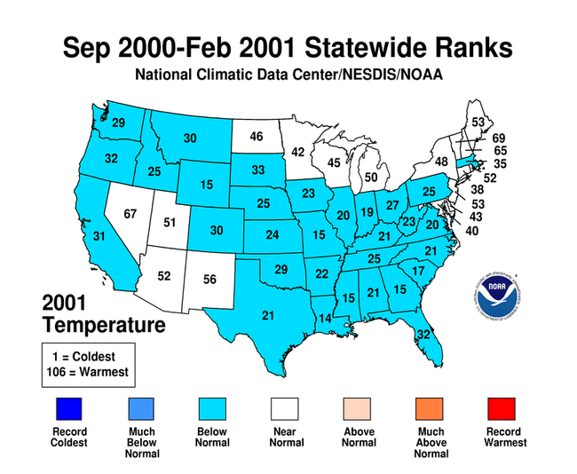

Slide 6
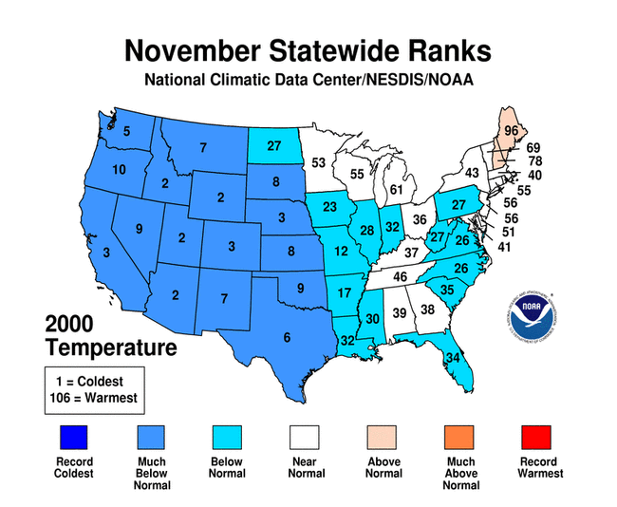

Slide 8
EIA data for Consumption

Slide 9
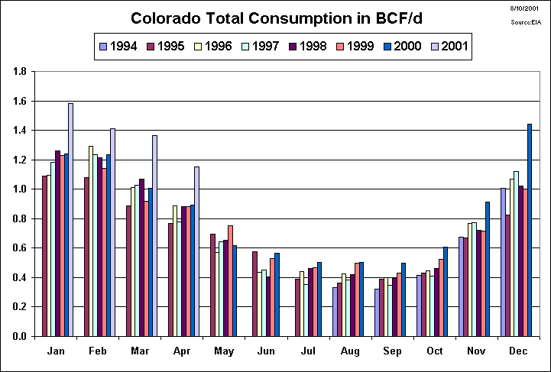

Slide 10
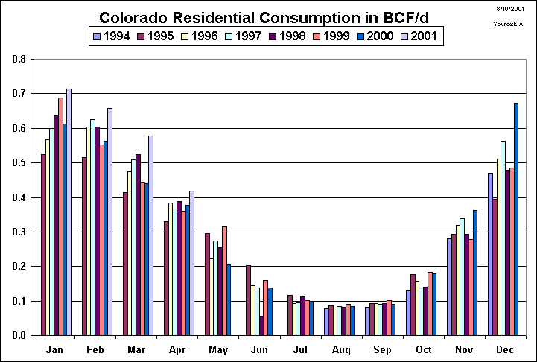

Slide 11
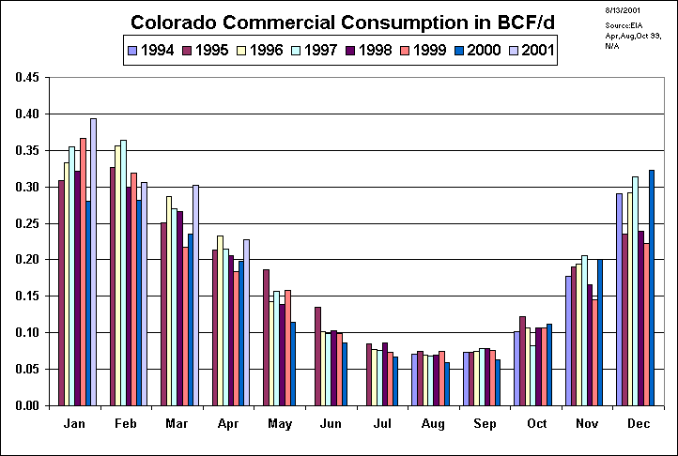

Slide 13
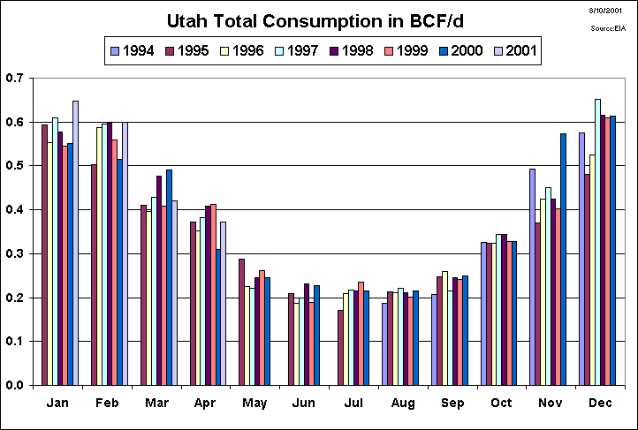

Slide 14
Nearly 7 Bcf withdrawn
over 8 day period with
average temp 21.6
VERY COLD
Nearly 3.3 Bcf withdrawn
over 4 day period with
average temp 14
VERY COLD

Slide 15
COLD
COLD

Slide 17
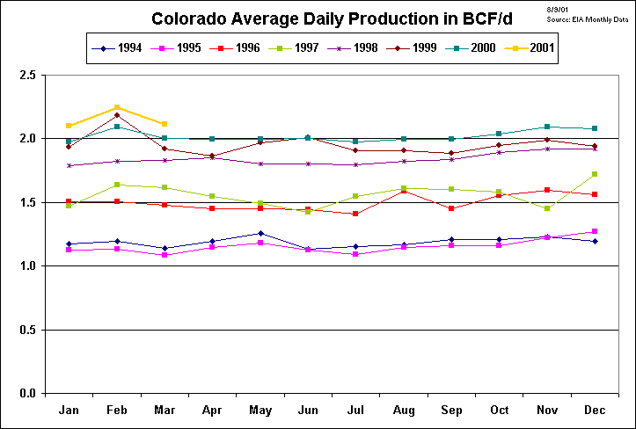

Slide 18
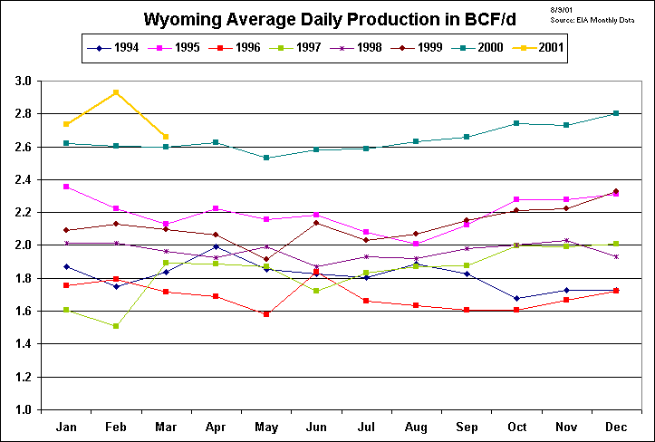

Slide 19
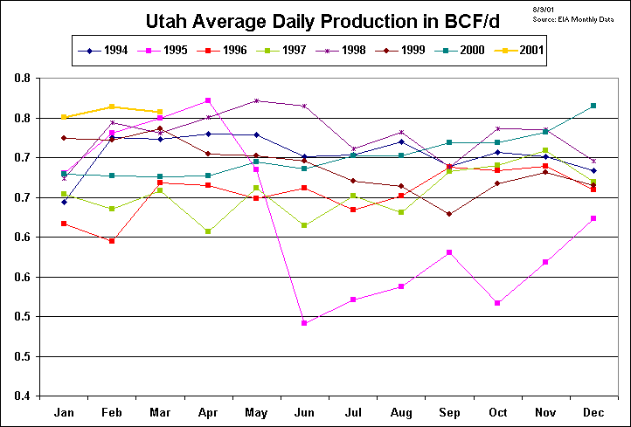

Slide 20
Wellhead Gas before Fuel
Wyoming Oil and Gas Commission

Slide 21
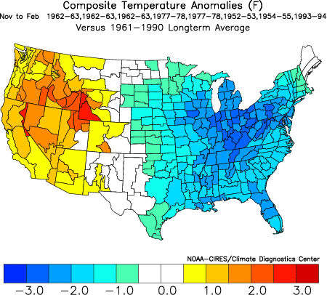
Forecast Maps
November – February 2001- 02 Temperature
0
0
-2
- 4
- 5
Below
Above
+2
0
- 4
+ 4
-2
0

Slide 22
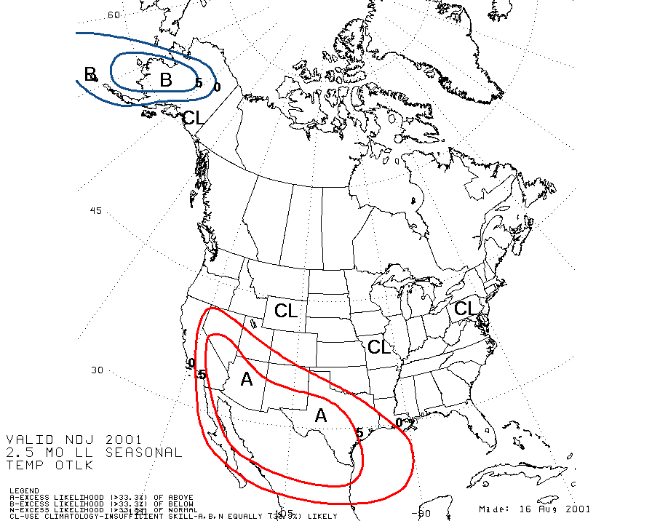

Slide 23
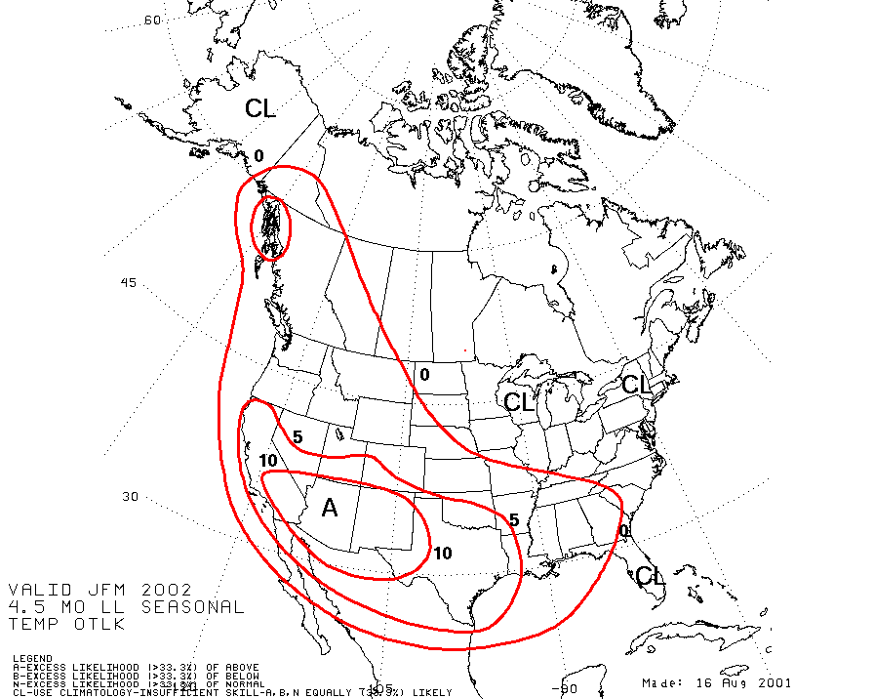

Slide 24
EASTERN ROCKIES
WBI
Elk Basin
50
WBI/MPC Storage
Powder River
Medicine Bow fully expands December 2001.
Wind River
Additional 375 firm capacity to Cheyenne Hub begins.
Glenrock
Expect additional flowing gas of 100-200/day.
Lost Creek
20
30
100 - 200
Medicine Bow
Cheyenne Hub
WBI and MPC storage filled faster and more consistently this summer than ever.
Elk Basin compressor should be near full ~100/day most of the winter. Elk Basin’s physical premium is severely reduced now in lieu of this.
Denver
CIG/PSCO storage will be near or slightly over typical levels.
Changes for Winter 2001-2002

Slide 25
EASTERN ROCKIES
NNG/Ventura
Elk Basin
WBI
85 - 100
WBI/MPC Storage
Powder River
~125 – 175 Withdraw
Wind River
Glenrock
240
NGPL/Gage…A-ML…Beatrice
100 - 150
Medicine Bow
Opal Plant
Lost Creek
20
150
110
450 - 550
250
100
Kanda
130
450
450
Cheyenne Hub
550
Clay Basin
185
250
500
Into PSCO
~200 Withdraw
Denver
CIG/PSCO Storage
1100
~100 Withdraw
Uinta/Meter Station 101
Kit Carson
150
200
Springfield
Raton Basin
100
Projected Winter Flows 2001-2002
NGPL/Midcon…PEPL

Slide 26
SUMMARY
Winter 00-01 extreme cold caused highest Rockies demand ever. November 00 was 3rd coldest in Colorado since 1895.
Outlook for Winter 01-02:
Expect lower demand with more normal weather
Expect higher supply due to
Medicine Bow expansion
Increased production especially in Powder River
Higher November 01 storage levels

Slide 27
FUTURE FUNDAMENTALS
Better handle on production forecast including decline curves.
Better handle on actual load in Colorado through PSCO and/or state sources.
Scrub and improve operations reports.
Using regression analysis…forecast load in Colorado and Utah for next 10 days.

Slide 28
Worksheet to Solve for Colorado Load

