Slide 1
Status of Retail Markets and
REM2001 Research
William Huss, Ph.D
Taff Tschamler
Tom Michelman
October 3, 2001

Slide 2
Wide Ranging Fallout From California Has Slowed Several Markets
AR: PSC delayed opening from January 2001 to October 2003
MT: June 2001 law extended transition period
NV: May 2001 law repealed restructuring law; July 2001 re-opened large customer market
NM: May 2001 law delays opening from 2002 to 2007/2008
OK: June 2001 law postponed market opening
OR: August 2001 law delayed market opening to March 2002

Slide 3
However, Expansion Continues Despite California
Source: XENERGY research

Slide 4
Outlook is Mixed on Markets Set To Open in 2002
Four Major States Are Charging Ahead Despite California
  Texas (full market opening)
    Most promising retail market; ‘Headroom’ will insure gross margin for retailers
  Michigan (full market opening)
    Market outlook uncertain; Several contested rate cases underway; Unbundled rates have been proposed, but not approved
  Virginia (partial and full market opening)
    Aggressive implementation and pro-competition Commission may lead to pockets of activity in unheralded market; 2002 unbundled rates not yet approved
  Illinois (residential market opening)
    Market outlook uncertain; ComEd expects slow start; Delivery tariffs submitted, but will not be approved until early 2002

Slide 5
Residential Activity Has Been Anemic
Source: XENERGY research, state government agencies, Summer 2001

Slide 6
National Market Share
Customer counts have jumped in recent months due to block acquisitions (e.g. municipal aggregation and CDS), but organic acquisition remains stagnant in most markets
Estimates of Competitive Electricity Customer Counts, Fall 2001
Source: XENERGY estimates, company sources
Includes estimates of OH municpal aggregation customers that have not yet been processed

Slide 7
Nonresidential Activity Has Been Mixed, But Primarily Weak
*
Source: XENERGY research, state government agencies, Summer 2001
*Includes PPO customers

Slide 8
Recent Dropouts
The number of drop outs and pull backs has subsided in 2001, but the 2001 roster includes major players
2001
AES Power Direct
Power Trust
ServiSense
PG Energy Services
Shell Energy Services
Total Gas & Electric
Note: Companies in bold have left the retail market, companies not in bold have exited service territories or dropped blocks of customers

Slide 9
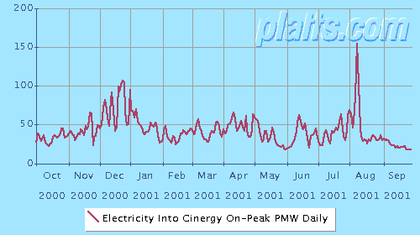
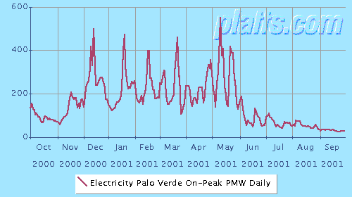
High Wholesale Prices Create Retail Shake Out Then Prices Plunge
High wholesale prices helped to cull the heard of retailers, but now that prices are low, where are the new crop of retailers?

Slide 10
Pennsylvania Market is in Decline
High PJM wholesale prices and fixed shopping credits have forced retailers out of the market
Switchers now total 575k residential (includes 225k customers assigned under CDS) and 17k nonresidential, down from 708k and 80k
Source: Pennsylvania Office of Consumer Advocate, July 2001

Slide 11
Illinois Status Report
Steady increase in customer participation during 2001
    Customer switching increased from 8,300 accounts at beginning of year to 17,100 at end of July (includes PPO), equals 3.3% of all accounts
    Over 15K are in ComEd’s territory
    Roughly half are with the PPO
Market leaders have stayed constant, but shifted positions
    AES NewEnergy has 36% and Exelon Energy has 27% of the market -- NewEnergy overtook Exelon Energy in market share sometime during 2001. (Source: MAIN data cited in August 27, 2001 article in Crain’s Chicago Business)
5 leading retailers in Illinois nonresidential market
    NewEnergy is making money, although not much -- over 1,000 commodity customers in Illinois.
    Peoples Energy Services is not making money, but continues to sell
    Nicor Energy reported 4,000 electric customers this summer
    Enron struck deal with City of Chicago and others for 400 MW
    Exelon Energy is still taking customers, but future is uncertain
State policy makers focused on new tariffs
    Rate cases currently being contested – 30 to 50% increases in delivery rates sought by ComEd and IP

Slide 12
Illinois: Commercial and Small C&I Switching
Source: Illinois Commerce Commission, July 2001

Slide 13
Illinois: Industrial and Large C&I Switching
Source: Illinois Commerce Commission, July 2001

Slide 14
Ohio Status Report
4th largest market opened January 1, 2001
Market activity centered in FirstEnergy territories, although Cinergy territory may heat up soon
Consumer awareness of electric competition increasing -- 62% this summer versus 38% the previous summer – but levels are still relatively low (source: PUCO)
Fixed rate transition period until 2005 (2003 for DPL)
Unique provisions for Municipal aggregation
20% of each customer class required to switch by Dec 31, 2003 or PUCO can take action to improve markets
Midwest ISO and Alliance RTO, under May 2001 Settlement, will acquire operational control of Midwest grid in late 2001 or early 2002
FirstEnergy offered Market Support Generation at discount, has created controversy and legal battles as retailers and consumers battle for cheap energy

Slide 15
MSG Controversy
FirstEnergy allocated 1,120 MWs of full requirements generation supply to participants in the retail market at relatively low rates and on a first come, first served basis
Allocation process generated substantial controversy
  Parma MSG award challenged by Cleveland on grounds that wording of ordinance was flawed and the submission deadlines confusing
  Enron, Exelon, Strategic Energy, AES NewEnergy claim Industrial Energy users MSG allotment is invalid
  City of Toledo intervenes in MSG proceeding, claiming FirstEnergy used a “black box” procedure

Slide 16
Ohio Residential Market Activity
Most Activity limited to FirstEnergy territories (Northern Ohio)
  307,000 or 8 percent of residential customers have switched electric suppliers statewide
  Up to 600,000 additional consumers to switch this Fall through aggregation deals
    Roughly 50% of FirstEnergy’s residential customer base
    NOPEC struck deal with Green Mountain Energy -- September through November, up to 450,000 consumers previously served by FirstEnergy companies
    City of Toledo struck deal with FirstEnergy Solutions -- more than 100,000 residential consumers
    Northwest Ohio Aggregation Coalition (NOAC) has deal with WPS Energy Services -- 35,000 accounts
  Cinergy switching is at 0.6% of total residential kWh

Slide 17
Switch Rates By Service Territory
Percentage of Total Energy and Total Accounts Switched, June 30, 2001
Source: PUCO website

Slide 18
Texas Status Report
Overview
    Largest US market in terms of kWh sales – 8.8 million customers
    ERCOT represents 85% of load and is under PUCT jurisdiction – central clearinghouse for most retail transactions
    Several pro-competition provisions, including capacity auction, clawback provision, POLR and Price to Beat likely to create active retail markets
Pilot underway – roughly 78,500 customers being switched to competitive supplier
    Marketing activity has been moderate – residential quota not filled
    IT system and billing glitches delayed pilot start by 2 months
    Shell was a leading marketer, but pulled out – acquired ~40,000 customers
    Significant accomplishments building systems and setting rules
Full market opening slated for January 1, 2002
    ERCOT and PUCT officials claim they are on schedule, but some have questioned readiness of information systems and data exchange
    Non-ERCOT regions may face delay
    Large customers currently being courted for full market opening
    Price to Beat ruling later this month will determine retail economics for less than 1 MW customers
    Scripps-Howard Survey: 40% will switch; 37% will not

Slide 19
Texas Pilot Participation Levels

Slide 20
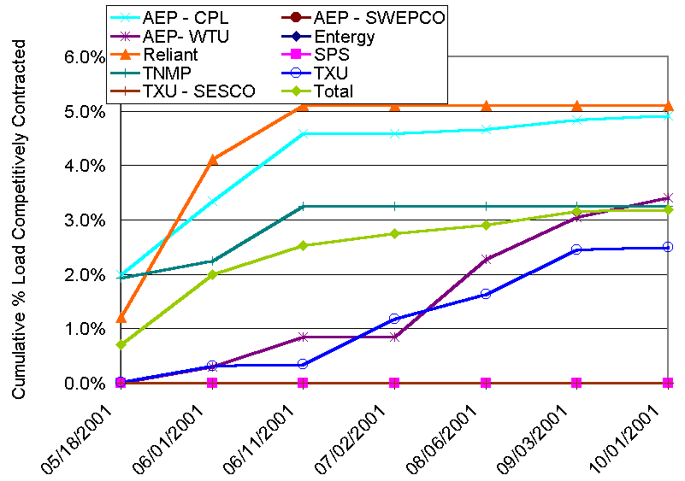
Residential Customer Migration in Texas Pilot

Slide 21
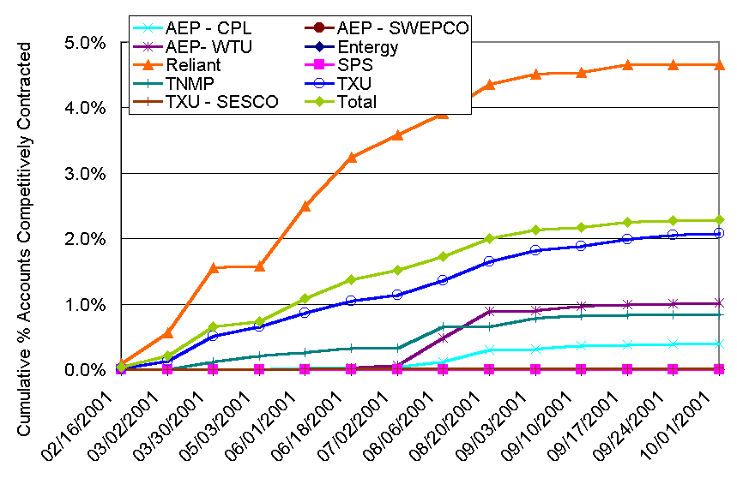
Commercial Customer Migration in Texas Pilot

Slide 22
Residential REPs in Texas Pilot

Slide 23
REM2001 Research Update

Slide 24
REM2001 Deliverables Summary
California report (July)
Texas Pilot Analysis (October)
Ohio Market Analysis (November)
The Retailer Yearbook (December)
Illinois C&I Survey and Market Analysis (December)
Retail Report Card (January)
Texas Survey and Market Analysis (January & February)

Slide 25
Texas Pilot Analysis
Work Product: Provide overview and status report of pilot (30 – 40 page report) Report structure: Key Findings Intro & Market Structure Pilot Activities and Lessons Comparison to Other Markets Full Market Opening Outlook
Key Questions: How does the Texas pilot compare to other pilots and market openings? What were marketing activities, and how did customers react? Why did Shell pullout, and how does it affect the market? How is the market progressing logistically? How does the market look for the full-scale opening?
Data Sources for Analysis Interviews with Key marketers & utilities Regulators & policy makers Aggregators and consultants ERCOT and PUCT documents Secondary research
Schedule: Research commenced early September Final report week of October 8
Project Leader: Tom Michelman, 781.273.5700 x363, tmichelman@xenergy.com

Slide 26
Ohio Market Analysis
Work Product: Status report and Outlook of retail competition in Ohio (30 – 40 page report) Focus on residential and municipal aggregation markets. Report content: Key findings Market structure Competitive activity Trends & outlook
Key Questions to Investigate: How have municipal aggregation deals developed so far? What is the status of wholesale markets and how will the Alliance RTO and Midwst ISO change the retail market? What marketing activities have been effective in Ohio so far? What’s the outlook for residential and nonresidential competition in Ohio? What market structure issues remain?
Data Sources: Interviews with: Market participants Regulators Municipal officials. State regulations and PUCO filings Secondary research
Schedule: Interviews & other research begins October 1 Draft report week of November 5 Final report week of November 19
Project Leader: Chris Dyson, 608.277.9696, cdyson@xenergy.com

Slide 27
The Retailer Yearbook
Work Product: Executive Summary with overview on 2001 supplier activity and data on retailer gross margins and start up costs; customer acquisition costs; retailer valuations; and retailer rankings by total customer count. Company Profiles on leading suppliers: AES NewEnergy Centrica/Energy America Enron Energy Services FirstEnergy Solutions Green Mountain Energy The New Power Company Reliant and TXU Competitor Snapshots for all active electric marketers
Company Data to Be Included: Corporate Strategy Markets Served Retail Pricing Commodity Sourcing Customer Acquisition Strategies Marketing Channels Market Share/Customer Base Data Product Launches Products and Services Offerings
Schedule: Company Profiles: week of Nov. 16 Final Report: week of December 14
Project Leader: Susan Weber, 781.273.5700 x387, sweber@xenergy.com

Slide 28
Illinois C&I Survey and Market Analysis
C&I Interview Data to Be Collected:
Awareness and Attitudes
Decision Factors
Supplier Market Share
Supplier Acquisition Channels
Aggregation Participation
Product & Service Interest and Purchases
Contract and Pricing Intelligence
Gas Cross Selling Interest and Activity
C&I Sample Description:
Sample Size: 300 to 400 completes
Territories: ComEd
Sample: revisits, D&B, other sources
Oversample large customers
Work Product:
Executive Summary
Review of Market Structure
Survey Analysis
Competitor Snapshots
Survey Data Summaries (Crosstabs)
Marketing and Contract Materials
Ad Spending Data
Schedule:
Draft Survey: week of Oct. 8
Final Survey Oct. 22
Field Survey November 1
Complete Survey November 30
Survey Analysis December 1 – 14
Draft Report December 21
Final Report December 31
Project Leader: Tom Mauldin, 781.273.5700 x318, tmauldin@xenergy.com

Slide 29
Retail Report Card
Work Product: Concise, consistent summaries of market structures, including outlook for competition and extensive data set on key retail market metrics Report Contents: Comparative market analysis. 10 most promising retail markets. Report cards on state markets.
Work Product (continued): Comprehensive Data Collection: Default and wholesale prices Switch rates Market size Summary of key rules Registered suppliers Customer characteristics
Data Sources for Analysis: Interviews with key market participants, utility officials & regulators State & utility switching data XENERGY customer research. XENERGY competitor profiles State restructuring rules and regulatory proceedings. Secondary research
Schedule: Research begins November 6 Draft report: week of January 2 Final report: week of January 16
Project Leader: Chris Dyson, 608.277.9696, cdyson@xenergy.com

Slide 30
Texas Market Analysis and Survey Plan
Interview Data to Be Collected: Awareness and Attitudes Decision Factors Supplier Market Share and Churn Supplier Acquisition Channels Aggregation Participation Product & Service Interest and Purchases Contract and Pricing Intelligence Pilot Activity and Experience
C&I Analysis and Schedule: Sample Size: 400 completes Territories: TXU and Reliant Sample: D&B Oversample > 1 MW customers Timeframe: Distribute Instrument November 1 Field Survey December 3 Complete Survey by December 31 Draft Report January 31
Work Product: Executive Summary Review of Market Structure Residential Survey Analysis Nonresidential Survey Analysis Competitor Snapshots Survey Data Summaries (Crosstabs) Marketing and Contract Materials Ad Spending Data
Residential Analysis and Schedule: Sample Size: 600 completes Territories: TXU and Reliant Sample: Random Digit Dialing Timeframe: Distribute Instrument December 17 Field Survey January 14 Complete Survey by January 31 Final Report February 22
Project Leader: Tom Michelman, 781.273.5700 x363

Slide 31
Other REM Project Activities and Work Products
Ad Hoc Information Requests
Website and Industry Highlights
Conference in Austin, Texas (February 25-27, 2002)
Ad Tracking and Spending Data
Source Data From Customer Surveys

Slide 32
Questions And Feedback

