Slide 1

Challenges and Opportunities for Natural Gas:
Lessons From This Winter
Stan Horton
Chairman & CEO
Enron Gas Pipeline Group
Natural Gas Roundtable
Washington, D.C.
March 15, 2001
®

Slide 2
Proved and Potential U.S. Natural
Gas Resources
Current estimates:
1,470 average
Shortage
Era
Trillion Cubic Feet

Slide 3
U.S. Natural Gas Replenishment
Trillion Cubic Feet--Proved Reserves
847
147
167
YE 1944
Reserves
1945-2000
Production
YE 2000
Reserves

Slide 4
1999-2000 U.S. Proved Natural Gas Reserves
(TCF)
9.9
9.7
Alaska
WY
14.2
13.8
UT
App. +All others
3.2
CO
16.9
18.0
2.4
7.9
9.0
167.4
6.4
5.7
164.0
NM
KS
13.6
14.9
15.4
OK
12.5
ALA
37.6
40.2
9.2
4.6
9.1
4.3
TX
LA
1999
2000
26.9
26.0
Total U.S.
Offshore
Source: U.S. DOE EIA
U.S. proved natural gas reserves increased 2% in 2000

Slide 5
Canadian Natural Gas Replenishment
Trillion Cubic Feet--Proved Reserves
97
61
46
YE 1964
Reserves
1965-2000
Production
YE 2000
Reserves

Slide 6
1999-2000 Canadian Proved Natural Gas Reserves
(TCF)
63.7
61.0
Canadian proved natural gas reserves fell 4.5% in 2000
Source: Oil & Gas Journal, 12/18/00
MC-USPipelineTrans-0201

Slide 7
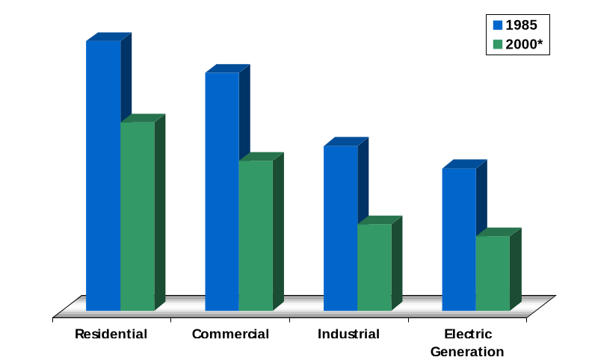
U.S. Average Gas Prices by Sector
1985 vs. 2000
(2000$/MMBTU)
-26%
$9.90
-34%
$8.73
-33%
$7.29
-26%
$6.05
$5.75
$5.22
$4.06
$3.89
Source: Energy Information Administration (U.S. DOE)
* Through October

Slide 8
U.S. Residential Natural Gas Prices
Since 1984
(1999 $/MMBTU)
2000/2001
Winter Estimate
1984
1986
1988
1990
1992
1994
1996
1998
1985
1987
1989
1991
1993
1995
1997
1999
Residentials users payed the same prices this winter as in 1986
Source: U.S. DOE (EIA)

Slide 9

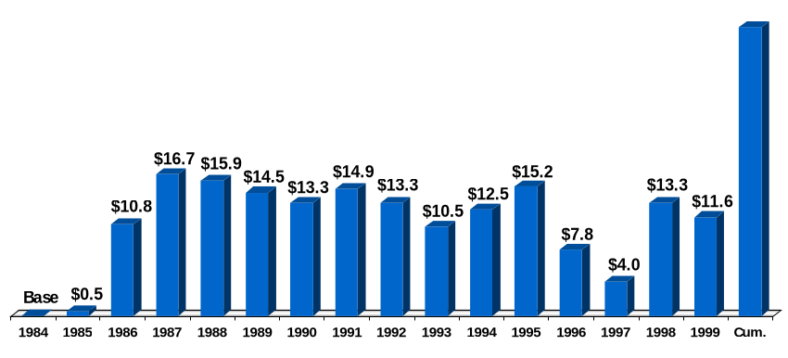
U.S. Natural Gas City Gate Cost Decline
(Billions 1999$)
$174.2
Total savings
since 1984
[Price savings volume = total savings]
x
Source: U.S. DOE Natural Gas Annual, Table 21, and Natural Gas Monthly, May 2000

Slide 10
Natural Gas:
A Maturing Financial Commodity

Slide 11
Comparative Annualized Daily Volatility

Slide 12
Trading Margins
Natural Gas vs. Electricity
(MMBTU equivalent - October 2000 Spreads)
Natural Gas
Electricity
Inefficient Wholesale Grid
Efficient Wholesale Pipeline System

Slide 13
2000/01 Winter Price Hedging

Slide 14
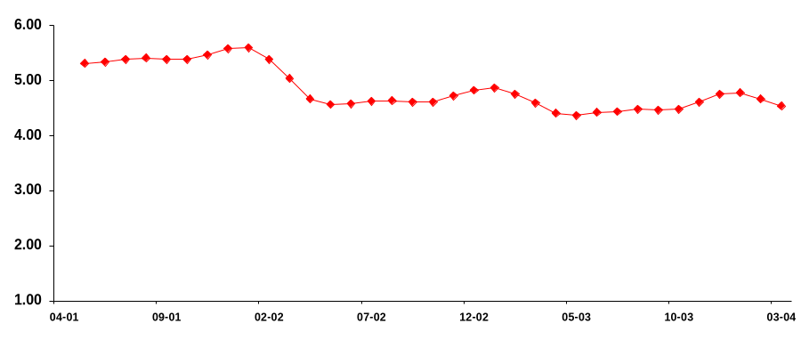
Backwardation Price Curve for Wellhead Gas
($/MMBtu)
$5.50
Next Winter
$4.80
Winter 02/03
Source: NYMEX (September 15, 2000)

Slide 15
Natural Gas: Lessons From This Winter
All about economics (supply and demand)
Unique weather drivers
System tested but performed
Wake-up call for future

Slide 16
Gas Demand Growth by 2005
Three Major Forecasts
(in MMcf/d)
West 1,400 - 1,700
Midwest 1,500 - 1,675
South Central 450 - 1,785
Northeast 1,180 - 1,270
South Atlantic 1,350 - 2,220
Range 5,930 - 8,650
45% Variance
Source: Various Consultants Forecasts (2000 vs. 2005)
MC-Forecasts-0201

Slide 17
Natural Gas: Areas for Improvement
Expedite incentives for supply and infrastructure
Use of financial markets to control uncertainty
Better coordination and support within gas industry

Slide 18
U.S. Lower-48 Natural Gas Resources
Subject to Access Restrictions
*29 Tcf closed; 108 Tcf available restrictions
Source: National Petroleum Council

