Slide 1






Challenges and Opportunities for Natural Gas in a Winter of Discontent
Dr. Kenneth L. Lay Chairman & CEO
National Governors Conference Columbus, Ohio September 20, 2000
®

Slide 2
Introduction
Assess natural gas infrastructure
Put current gas prices into historical context
Describe new natural gas industry
Review opportunities for market and policy reform

Slide 3
Proved and Potential U.S. Natural Gas Resources (Trillion Cubic Feet)
1,470 average

Slide 4
U.S. Natural Gas Replenishment Trillion Cubic Feet--Proved Reserves
809
167
147
YE 1944
Reserves
1945-98
Production
YE 1998
Reserves

Slide 5
Canadian Natural Gas Replenishment Trillion Cubic Feet--Proved Reserves
88
61
46
YE 1964
Reserves
1965-98
Production
YE 1998
Reserves

Slide 6
U.S. Natural Gas Spot Price Outlook
(in $/MMBTU Henry Hub, LA.)
[update]
2001
2000
2001
2000
1999
1999
Source: Cambridge Energy Research Associates, 7/14/00

Slide 7
The Tyranny of the Status Quo
Predicted vs. Actual Gas Prices
[Stinson Gibner]

Slide 8
U.S. Residential Natural Gas Prices
(1999$ per MMBtu)
2000/2001
Winter Estimate
Residentials will purchase gas this winter
at real prices they paid during the 1980s
Source: U.S. DOE (EIA)

Slide 9
U.S. Average Gas Prices by Sector 1985 vs. 1999 (In constant 1999$)
-30%
-37%
-48%
$/MMBtu
-48%
The average real price to all end users has fallen 42% under open access. In the prior decade, real prices increased 71%.

Slide 10

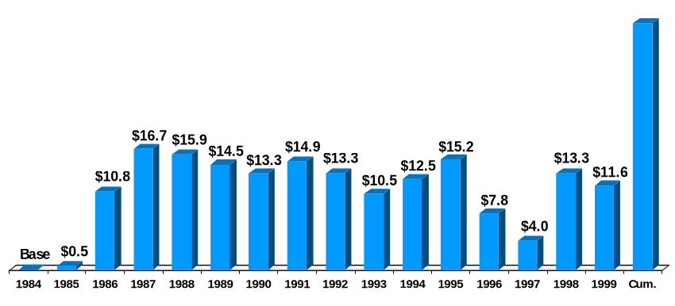
U.S. Natural Gas City Gate Cost Decline
(Billions 1999$)
$174.2
Total savings
since 1984
[Price savings volume]
x
Source: U.S. DOE Natural Gas Annual, Table 21, and Natural Gas Monthly, May 2000

Slide 11
Current Natural Gas Backwardation Curve
August 29, 2000
($/MMBtu)
$4.70
This Winter
$3.95
Next Winter
$3.50
Winter 02/03

Slide 12
Natural Gas Volatility
Spot Price Electricity ERCOT
NYMEX Natural Gas
NYMEX Sweet Crude
30-year Treasury Bond Yield
Power
Gas
Oil

Slide 13
Natural Gas vs. Electricity Margins

Slide 14
A Real Energy Crisis
Schools Closed for Lack of Heat
Factories Closed in 15 states
[more]

Slide 15
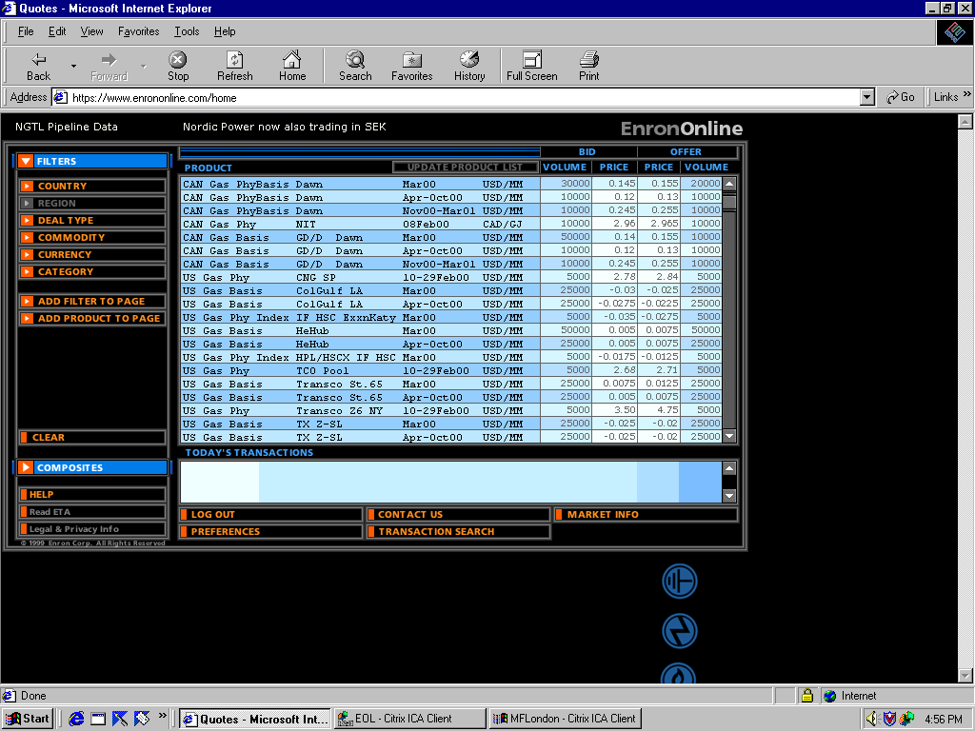

It’s a New Industry!

Slide 16
Hedging Products for the Wholesale Market
[Stinson Gibner]

Slide 17
New Retail Products
The New Power Company™
[Kathleen Magruder]

Slide 18
Public Policy Reform
Expedited certification
Drilling access and incentives
Open hedging environment

Slide 19
Marketing Pricing or Political Pricing?
“In gas production, there is no question of the positive relation between price and supply. As with any commodity, it is most difficult, if not impossible, to measure that relationship precisely and more difficult to forecast. Like a giant calculating machine, the competitive market price registers and weighs these variables of supply and demand, seeking to establish an equilibrium. Personally, I can see no escape from the competitive market price for any regulatory body which seeks to establish just and reasonable prices for natural gas.”
- M.A. Adelman (1958)

Slide 20


Slide 21
Extras

Slide 22
U.S. and Canadian Natural Gas Pipeline Construction Survey
# of Projects/MMCFD Capacity
4,750
3,110
12
projects
2,930
12
projects
1,900
7
projects
1,075
1,050
5
projects
3
projects
4
projects
1996
1997
1998
1999
2000
2001
and beyond
Source: AGA New Pipeline Construction Status Report; Oil and Gas Journal; and Trade Publications

