Slide 1
Why the Rhetoric Denying Economic Reality?
“The market makes a perfect totalizing enemy: it is impersonal, has no particular location and legitimates itself through a myriad of democratic practices of buying and selling…. The problem is that. . .the market is a democratic institution aggregating the decisions of whomever participates in it. When all is said and done, complaints about the market are nothing but complaints about the people themselves.”
— Paul Piccone, “From the New Left to the New Populism” (1994)

Slide 2
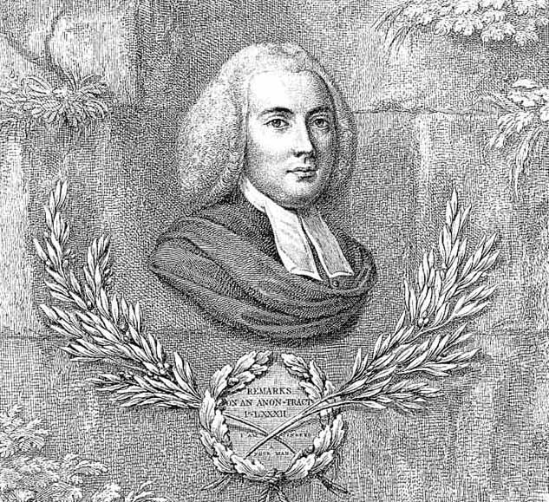
Moral Philosophy:
“If you make a law that I shall be obliged to sell my grain, my cattle, or any commodity, at a certain price, you not only do what is unjust and impolitic, but with all due respect be it said, you speak nonsense; for I do not sell them at all: you take them from me. You are both buyer and seller and I am the sufferer alone.”
“Instead of producing moderation and plenty, [the laws] uniformly produced dearness and scarcity.”
— Reverend John Witherspoon,
“The Futility of Price-Fixing,” 1802
Economics:

Slide 3
“[Price controls]. . .are not only unjust and unwise, but for the most part impracticable….Instead of producing moderation and plenty, [they] uniformly produced dearness and scarcity.”
— Reverend John Witherspoon, “The Futility of Price-Fixing,” 1802

Slide 4
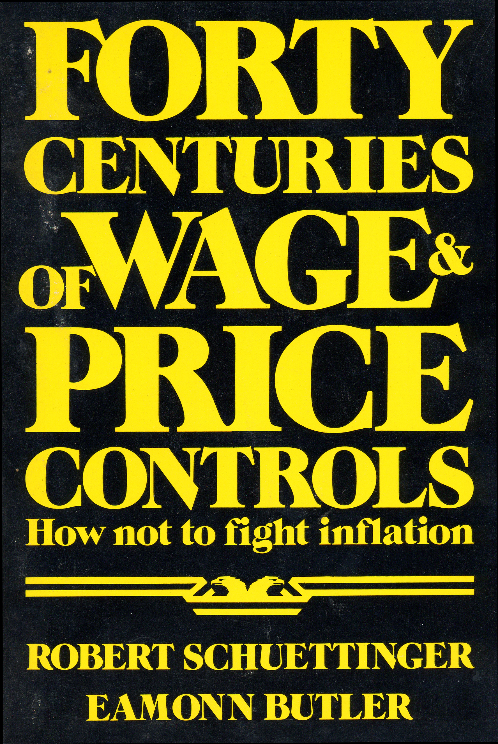
“We have examined over one hundred cases of wage and price controls in thirty different nations from 2000 B.C. to A.D. 1978…. In all times and in all places they have invariably failed to achieve their announced purposes.”

Slide 5
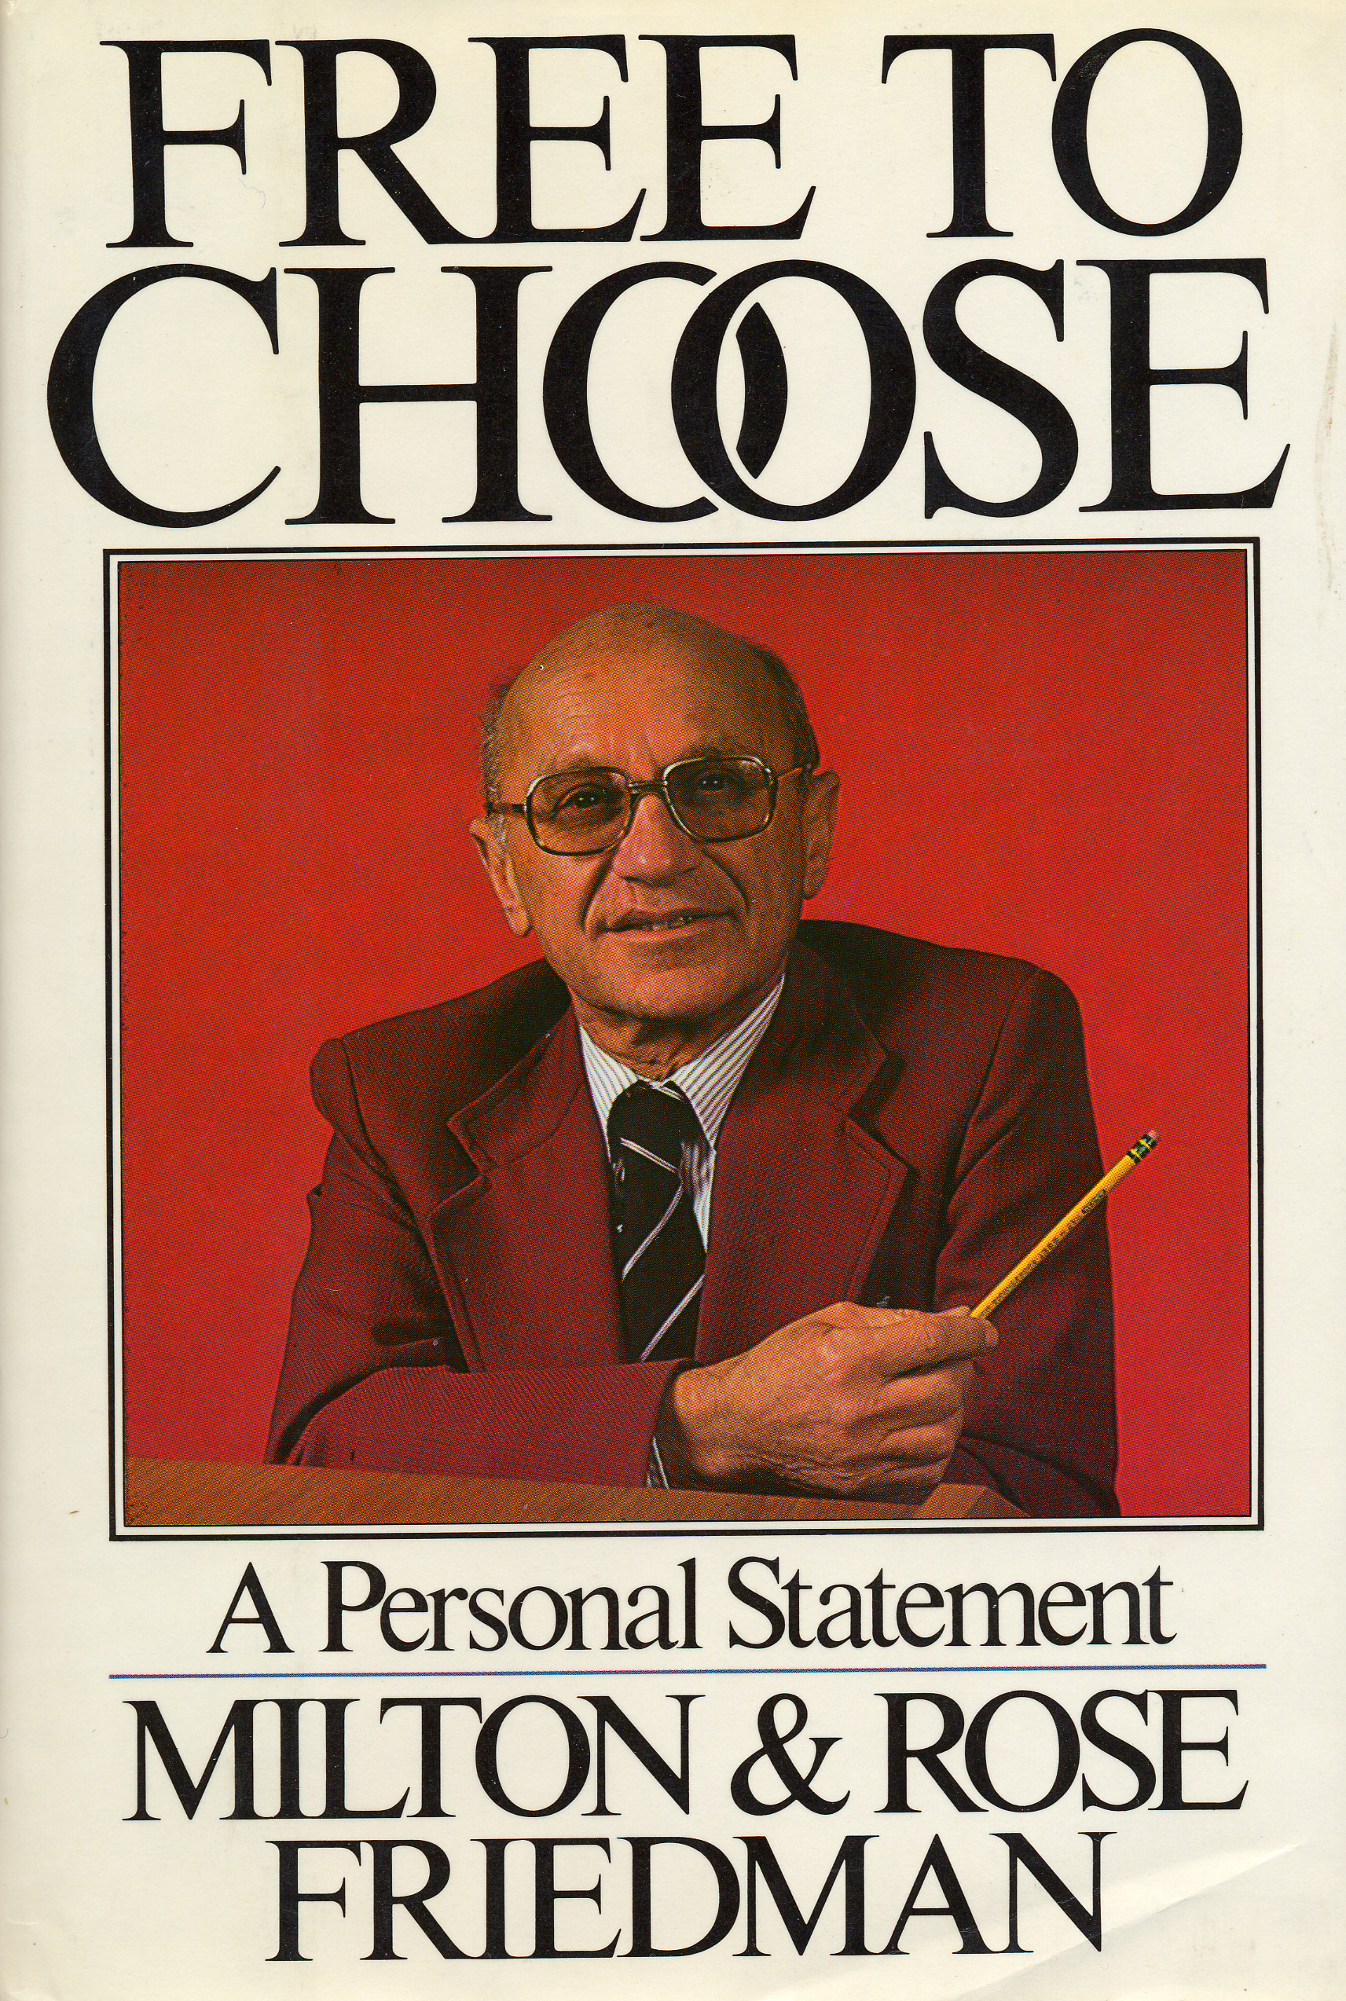
“.Do you want a shortage? Have the government legislate a maximum price that is below the price that would otherwise prevail.”

Slide 6
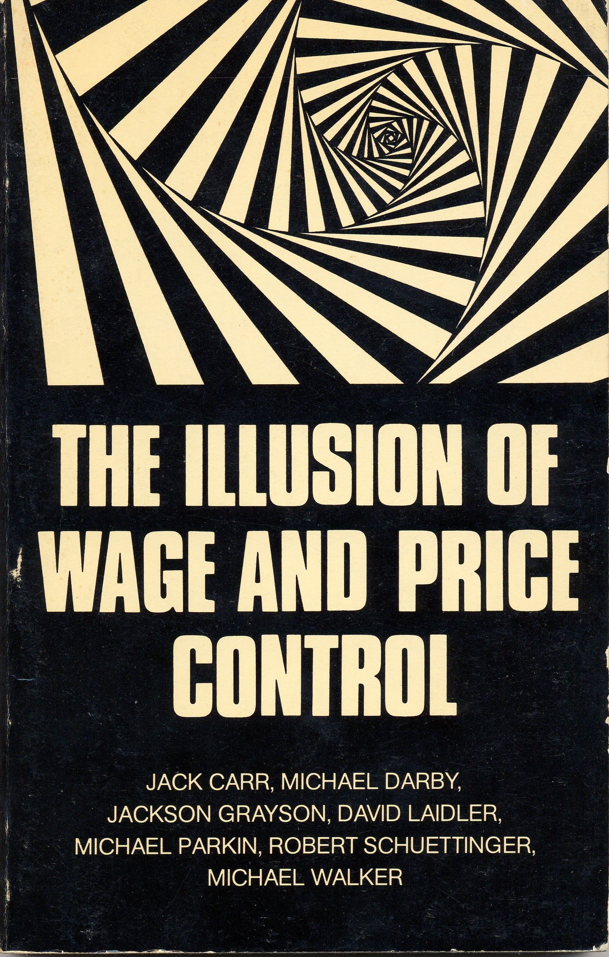
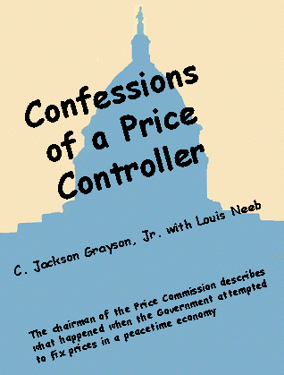
Economists Do Not Like Price Controls

Slide 7


Confessions of a Price Controller
“This book reports what happened when an ‘economic jury’. . . substituted their collective judgement for that of the marketplace.”
C. Jackson Grayson, Jr. with Louis Neeb
The chairman of the Price Commission describes what happened when the Government attempted to fix prices in a peacetime economy

Slide 8

Confessions of a Price Controller
“Running a [price] control system was not a calm, orderly application of economic theories, but an eclectic mixture of economics, power, pressure, and politics. It was a drama of trivial and major events, a clash of personalities, brinkmanship, day-to-day craziness, improvisations, and squabbles.”
C. Jackson Grayson, Jr. with Louis Neeb
The chairman of the Price Commission describes what happened when the Government attempted to fix prices in a peacetime economy

