Slide 1


Completing the Revolution
Dr. Kenneth L. Lay
Chairman & CEO
World Forum on Energy Regulation
Montreal, Canada
May 23, 2000

Slide 2
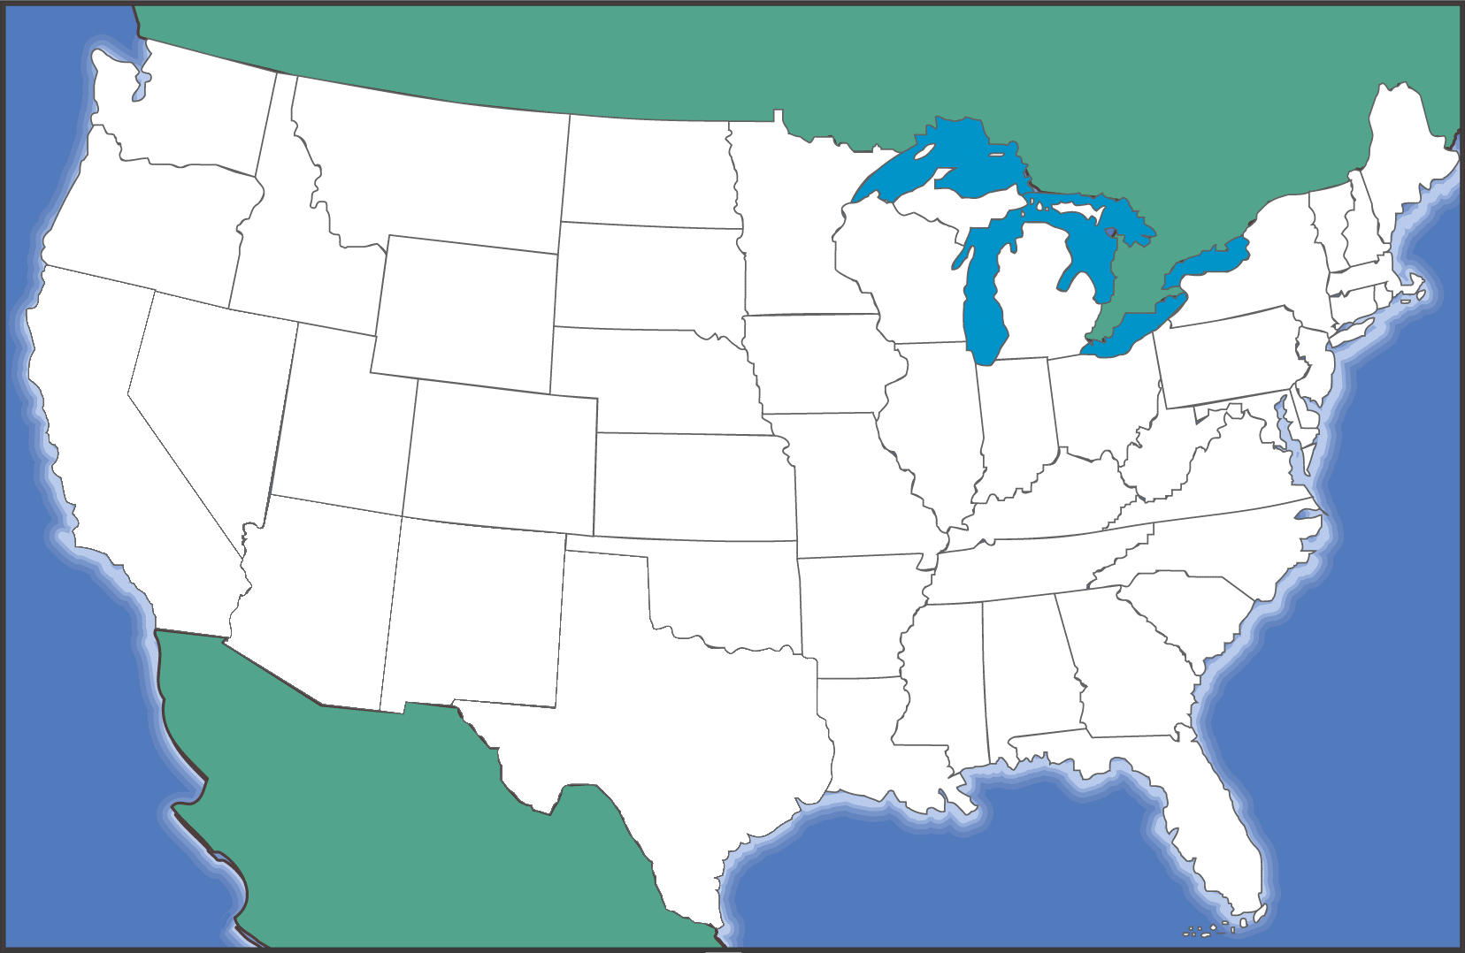
The Old Enron (1985)
Trailblazer
Intrastate Pipelines
HPL Houston Pipe Line
Interstate Pipelines
NNG Northern Natural Gas
TW Transwestern Pipeline
FGT Florida Gas Transmission
NBPL Northern Border Pipeline

Slide 3
Enron Today - North America
Marketing Offices
Owned and Leased Capacity
NYMEX Trading
Owned Gas Storage
Leased Storage
Power Plants
In Operation
In Construction
Under Development
Energy Marketing Activity
Gas
Power
Coal

Slide 4
The Energy Network Model
Applications
Utility Facility
Operations
& Management
Energy
Outsourcing
Fuel
Management
Services
eCommerce
Applications
Physical Delivery
Contracts
Price Risk
Management
Contracts
Settlement
Services
Peaking &
Storage Services
Finance
Market Making
Contract Access
Physical Assets

Slide 5
Energy Customization
Oil and Products
NYMEX
Natural Gas
CBOT/MGE
Coal
IPE
Electricity
Nordpool
BASIS
EAST-BASIS
EAST-OPTION-BASIS
GAS DAILY
KC-EAST-BASIS
East
PRM-EAST-BASIS
East
PRICE
EAST-GD-GDL
EAST-BASIS
POWER
EAST-OPTION-BASIS
NY
KC-EAST-BASIS
PRM-EAST-BASIS
BASIS
EAST-GD-GDL
EAST-OPTION-PRICE
Central
GAS DAILY
EAST-PRICE
KC-EAST-PRICE
Long Term
PRICE
NG-INDEX-ANN-EAST-PRICE
EAST-PWR-PRICE
POWER
EAST-PWRP-PRC
KC-NY-BASIS
Texas
BASIS
NY-BASIS
NY-OPTION-BASIS
GAS DAILY
PRM-NY-BASIS
NY-GD-GDL
PRICE
KC-NY-PRICE
POWER
NY-OPTION-PRICE
West
NY-PRICE
Commodity
BASIS
PRM-NY-PRICE
BASIS
NY-PWR-PRICE
GAS DAILY
NY-PWRP-PRICE
Canada
GAS DAILY
CENTRAL-BASIS
CENTRAL-OPTION-BASIS
PRICE
KC-CENTRAL-BASIS
PRICE
PRM-CENTRAL-BASIS
POWER
CENTRAL-GD-GDL
POWER
INTRA-CAND-EAST-BASIS
CENTRAL-OPTION-PRICE
NE
INTRA-CAND-WEST-BASIS
INTRA-CAND-BC-GD-GDL
INTRA-CAND-EAST-BASIS
INTRA-CAND-WEST-BASIS
BASIS
IN
TRA-CAND-BC-PHYSICAL
INTRA-CAND-BC-GD-GDL
GAS DAILY
IN
TRA-CAND-BC-PHYSICAL
INTRA-CAND-WE-GD-GDL
SE
PRICE
INTRA-CAND-WEST-PHYSICAL
INTRA-CDBC-GDOPT-GD
INTRA-CDEA-GDOPT-GDL
Short Term
POWER
INTRA-CANADA-PRICE
Volume
BASIS
INTRA-CAND-BC-PRICE
INTRA-CAND-EAST-PRICE
Central
INTRA-CAND-WEST-PRICE
PHYSICAL
TP-FINANCIAL-BASIS
TP-FINANCIAL-PRICE
PRICE
HPL
LRC
BASIS
NORTHERN BORDER PIPELINE
PHYSICAL
TRANS CANADA PIPELINE
Texas
PACIFIC GAS TRANSMISSION
PRICE
BAMMEL
NAPOLEONVILLE
BASIS
BISTINEAU
PHYSICAL
UNION GAS
TRANSCO
PRICE
OPTIONS-CE-BASIS
West
OPTIONS-EA-BASIS
BASIS
OPTIONS-NY-BASIS
PHYSICAL
OPTIONS-PRICE-BASIS
BASIS
OPTIONS-TX-BASIS
PRICE
Canada
OPTIONS-WE-BASIS
BASIS
OPTIONS-CE-PRICE
PHYSICAL
OPTIONS-EA-PRICE
OPTIONS-NY-PRICE
OPTIONS-PRICE-PRC
Transport
PRICE
OPTIONS-TX-PRICE
OPTIONS-WE-PRICE
GAS-DAILY-BASIS
GAS-DAILY-OPTION-BASIS
GAS-DAILY-GDL
GAS-DAILY-OPTION
-GDL
GD-OPTION-CENTRAL-GDL
Storage
GD-OPTION-EAST-GDL
GD-OPTION-NY-GDL
GD-OPTION-TEXAS-GDL
GD-OPTION-WEST-GDL
OPTIONS-GDOPT-GDL
GAS-DAILY-OPTION-PRICE
GAS-DAILY-PRICE
OMICRON-PRICE
POWER HEDGE
EXOTIC PRC
INDEX-OP-BAS
HEDGE SPEC
Futures
ERMS-XL
INDEX-OP-PRD
OPTIONS
MAH II - PRC
PRICE
OPTIONS
Price
MAH IV - PRC
PRICE
OPTIONS
ECT STRATEG-PRC
PRICE
ENERGY-AMER-PRC
OPTIONS
PRICE
Central
CANADA
OPTIONS
PRICE
CENTRAL
OPTIONS
NORTHEAST
PRICE
Regions
East
OPTIONS
PRICE
SOUTHEAST
OPTIONS
PRICE
West
OPTIONS
PRICE
EAST TX
OPTIONS
Texas
PRICE
OPTIONS
WAHA
PRICE

Slide 6
Fastest Social Change in History...
Users (Millions)
Radio
Television
Cable
Internet

Slide 7







EnronOnlineTM
Putting the Energy into e-commerceTM

Slide 8
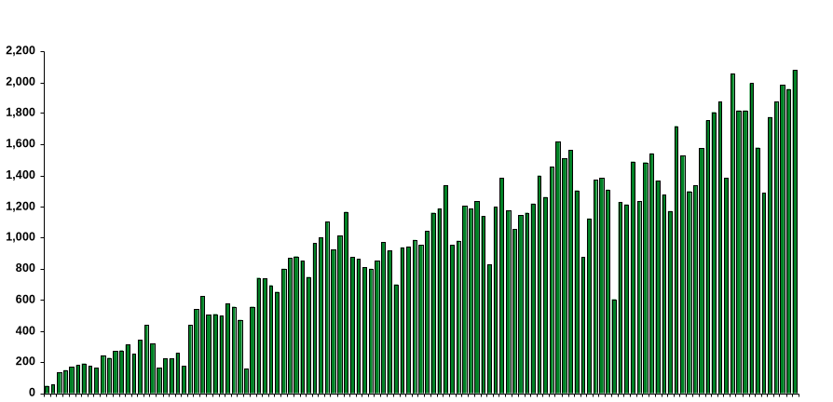

EnronOnline
Daily Transactions
Nov & Dec 1999
Jan
Feb
Mar
Apr
May

Slide 9
EnronOnline vs. Traditional Channels
(Currently)
Volume
Transactions

Slide 10
Mass Customization in Energy Markets
Enron Risk Products: 1989-2000
EnronOnline: 840 products
Gas
Electricity
Liquids
Other

Slide 11
Total Energy Outsourcing
Traditional Suppliers
Customer Needs
Enron
Utilities
Commodity
Management
Software Vendors
Light
Control Manufacturers
Architects
Energy Information Management
Engineers
Equipment Manufacturers
Conditioned Air
Mechanical Contractors
Energy Asset
Management
Electrical Contractors
HVAC Svc Companies
Consultants
Facilities
Management
Specialty Contractors
Managed Facilities
Lenders
Capital
Management
Internal Treasury

Slide 12
Enron Energy Services - National Network
Enron Offices
HVAC Service
Facility Management
Energy System Design &
Installation
$16 Billion in contracts expected by YE-2000
16,500 total facilities
1 billion square feet of managed space
Customer Sites

Slide 13
New Power CompanyTM
First national provider of energy and related services to residences and small businesses in deregulated markets
A partnership of industry leaders
Initial investment of $120 million
First customer sign-up in Pennsylvania and New Jersey later this year

Slide 14
The Imperative of Regulatory Reform

Slide 15
Benefits of Natural Gas Competition
Price: -42% between 1985 and 1999
Supply: +24% between 1985 and 1999
U.S.
Price: -28% between 1985 and 1999
Supply: +38% between 1985 and 1999
Canada
Open Closed

Slide 16
Enron Gas Pipeline Volume Growth
(Bbtu/d)
62% Increase
1986 and 1989

Slide 17
Needed Regulatory Reform
Provide nondiscriminatory access in the wholesale electricity market
Standardize best practices across the U.S. and Canada in wholesale and retail markets
Encourage new-generation gas and electricity retailing
Take the competitive model global

Slide 18
Obstacles to Wholesale Electricity Competition
Monopoly services bundled with competitive services
Transmission capacity set-asides block independent access to the grid
Few trading points and low liquidity with “balkanized” interstate transmission grid

Slide 19
Solutions for Wholesale Electricity Competition
Unbundle transmission and distribution monopoly services from competitive services
Offer nondiscriminatory (competitive) access to monopoly services
Set common standards across jurisdictions

Slide 20
Standardization: A New Initiative
Need for wholesale standards for best-practices transmission
Need for retail standards for customer services
Coalition for Uniform Business Rules (CUBR)
Taking standards global

Slide 21
Natural Gas vs. Electricity
EnronOnline Locations and Products
Natural Gas Power
* April 14, 2000

Slide 22
Btu Equivalent Spread Comparison*
Natural Gas Power
* April 17, 2000 Henry Hub May-Oct Gas vs. Jul-Aug Power

Slide 23
Economic Change
Old Economy
Supply-driven
Mass production
Monopoly franchises
Technology slows speed to market
Value in physical assets
Geographical
New Economy
Demand-driven
Mass customization
Competition
Technology increases speed to market
Value in intangibles & people
Global

Slide 24
Regulatory Change
De Jure Open Access De Facto Open Access
Central Dispatch (POOLCO) Competing Merchants/
Market-Makers
Geographical Standards Coordinated Standards
Cost-based Rates Market-based Rates
Adversarial Certification Expedited Certification

Slide 25


