Slide 1


Energy & Climate Realism in a
Political World
Dr. Kenneth L. Lay
Chairman
“Securing the Energy Future
for the Western States”
Forum on Power & Energy in the West
Denver, Colorado
May 23, 2001
®

Slide 2
Introduction
Energy sustainability — economics joins environmentalism at the forefront
Natural gas — still good news for new capacity additions
Climate change — a huge challenge for energy policy

Slide 3
Energy Sustainability Includes Affordability and Reliability
“Affordable energy in ample quantities is the lifeblood of the industrial societies and a prerequisite for the economic development of the others.”
John Holdren, Harvard University
“Taking action on the basis of worst-case prognoses would. . . be inappropriate and costly; suddenly imposing fuel rationing and high taxes on industrial activity with no tangible justification would cause economic disruption and most likely would backfire.”
Paul Ehrlich and Anne Ehrlich,
Stanford University

Slide 4
No Regrets-Price Neutral CO₂ Policy
End government pricing of energy below cost
Remove non-market barriers on less carbon intensive fuels
Promote energy outsourcing for private and public facilities
Improve air and water quality to regulated standards
Simplify and modernize the tax code for faster capital turnover

Slide 5
Energy Outsourcing: A New Option
Energy Service Companies
Operate energy systems more efficiently
Upgrade energy infrastructure to drive efficiency
Improve preventive, replacement and repair procedures
Energy Asset
Management
New Core Competencies

Slide 6
Enron Energy Services
Manages 31,000 facilities representing 3.1 billion square feet
Anticipates energy savings between 5% and 15% over the life of the contract (typically ten years)
Calculates emission reductions from current contracts of
  31,600 metric tons of SO_{x}
  18,000 metric tons of NO_{x}
  5.8 million metric tons of CO₂

Slide 7
Energy Efficiency Policy
Market driven real-time price signals to shave peak demand
Government driven retail price caps joined by efficiency subsidies and conservation edicts
Which efficiency path is more “sustainable”?

Slide 8
Enron’s Multi-Pollutant Strategy
Clean Power Group members — Enron, El Paso, Trigen, Calpine, NiSource
Goals:
  Provide incentives for efficiency and clean new generation
  Increase regulatory certainty for all plants—new and “grandfathered”
  Promote emissions trading for lowest cost reductions
Do 3 pollutants right and get CO₂ for free!

Slide 9
Natural Gas
Still the One

Slide 10
Electricity Technology Comparison
Capital O&M Fuel Total
($/kW) (¢/kWh) (¢/kWh) (¢/kWh)
Gas CC $ 455 0.26 2.9 3.9
Coal $1,092 0.64 1.7 4.2
Nuclear $2,188 0.79 0.0 4.6
Source: U.S. DOE/EIA; Energy and Environmental Analysis, Inc.

Slide 11
Natural Gas vs. Coal Emissions
(New 500 MW Power Plant -Tons/year)
Sulfur Dioxide
Nitrogen Oxides
Particulates
8,043
5,056
428
~100%
81%
95%
971
7
21
Natural Gas CC
Controlled Coal
Natural Gas CC
Controlled Coal
Natural Gas CC
Controlled Coal
Ash
Sludge
Carbon Dioxide
100%
125,000
100%
350,000
58%
2,942,375
1,241,292
0
0
Natural Gas CC
Controlled Coal
Natural Gas CC
Controlled Coal
Natural Gas CC
Controlled Coal
Source: ICF Resources

Slide 12
U.S. Natural Gas Resources
(Proved and Potential in Tcf)
1,470 Average
Shortage
Era

Slide 13
U.S. Natural Gas Replenishment
Proved Reserves -Trillion Cubic Feet
847
147
170
YE 1944
Reserves
1945-2000
Production
YE 2000
Reserves

Slide 14
Canadian Natural Gas Replenishment
Proved Reserves-Trillion Cubic Feet
97
61
46
YE 1964
Reserves
1965-2000
Production
YE 2000
Reserves

Slide 15
Natural Gas Forward Curve
($/MMBtu)
12/27/00 Peak Quotes
05/09/01 Quotes

Slide 16
NIMBY and the Environment
Postponed modernization of gas plants creates more pollution from
  Higher utilization of older, less efficient plants
  Emergency new generation such as diesel units
Price spikes/shortages have resulted in air permit exceptions
Imports of emergency power to California have exported “environmental stress” to the Southwest and Northwest

Slide 17
California’s Aging Gas-Fired Powerplants
(BTU’s per KWH)
14,425
Gas Usage Premium = Emission Premium
40%
10,360
10,506
10,264
9,883
9,751
U.S. Average
California
NY
TX
LA
FL
Source: 1999 EEI Statistical Yearbook, Table 26

Slide 18
Emissions Comparison
California Power Generation
(pounds/MWh)
NO_{X}
SO₂
2.9
2.9
-80%
-99%
-85%
0.6
-60%
0.08
0.01
0.004
Old
Oil Boiler
Old
Gas Boiler
New
Gas CC
Old
Oil Boiler
Old
Gas Boiler
New
Gas CC
Source: Energy and Environmental Analysis, Inc.

Slide 19
Emissions Comparison
California Power Generation (cont.)
(pounds/MWh)
PM₁₀
CO₂
0.4
1,644
-75%
-32%
-26%
1,112
819
-60%
0.1
0.04
Old
Oil Boiler
Old
Gas Boiler
New
Gas CC
Old
Oil Boiler
Old
Gas Boiler
New
Gas CC
Source: Energy and Environmental Analysis, Inc.

Slide 20
Wind Power Progress
Cost
Annual Growth:1990-98
(Cents per kWh)
40
38 cents
35
30
25
20
15
10
Goal
15
5
10
8
6
4
2.5- 3.5*
0
'80
'80
'84
'84
‘85
'88
'88
'89
'89
'91
'91
'92
'92
'95
'95
'97
'97
'00
2005
Assumptions: Levelized cost at excellent wind sites, large project size, not including PTC (post 1994)
Source: REPP, Worldwatch 1998/99

Slide 21
“The balance of evidence suggests a discernible human influence on global climate.”
- IPCC (1995)
The balance of political evidence to date suggests a non-discernible reversal of the human influence on global climate?
but does…

Slide 22
Kyoto Temperature Effect: Year 2100
8.1
°
F
7.7
°
F
4.5
°
F
4.2
°
F
4% - 7% Decline
2.7
°
F
2.5
°
F
-.18
°
F
-.27
°
F
-.36
°
F
Warming From
Kyoto
Remaining to
CO
2
Doubling
Reduction
be Resolved
Source: T.M.L. Wigley, Geophysical Research Letters

Slide 23
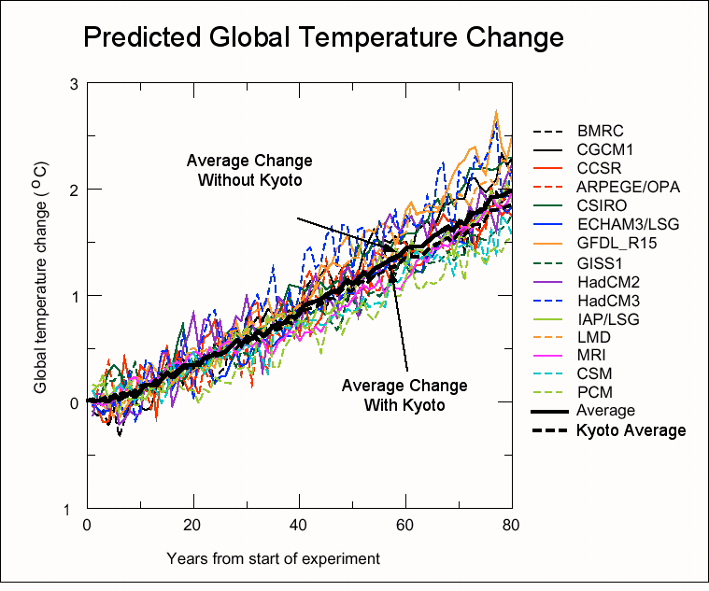
Predicted Global Temperature Change
With and Without Kyoto Protocol
3
Model Runs
BMRC
CGCM1
CCSR
ARPEGE/OPA
CSIRO
ECHAM3/LSG
GFDL_R15
GISS1
HadCM2
HadCM3
IAP/LSG
LMD
MRI
CSM
PC
Average
Kyoto Average
Average Change
Without Kyoto
2
Cº
1
0
Average Change
With Kyoto
-1
0 20 40 60 80
(Years of Implementation)

Slide 24
The Challenge of Climate Policy
How far beyond price neutral, “no regrets” GHG emission reduction policies should we go?
Will the incremental reductions beyond “no regrets” have an appreciable effect on global climate?

Slide 25
Conclusions
Natural gas is still the fuel of choice for the Western U.S.
Consumer sensitivity to higher energy prices makes NIMBY a problem for the environment
Energy conservation from price signals may be more “sustainable” than command-and-subsidy conservation
Climate change policy will need to be as price neutral as possible — at least in the short term

