Slide 1

Services & Energy in the New Economy
Dr. Kenneth L. Lay
Chairman & CEO, Enron
on behalf of the
Coalition of Service Industries
Energy Services Coalition
3rd Ministerial Conference
World Trade Organization
Seattle, Washington
December 2, 1999

Slide 2
Economic Change
Old Economy
Supply-driven
Mass production
Monopoly franchises
Technology slows
speed to market
Value in assets
Geographical
New Economy
Demand-driven
Mass customization
Competition
Technology increases
speed to market
Value in people
Global

Slide 3
New Economy Evolution
Market
Liberalization
Falling
Information
Costs
Increased
Demand for
Services
Fluid
Venture
Capital
Phase 1
First-Mover
Businesses
Network
Economies
Mass
Customization
Phase 2
Open
Efficient
Markets
Final Phase

Slide 4
Globalization of the World Economy
1970 – 1995
Billion 1996 $ U.S.
1970 1980 1990 1995
World Exports 298 1921 3379 5080
World GNP 15,700 22,900 30,700 34,600
Percent 1.9% 8.4% 11.0% 14.7%
The world economy is becoming
increasingly interdependent
  Source: U.S. CIA

Slide 5
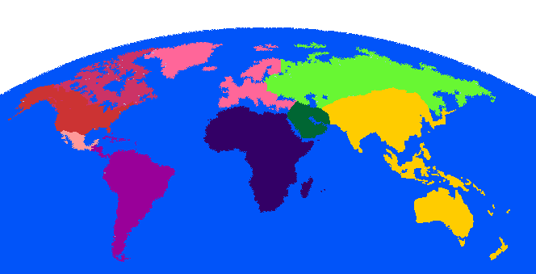
The Global Reach of Services

Slide 6
Coalition of Service Industries
Telecom
Professional
Financial
Air
Cargo
Transportation
Information
Technology
Travel
Energy
Services
Retail
Distribution
Education
Entertainment

Slide 7
Services Industry Accomplishments in WTO/GATS Process
Financial Services Agreement (1997)
Basic Telecommunications Agreement (1997)
Maintain existing levels of market openness
Significant opportunities remain
for Services 2000 negotiations

Slide 8
Definition of Energy Services
"Energy services are those services that comprise or are related to the exploration, development, extraction, production, generation, transportation, transmission, distribution, marketing, consumption management and efficiency of energy, energy products and fuels."
- Energy Services Coalition

Slide 9
Two Categories of Energy Services
Finance
Risk Management
Management
Logistics
Physical Infrastructure
Value-Added Services

Slide 10
Global Energy Market Infrastructure Needs to 2010
(U.S. $ Billions)
$400
$4,725
$1,575
$2,750
Source: J.S Herolds, McGraw-Hill, OGJ, Gas & Pipeline Journal, Hydrocarbon Processing, Enron

Slide 11
New Energy Services
Futures Trading
Competitive Access
Product Customization
Internet Access
Outsourcing
Environmental

Slide 12
Energy Futures Markets: U.S. and Europe
NYMEX
CBOT
MGE
IPE
Nordpool
Oil and
Products
Heating Oil
Unleaded Gasoline
Light Sweet Crude
Brent Crude Futures
Gas Oil Futures
Brent Crude Options
Gas Oil Options
Coal
Central Appalachian
Natural
Gas
Henry Hub
Permian Basin
Alberta, Canada
Gas Futures
CA/OR Border
Palo Verde/AZ
Cinergy
Entergy
PA/NJ/MD (PJM)
Com Ed
Twin Cities
TVA
Electricity Spot
Electricity Futures
Electricity Options
Electricity

Slide 13
Potential Markets for
Direct-Access Energy
(Annual Revenue in U.S. $ Billions)
$720
$360
$371
$120
$40
U.S. Wholesale Gas
U.S. Wholesale Power
U.S. Retail Gas & Power
Europe Gas & Power
Rest of World Gas & Power
$1.6 Trillion Annual Market Size
Source: Enron

Slide 14
EAST-BASIS
BASIS
EAST-OPTION-BASIS
KC-EAST-BASIS
East
GAS DAILY
PRM-EAST-BASIS
EAST-GD-GDL
EAST-OPTION-PRICE
Natural Gas Customization
PRICE
EAST-PRICE
East
KC-EAST-PRICE
NG-INDEX-ANN-EAST-PRICE
POWER
EAST-PWR-PRICE
EAST-PWRP-PRC
KC-NY-BASIS
BASIS
NY-BASIS
NY-OPTION-BASIS
NY
GAS DAILY
PRM-NY-BASIS
NY-GD-GDL
KC-NY-PRICE
PRICE
NY-OPTION-PRICE
NY-PRICE
PRM-NY-PRICE
POWER
NY-PWR-PRICE
NY-PWRP-PRICE
CENTRAL-BASIS
BASIS
CENTRAL-OPTION-BASIS
KC-CENTRAL-BASIS
Central
GAS DAILY
PRM-CENTRAL-BASIS
CENTRAL-GD-GDL
CENTRAL-OPTION-PRICE
PRICE
CENTRAL-PRICE
KC-CENTRAL-PRICE
PRM-CENTRAL-PRICE
POWER
NG-INDEX-ANN-CENTRAL-PRICE
Long Term
CENTRAL-PWR-PRICE
CENTRAL-PWRP-PRICE
KC-TEXAS-BAS
IS
KC-WAHA-BASIS
BASIS
PRM-TEXAS-BASIS
TEXAS-BASIS
TEXAS-OPTION-BASIS
Texas
GAS DAILY
WAHA-BASIS
TEXAS-GD-GDL
KC-TEXAS-PRICE
KC-WAHA-PRICE
PRM-TEXAS-PRICE
PRICE
TEXAS-OPTION-PRICE
TEXAS-PRICE
WAHA-PRICE
NG-INDEX-ANN-TEXAS-PRICE
NG-INDEX-ANN-WAHA-PRICE
POWER
TEXAS-PWR-PRICE
TEXAS-PWRP-PRICE
BASIS
KC-WEST-BASIS
WEST-BASIS
WEST-OPTION-BASIS
West
GAS DAILY
NG-KG-PRICE-BASIS
WEST-GD-GDL
KC-WEST-PRICE
PRM-TEXAS-PRICE
PRICE
TEXAS-OPTION-PRICE
WAHA-PRICE
NG-INDEX-ANN-WEST-PRICE
POWER
NG-KC-PRICE-PRC
WEST-PWR-PRICE
Commodity
WEST-PWRP-PRICE
Canada
BASIS
CAND-EGSC-BASIS
CAND-ERMS-BASIS
GAS DAILY
CAND-EGSC-GD-GDL
PRICE
CAND-EGSC-PRICE
CAND-ERM
S-PRICE
POWER
NG-AIR-PRICE-PRC
INTRA-BUG-BASIS
CAND-PWR-HDG-PRICE
BASIS
INTRA-BUG-GDOPT-GDL
INTRA-NORTHEAST-BASIS
ST-HATTIESBURG-BASIS
ST-SYNTHETIC-NE-BASIS
INTRA-BUG-GDL
NE
PHYSICAL
INTRA-BUG-GDOPT-GDL
INTRA-BUG-PHYSICAL
INTRA-NE-GDOPT-GDL
INTRA-NE-PROMPT-PHYSICAL
INTRA-NORTHEAST-GDL
INTRA-NORTHEAST-PHYSICAL
INTRA-BUG-GDOPT-PRICE
PRICE
INTRA-BUG-PRICE
INTRA-NORTHEAST-PRICE
ST-HATTIESBURG-PRICE
ST-SYNTHETIC-NE-PRICE
INTRA-SOUTHEAST-BASIS
BASIS
ST-NAPOL-EAST-BASIS
ST-PARK/LEND-BASIS
SE
ST-SYNTHETIC-SE-BASIS
INTRA-SE-GDOPT-GDL
PHYSICAL
INTRA-SE-PROMPT-PHYSICAL
INTRA-SOUTHEAST-GDL
INTRA-SOUTHEAST-PHY
INTRA-SOUTHE
AST-PRICE
PRICE
ST-NAPOL-EAST-PRICE
ST-PARK/END-PRICE
ST-SYNTHETIC-SE-PRICE
BASIS
INTRA-CENTRAL-BASIS
ST-SYNTHETIC-CE-BASIS
ST-YAGGY-CENT-BASIS
Volume
Central
INTRA-CE-PROMPT-PHYSICAL
PHYSICAL
INTRA-CENT-GDOPT-GDL
INTRA-CENTRAL-GDL
INTRA-CENTRAL-PHYSICAL
PRICE
INTRA-CENTRAL-PRICE
INTRA-KC-CENTRAL-PRICE
Short Term
ST-SYNTHETIC-CE-PRICE
ST-YAGGY-CENTRAL-PRICE
INTRA-KC-TEXAS-TEXAS-BASIS
BASIS
INTRA-KC-WAHA-BASIS
INTRA-TEXAS-BASIS
INTRA-WAHA-BASIS
ST-SYNTHETIC-TEXAS-BASIS
INTRA-TEXAS-GDL
Texas
INTRA-TEXAS-PHYSICAL
INTRA-TEXAS-GDOPT-GDL
PHYSICAL
INTRA-TX-PROMPT-PHYSICAL
INTRA-WA-PROMPT-PHYSICAL
IN
TRA-WAHA-GDL
INTRA-WAHA-GDOPT-GDL
INTRA-WAHA-PHYSICAL
INTRA-KC-TEXAS-PRICE
INTRA-KC-WAHA-PRICE
PRICE
INTRA-PRM-TEXAS-PRICE
INTRA-PRM-WAHA-PRICE
INTRA-TEXAS-PRICE
INTRA-WAHA-PRICE
ST-SYNTHETIC-TX-PRICE
Natural
Gas
INTRA-KC-WEST-WEST-BASIS
BASIS
INTRA-WEST-BASIS
West
ST-SYNTHETIC-WE-BASIS
INTRA-WE-PROMPT-PHYSICAL
PHYSICAL
INTRA-WEST-GDL
INTRA-WEST-GDOPT-GDL
INTRA-WEST-PHYSICAL
INTRA-KC-WEST-PRICE
PRICE
INTRA-PRM-WEST-PRICE
INTRA-WEST-PRICE
ST-SYNTHETIC-WE-PRICE
INTRA-CANADA-BASIS
BASIS
INTRA-CAND-BC-BASIS
INTRA-CAND-EAST-BASIS
INTRA-CAND-WEST-BASIS
Canada
INTRA-CAND-BC-GD-GDL
IN
TRA-CAND-BC-PHYSICAL
PHYSICAL
INTRA-CAND-WE-GD-GDL
INTRA-CAND-WEST-PHYSICAL
INTRA-CDBC-GDOPT-GD
INTRA-CDEA-GDOPT-GDL
INTRA-CANADA-PRICE
PRICE
INTRA-CAND-BC-PRICE
INTRA-CAND-EAST-PRICE
INTRA-CAND-WEST-PRICE
Transport
TP-FINANCIAL-BASIS
TP-FINANCIAL-PRICE
HPL
LRC
NORTHERN BORDER PIPELINE
TRANS CANADA PIPELINE
PACIFIC GAS TRANSMISSION
Storage
BAMMEL
NAPOLEONVILLE
BISTINEAU
UNION GAS
TRANSCO
OPTIONS-CE-BASIS
OPTIONS-EA-BASIS
BASIS
OPTIONS-NY-BASIS
Options
OPTIONS-PRICE-BASIS
OPTIONS-TX-BASIS
OPTIONS-WE-BASIS
OPTIONS-CE-PRICE
OPTIONS-EA-PRICE
PRICE
OPTIONS-NY-PRICE
OPTIONS-PRICE-PRC
OPTIONS-TX-PRICE
OPTIONS-WE-PRICE
BASIS
GAS-DAILY-BASIS
GAS-DAILY-OPTION-BASIS
GAS-DAILY-GDL
Gas Daily
GAS-DAILY-OPTION
-GDL
GD-OPTION-CENTRAL-GDL
GAS DAILY
GD-OPTION-EAST-GDL
GD-OPTION-NY-GDL
GD-OPTION-TEXAS-GDL
GD-OPTION-WEST-GDL
OPTIONS-GDOPT-GDL
GAS-DAILY-OPTION-PRICE
PRICE
GAS-DAILY-PRICE
OMICRON-PRICE
POWER HEDGE
EXOTIC PRC
INDEX-OP-BAS
HEDGE SPEC
NYMEX
ERMS-XL
INDEX-OP-PRD
MAH II - PRC
OPTIONS
PRICE
MAH IV - PRC
OPTIONS
Price
PRICE
ECT STRATEG-PRC
OPTIONS
PRICE
ENERGY-AMER-PRC
OPTIONS
PRICE
CANADA
OPTIONS
Central
CENTRAL
PRICE
OPTIONS
NORTHEAST
PRICE
Regions
East
OPTIONS
PRICE
SOUTHEAST
OPTIONS
PRICE
West
OPTIONS
PRICE
Texas
EAST TX
OPTIONS
WAHA
PRICE
OPTIONS
1989
1990
1991
1992
1993
1994
PRICE
1995
1996

Slide 16
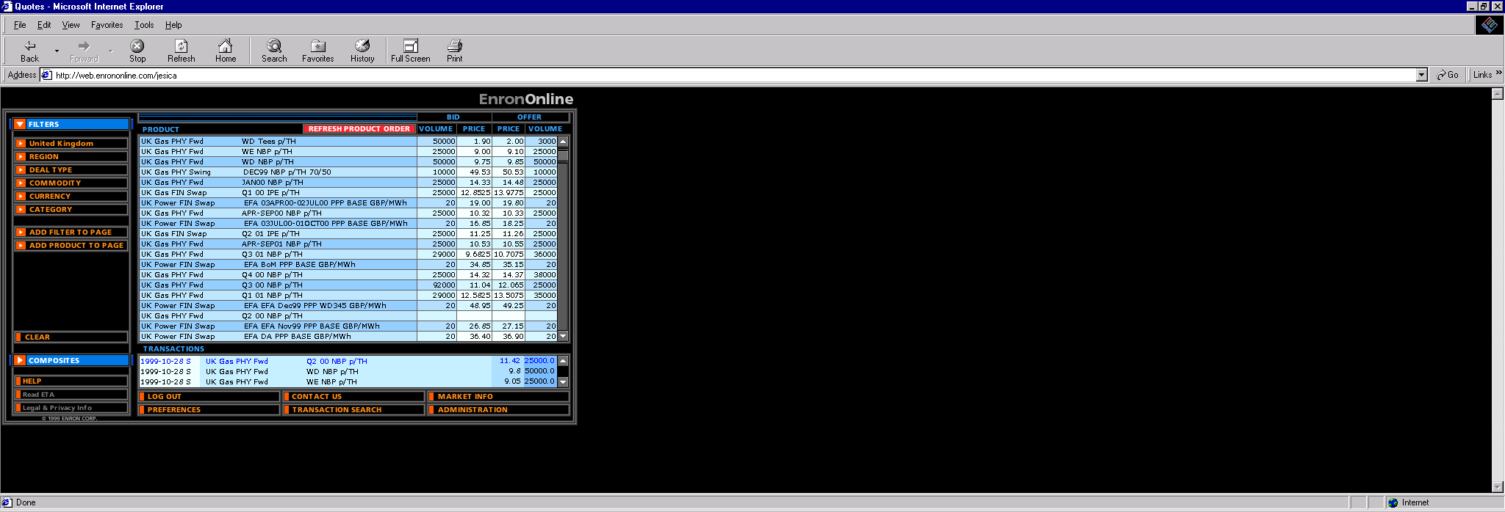
Global Internet Quote Screen

Slide 17
Total Outsourcing for Energy Efficiency
Traditional Suppliers
Single Source Supplier
Customer Needs
Utilities
Commodity
Management
Software Vendors
Light
Controls Manufacturers
Architects
Energy Information Management
Engineers
Equipment Manufacturers
Conditioned Air
Mechanical Contractors
Energy Asset
Management
Electrical Contractors
HVAC Svc Companies
Consultants
Facilities
Management
Specialty Contractors
Managed Facilities
Lenders
Capital
Management
Internal Treasury

Slide 18
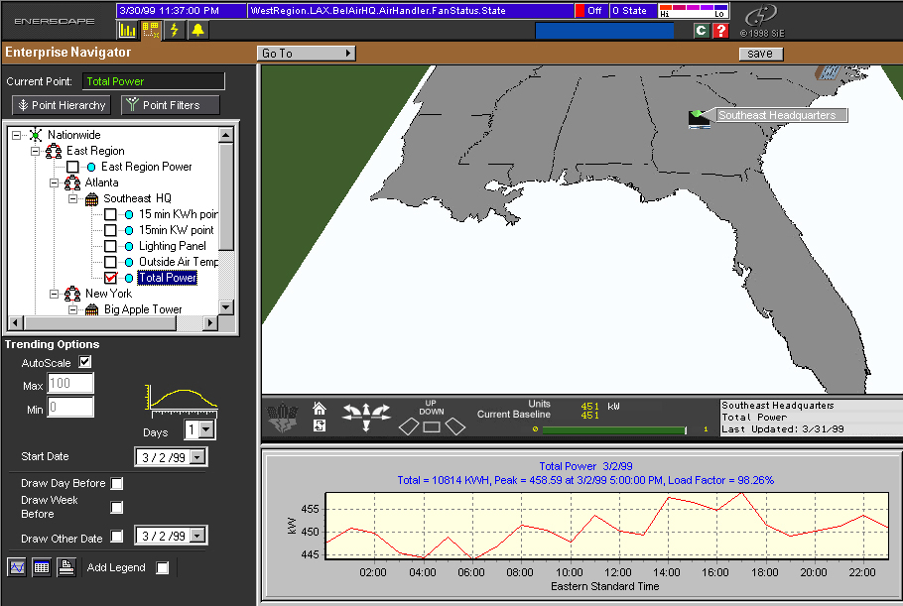
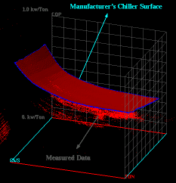
Information-Age Energy Management
Performance Risks
Risk Management
ViewPort
Consumption
Diagnostics
Failure
Optimization
Weather
Performance
Internet
Connectivity
Production
Operations
Labor
Analytics
Management
Control

Slide 19
Energy-Environmental Nexus
Energy
Services
Energy Efficiency
Emissions Trading
Compliance
Environmental
Services

Slide 20
Benefits to Services from WTO Status in GATS Negotiation
Promote open trade and nondiscriminatory treatment of foreign investment
Encourage “best practices” with privatization and regulation to achieve transparency, equity and efficiency
Facilitate the globalization of the latest technologies for economic and environmental benefits

Slide 21
Conclusions
Services is the largest and fastest growing segment of the global New Economy
The services market is information-driven, transparent, competitive, and global – government policies must adapt to these realities
Energy services is integral to the New Economy
WTO status is as imperative for energy services as for financial services, telecommunications, and other pillars of the service economy

