Slide 1
Notes for using Adhoc VaR
Internet Explorer & Settings
Ensure that you are using Internet Explorer version 5 or later
Make the following changes to settings (Adhoc VaR utilizes ActiveX
controls and if these are disabled, it will not run)
a) In Internet Explorer, go to the Tools menu item and select
Internet Options
b) Select the Security tab
c) Make sure Local Intranet is highlighted
d) Select the Custom Level button
e) Make sure that the choices for ActiveX controls and plug-ins
are all enabled. There are five sub-items which all must be
enabled.
f) Click on OK and OK again

Slide 2
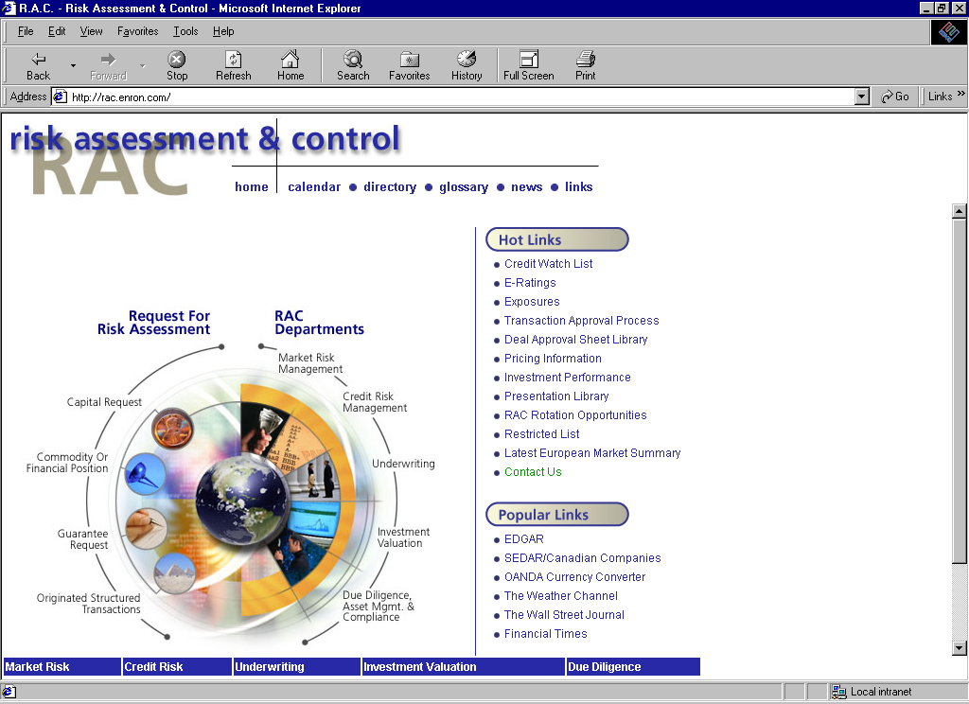
Click on Market
Risk Management

Slide 3
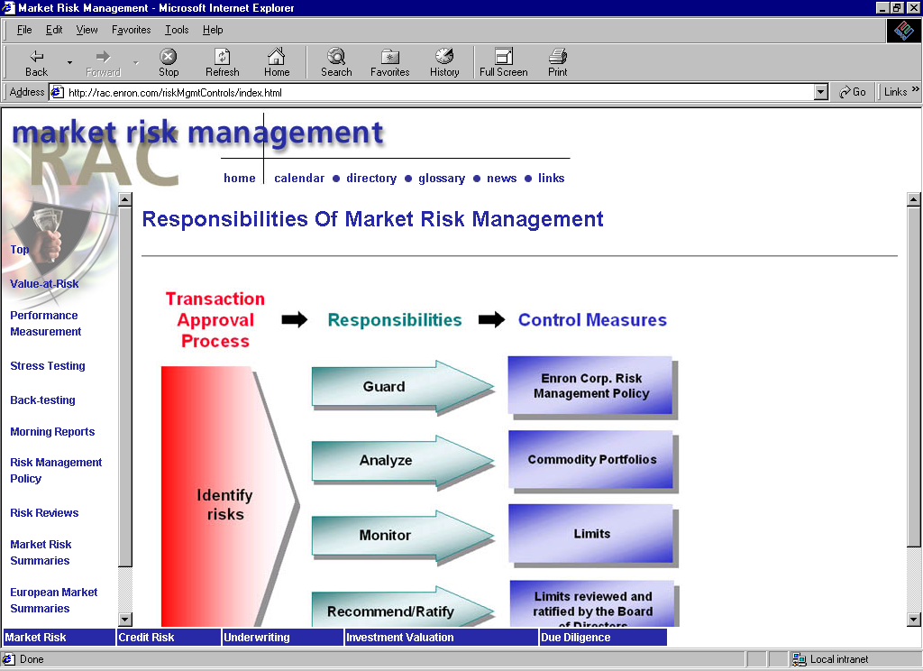
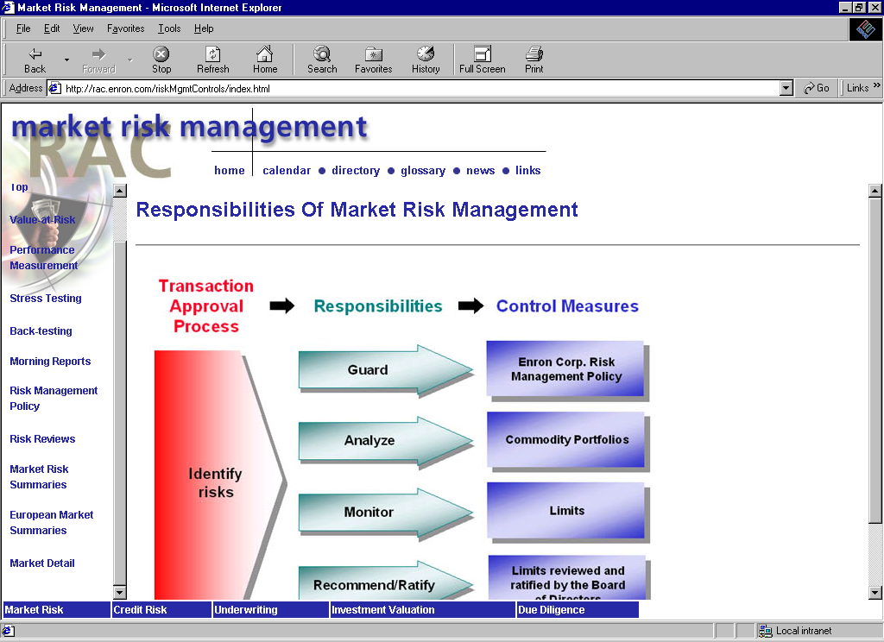
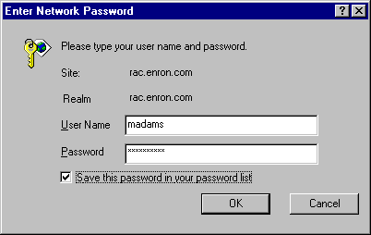
Scroll to “Market Detail”
at the bottom, then use
Corporate Network login
and password

Slide 4
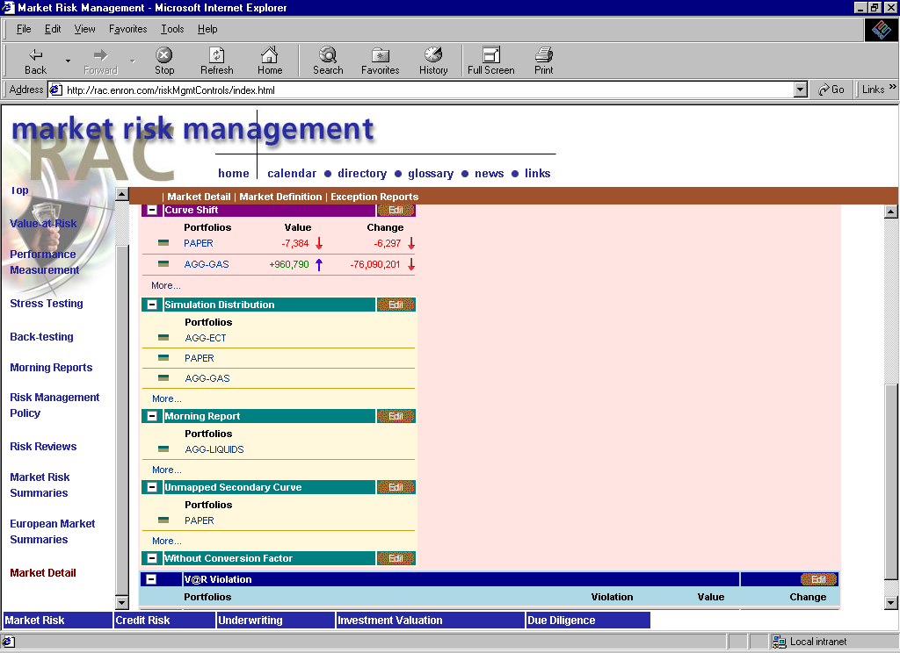
When you get into the “Market
Detail” section, scroll down to
“Simulation Distribution” and
select “Edit” to select the
portfolios you will use for
Adhoc VaR.

Slide 5
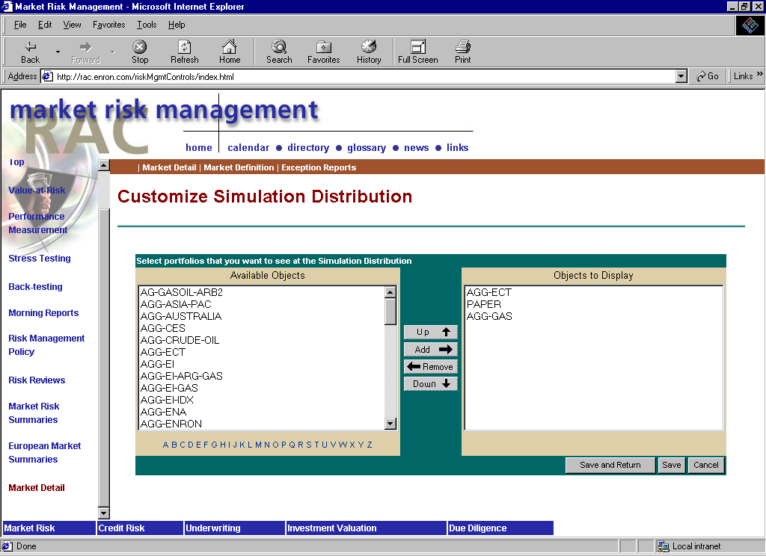
Select portfolio(s) and click on
“Add” after each choice. Then
choose “Save and Return”

Slide 6
At the main screen click on the
portfolio you will be using for
Adhoc VaR. This is still required
even if you intend to only run
Adhoc VaR against a spreadsheet.

Slide 7
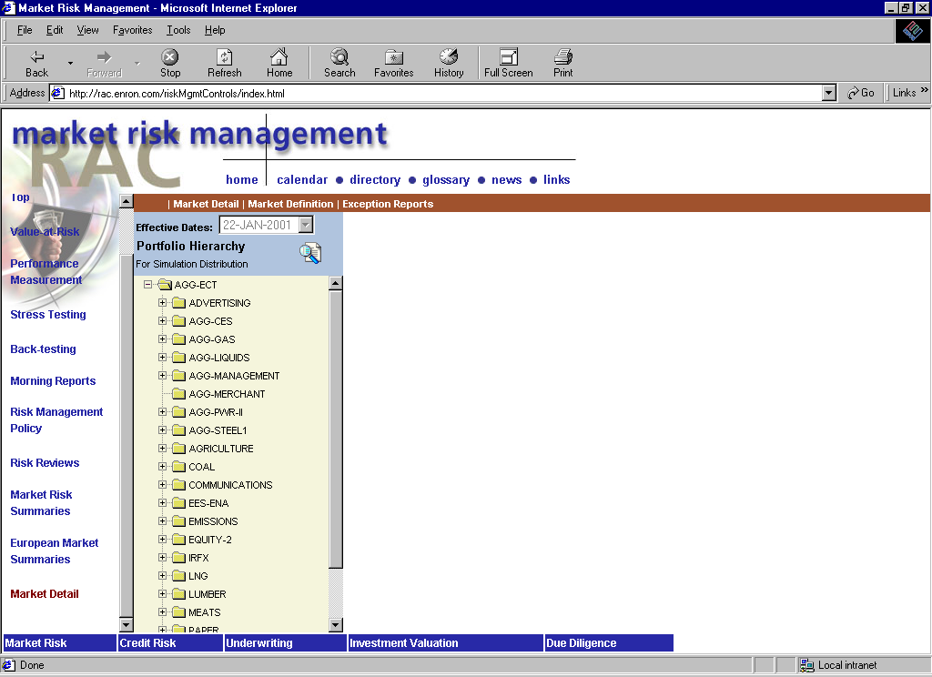
If the portfolio you selected has
sub-portfolios beneath it, it will
show the hierarchy and give you
the ability to select one of the
sub-portfolios instead. Click on
either the parent or one of the
sub-portfolios.

Slide 8
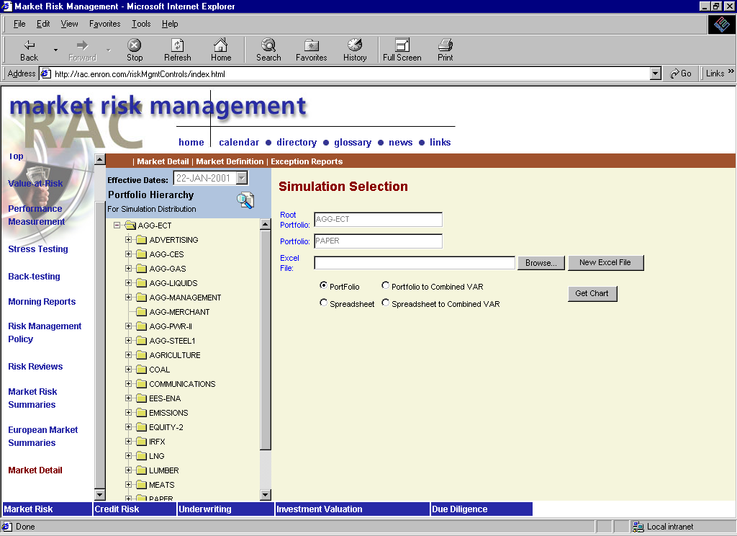
Here we have selected the “Paper”
portfolio. The options are:
1) Load an existing spreadsheet
by clicking on “Browse”
2) Retrieve the Adhoc VaR
spreadsheet template and
set up an adhoc by clicking on
“New Excel File”
3) Run Adhoc VaR on either
the portfolio, the spreadsheet,
or see the combined effect from
either the portfolio’s or the
spreadsheet’s perspective
* Click on “Get Chart” after an
option has been selected

Slide 9
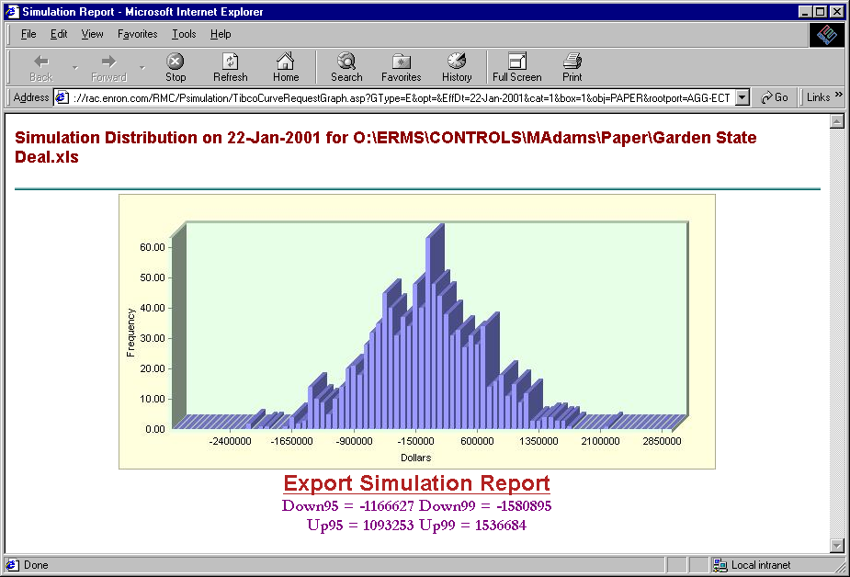
The Adhoc VaR should populate
in a new window. You can
“Alt-Print” the screen, and you
can also export the distribution
to Excel by clicking on the
“Export Simulation Report” link

