Slide 1
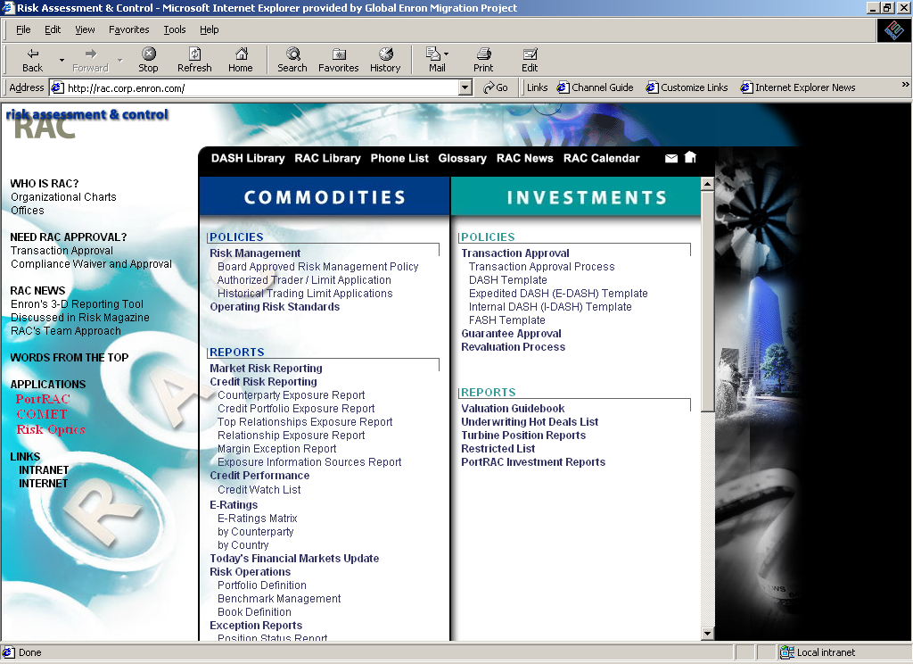
http://rac.corp.enron.com
Click on Market
Risk Reporting

Slide 2
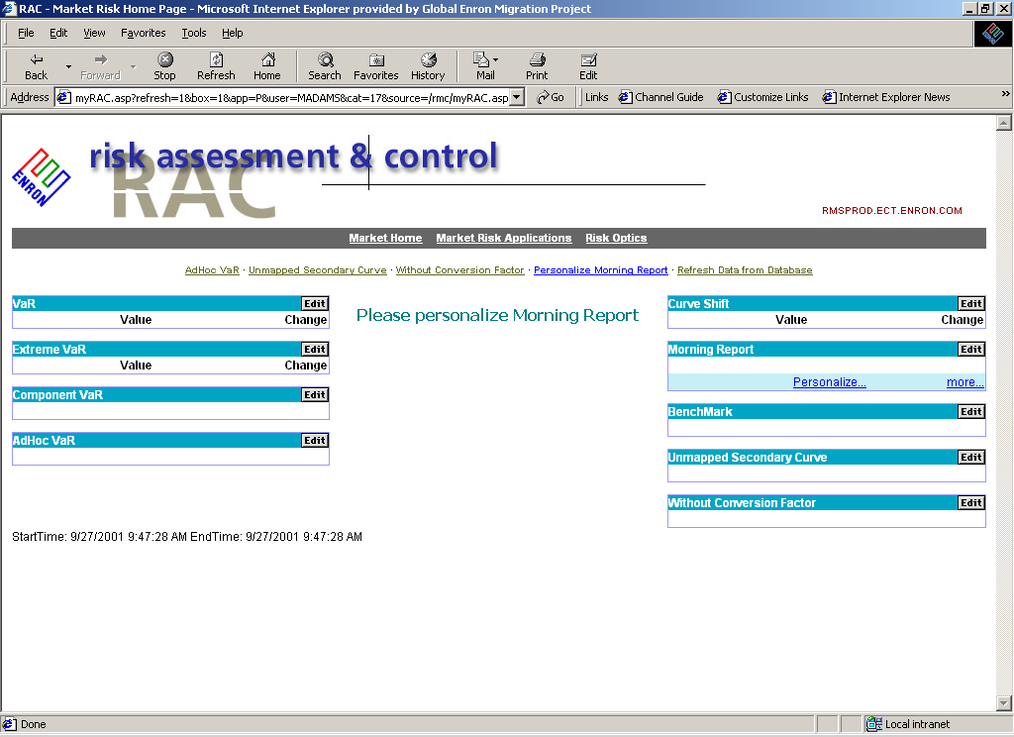
Once you have decided a
Report to view, select its “Edit”
button which will take you to
a new screen to add portfolios
There are various choices,
including VaR, Extreme VaR,
Component VaR, etc.

Slide 3
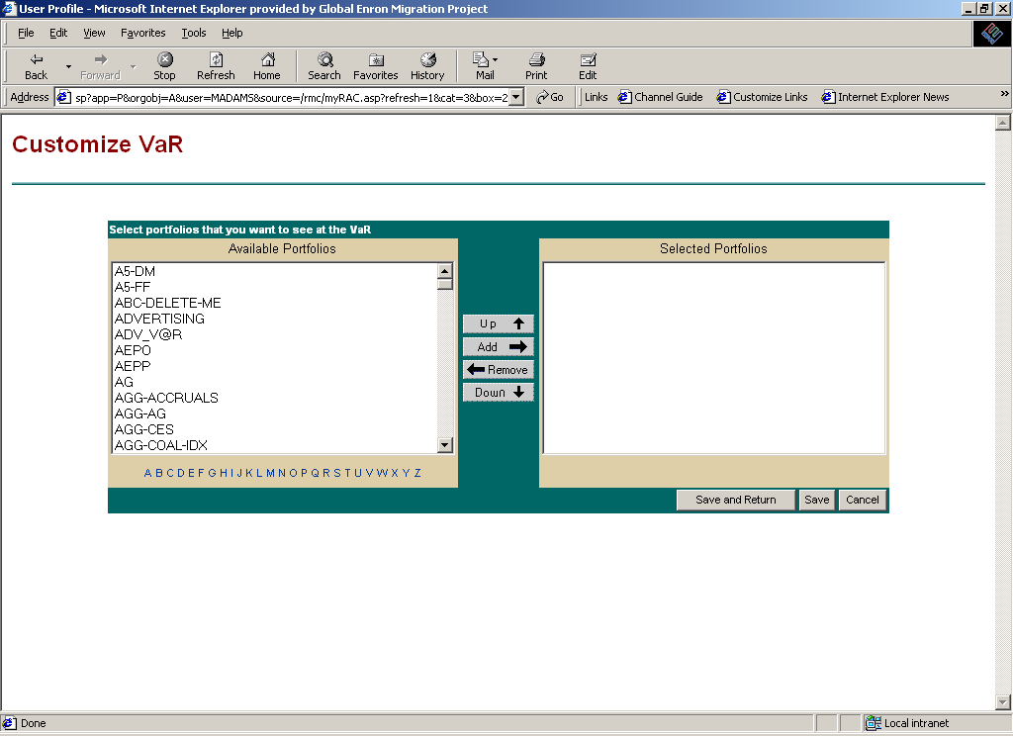
This screen sets up your “preferences,” meaning the portfolios you will immediately
see each time you log into the website. You can change them at any time using
these same steps:
Choose a letter of the alphabet corresponding to the first letter of the portfolio name
(such as “U” for UK-GAS or UK-POWER)
Select the “Add” button
Select the “Save” button
Repeat steps 1-3 for to add additional portfolios (one-by-one)
You may re-order your choices by highlighting a portfolio and using the up/down arrows
Press the “Save and Return” button after the last choice

Slide 4
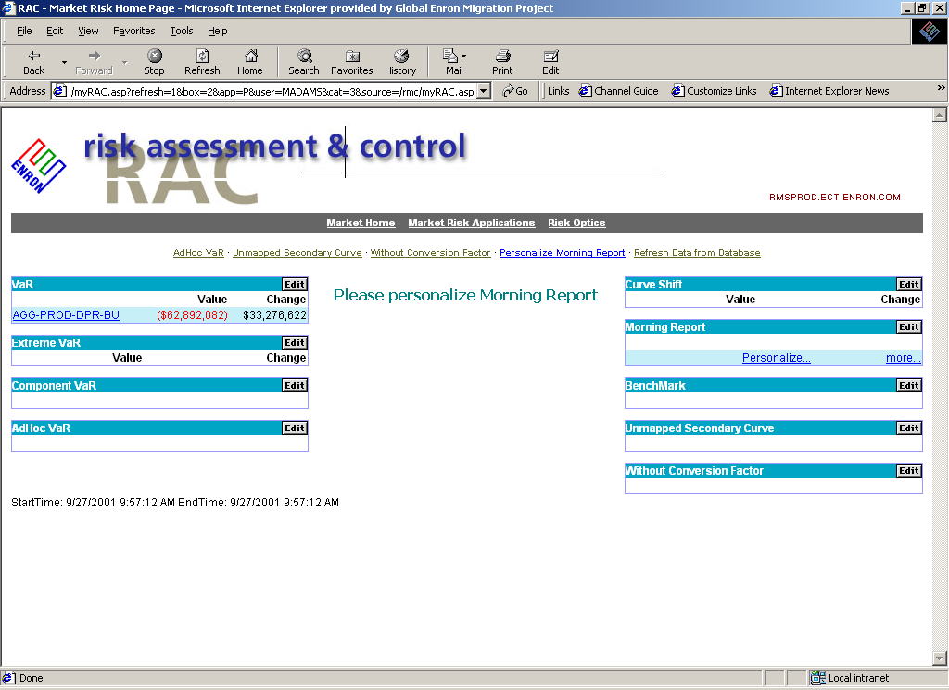
Now that a portfolio has been chosen, you can quickly see the
relevant number immediately on the web page, or you can click
on the name of the portfolio to launch a more detailed report

Slide 5
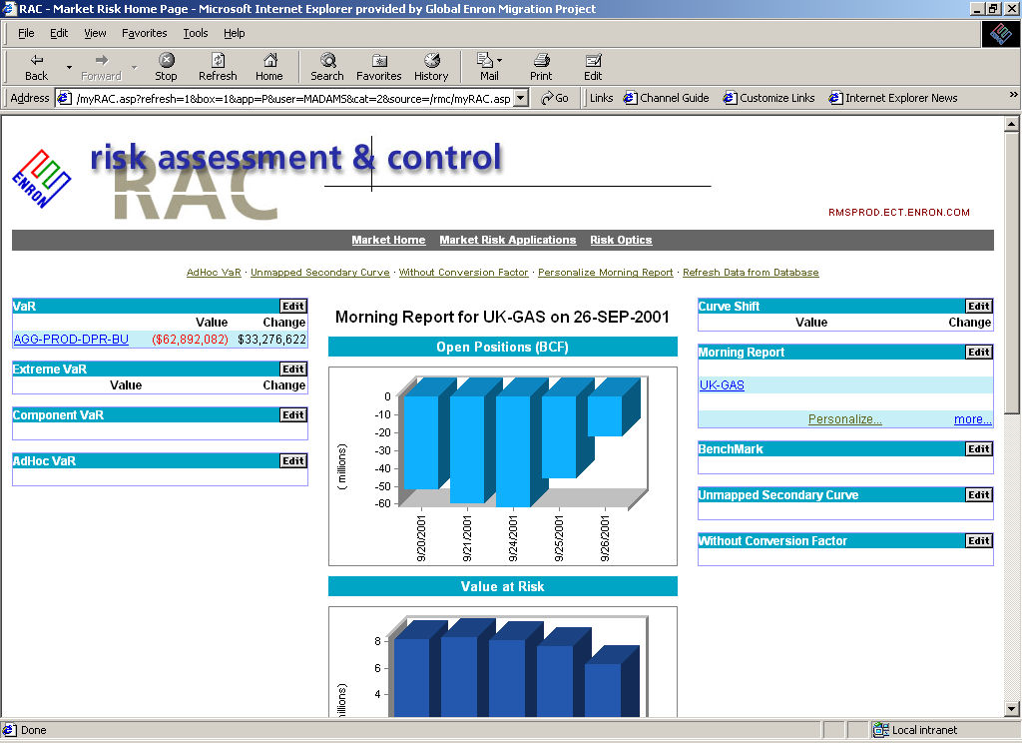
You may also create a personalized morning report which will
automatically appear in the center of your web page by choosing
the “Personalize” button

