Slide 1

TASKER FINANCIAL GROUP
PRESENTS
April 26, 2001
Notes:
<number>
<footer>
<header>
<date/time>

Slide 2
Warren Buffet
“The Oracle of Omaha” or
“The Mistake of a Miser”
Notes:
<number>
<footer>
<header>
<date/time>

Slide 3

TASKER FINANCIAL GROUP
Europe
Jeff Dasovich
Mark Guinney
North America
Carolyn Vavrek
Asia
Anil Sama

Slide 4
THE DEAL
November 2000
Pepsi makes surprise takeover offer – OAT rejects
Coke makes an offer
Group Danone (French-based seller of Evian) makes an offer
Coke withdrawals offer
    “The Board of The Coca-Cola Company expressed its enthusiastic support for the current strategic course of the Company under Doug Daft’s leadership as the best means for enhancing shareowner value”
December 2000
Pepsi and OAT agree on deal: pooling—stock and $750 of assumed debt
  2.3 Pepsi shares/OAT share up to a maximum value of $105/OAT share
  OAT can exit if value falls below $92/share
April 2001
Pepsi announces sale of 13.2 million shares to ensure merger can qualify for “pooling of interests”
Notes:
OAT rejects Pepsi’s offer because Pepsi would not provide security against share price drop
Points about Coke’s offer
Rookie CEO Douglas Daft’s idea
Strategy: boost Coke’s sales of non-carbonated drinks
CEOs posed for publicity photos together
“Giving up 10.5% of the Coca-Cola Company was just too much for what we would get” Mr. Buffet says.
- offer never brought to a vote
Clearance from European and Mexican regulators
Still under review by FTC
- FTC is interviewing bottlers and retailers
- deal expected to close in mid or late June

Slide 5
SUMMARY OF DEALS

Slide 6
PRESENTATION AGENDA
Industry Analysis
Company Analysis
Deal Analysis
Epilogue

Slide 7
INDUSTRY ANALYSIS- Food
Consolidated, concentrated with few niche players
Major factors of growth:
  Increasingly global
  Low margin, high volume
  New markets (international)
  New products
  Distribution
  Asset Intensive
Recent industry changes:
  Snack food growth up
  Cereal food growth down
General Mills, Nestle, Pepsi, Kraft, Kellogg

Slide 8
INDUSTRY ANALYSIS- Beverage
Consolidated, concentrated with few niche players
Major factors of growth:
  Increasingly global
  Low margin, high volume
  New markets (international)
  New products
  Distribution
  Asset Intensive
Recent industry changes:
  Stagnant carbonated drinks
  High growth of sports, non-carbonated, “alternative” beverages
Coke, Pepsi, Cadbury-Schweppes

Slide 9
BEVERAGE VERSUS FOOD

Slide 10
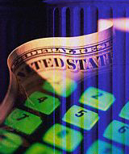
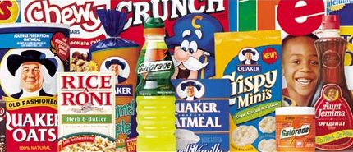
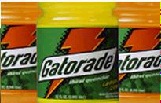
WHO IS QUAKER OATS?
FOOD
BEVERAGE
60% of Sales & Income
RTE Cereals Lagging
40% of Sales & Income
Impressive growth
Notes:
Gatorade= 85% of US sports market beverage
Food products expecting 2% compounded growth rate
Gatorade expecting a 12% compounded growth rate

Slide 11
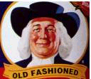
QUAKER OATS- Financial Analysis

Slide 12

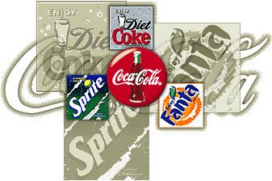




WHO IS COCA-COLA?
#1 Global Carbonated
#1 US non-carbonated
#2 US sports drink
New CEO- Daft
Notes:
<number>
<footer>
<header>
<date/time>

Slide 13
COCA COLA- Financial Analysis

Slide 14


PURPOSE OF ACQUISITION
Notes:
<number>
<footer>
<header>
<date/time>

Slide 15
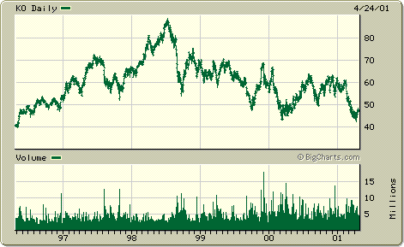
PURPOSE OF ACQUISITION
Notes:
<number>
<footer>
<header>
<date/time>

Slide 16
TFG VALUATION- Conservative
13% WACC
14.7x EBITDA Multiple
10 year forecast
Discounted Cash Flow Model
Constant Sales growth of 6%
Enterprise Value= $9.8 b
Difference of $5.9 billion
Notes:
<number>
<footer>
<header>
<date/time>

Slide 17
TFG VALUATION- Aggressive
9% WACC
18x EBITDA Multiple
10 year forecast
Discounted Cash Flow Model
Constant Sales growth of 6%
Enterprise Value= $15.7 b
Coke Bid= $15.75 b
Equals the Bid on the Table
Notes:
<number>
<footer>
<header>
<date/time>

Slide 18
TFG ACQUISITION VALUATION
Deal Comps (18 F&B companies acquired in ‘00 w/ value >$500MM)
Trading Comps (48 Food & Beverage Companies w/ Rev >$500MM)
Coke/Quaker proposed multiples:
  EBITDA: 20.4
  TEV / EPS: 38.8
  TEV / Sales: 2.9
Notes:
Include Deal comps
Trading comps
DCF valuation
Include basic assumptions

Slide 19
TFG VALUATION
Notes:
Include Deal comps
Trading comps
DCF valuation
Include basic assumptions

Slide 20




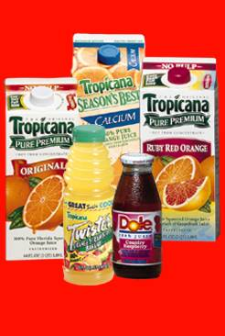

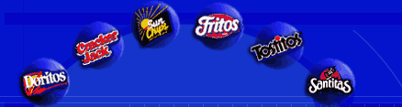
WHO IS PEPSI?
#2 US Carbonated beverages
#2 Global Refreshment Co.
#1 Salty Snack- globally
Notes:
<number>
<footer>
<header>
<date/time>

Slide 21
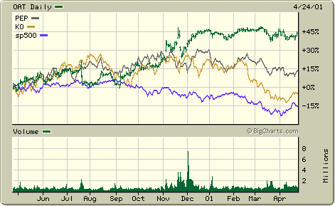
MARKET REACTION TO EVENTS
Daily percentage change of OAT, PEP, KO and S&P 500 for 12 months

Slide 22
Notes:
<number>
<footer>
<header>
<date/time>

Slide 23
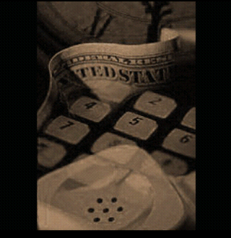
Warren Buffet
Still
“The Oracle of Omaha”

