Slide 1

Tasker Financial Group
Presents
April 26, 2001
Notes:
<number>
<footer>
<header>
<date/time>

Slide 2

TASKER FINANCIAL GROUP
Europe
Jeff Dasovich
Mark Guinney
North America
Carolyn Vavrek
Asia
Anil Sama

Slide 3
Coca-Cola/Quaker Oats Acquisition
Buffet Right or Wrong

Slide 4
Summary of Deals

Slide 5
History of Deal
Beginning of Deal
  Pepsi offers $14.8b in stock using pooling
  OAT rejects offer because PEP refuses to offer collar
  KO offers $15.75b
  KO withdrawals offer
    Why?

Slide 6
Table of Contents
Industry Analysis
Company Analysis
Deal Analysis

Slide 7
Industry Analysis- Food & Beverage
Consolidated, concentrated with few niche players
Major players
  Food: General Mills, Nestle, Pepsi, Kraft, Kellogg
  Beverage: Coke, Pepsi, Cadbury-Schweppes
Major factors of growth:
  New markets (international)
  New products
  Distribution
Recent industry changes:
  Boom in of non-carbonated beverages
  Slowdown in carbonated drinks
  Emphasis on health products
  Convenience

Slide 8
Industry Analysis- Food
Consolidated, concentrated with few niche players
Major factors of growth:
  Increasingly global
  Low margin, high volume
  New markets (international)
  New products
  Distribution
  Asset Intensive
Recent industry changes:
  Snack food growth up
  Cereal food growth down
Add logos of competitors

Slide 9
Industry Analysis- Beverage
Consolidated, concentrated with few niche players
Major factors of growth:
  Increasingly global
  Low margin, high volume
  New markets (international)
  New products
  Distribution
  Asset Intensive
Recent industry changes:
  Snack food growth up
  Cereal food growth down
Add logos of competitors

Slide 10

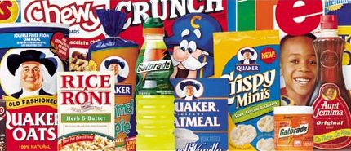
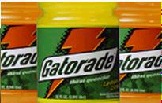
Who is Quaker Oats?
FOOD
BEVERAGE
60% of Sales/Income
40% of Sales/Income
Notes:
Gatorade= 85% of US sports market beverage
Food products expecting 2% compounded growth rate
Gatorade expecting a 12% compounded growth rate

Slide 11
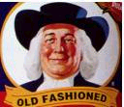
Quaker Oats – Financial Analysis
ROE decomposition
Common size financials
Cash flow analysis
Our valuation results

Slide 12

Who is Coca-Cola?
BEVERAGE
#1 Global Carbonated
#1 US non-carbonated
#2 US sports drink
New CEO
  - Douglas Daft
Notes:
Coca Cola expecting 2% growth rate over 4 years
#1 Non-US sport drink and #2 US sport drink- Powerade
Soft Drinks expecting 5% growth over 5-years
Add Minute Maid & Dasani, Nestea

Slide 13

Purpose of Acquisition

Slide 14
TFG Acquisition Valuation
Notes:
Include Deal comps
Trading comps
DCF valuation
Include basic assumptions

Slide 15
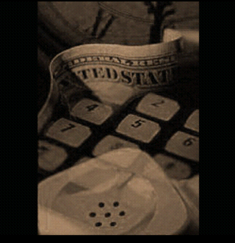

Slide 16
Who is Pepsi?
#1 Salty Snack- globally
  Frito Lay=66% profits
#2 Global refreshment company
#2 US Carbonated beverages
Notes:
Own Tropicana, Lipton, Sobe add brands

Slide 17
Coca-Cola/Quaker Oats Acquisition

Slide 18
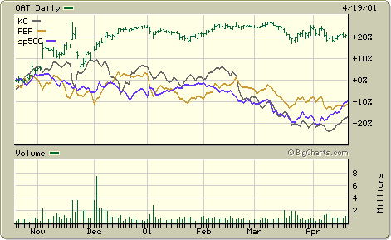
Stock Price Reactions
Stock price weekly percentage change for last 6 mos. For OAT, KO, PEP and S&P 500

Slide 19
Coca-Cola/Quaker Oats Acquisition
Buffet Right or Wrong

Slide 20
Title

Slide 21
Title

Slide 22
Title

