Slide 1

Back to Basics
What is ePowered™ Media Cast?
  Enron Communications is enabling video over the Internet the way it was meant to be seen.
  Brings broadcast quality video to users of the Internet in a manner previously unavailable by delivering live and on-demand content without the jerky video and constant buffering caused by the bottlenecks of today's Internet.
  By combining a private fiber and satellite network with a distributed server architecture, Enron has created a premium delivery platform to revolutionize the way people use video on the Internet.

Slide 2
Requesting and Receiving Basic Information over
The Internet
Network 1
Network 2
Network 1
Network 3
Web page or content site in Seattle, Washington
Network 4
End user in Muskogee, Oklahoma
Network 4
Request
Response
Requests and content packets must “hop” across multiple networks and interconnect points to reach their destination
Notes:
<number>

Slide 3
The Major Access Points Have Become Major Bottlenecks and Congestion Points
Chicago NAP
Ameritech/Bellcorp
CIX
Santa Clara
New York NAP
SprintLink
Pennsauken, NJ
San Francisco
NAP
PacBell
MAE-West
San Jose
MAE-Chicago
MAE-East
MAE-East+
Washington DC
FIX-East
College Park MD
FIX-West
Ames Research Center
Mountain View
MAE-Dallas
MAE-LA
Los Angeles
MAE-Houston
Locations
Official NAPs
  4 NAPs created by the NSFnet through outsourcing to PacBell, Sprint, Ameritech, and MFS (MAE, D.C.)
  6 Metropolitan Area Ethernets were designed to handle interconnect traffic around major metro areas; these have become de facto NAPs
  2 Federal Internet Exchange points and 1 Commercial Internet Exchange points created to provide exclusively government and commercial NAPS
MAE
FIX, CIX
Source: Telegeography; Chicago/Ameritech NAP Web site; press articles
Notes:
<number>

Slide 4
Traversing the Current Internet
GTE/Internet backbone
Chicago NAP Ameritech peering point
VERIO network
Web host handling Amazon website
Seattle
Minneapolis
Boston
New York
Philadelphia
Palo Alto
Chicago
D.C.
Vienna
Denver
Richmond
Los Angeles
Durham
Orange
Mindspring ISP provides local dial-up local access
Atlanta
Dallas
Jacksonville
Interconnect with GTE to provide backbone
Houston
  For a Mindspring user to access the Amazon website, it could traverses 3 different private networks, 2 interconnect points, and a web hosting site.
  This makes guaranteeing delivery or providing high quality delivery of basic web content very difficult.
Notes:
<number>

Slide 5
Media Cast Streaming – TODAY
End user
Mediacast streaming server
Stream delivery
“Public” Internet
ISP
InterNAP
Level 3
Content
EIN
Provider
ePowered ISP
Media Cast distributes customer content to its streaming servers on the edges of the EIN, and to server farms at partner WANs to put content close to the user and to avoid congestion . . . this creates a superior streaming experience.
Notes:
<number>

Slide 6
Media Cast Streaming – FUTURE
ISP
End user
Mediacast streaming server
“Public” Internet
ISP
Stream delivery
InterNAP
Level 3
Content
EIN
Provider
ePowered ISP
In the future, Media Cast will also distribute servers to ISPs not on the EIN network to enable a caching solution to avoid Internet congestion.
Notes:
<number>

Slide 7

Improving the Quality of Stream Delivery
Network congestion
Standard portal
Across the public Internet from centralized server
Streaming media delivery “sweet spot” provided by Media Cast
Delivery origin of the stream
Media Cast server at a non-ePowered ISP
Media Cast backbone WAN partner
ePowered ISP
“Hop count” from end user
Notes:
<number>

Slide 8
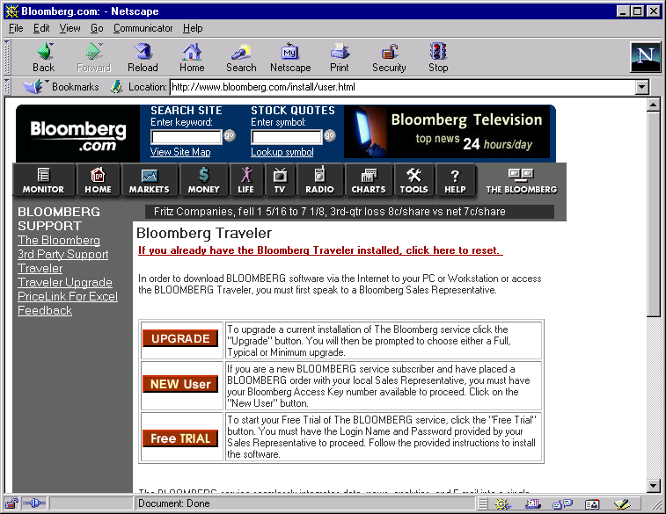






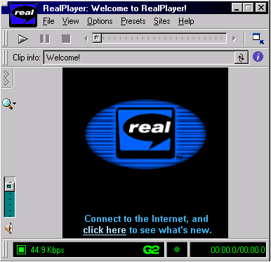
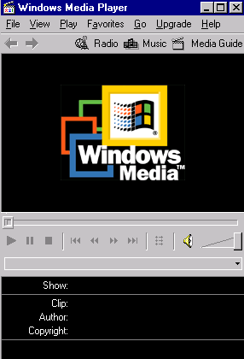
Media Cast - Content Viewing
1
End User browses content provider’s web site
3
End User is re-directed to closest ECI Edge Server for stream
2
End User clicks on streaming media link
xyz.com
ePowered
ISP
Internet
Internet
“Best Effort”
End User
ECI
Server Farm
(Co-Located)
EIN
Encode
High Quality rich media is streamed without delay and congestion to End User’s media player (1-hop routing)
Content
Provider
4
EIN
“Guaranteed QoS”
Notes:
<number>

Slide 9
Reach in 2000
_{Seattle}
_{Canada}
_{Portland}
_{Minneapolis}
_{Toronto}
_{Boston}
_{London}
_{Albany}
_{Boise}
_{Paris}
_{Detroit}
_{Copenhagen}
_{Salt Lake City}
_{Omaha}
_{New York}
_{Denver}
_{Cleveland}
_{Munich}
_{Sacramento}
_{Kansas City}
_{Chicago}
_{St. Louis}
_{Philadelphia}
_{Amsterdam}
_{San Francisco}
_{Las Vegas}
_{D.C.}
_{Rome}
_{Asia}
_{San Jose}
_{Albuquerque}
_{Charlotte}
_{Los Angeles}
_{Phoenix}
_{Atlanta}
_{San Diego}
_{Dallas}
_{Jackson}
_{New Orleans}
_{Orlando}
_{Houston}
_{Miami}
_{San Antonio}
_{Latin and South America}

Slide 10
ECI Distribution Alliances
Cmetric
Easystreet
Electric Lightwave
Epoch Internet
Firstworld
Flash.net
GST
GTE internetworking
InterNap
Level 3
Netrail
NorthPoint
OrcoNet
PDQ.net
RCN
RMI.Net
showdigital
TeleCommute Solutions
Verio
Villagenet
Represent Over 500 PoPs
Directly Accessing 24 Million Desktops

Slide 11
Media Cast Success
Country Music Association(CMA) Awards
  CountryCool.com
  Our first live event
Drew Carey
  Warner Brothers and ABC
  Largest Webcast ever on the Internet
Signed Content Deals
  DEN(Digital Entertainment Network) Roadshow.com
  AtomFilms Jumpcut
  Lehman Brothers Gotham Interactive
  CountryCool.com Mshow.com
  Envoy Global Telescan
  LatinSoccer.net FYI-Net
  NextVenue Real Networks
  Enron Corp. Capstone Institute
  Q4i.com

Slide 12
Getting to Capacity
Short Term Strategy
  Adding stream capacity at the InterNAP sites
  Gets us enough capacity/reach to win business
Long Term Strategy
  Lots of ePowered ISP POPs
  Direct Connections Give Best Experience

Slide 13
MEDIA CAST STREAMING SERVER STRATEGY
From
Design
To
A – 1,000
simultaneous streams
  Multiple server sizes based on the ISP size, user base, and available rack space
  Capital efficient
B – 3,000 simultaneous streams
C – 5,000 simultaneous streams
D – 10,000 simultaneous streams
  “One size fits all”
  “Jam it in the rack space”
  “Gold-plated”
  Capital inefficient
E – >10,000 simultaneous streams
Notes:
<number>

Slide 14
Media Cast Ingress Solutions
Colocation
facility
FTP (On Demand Only)
Content
Provider
DS 3
Enron
POP
Content
Provider
T1
Fast Ethernet
1. Fast Ethernet for collocated Content Providers
2. Provisioned circuits - DS 3 orT1
3. FTP (On Demand content only)
4. Satellite downlink, ISDN, Internet (Future)
Notes:
<number>

Slide 15
Media Cast Egress Solutions
Cable modem
Satellite downlink
ISP
xDSL
Colocation
facility
ISDN
DS-3
Dial-up access
T-1
Enron
POP
Cable
modem
ISP
ISP
xDSL
Fast Ethernet
ISDN
Dial-up
access
Mediacast has two current egress solutions to distribute content to ePowered ISPs
1. Fast Ethernet for collocated ISPs
2. Provisioned circuits - DS 3
3. Satellite downlink (Future)
Notes:
<number>

Slide 16
What’s New?
Universal Content Locator
  Enron written software that allows us to redirect streams in any format (G2, WMP, QT)
Universal Log Processor
  Enron written software that captures activity logs and imports them into billing system for usage reporting
Inktomi Caching
  Relieves storage limitations and intelligently keeps recently accessed files close to the end user.
Multicast (Currently G2 only)
  Allows live events to be handled with minimal bandwidth usage on the network

Slide 17

How Does Caching Work?
Content Ingressed &
Stored (PDX for now)
4) Content found,
deliver downstream
3) Content not found,
request upstream
2) Content not found,
request upstream
Enron City POP
5) Store content,
deliver downstream
ePowered ISP 2
ePowered ISP 1
1) Stream
Request
6) Store content,
deliver downstream
End User 3
End User 1
End User 2

Slide 18
How Does Caching Work?
Content Ingressed &
Stored (PDX for now)
2) Content not found,
request upstream
Enron City POP
3) Store content,
deliver downstream
ePowered ISP 2
ePowered ISP 1
1) Stream
Request
4) Store content,
deliver downstream
1) Stream
Request
2) Store content,
deliver downstream
End User 3
End User 1
End User 2

Slide 19
What is Coming Next?
Technical Product Briefs
  Short technical papers covering specific product features
    Multicast, caching, satellite, etc.
Improved access to information
  Notes Database cleanup
  Website for latest product info.

Slide 20
Egress Strategies
Tiered Qualities of Service
  One hop EIN QoS
    ePowered ISPs connected directly to the EIN
  Partner WAN QoS
    Internet Transit via InterNAP and Level 3 POPs
      InterNAP and Level 3’s WANs connected to the EIN
      Fewer hops than public Internet because of their WAN
  Internet QoS
    Distribute servers to ISP POPs without direct connection to EIN
      On Demand content delivered One hop

Slide 21
Broadband Delivery Program
Formerly known as “Distribution” and/or “ISP Sales”
What we do:
  We contract with companies to facilitate server deployment that reaches Internet eyeballs for ECI services
How we succeed
  # of servers equates to simultaneous streams
  place those servers in public and private network points
  gain reach for ECI Broadband Service Delivery
Notes:
<number>

Slide 22
Our goal for the BDP is to deploy approximately 3500 servers across the following potential program members and current participants:
Broadband Delivery Program
CLECs
  Level 3, Northpoint Communications, Rythms
RBOCs
  SBC, BellSouth, USWest, GTE
ISPs
  Verio, Earth Link, PDQ.Net
Universities
  U. of Texas, Stanford
Data / Hosting Centers
  Globix, Exodus, Digex
CoLo Facilities
  Equinix, AboveNet
Internet Exchange Points
  PAIX, MFS, InterNAP
Notes:
<number>

Slide 23
Regulatory Conflict
Technology Convergence
Market Convergence
Conflicts With
Legacy Regulatory Paradigms
New Paradigm Enforcement

Slide 24
Issue Examples
Is EIN a Common Carrier Network
RBOC Service Restrictions
Cable / ISP Exclusivity
Cable Franchise Rights
Microsoft Breakup Proposal

