Slide 1
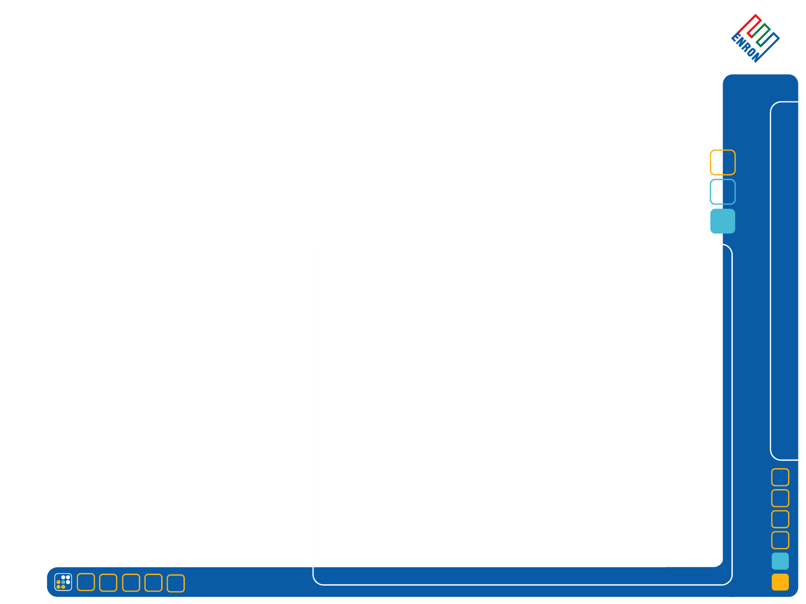
NEW PROPOSALS – OBJECTIVE
Construct a global performance management system that delivers 3 separate components: employee performance evaluation, facilitation of the annual reward decisions; facilitation of management discussion of employee talent/potential and promotions.
1
FEEDBACK / EVALUATIONS
Collect 360 feedback and facilitate evaluation process to provide direct and valuable feedback to employees on their performance and development.
Objective coaching tool
Continuous development process
Risk management tool/potential cost savings
2
COMPENSATION
Bonus pool determined by BU profitability and ENE OTC
Employee recruitment and retention
Year End equity and base pay review process
3
PROMOTIONS / INTELLECTUAL CAPITAL
Discussion on identification of and deployment of talent within the organization focusing on intrinsic skills and potential
Separate process for Commercial and Non Commercial
Bonus pool determined by BU profitability and ENE OTC
Identify top 10% talent and bottom 10% performers
See Following

Slide 2
PERFORMANCE SCALE AND TALENT DISCUSSION
DISCUSSION OBJECTIVES
HIGH IMPACT
LOW POTENTIAL
HIGH IMPACT
HIGH POTENTIAL
10%
Identification of what performance is currently valued at Enron
Breadth/depth of contribution; teamwork
Focus on intrinsic skills, leadership, promotion potential
Where talent is deployed and maximizing use of talent
Identify the team management wants going forward
Discussion of the relative value to/and needs of the organization
TALENT POOL AND SOLID PERFORMERS
TOP TALENT POTENTIAL
CURRENT IMPACT ON COMPANY
80%
10%
LIMITED PERFORMERS
LOW IMPACT
LOW POTENTIAL
LOW IMPACT
HIGH POTENTIAL
POTENTIAL

Slide 3
RELATIVE REVIEW OF INTELLECTUAL CAPITAL
VP/MD
Management Committee decide promotions to VP/MD across all peer groups
DIR
MGR
C
CS
ST
T
BU decides promotions to Mgr/Dir and talent allocation
Results presented to ENE OTC, I hour meetings
Annual event
Functional review of talent
Promotion decisions to Mgr/Dir/Sen Dir
Results circulated to BU OTC’s
Bi Annual event

Slide 4
YEAR END 2001 - QUICK VIEW/OPTIONS
RESULT
FORMAT
QUESTIONS/OPTIONS
Motivation
Development
Risk management
FEEDBACK / EVALUATIONS
360* Year End required
Written review at Mid Year and Year End
Qualitative feedback/coaching provided
Objective setting in evaluation?
Customize forms ie by BU, activity?
BU discretion MY 360*?
10/80 bonus eligible
Bonus/ LTI
‘
Market
Retention
Performance related
Bottom 10 bonus eligible?
Targets based on market review?
BU discretion to split 80% for bonus purposes?
PEP support for separate bonus discussions?
Functional input on bonus process?
COMPENSATION
PROMOTIONS / INTELLECTUAL CAPITAL
Management discussion
Agree value drivers
Intrinsic skills
Depth/breadth
Leadership/teamwork
Promotions
Managers and above (A/A) annual YE process
10%/10% identified per BU job level below VP and presented to OTC ENE at YE
Promotions decide twice a year below VP; once a year at YE for VP’s
BU complete commercial
Functional Leads complete Non – Commercial with BU review
VP/MD cross calibration10/80/10 at YE for ENE OTC
BU discretion to hold MY talent discussion?
Talent discussion below manager?
10%/10% identified and presented to OTC ENE at MY?
BU determination of Committee members

