Slide 1

Project Triple-Lutz
December 21, 2000

Slide 2
HPL Sale Rationale
A. HPL Outlook
1. Transport
  Declining margins due to compressing basis and pipe-on-pipe competition
  Lack of volume growth - capacity already nearly fully used
2. Sales & Marketing
  Constrained by lack of supply
  Industrial margins meager
  IPP market requires meaningful capex investment
3. Supply
  Declining resource in South Texas
  Capex requirements - C0₂, expensive well connects
4. FASB 121 Risk for Goodwill
  Entex Renegotiation in 2007

Slide 3
HPL Sale Rationale
B. Financial
Very Attractive Price
Accretive to Earnings and ROCE
Generates $325 million in cash for redeployment
Accretive to management time and attention - labor-intensive asset
C. Network/Market-Making Strategy
Will not affect our ability to make markets or grow our commodity and services business
Flexibility - No longer protecting an asset position
Will affect volumes (1.8 Bcf/d); mitigated by EOL volume growth

Slide 4


Transaction Summary
AEP
$332.5mm
100% Equity
ENE
SPE
Stock of HPL (Non Houston)
100% Equity
Lease
LeaseCo
$25.5 mm annual
lease payments
Bammel &
Houston Loop
Assets
The transaction will be structured as a sale of common stock of HPL. Enron intends to provide a tax “step-up” under Section 338(h)(10) of the Internal Revenue Code.
In connection with the transaction, a newly formed affiliate of Enron (“LeaseCo”) will enter into a thirty-year operating lease (the “Lease”) with HPL pursuant to which HPL will lease the Houston Loop, the Texas City Loop, and the Bammel Storage Facility (the “Leased Assets”) from LeaseCo for $25.5 million per year. The lease will contain an extension at $25.5 million/year, allowing buyer the right to extend the lease an additional 20 years.

Slide 5
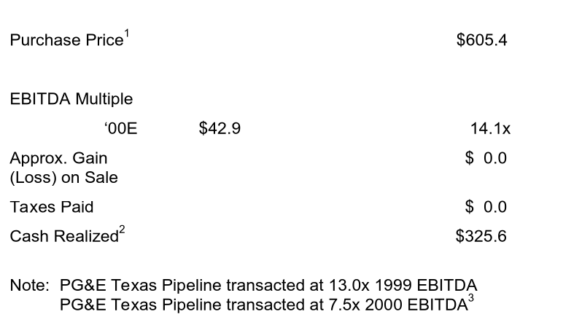
Valuation & Impact
($ millions)
1. Purchase price of $332.5mm + NPV of lease of $272.9mm.
2. Purchase price net of fees and expenses of $6.9mm
3. Per Lehman Brothers’ Data

Slide 6
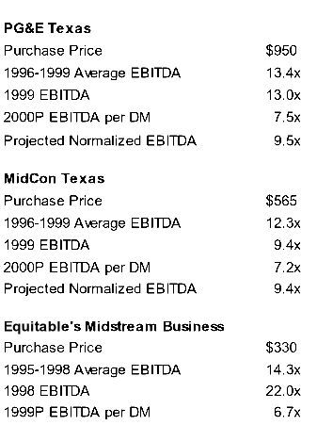
Comparables & Recent Transactions¹
1. Per Lehman Brothers data.

Slide 7
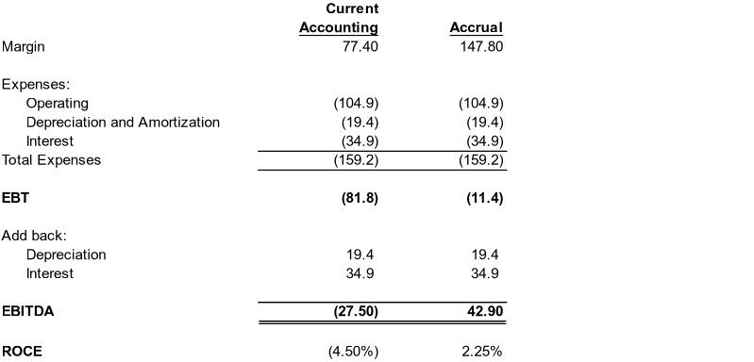
Earnings Impact
(a)
$
$
$
$
(b)
$
$
Post Sale results in non-cash charge to earnings of $15.6 million/year for seven years, then positive $7 million/year for remaining 23 years due to accounting rules.
(a) Accrual case assumes no mark to marketing of contracts in past years
(b) Does not include FV amortization of $28.5mm.

