Slide 1

Project Triple-Lutz
December 21, 2000

Slide 2
HPL Sale Rationale
A. HPL Outlook
1. Transport
Declining margins due to compressing basis and pipe-on-pipe competition
Lack of volume growth - capacity already nearly fully used
2. Sales & Marketing
Constrained by lack of supply
Industrial margins meager
IPP market requires meaningful capex investment
3. Supply
Declining resource in South Texas
Capex requirements - C0₂, expensive well connects
4. FASB 121 Risk for Goodwill
Entex Renegotiation in 2007

Slide 3
HPL Sale Rationale
B. Financial
Very Attractive Price
Accretive to Earnings and ROCE
Generates $325 million in cash for redeployment
Accretive to management time and attention - labor-intensive asset
C. Network/Market-Making Strategy
Will not affect our ability to make markets or grow our commodity and services business
Flexibility - No longer protecting an asset position
Will affect volumes (1.8 Bcf/d); mitigated by EOL volume growth

Slide 4



Transaction Summary
AEP
ENE
$332.5mm
SPE
Stock of HPL
and Newco
Newco
HPL
Lease
LeaseCo
$
Trading
Contracts
Bammel &
Houston Loop
ENE
Guaranty, LC
AEP
$25.5 annual
lease payments
LeaseCo
SPE
Lease

Slide 5
Form of Transaction
The transaction will be structured as a sale of common stock of HPL. Enron intends to provide a tax “step-up” under Section 338(h)(10) of the Internal Revenue Code.
In connection with the transaction, a newly formed affiliate of Enron (“LeaseCo”) will enter into a thirty-year operating lease (the “Lease”) with HPL pursuant to which HPL will lease the Houston Loop, the Texas City Loop, and the Bammel Storage Facility (the “Leased Assets”) from LeaseCo for $25.5 million per year. The lease will contain an extension at $25.5 million/year, allowing buyer the right to extend the lease an additional 20 years.
HPL will be purchased by an AEP Special Purpose Vehicle. HPL’s lease obligation to LeaseCo is backed by $280 million Letter of Credit issued by a financial institution acceptable to Enron. The LC may be replaced by a guaranty from an AEP affiliate with a BBB (or better) credit rating
In addition to the Lease, an Enron affiliate will grant to HPL an exclusive 30-year right to use the Cushion Gas in the Bammel Storage Field
Enron Corp. will enter into an Assurances and Indemnity Agreement with the Buyer guaranteeing LeaseCo’s obligations under the Lease and the Right to Use Agreement

Slide 6
Form of Transaction (cont.)
Most representations and warranties qualified by materiality and/or knowledge (although the qualifiers are disregarded for indemnity claims until the Deductible Amount is satisfied), and Enron liable only if and to the extent losses for breach of representations and warranties exceed the Deductible Amount of $15 million.
Enron liability for breach of representations and warranties capped at $180 million.
Representations and Warranties have limited survival (18 months), except environmental (2 years), and tax, ERISA and others (statue of limitations).
Enron making representations to unaudited Pro Forma Balance Sheet of HPL as of 7/31/00, not full financial statements.
If by May 1, 2001 AEP has not received permission from the SEC to increase the amount it can spend to acquire “energy assets,” and no intervention has been filed, then Enron is entitled to receive a $35 million termination fee. AEP filed in September, 2000 for this increase, and it appears to be on track.
HSR approval required. AEP required to use “reasonable best efforts” to obtain approval, provided AEP is not required to sell the major assets of HPL or any AEP power plants.
AEP will have an option to purchase the Leased Assets and Cushion Gas upon: (i) decline in Enron Corp.’s credit rating below BBB-; (ii) Enron Corp. bankruptcy; (iii) Enron’s failure to reimburse AEP for amounts advanced by AEP due to Enron’s default under certain monetizations; or (iv) Enron refusing to pay under the Assurances Agreement based on claim that such an agreement is unenforceable. Purchase price will be NPV of future rentals under Lease and NPV of fair market value of Leased Assets as of the end of the lease.

Slide 7
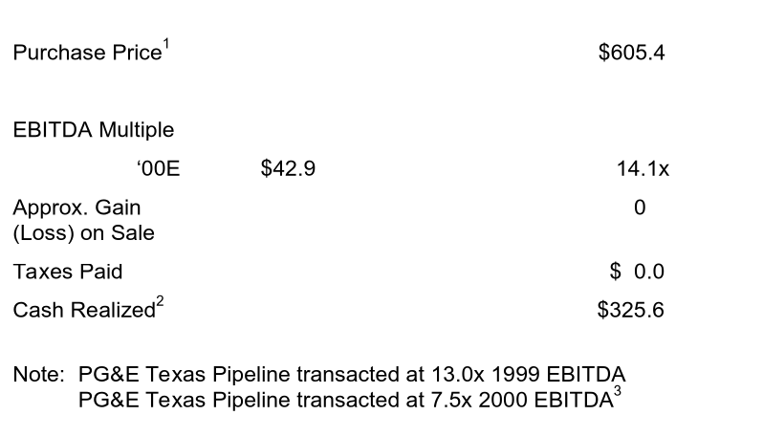
Valuation & Impact
($ millions)
1. Purchase price of $332.5mm + NPV of lease of $272.9mm.
2. Purchase price net of fees and expenses of $6.9mm
3. Per Lehman Brothers’ Data

Slide 8
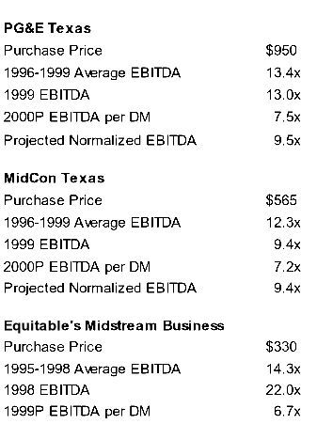
Comparables & Recent Transactions¹
1. Per Lehman Brothers data.

Slide 9
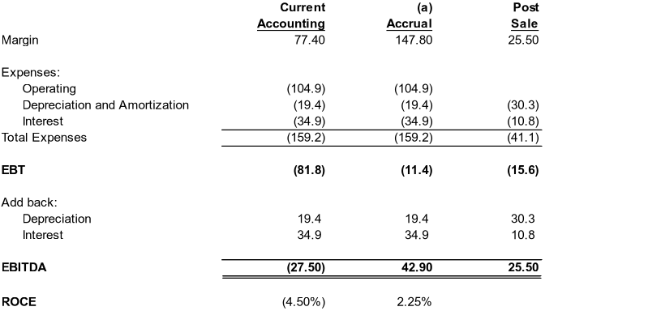
Earnings Impact
2001 (b)
$
$
$
$
$
$
^{c}
$
$
$
(a) Accrual case assumes no mark to marketing of contracts in past years
(b) Post Sale case includes amortization of PRM assets of $22.5mm/yr for eight years
(c) Does not include FV amortization of $28.5mm.

Slide 10
Appendix

Slide 11
Supply Volume
Additional supply volume growth is a function of pipe capacity, supply availability, and growth capex
HPL capacity utilization has limited upside (% utilization = throughput/capacity of 2.1 BBtu/d )
South Texas gas supply will decline over time (forecasted wellhead gas flow rates in South Texas indicate over a 10% decline from 1998 to 2003)
Higher CO₂ gas will require additional treating capacity (% CO₂)

Slide 12
Margins (Sales - Purchases)
Margins have declined over time due to competition, and Entex contract pricing structure.
Other sales margins have been flat - New IPPs will increase margins from other sales and transportation margins:

Slide 13
Treating/Transport Cost & New Capex
Additional capital will be required to support the ongoing operation of HPL
New safety regulations may require higher maintenance capital to test and upgrade pipeline
IPPs will require substantial investment in new pipeline connections to be paid back through sales margins
Higher CO₂ gas will require additional investment in treating capacity to be paid back in transport margin
1997 1998 1999 2000
Yearly Maintenance Capex $9.8 $8.7 $6.3 $7.0
Supplier/Customer Connections $3.0 $3.5 $2.2 $2.0
Additional Treating/Processing $0.0 $1.4 $0.0 $0.7

Slide 14
Sales Volume
Sales volume growth is primarily a function of Entex demand and new IPP load
Cold winter Entex demand is approximately 150% of warm winter Entex demand:
50% volume increase provides $12MM/yr of revenue growth
Fluctuating short position that must be managed
New IPPs may potentially provide approx 1 bcf/d of new peak service flows:
New 1 bcfd load will provide $11.5 MM/yr of revenue (65% load factor)
New capital investment will be required
Other volumes (industrial, marketing) have increased, but at a lower margin - these volumes will be displaced or margins will be increased
3rd party transport volumes have increased, but at lower margins - these volumes will be displaced or the margins will be increased

Slide 15
Significant Out-Year Risks to Consider
Entex renegotiation - 7 year brick wall that could potentially lead to reduced profitability
Accounting risk - Potential FAS 121 Asset Impairment write-down recognition if Entex re-negotiation is unsuccessful
Additional safety requirements may require Enron to accept higher insurance premiums and uninsured liability
Increased cost for new ROW and pipe relocation due to highway expansion, city taxes, and port construction

