Slide 1
Appendix
May 2001
Confidential and Proprietary

Slide 2
Outside Services Top 20 Vendor / Owners
Fact: Enron incurred $663M in outside services in 2000 of which roughly $300M are related to
base outsource functions.
Base outsource functions include Audit, Benefits, Building Services, some IT and support functions (EES), etc.
Top Twenty Vendors comprise $365M or 55%. Enron uses over 500 vendors each year.
This amount ($663M) excludes construction services being capitalized.

Slide 3
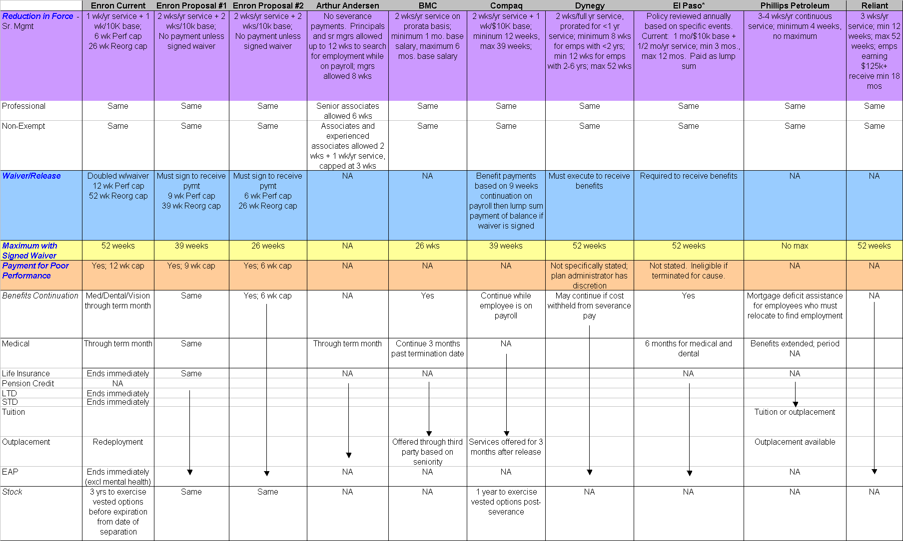
Severance Plan – Houston Employers
* Severance plan allows employees to modify terms.
A significant number of employees come from consulting firms which traditionally provide little or no severance benefits.
Notes:
Changed 5-17-01

Slide 4
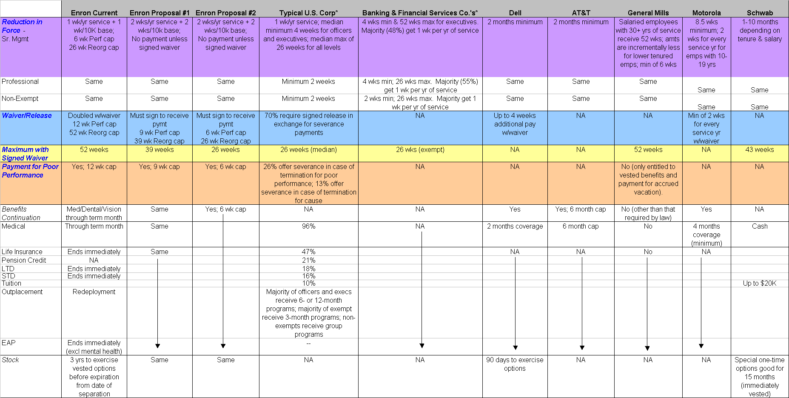
Severance Plan – Other Major Companies
* “Severance and Separation Benefits,” Lee Hecht Harrison, 1998. Survey based on 2,000 responses from human resource executives at
organizations of all sizes and in a wide range of industries.
** A significant number of employees come from consulting firms which traditionally provide little or no severance benefits.

Slide 5
Comparison of Severance Benefits

Slide 6
Background of Enron’s Severance Plan
Plan Last Amended and Restated in December 1992, effective January 1, 1993
  Since approximately 1986, severance payments caps were 12 weeks for failure to meet performance objectives and 1 year for reduction in force and business reorganization. In December 1992, the plan was amended to require a signed waiver by the employee to receive this full benefit; without a signed waiver, the employee received half based on certain formulas.
Redeployment
  Commenced in early 2000
  Redeployment, while not part of the severance plan, is essentially an extension of the employee’s current compensation, as employees have gained another 45 days of paid compensation via redeployment.
Current Enron Plan
  Cause: No severance benefit; two weeks pay when waiver is signed
  Failure to Meet Performance Objectives: One week of base for each year of service or portion thereof, up to max of 6 weeks; the same amount is paid with signed waiver (total max of 12 weeks).
  Reorganizations: One week of base for each year of service or portion thereof, plus one week for each $10k or portion thereof of base; the same amount is paid with signed waiver (total max of 52 weeks).

Slide 7
Enron’s 2001 YTD Severance Payments
Severance Payment Distribution by Business Unit*
Total Severance Payment Dollars by Termination Reason*
EES | EBS | EWS | CORP | ETS
32% | 38% | 13% | 15% | 1%
$2.97 | $3.45 | $1.23 | $1.38 | $0.13
$0.03 | $0.02 | $0.03 | $0.05 | $0.02
Reorganization | 98% | $8.96
Unsatisfactory Performance | 2% | $0.18
Cause | 0% | $0.00
Total $M
Avg $M
Total Severance Payments
Severance is generally a small part of the compensation and benefits budget, roughly less than one-half percent.
Enron spent 1% or $9M+ this year.
Total Percentage of Employees Receiving Severance Payments
EES | EBS | EWS | CORP | ETS
27% | 49% | 14% | 8% | 2%
88 | 163 | 46 | 27 | 8
%
#
*In $M

Slide 8
Enron’s Current Plan vs. Revised Plan
Recomm. Chnge
Current Plan Recommended Change Mkt Indicator
Severance Pay Floor and Ceilings
Cause No Payment Same Market avg
Poor Performance (1) Min: 1 wk of base/yr svc; max: 6 wks of base No Payment unless waiver is signed Market avg
Reduction in Force/Reorganizations (2) Min: 1 wk of base/yr svc + 1 wk of 10K base; No Payment unless waiver is signed Market avg
Max: 26 wks of base No Payment unless waiver is signed Market avg
Payment when Waiver is Signed
Cause 2 wks of base; not defined as severance benefit Same Avg to Rich
Poor Performance Above (1) doubled up to a max of 12 wks Same Rich
Reduction in Force/Reorganizations Above (2) doubled up to a max of 52 wks; Max 39 wks and 1.5 wks/yrs of service + Market avg
2 wk of base/yr svc + 2 wk of 10K base; 1.5 wks/10K base Market avg
Analyst/Associate Program Same as above Poor Performance: 3 wk cap Market avg
Reduction in Force: 4 wk cap for similar prog
Severance Pay Recipients
Regular Full-Time Yes Yes Market avg
Reduced hours/part-time No No Below market
Contractors No No Market avg
Method of Payment
Sec 3.2 – base pmts (1) and (2) Monthly No Payment unless waiver is signed Market avg
Sec 3.3 – waiver is signed; add’l benefit Lump sum Change from lump sum to monthly Market avg
Stock Treatment Exercise period for vested options pursuant to grant Same Rich
agreement, generally three (3) years
Benefits Treatment Active coverage terminates at the end of term month Same Below market
COBRA up to 18 months (employee’s expense) Same Req’d by law
Portable coverage unlimited (employee’s expense) Same Rich
Portable is available to those with 5 yrs of service
and age of 40 yrs.
Relocation No severance benefit if employee declines
relocation offer
Summary of Recommendations:
  Eliminate any severance payment unless waiver is signed
  Reduce cap on reorganizations from 52 weeks to 39 weeks and reduce formula from 2 wks to 1.5 wks
  Eliminate lump sum payout and only payout periodically (i.e., monthly)
  Create separate stipulation for Analysts and Associates
  Eliminate severance benefit if employee receives offer or transfer of employment at employee’s same salary or accepts offer or transfer of employment at any salary from the Company or from a divested employer or another employer which at the time of transfer is affiliated by reasons of stock ownership, partnership or business venture with Enron Corp or one of its subsidiaries or affiliated companies.

Slide 9
Severance Plan Trends
Who Receives Severance Payments*?
Employment Status:
  48% offered severance to part-time employees
  7% offered to temporary or contract staff
  Enron - no severance for the above groups
Termination Reason:
  96% for downsizing/job elimination
  26% for poor performance
  13% for cause
  Enron: max of 52 weeks for reorganizations; max of 12 weeks for poor performance; no severance for cause
70% require a release in exchange for severance payments.*
Recent trends show while the money employees receive in severance packages has declined throughout the past decade, other benefits in the package have increased (i.e., stock options and tuition reimbursement).
Severance Pay Formula
  Most employers use a formula based on years of service; some factor in salary and job level.
  17% use a graduated scale, with weeks of severance increasing with tenure.
  Those with employment agreements tend to have guaranteed severance payments not dictated by formulas (i.e., one year)
  Most employers do not stop payments when the laid-off employee finds a new job.
 | Executives | Exempts | Non-Exempts
Minimum Amount (median)* | 4 wks | 2 wks | 2 wks
Maximum Amount (median)* | 26 wks | 26 wks | 26 wks
* “Severance and Separation Benefits,” Lee Hecht Harrison, 1998.

Slide 10
Vacation Payout at Termination
Vacation Allowance
Length of Continuous Service Vacation Allowed
From hire date to the end of the calendar year in which Prorated accrual of 10 hours per month for each full
the employee was hired calendar month completed
Employee with <10 yrs service (hired in a prior calendar year) 3 weeks (120 hours) per year
Employee with 10-20 yrs service 4 weeks (160 hours) per year
Employee with 20+ yrs of service 5 weeks (200 hours) per year
Vacation Payout at Termination Policy - Current
Cash payments are made for vacation allowed (min. 120 hours) in the year of termination, regardless of months of service. For example, an employee who terminates in their second year of service on January 2 will have vacation payout based on 120 hours, equal to 6% of their total base salary regardless of the months of service for that year.
2001 YTD Vacation Payout with Existing Policy vs. Payout as Accrual*
Number of Affected Payout Under Payout if 2001 2000 Affected 2000
Terminated Employees Existing Policy Using Accrual YTD Savings Employees Payout
713 $3.9M $104K $3.8M 1,595 $6.3M
Recommendations
Switch to payout using accrual – estimated annual savings = $4M
Employees with less than 10 years of service would accrue 10 hours/month; employees with greater than 10 years but less than 20 years would accrue 13.3 hours/month, etc. Employees can borrow from accrued balance at any time.
* Assumes employees have taken 2 days vacation in 2001. Uses 8 hour workday, 40 hour workweek and 50 weeks per work year.

Slide 11
Business Growth since 1999
Acquisitions during 2000 include:
  Garden State (approximately 350 employees)
  MG Metals (approximately 450 employees)
  Torpy (approximately XX employees)
  WarpSpeed
  DSG
  Integrated Process Technologies
New Businesses or Product Lines Created in 2000 / 2001 include:
  Enron Networks (April 2000)
      EnronCredit.com
      ClickPaper
      Deal Bench
      Commodity Logic
      EnronOnline (late 1999)
    EIM (Forest Products, Steel and other industrial products, Freight Market)
    Commercialization efforts
  Entertainment On-Demand (Blockbuster) Launch
  Digital Delivery Platform
  Expansion into European and Asian Markets
  EBI (Enron Broadband Investments)
  Bandwidth Risk Management - Capacity, Streams, Storage, Semiconductors
  IP NetConnect Product Release
  Enron Media Services

Slide 12
Business Growth since 1999
Active New Deals have increased 498% in total for gas, power, financial since 9/99
Other indicators of employee growth include:
  Houston-area workstation count increased over 3,000 stations with expansions in :
    2 Allen Center
    3 Allen Center
    Jefferson buildings
    Pennzoil
    1201 Louisiana
    Shepard
    Enron Building
  New offices in Dubai and Tokyo

Slide 13
Headcount Changes in 2000 and 2001

Slide 14
Headcount Changes in 2000 and 2001

Slide 15
Headcount Changes in 2000 and 2001

Slide 16
Current Ratios

