Slide 1
Project 300M (Hannon)
April 2001
Confidential and Proprietary

Slide 2
Summary
Mark to verify and confirm #
The rate of growth for Enron’s expense base is 35%, relative to earnings growth of 145% from 1997 to 2000.
Headcount increased 33% for the same period.
Excluding Cash Compensation and Qualified Benefits, Enron’s expense base as defined for the scope of this report for the year ending 2000 is $1.2B of which 55.2% is related to Outside Services costs; this includes costs for all consultants, contractors and outsourced functions
Largest cost components excluding Compensation and Benefits, include Outside Services and Travel and Entertainment.
Outside services increased from $485M in 1997 to $663M in 2000 or 37% increase.
Travel and entertainment has increased from $70M in 1997 to $184M in 2000, an increase of 162%.
Greatest opportunities include: increasing awareness of procurement best practices and tighter controls related to outside services and travel and entertainment.
Expected 2001 reductions include EI, EECC, and EBS expenses ($200M or 17%). 2000 Actuals 1.2B ; 2001 Plan 1.0B
A 10% reduction in expenses from Plan or $95M will result in an improved E.P.S. of $1.80 from $1.71.
2001 Plan
Expenses($B)** Earnings($B) Shares Out(M) EPS
$0.953 $1.51 885 $1.71
Expense Reduction Earnings($B) Shares Out (M) EPS
5% 48M $1.55 885 1.75
10% 95M $1.60 885 1.80
15% 143M $1.64 885 1.86
20% 191M $1.69 885 1.91
25% 238M $1.75 885 1.98

Slide 3
Summary
Mark to verify and confirm #
Summary of Recommendations include options ranging from $234M to $129M in cost savings from Plan :

Slide 4
Outside Services
Mark to verify and confirm #
Fact : Enron incurred $663M in outside services in 2000 of which about roughly $300M are related to
base outsource functions.
Base outsource functions include Audit, Benefits, Building Services, some IT and support functions(EES), etc.
Top Ten Vendors comprise $308M or 46%. Enron uses over 500 vendors a year.
This amount ($663M) excludes construction services being capitalized.

Slide 5
Outside Services
Mark to verify and confirm #

Slide 6
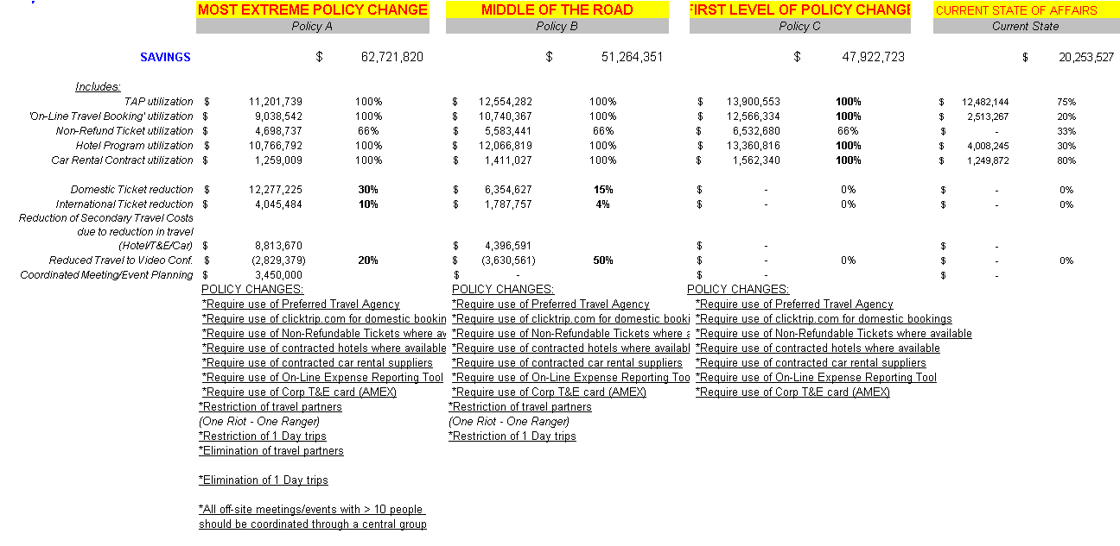
Travel and Entertainment
Mark to verify and confirm #

Slide 7
Other Potential Cost Savings
Mark to verify and confirm #

